Slide 1
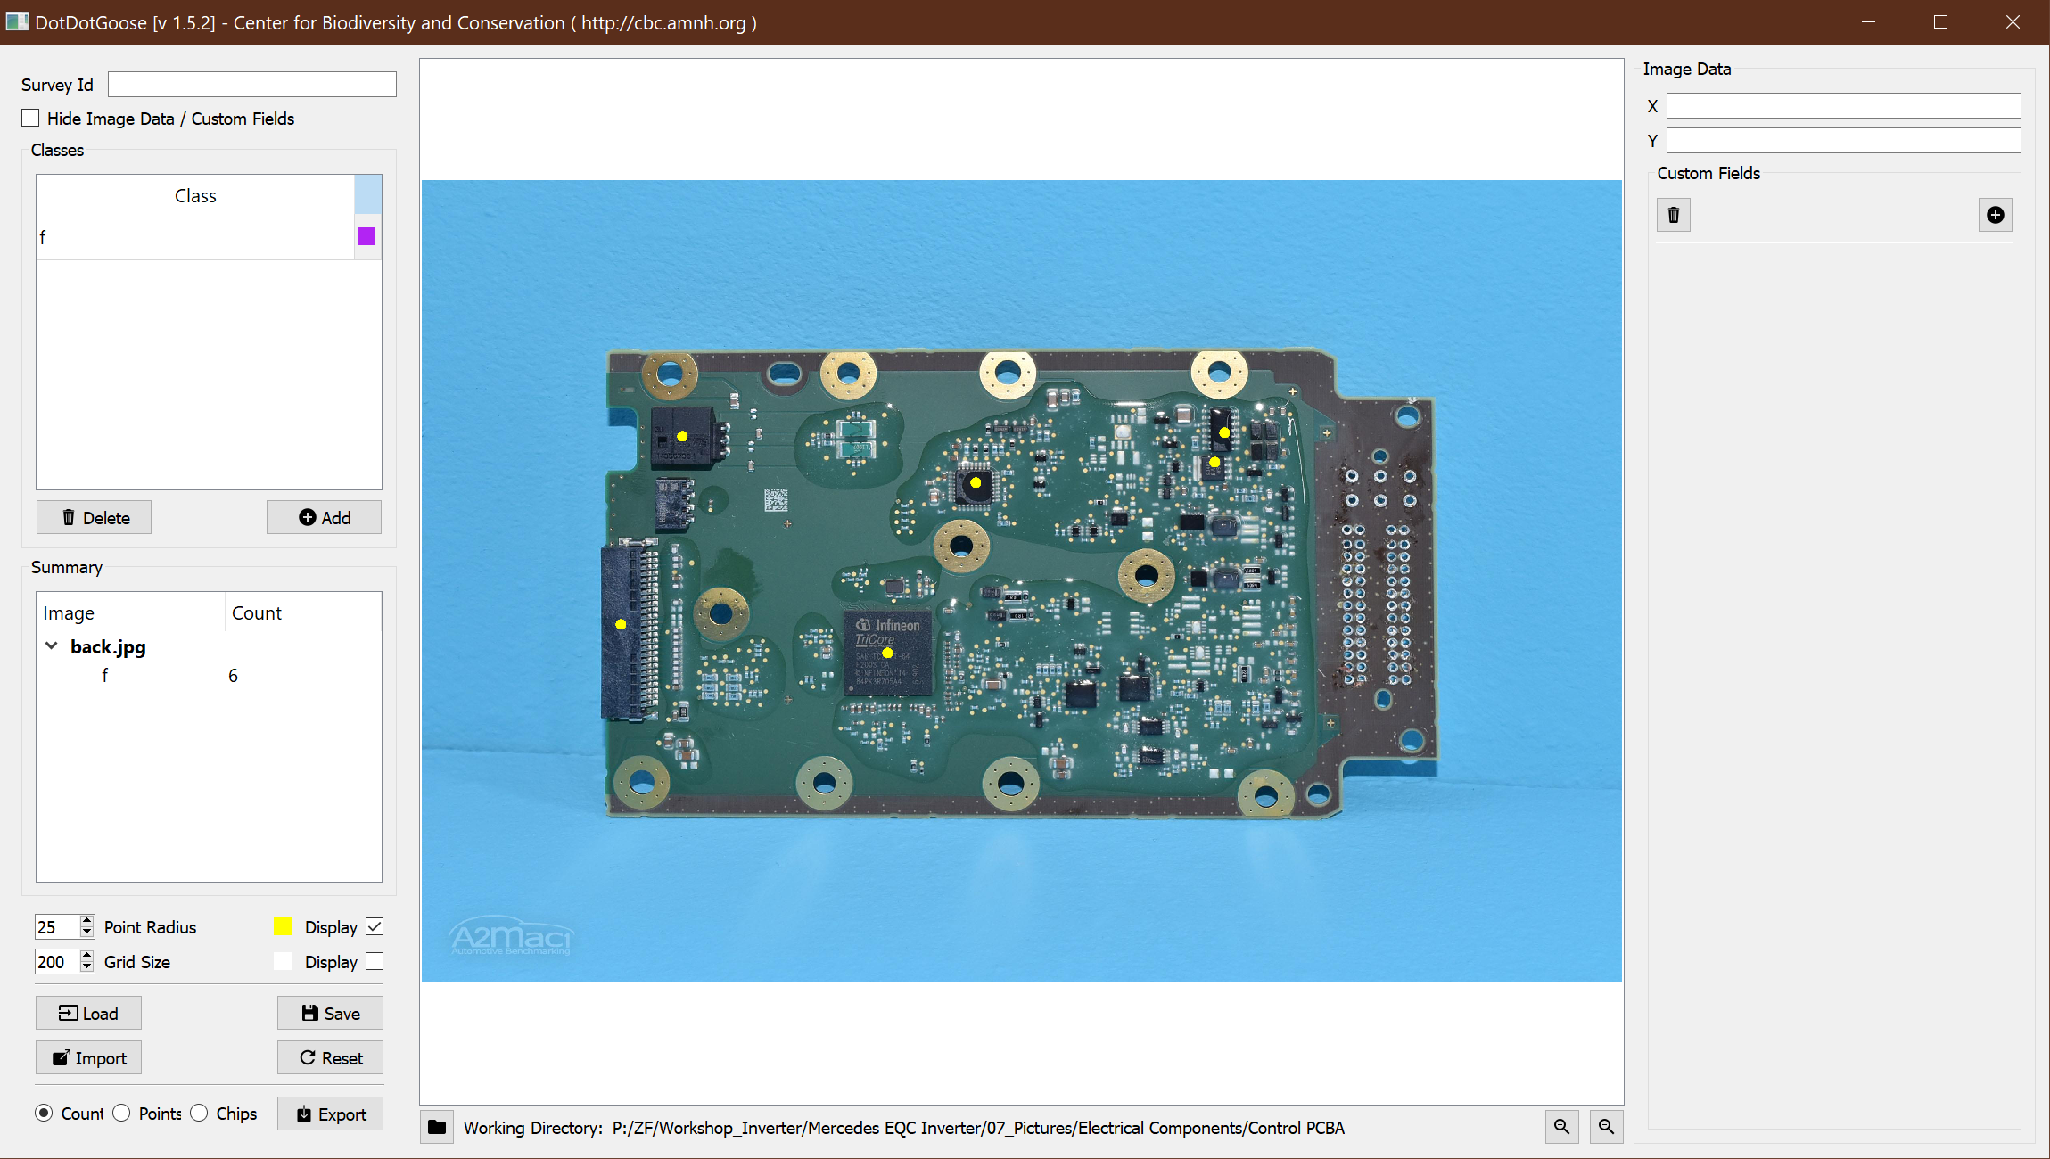
Ideas
Project details
ID
Vehicle
Class Details
Partnumber
Link to detail picture
Implement Menus
Saving, Loading, Scaling
Implement TreeView
Parent Classes (Ics, …)
Count Visible
Checkbox for Visibility
Rename to details pic
Export functionality to Kalk-BOM / A2MAC1 Structure
Display Position in pixel/cm

Slide 2
To Implement
Implementation/Features | Reasoning | Time needed
Tree View for classes | Usability
Class Templates | Consistency
Class sorting | Usability
Export functionalities | Usability
Part Details | Necessary Goal
Link to detail picture | Usability
Menus | Usability

Slide 3
Central Widget
Central Graphics View
Handles key & mouse events
Renders Image
Image Size
Point Widget
Displays Classes as Table
Renders Count
Saves state
Canvas
Data for
Points
Classes
Coordinates
Directory etc

