Slide 1
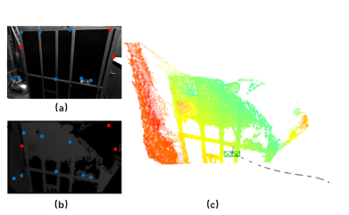
Depth Enhanced Visual-Inertial Odometry Based on Multi-State Constraint Kalman Filter
Fumin Pang, Zichong Chen, Li Pu, and Tianmiao Wang
Segway Robotics Inc.
School of Mechanical Engineering and Automation, Beihang University, China
Accurate 6DOF pose estimation in unknown environment is a critical task in autonomous navigation.
Make use of sparse depth information to enhance landmark position estimate
Combine 2D and 3D measurement to improve pose estimation accuracy
Compared with than monocular-MSCKF and ROVIO, the proposed method attains substantially higher accuracy .
This method make use of depth information, all take it’s sparse nature into consideration

