Slide 1
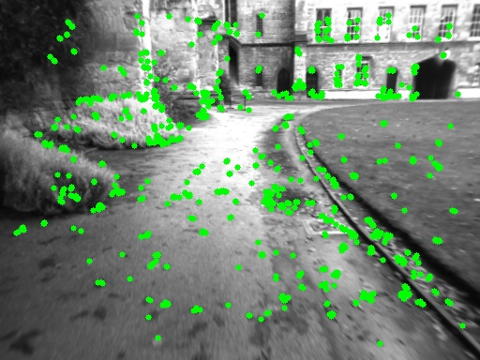
Flowchart of Tracking in ORB-SLAM
Initialization
Compute:
- Keypoint
- Descriptor
- ORB features
Tracking state?
configure:
read map,
settings, etc.
Image Frame
Relocalisation
TrackPreviousFrame /
TrackWithMotionModel
Create New KF
Set State=WORKING
Refine Pose
Pose acquired?
Set State=LOST

Slide 2
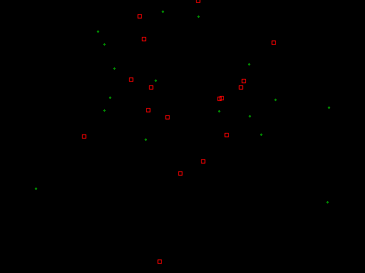
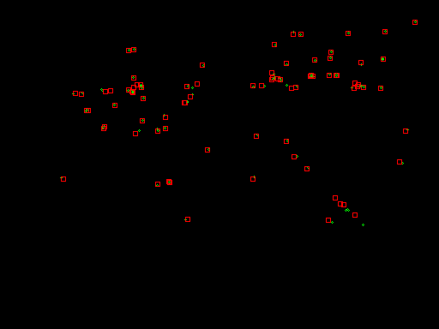
Relocalisation
Objective: find pose of current frame
Current
Frame
Find KF candidates
Filter KF candidates
Match keypoint and map point
KF Database
KF has ≥15 matches?
Discard KF
Return Pose
Find KF giving
best reprojection error
Success ?
Estimate pose from KF
(ePnP inside RANSAC)

Slide 3
Track from Previous Frame
Current
Frame (F1)
Match keypoints
from F1 to F2
Optimize pose,
project points
from F2
Discard
outliers
Prev.
Frame (F2)
Corresponding
KF
Matching keypoints ≥10 ?
Fail
Success

