Slide 1
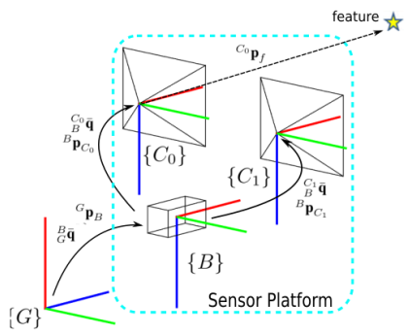
Stereo-Inertial Pose Estimation and Online Sensors Extrinsic Calibration
Fumin Pang and Tianmiao Wang
School of Mechanical Engineering and Automation, Beihang University, China
Accurate 6DOF pose estimation in unknown environment is a critical task in autonomous navigation.
A stereo-inertial VIO based on Multi-State Constraint Kalman Filter (MSCKF).
Online extrinsic calibration of sensors is included to improve the performance.
The proposed method attains substantially higher accuracy than monocular MSCKF.
Stereo-Inertial sensor platform and visual feature

