Slide 1
Chroma
2024-11-09

Slide 2
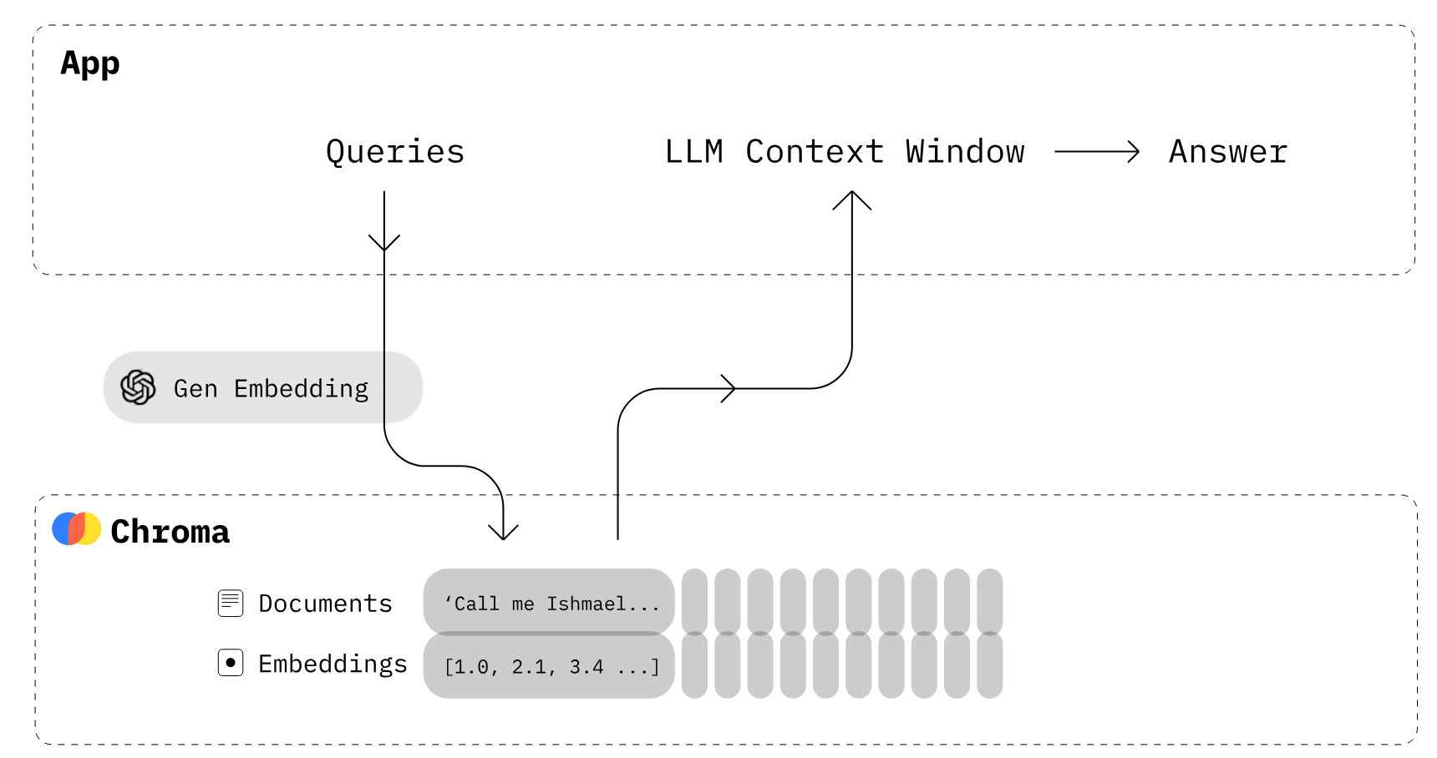
Introduction
Chroma is the AI-native open-source vector database.

Slide 3
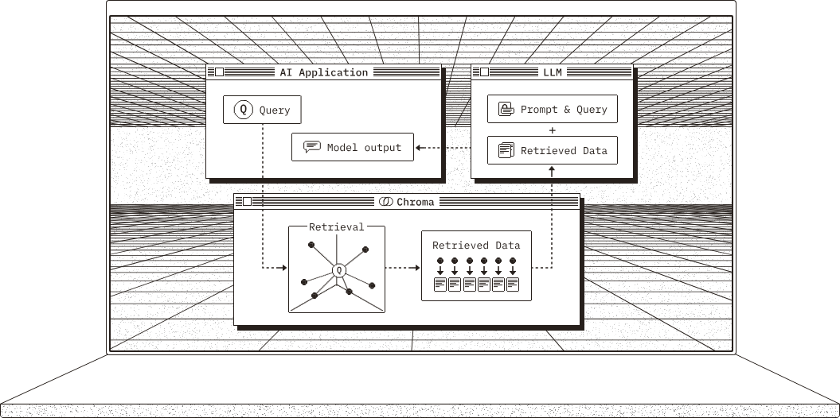
How It Works?

Slide 4
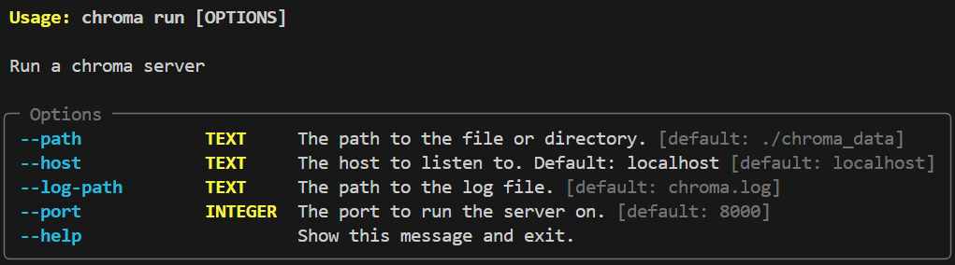
Installation / Deployment
Standalone: 单机模式 (for test and development only)
DB可以仅存在于内存中，接口：Client、EphemeralClient
也可以 persist 到本地目录中，接口：PersistentClient
Client/Server Mode: Single-Node Chroma
服务端：
客户端：接口：HttpClient、AsyncHttpClient
客户端可以安装完整的 chromadb 包，也可以仅安装 chromadb-client 包
Chroma Cloud: Multi-Nodes Chroma
略
pip install chromadb # no server-side
pip install chromadb
chroma run --port 8000 # see --help for more options
Notes:
Running Chroma in Client-Server Mode
https://docs.trychroma.com/deployment/client-server-mode
Chroma‘s Thin-Client:
https://docs.trychroma.com/deployment/thin-client
Single-Node Chroma: Performance and Limitations:
https://docs.trychroma.com/deployment/performance
Auth: 数据库配置用户校验
https://docs.trychroma.com/deployment/auth
Telemetry: 默认情况下 Chroma 会收集部分用户数据，可以禁止此操作：
https://docs.trychroma.com/telemetry

Slide 5
Standalone Example: in Memory
import chromadb, json
client = chromadb.Client() # db in memory
collection = client.get_or_create_collection("my_collection")
collection.add( # 自动 embedding
documents=[
"This is a document about pineapple",
"This is a document about oranges"
],
ids=["id1", "id2"]
)
results = collection.query(
query_texts=["This is a query document about hawaii"], # Chroma will embed this for you
n_results=2 # how many results to return
)
print(json.dumps(results, indent=2))
Notes:
https://docs.trychroma.com/guides#creating,-inspecting,-and-deleting-collections

Slide 6
Standalone Example: Persistent
import chromadb, json
client = chromadb.PersistentClient(path="./my_chroma")
collection = client.get_or_create_collection("my_collection")
collection.add(
documents=[
"This is a document about pineapple",
"This is a document about oranges"
],
ids=["id1", "id2"]
)
results = collection.query(
query_texts=["This is a query document about hawaii"], # Chroma will embed this for you
n_results=2 # how many results to return
)
print(json.dumps(results, indent=2))

Slide 7
Install and Start Chroma Server
Installation and Start
More options:
pip install chromadb
chroma run --port 8765 # 会自动创建目录 chroma_data 存储数据

Slide 8
Client/Server Mode Example
import chromadb, json
client = chromadb.HttpClient(host="localhost", port=8765, ssl=False)
collection = client.get_or_create_collection("my_collection")
collection.add(
documents=[
"This is a document about pineapple",
"This is a document about oranges"
],
ids=["id1", "id2"]
)
results = collection.query(
query_texts=["This is a query document about hawaii"], # Chroma will embed this for you
n_results=2 # how many results to return
)
print(json.dumps(results, indent=2))

Slide 9
Telemetry
默认情况下，Chroma 会收集部分用户数据，并上传至 posthog.com 服务器
禁止收集用户数据：
将环境变量 ANONYMIZED_TELEMETRY 设置为 False
将 Client 对象的 Settings 中将 anonymized_telemetry 设置为 False
from chromadb.config import Settings
client = chromadb.Client(Settings(anonymized_telemetry=False))
# or if using PersistentClient
client = chromadb.PersistentClient(
path="/path/to/save/to",
settings=Settings(anonymized_telemetry=False)
)
参看：https://docs.trychroma.com/telemetry

Slide 10
Chroma for LangChain
from langchain_chroma import Chroma
from langchain_ollama import OllamaEmbeddings
from chromadb import HttpClient
from langchain_core.documents import Document
client = HttpClient(host="localhost", port=8765)
embeddings = OllamaEmbeddings(model="nomic-embed-text")
db = Chroma(client=client, collection_name="my-collection", embedding_function=embeddings)
doc1 = Document(page_content="My name is Jack.")
doc2 = Document(page_content="I'm a boy.")
doc3 = Document(page_content="I'm 13 years old.")
db.add_documents([doc1, doc2, doc3])
r = db.similarity_search(query="What's your age?", k=2)
print(r)

Slide 11
Retriever
…
client = HttpClient(host="localhost", port=8765)
embeddings = OllamaEmbeddings(model="nomic-embed-text")
db = Chroma(client=client, collection_name="my-collection", embedding_function=embeddings)
doc1 = Document(page_content="My name is Jack.")
doc2 = Document(page_content="I'm a boy.")
doc3 = Document(page_content="I'm 13 years old.")
db.add_documents([doc1, doc2, doc3])
# https://python.langchain.com/docs/integrations/vectorstores/chroma/#query-by-turning-into-retriever
retriever = db.as_retriever(search_kwargs={"k": 1})
docs = retriever.invoke(input="What's your age?")
print(docs)

Slide 12
RAG
…
retriever = db.as_retriever(search_kwargs={"k": 1})
docs = retriever.invoke(input="What's your gender?")
from langchain_core.prompts import ChatPromptTemplate
cpt = ChatPromptTemplate([
("system", "{docs}"),
("human", "{question}")
])
prompt = cpt.invoke(input={"docs": docs, "question": "What's your gender?"})
from langchain_ollama import OllamaLLM
llama3 = OllamaLLM(model="llama3")
answer = llama3.invoke(input=prompt)
print(answer)

Slide 13
References
https://docs.trychroma.com/
https://python.langchain.com/docs/integrations/vectorstores/chroma/

