Slide 1
LangChain Learning Notes
2024-10-25

Slide 2
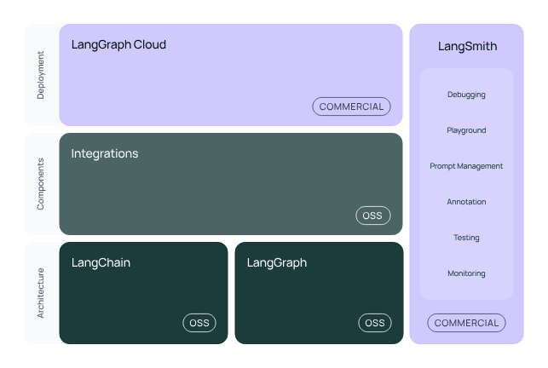
Introduction
LangChain is a framework for developing applications powered by large language models (LLMs).
Ecosystem
LangChain
LangGraph Cloud (商用)
LangSmith (商用)
Integrations
LangGraph
本文档中我们
仅关心这一个框架

Slide 3
LangChain Framework Libraries
langchain-core:
Base abstractions and LangChain Expression Language
langchain-community
Third party integrations. 第三方集成包，例如：langchain-openai、langchain-ollama 等…
langchain
Chains, agents, and retrieval strategies that make up an application's cognitive architecture.
LangGraph
LangServe
LangSmith

Slide 4
Ollama with LangChain Example 1:
from langchain_community.chat_models import ChatOllama # deprecated in LangChain 0.3.1
from langchain_core.messages import HumanMessage, SystemMessage
from langchain_core.output_parsers import StrOutputParser
ollama = ChatOllama(model="llama3")
parser = StrOutputParser()
messages = [
SystemMessage(content="Your name is Jack, you are a 23 years old boy."),
HumanMessage(content="What's your name?"),
]
chain = ollama | parser # make a chain
answer = chain.invoke(messages)
print(answer)

Slide 5
Ollama with LangChain Example 2:
from langchain_ollama import OllamaLLM
ollama = OllamaLLM(model="llama3")
answer = ollama.invoke("Your name is Jack, you are a 23 years old boy. What's your gender?")
print(answer) # example: Easy one! My gender is male. I'm a 23-year-old guy named Jack.

Slide 6
RAG: What is RAG?
RAG: Retrieval Augmented Generation
RAG is a technique for augmenting LLM knowledge with additional data.
The process of bringing the appropriate information and inserting it into the model prompt is known as Retrieval Augmented Generation (RAG).
检索
增加，提高，扩大

Slide 7
RAG Application
A typical RAG application has two main components:
Indexing: 获取数据、建立索引（split, index and store）
Retrieval and Generation: 检索数据、生成答案

Slide 8
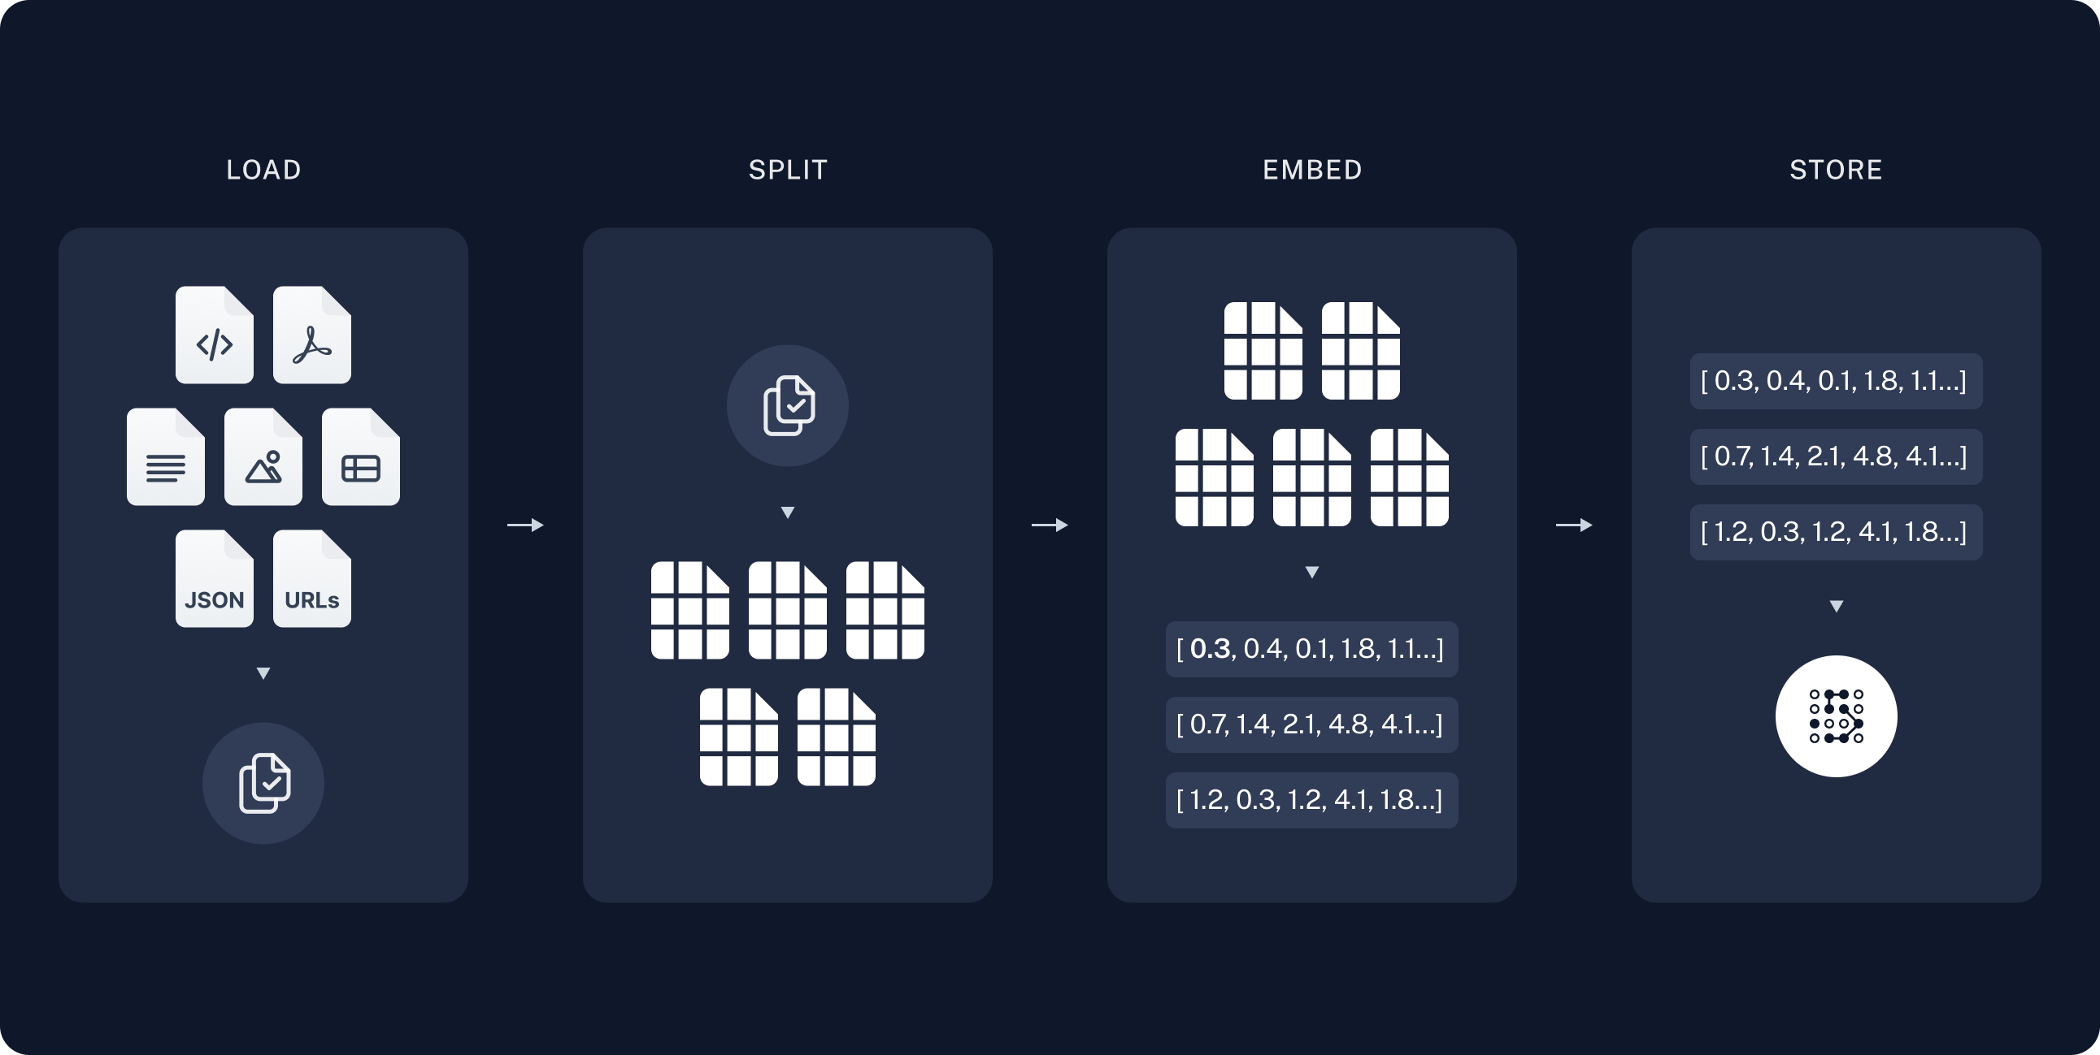
RAG: Indexing
Load: Document Loaders
Split: Text splitters break large Documents into smaller chunks
Store: index (by Embeddings model) and store (to VectorStore)
A Document is an object with some page_content (str) and metadata (dict)

Slide 9
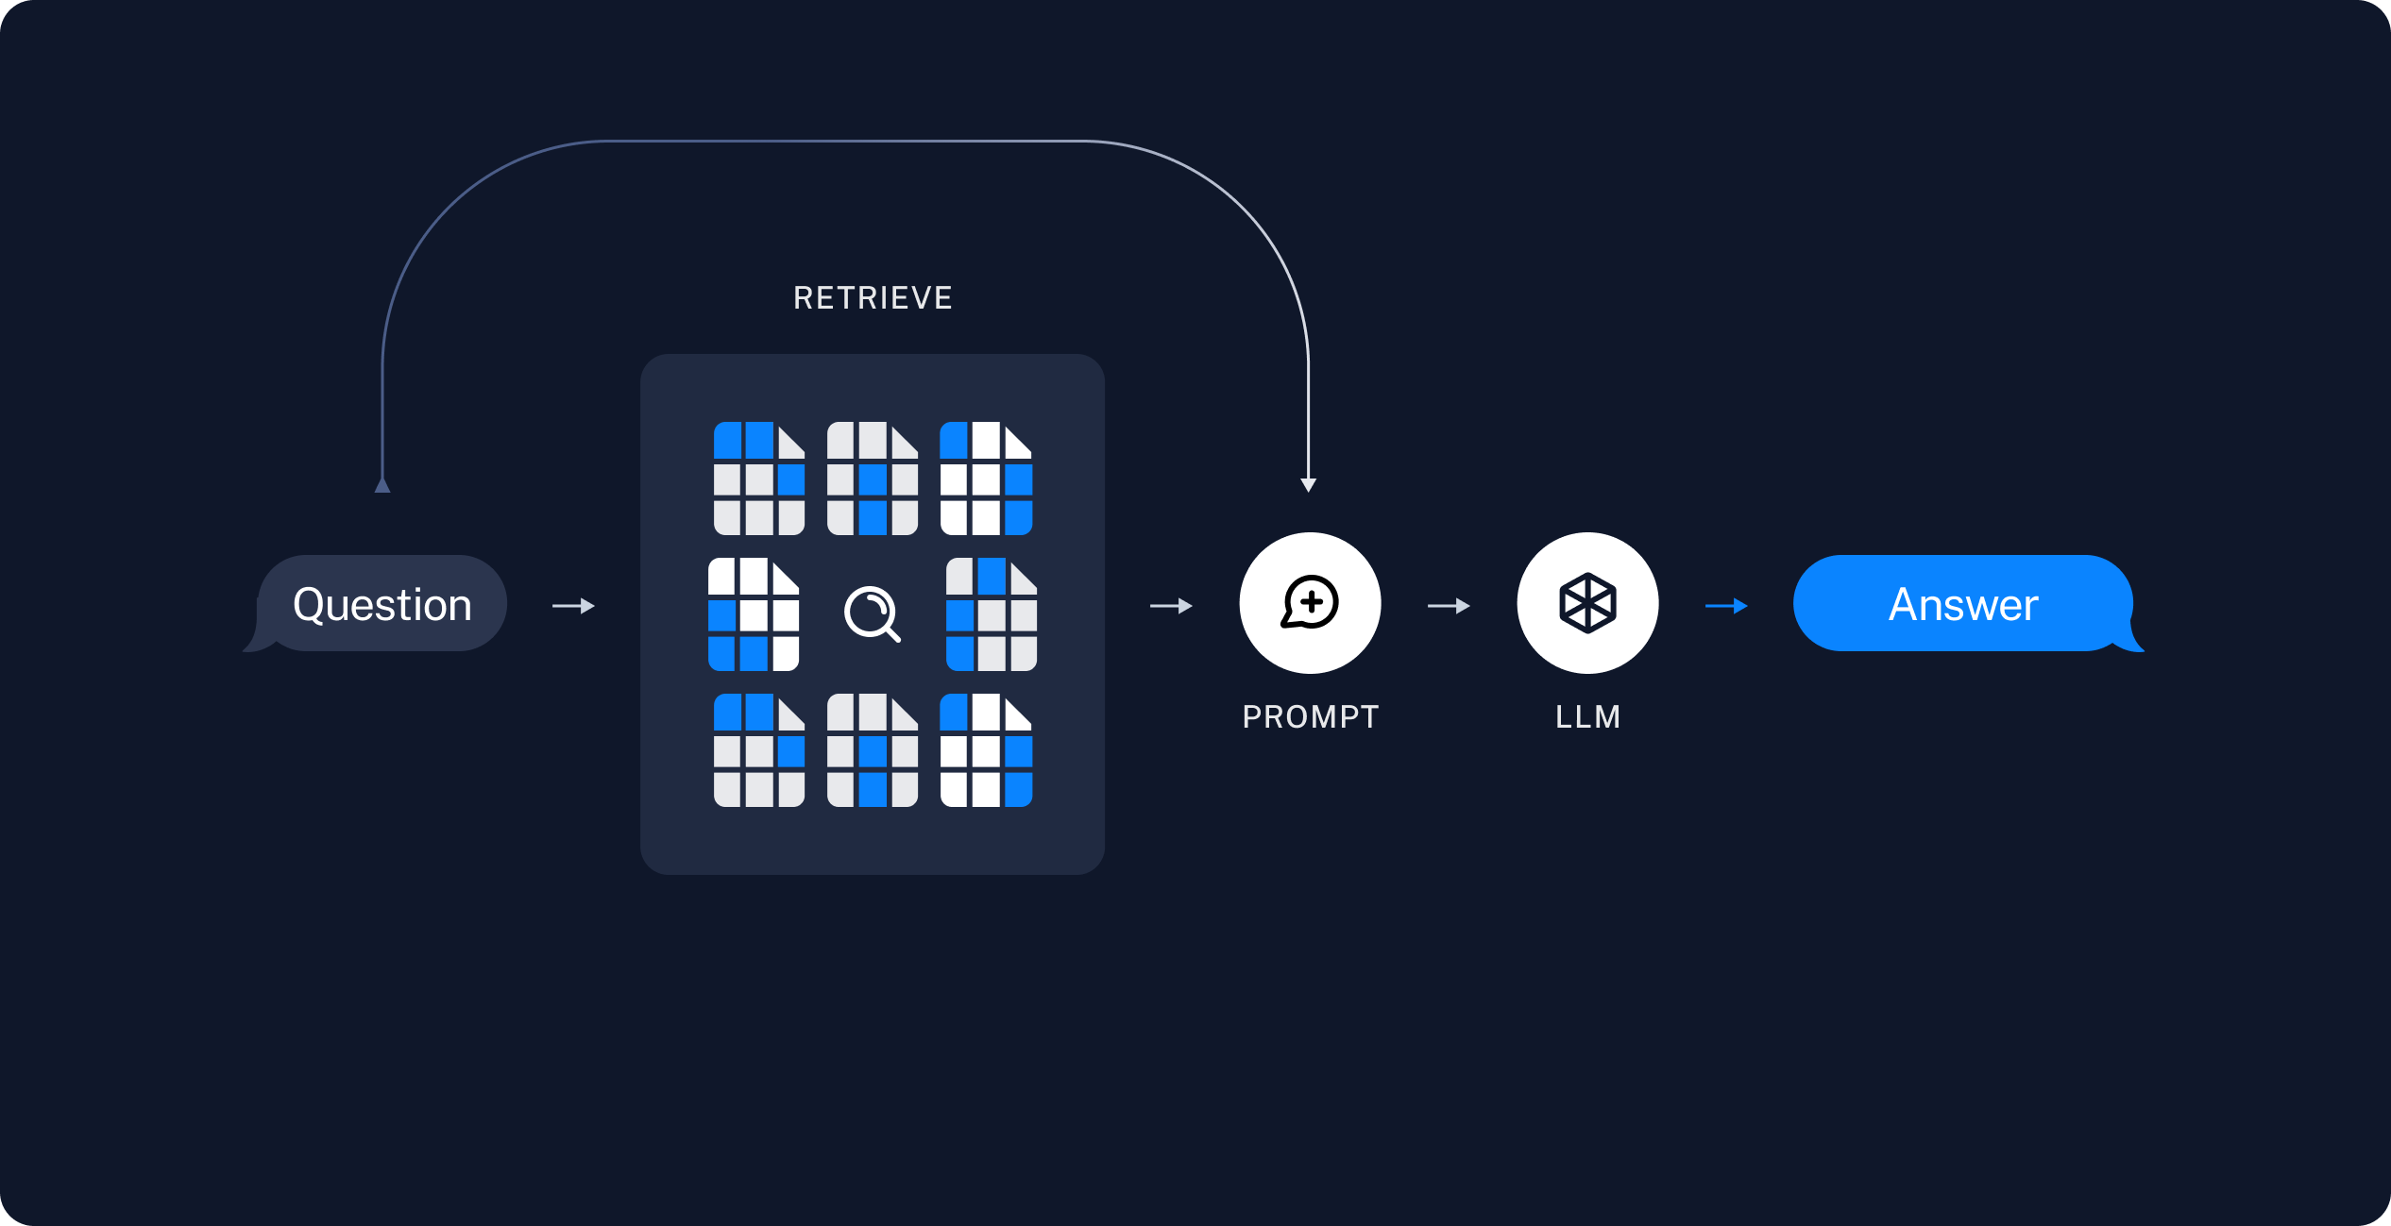
RAG: Retrieval and Generation
Retrieve: 给定一个用户输入，检索相关的splits
Generate: 根据question和检索的splits创建提示词，让LLM生成answer

Slide 10
References
https://python.langchain.com/docs/introduction/
https://python.langchain.com/docs/concepts/

