Slide 1
OUTLINE
Introduction to SVM
The concept of SVM
Large-margin linear classifier
  Linear separable
  Nonlinear separable
Reference

Slide 2
Introduction
What is support vector machine
SVM (Support Vector Machine) is a useful technique for data classification
takes advantages of nonlinear and high dimensional space problems
used in many applications : face detection, text recognition, video annotation, stock analysis ...

Slide 3
Concept of SVM
The SVM can be characterized as a supervised learning algorithm capable of solving linear and non-linear binary classification problems.
The purpose is to find the “hyperplane” to separate two different data.

Slide 4
Decision Boundary
Consider a two-class, linearly separable classification problem
Are all decision boundaries equally good?
Class 2
Class 1

Slide 5
Examples of Bad Decision Boundaries
Class 2
Class 2
Class 1
Class 1

Slide 6
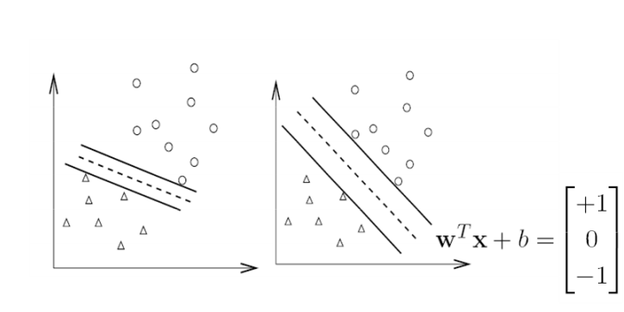
Concept of SVM

Slide 7
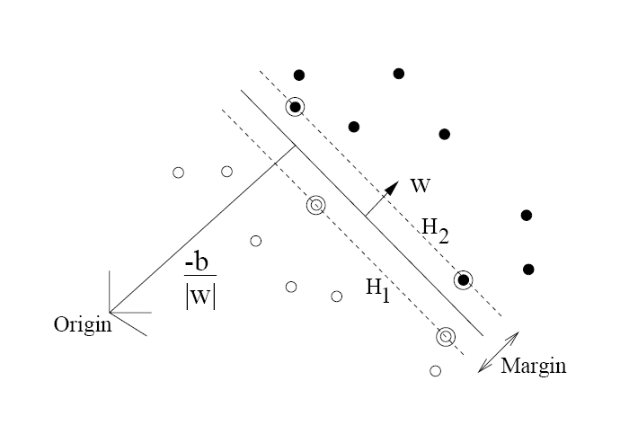
Preliminaries

Slide 8
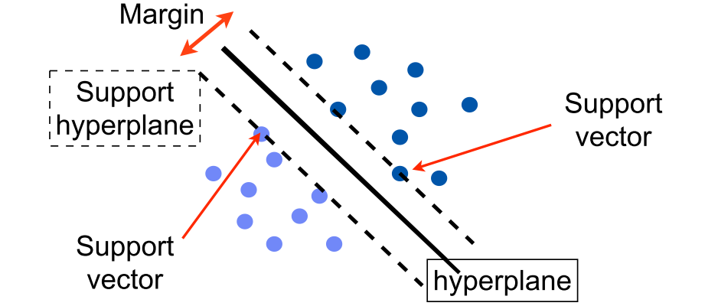
Linear classification
The main effort is to find the hyperplane
Support hyperplane -- two parallel hyperplane that maximize the margin
Support vector -- the vector point locate on support hyperplane

Slide 9
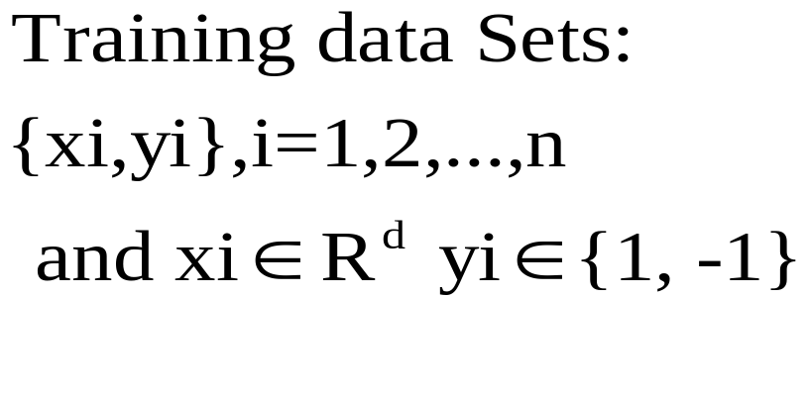
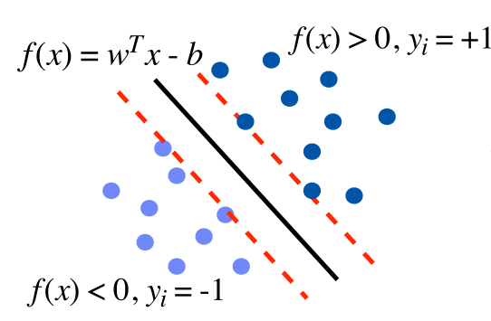
Math Form

Slide 10
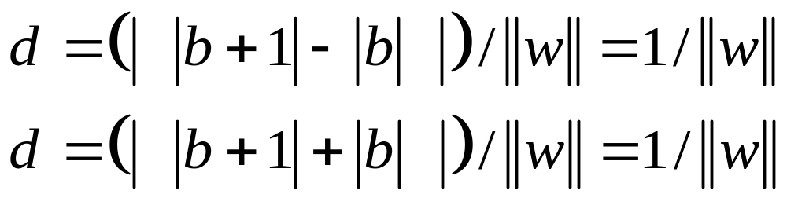
Two support hyperplanes
H1:wTx+b+δ→ H1:wTx+b=1
H2:wTx+b−δ→ H2:wTx+b= −1
We define the distance between separating hyperplane and support hyperplane as d
→

Slide 11




We should maximize the margin, m
Class 2
m
Class 1

Slide 12
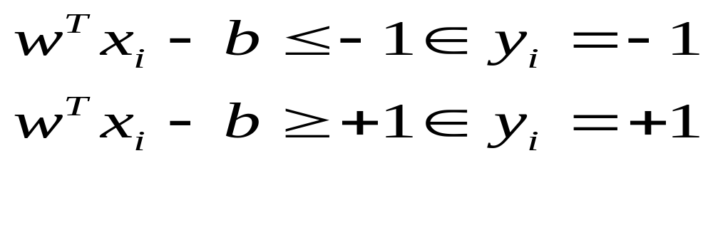
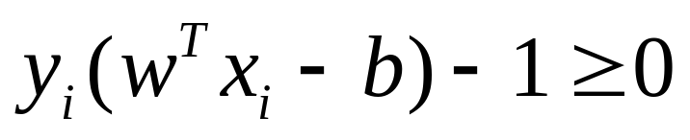
Continue
margin = 2d = 2/||w||
The small ||w|| is , the large margin become.
So, rewrite the inequality
The inequality

Slide 13
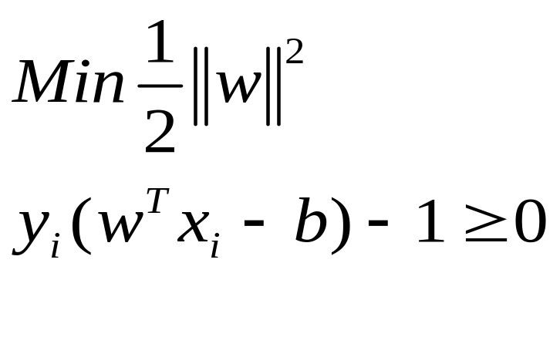
The primal problem of SVM
The decision boundary can be found by solving the following constrained optimization problem

Slide 14

Lagrange Multiplier Method
Lagrange Multiplier Method translate the above two equation and find out w, b, a that minimum L(w,b,a); Note that ||w||² = w^{T}w

Slide 15
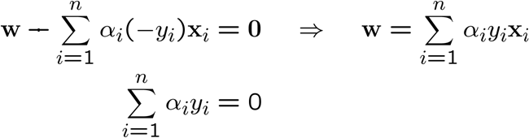
Setting the gradient of w.r.t. w and b to zero, we have

Slide 16
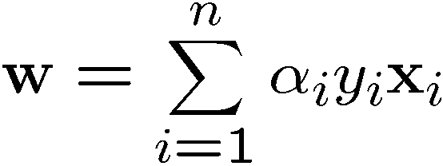

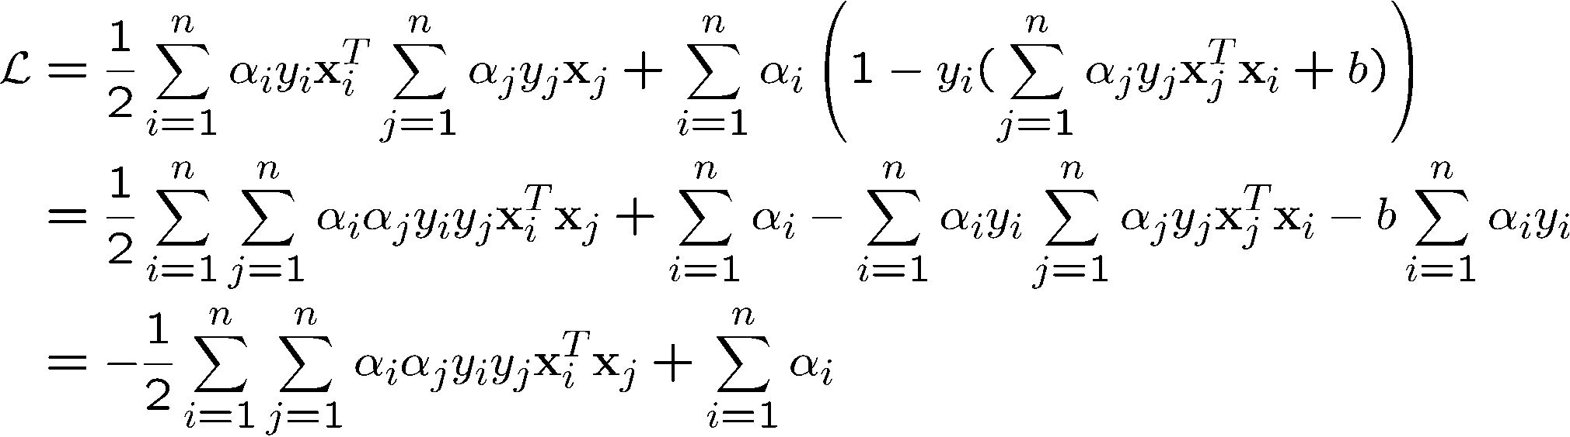
If we substitute to , we have

Slide 17
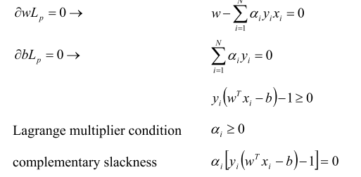
KKT condition

Slide 18




A Geometrical Interpretation
Class 2
α₁₀=0
α₈=0.6
α₇=0
α₂=0
α₅=0
α₁=0.8
α₄=0
α₆=1.4
α₉=0
α₃=0
Class 1

Slide 19
Non-linear Classification
Key idea: transform x_{i} to a higher dimensional space to “make life easier”
  Input space: the space the point x_{i} are located
  Feature space: the space of φ(x_{i}) after transformation
φ( )
φ( )
φ( )
φ( )
φ( )
φ(.)
φ( )
φ( )
φ( )
φ( )
φ( )
φ( )
φ( )
φ( )
φ( )
φ( )
φ( )
φ( )
φ( )
Input space
Feature space

Slide 20
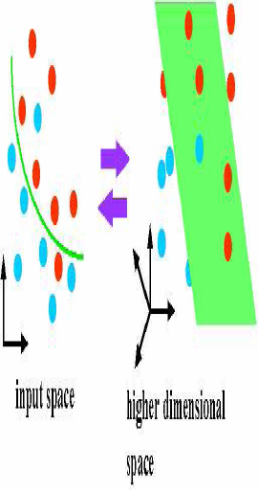
If the data is not linear, we can translate these
vectors into higher feature space

Slide 21








Non-linearly Separable Problems
We allow “error” ξ_{i} in classification; it is based on the output of the discriminant function w^{T}x+b
Class 2
Class 1

Slide 22
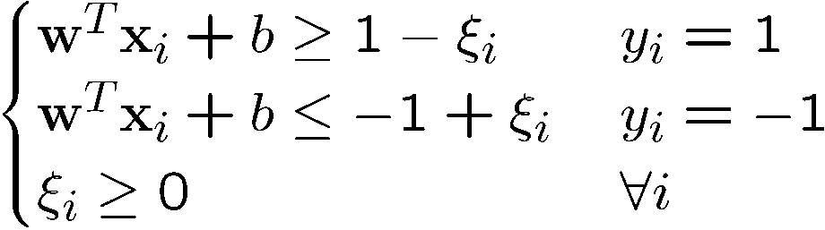
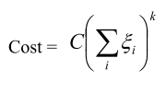
If we minimize ∑_{i}ξ_{i}, ξ_{i} can be computed by
  C : tradeoff parameter between error and margin
The optimization problem becomes

Slide 23
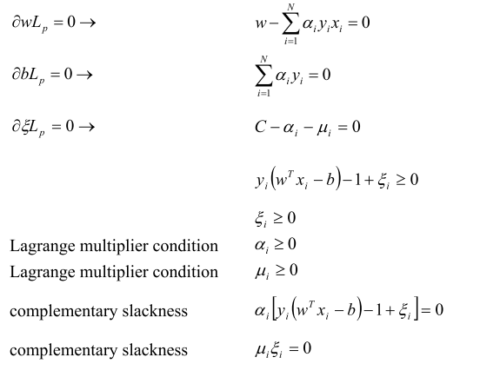
New KKT condition

Slide 24
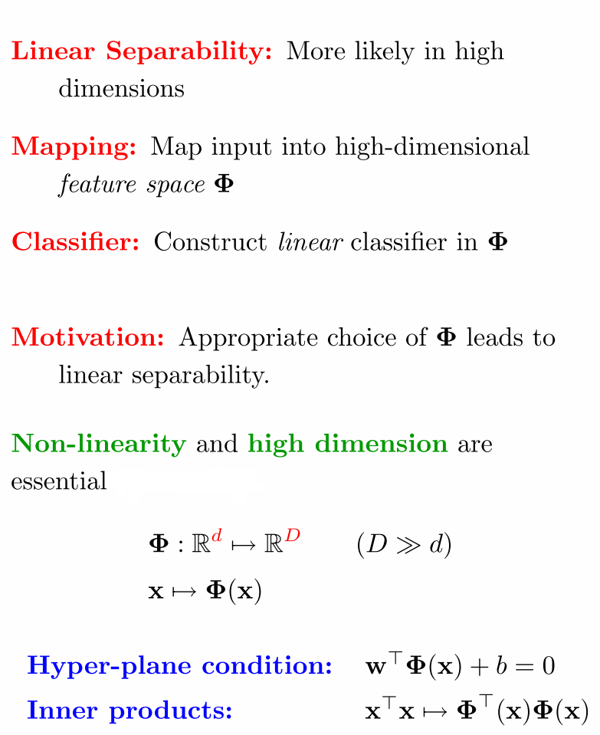

Slide 25
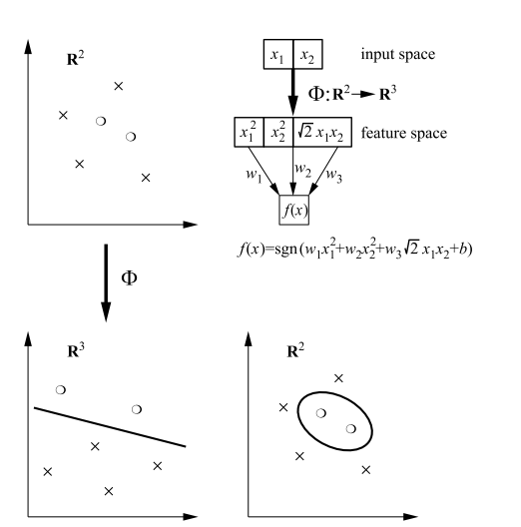
Decisions in Input and Feature Space: Problems becomes linearly separable in feature space

Slide 26
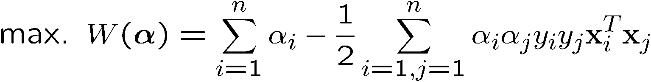
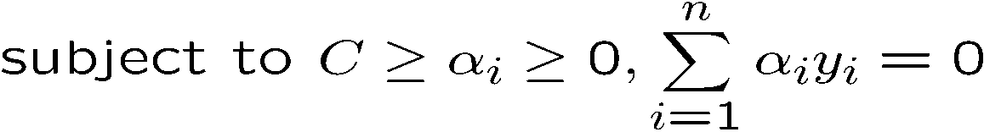
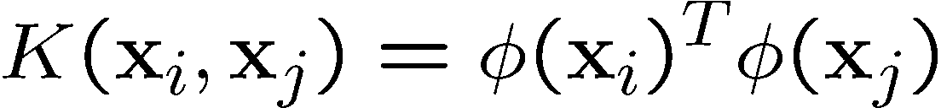
The kernel trick
Recall the SVM optimization problem
The data points only appear as inner product
As long as we can calculate the inner product in the feature space, we do not need the mapping explicitly
Many common geometric operations (angles, distances) can be expressed by inner products
Define the kernel function K by

Slide 27
An Example for φ(.) and K(.,.)
Suppose φ(.) is given as follows
An inner product in the feature space is
So, if we define the kernel function as follows, there is no need to carry out φ(.) explicitly
This use of kernel function to avoid carrying out φ(.) explicitly is known as the kernel trick

Slide 28

Examples of Kernel Functions
Polynomial kernel with degree d
Radial basis function kernel with width σ
  Closely related to radial basis function neural networks
  The feature space is infinite-dimensional
Sigmoid with parameter κ and θ
  It does not satisfy the Mercer condition on all κ and θ
Notes:
Despite violating Mercer condition, the sigmoid kernel function can still work

Slide 29
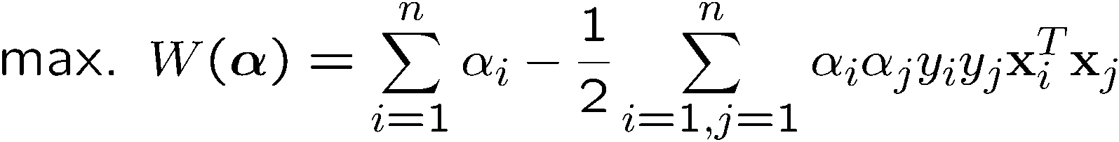
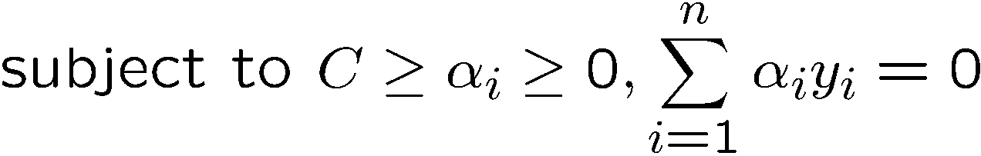
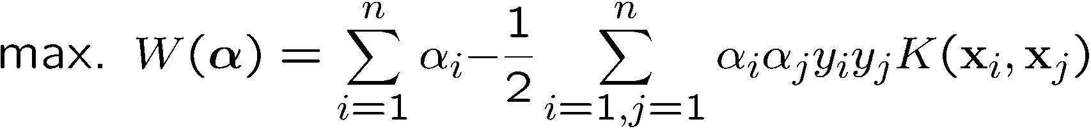
Modification Due to Kernel Function
Change all inner products to kernel functions
For training,
Original
With kernel function

Slide 30
More on Kernel Functions
Since the training of SVM only requires the value of K(x_{i}, x_{j}), there is no restriction of the form of x_{i} and x_{j}
  x_{i} can be a sequence or a tree, instead of a feature vector
K(x_{i}, x_{j}) is just a similarity measure comparing x_{i} and x_{j}

Slide 31
Kernel Functions
In practical use of SVM, the user specifies the kernel function; the transformation φ(.) is not explicitly stated
Given a kernel function K(x_{i}, x_{j}), the transformation φ(.) is given by its eigenfunctions (a concept in functional analysis)
  Eigenfunctions can be difficult to construct explicitly
  This is why people only specify the kernel function without worrying about the exact transformation
Another view: kernel function, being an inner product, is really a similarity measure between the objects

Slide 32
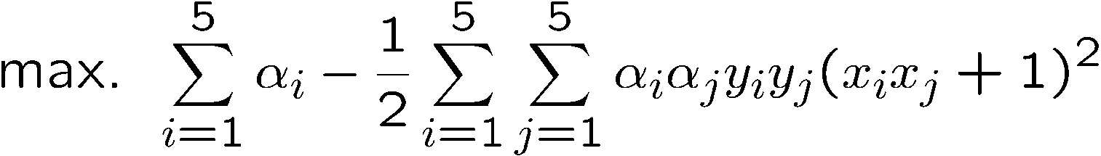
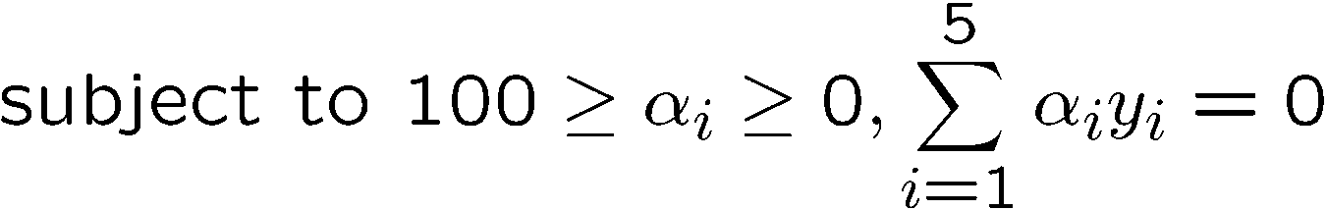
Example
Suppose we have 5 1D data points
  x₁=1, x₂=2, x₃=4, x₄=5, x₅=6, with 1, 2, 6 as class 1 and 4, 5 as class 2 ⇒ y₁=1, y₂=1, y₃=-1, y₄=-1, y₅=1
We use the polynomial kernel of degree 2
  K(x,y) = (xy+1)²
  C is set to 100
We first find α_{i} (i=1, …, 5) by
Notes:
H =
4 9 -25 -36 49
9 25 -81 -121 169
-25 -81 289 441 -625
-36 -121 441 676 -961
49 169 -625 -961 1369

Slide 33



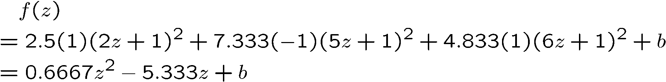
Example
By using a QP solver, we get
  α₁=0, α₂=2.5, α₃=0, α₄=7.333, α₅=4.833
  Note that the constraints are indeed satisfied
  The support vectors are {x₂=2, x₄=5, x₅=6}
The discriminant function is
Notes:
The optimization toolbox of matlab contains a quadratic programming solver

Slide 34


Continued
b is recovered by solving f(2)=1 or by f(5)=-1 or by f(6)=1, as x₂ and x₅ lie on the line
and x₄ lies on the line
All three give b=9

Slide 35
Example
Value of discriminant function
class 1
class 2
class 1
1
2
4
5
6

Slide 36
Choosing the Kernel Function
Probably the most tricky part of using SVM.
The kernel function is important because it creates the kernel matrix, which summarizes all the data
In practice, a low degree polynomial kernel or RBF kernel with a reasonable width is a good initial try

Slide 37
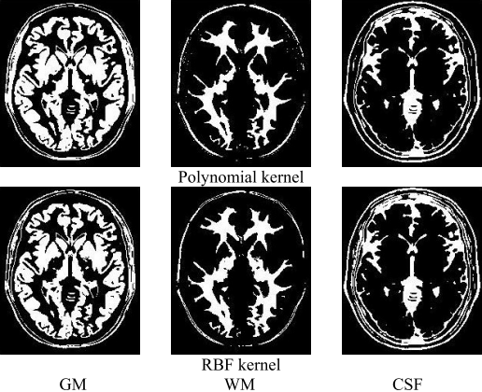
Different kernel using in MRI images

Slide 38



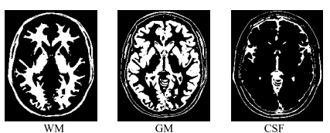
using a different set parameters in RBF kerenl
cost = 1, gamma = 0.5
cost =0.0313, gamma = 4

Slide 39
Summary: Steps for Classification
Prepare the pattern matrix
Select the kernel function to use
Select the parameter of the kernel function and the value of C
Execute the training algorithm and obtain the α_{i}
Unseen data can be classified using the α_{i} and the support vectors

Slide 40
Strengths and Weaknesses of SVM
Strengths
  Training is relatively easy
    No local optimal, unlike in neural networks
  It scales relatively well to high dimensional data
  Tradeoff between classifier complexity and error can be controlled explicitly
  Non-traditional data like strings and trees can be used as input to SVM, instead of feature vectors

Slide 41
Weaknesses of SVM
Weaknesses
  Need to choose a “good” kernel function.
  Need to select appropriate parameters to make it effective

Slide 42
Conclusion
SVM is a useful alternative to neural networks
Applications to
Clustering
Non-linear principal component analysis
Independent component analysis
Two key concepts of SVM: maximize the margin and the kernel trick

Slide 43
Reference
Wikipedia -- Support Vector Machine
林宗勳 SVM簡介 http://www.cmlab.csie.ntu.edu.tw/~cyy/learning/tutorial/SVM2.pdf
A Simple Introduction to Support Vector Machines-- Martin Law
Pattern Recognition, 3/e(IE) by Sergios Theodoridis, Konstantinos Koutroumbas
Stefan Lessmann, Robert Stahlbock, Sven F. Crone”Genetic Algorithms for Support Vector Machine Model Selection” 2006 International Joint Conference on Neural Networks

