Slide 1
MRI資料操作
M11017015 李昱杰

Slide 2
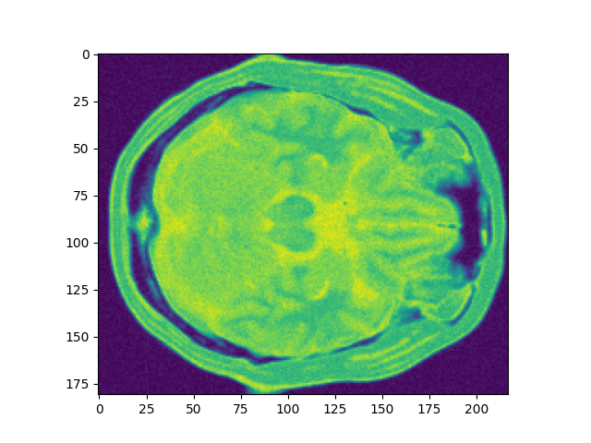
去腦殼
選取你需要的slice
將B1 B2 B3 合體(gt)
將原圖相乘

Slide 3
去腦殼
* sample code 僅供參考
b1 = gt["B1"]
b2 = gt["B2"]
b3 = gt["B3"]
b = b1 + b2 + b3
mask = b.copy()
mask[b>0]=1
pd = pd[:,:,0] * mask
t1 = t1[:,:,0] * mask
t2 = t2[:,:,0]* mask

Slide 4
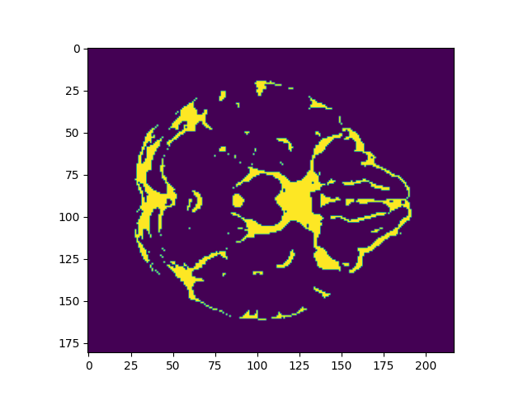
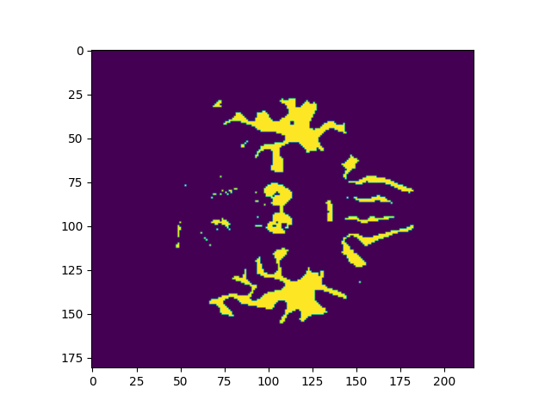
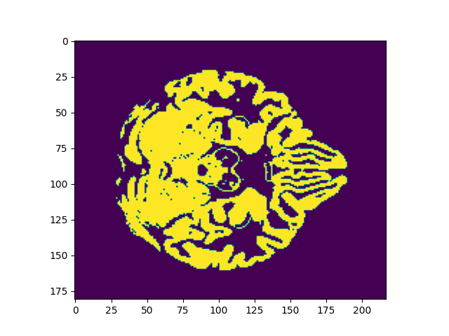
Groundtruth(答案) b1,b2,b3

Slide 5
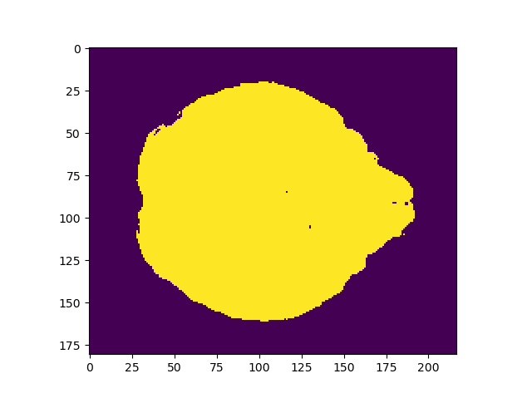
Groundtruth(答案) b1+b2+b3

Slide 6
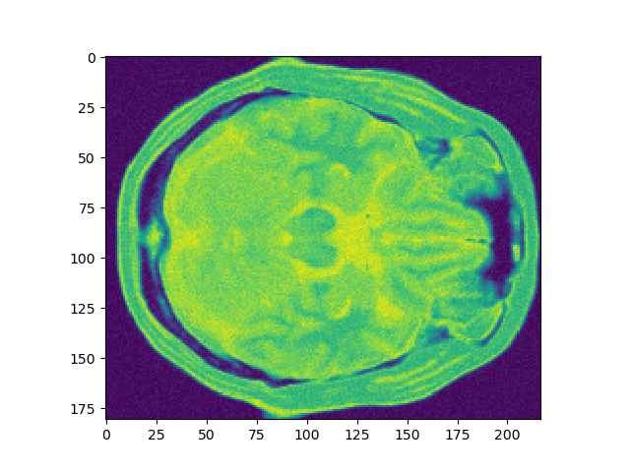
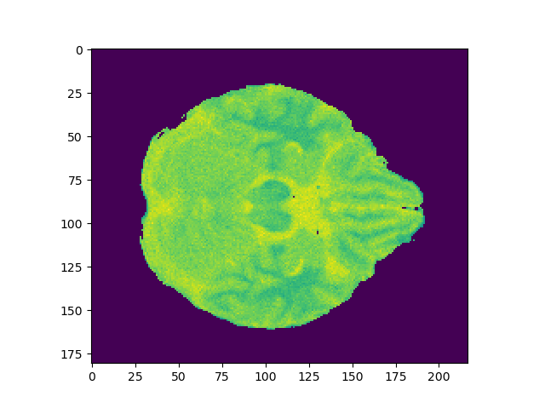
Mask與原圖相乘 =結果
X
=

Slide 7

結果

Slide 8
疊圖
* sample code 僅供參考
將去腦殼完的pd t1 t2的同一層 疊起來
pd = pd.reshape(39277)
t1 = t1.reshape(39277)
t2 = t2.reshape(39277)
mri = []
for i in range (39277):
mri.append( [pd[i],t1[i],t2[i]])
mri = np.asarray(mri)

Slide 9
跑kmeans

Slide 10
繳交重點
1. 動畫顯示or存成結果檔並做成ppt方便批改
2. 能看18張的result
3. 上傳code至tronclass

