Slide 1

Big Data
NBA Players Physiology Statistical Analysis
Song Xiao
Pang Wong
CS 454

Slide 2
Background
Big Data is a popular term to help describe growth and availability of data
This concept impacts not only business fields but also have a great influence on sports decision making for sport managers

Slide 3
Project Goal
Determine whether NBA teams roster physiology (height, weight) has an influence on their season performance
Make a prediction about a team winning percentage based on overall teams past successes and physical characteristics

Slide 4
Data Collection
Collect past 4 NBA seasons player's height and weight
Capture each NBA teams last 4 seasons wins and losses
Sources from www.basketball-references.com

Slide 5
Data Storage
Storage is based on CSV files

Slide 6
Analysis
Calculate the mean of each NBA teams last four seasons height and weight
Calculate the winning percentage of each teams last four seasons height and weight ( Wins / (Wins + Loss) )
Use the above data points to train the K- Nearest Neighbors

Slide 7
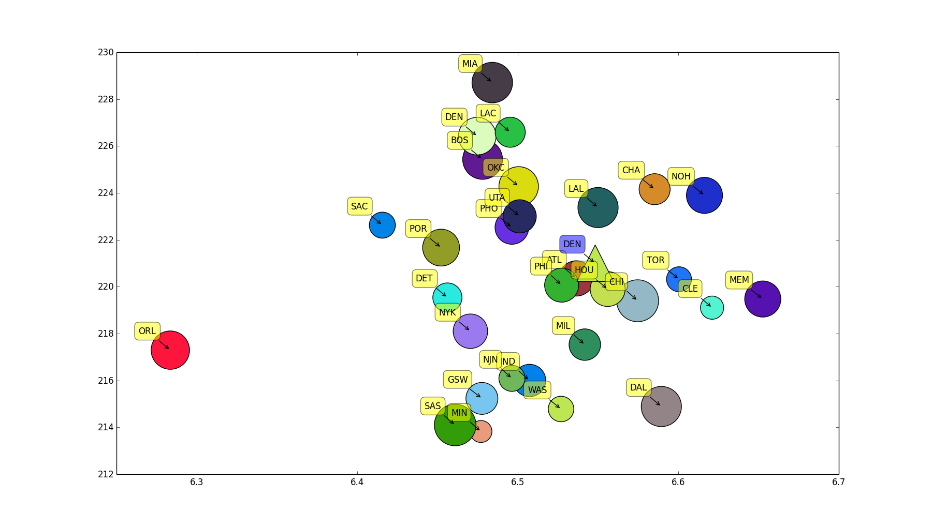
Visualization Nuggets 2013

Slide 8
K-NN Denver Nuggets 2013
Result: [[ 0.]] → Atlanta Hawks
Neighbors: [[ 0.]]
Distance: [[ 0.042036498]]

Slide 9
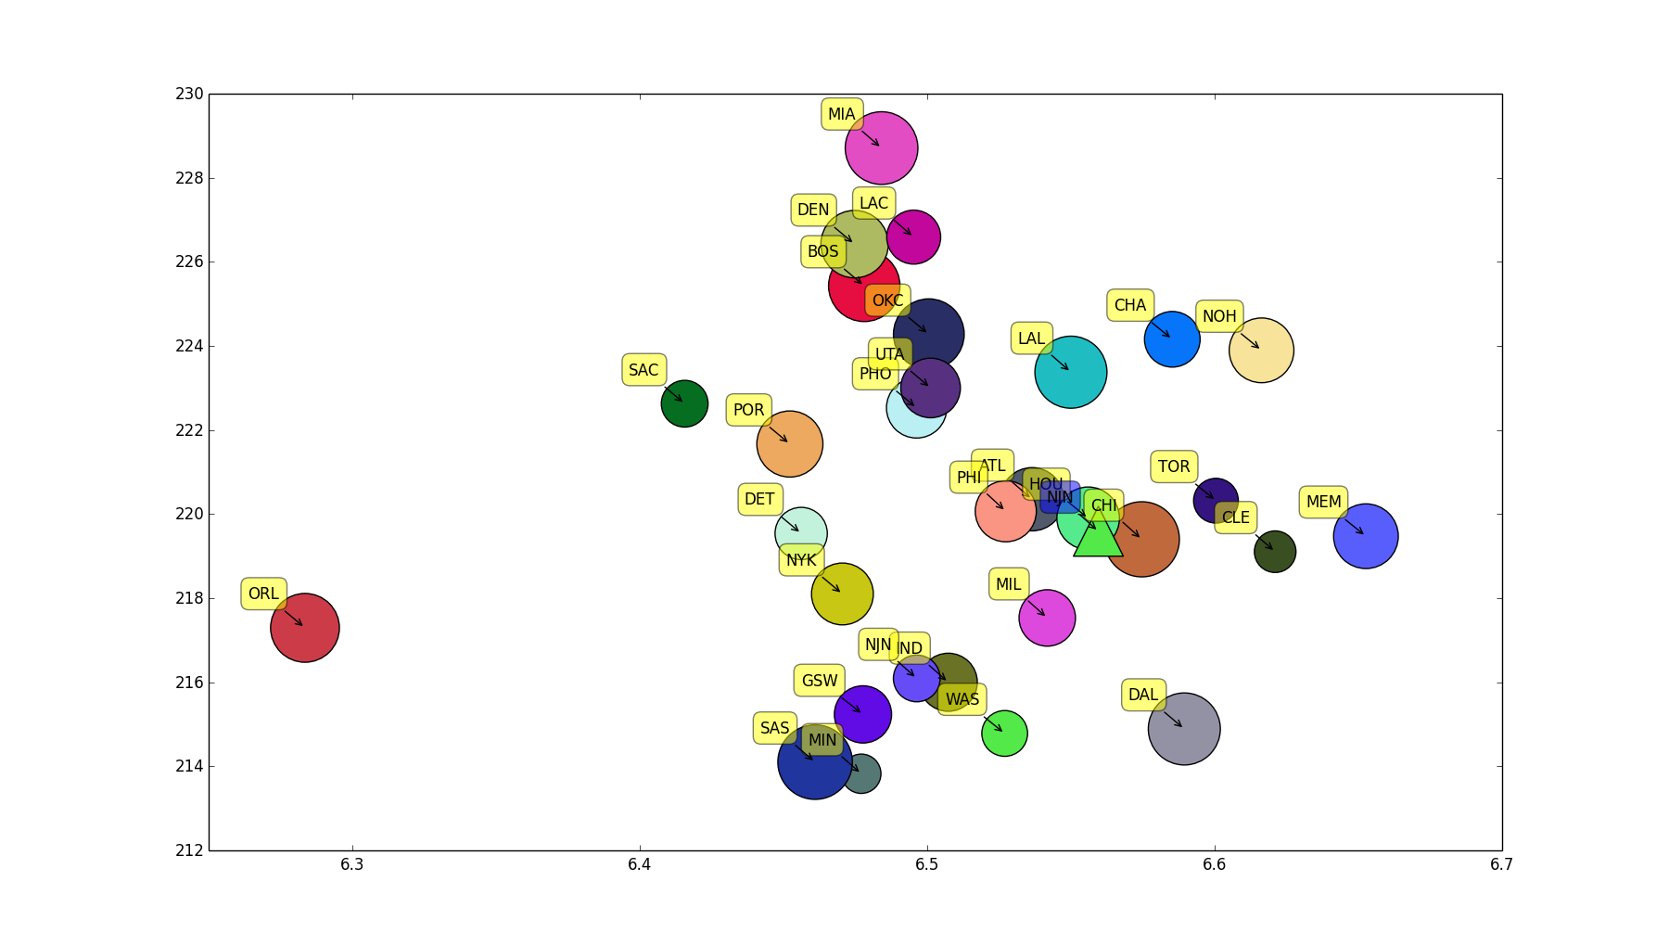
Visualization Nets 2013

Slide 10
K-NN Milwaukee Bucks 2013
Result: [[ 3]] → Chicago Bulls
Neighbors: [[ 3]]
Distance: [[ 0.01449782]]

Slide 11
K-NN Chicago Bulls 2013
Result: [[ 13.]] → Memphis (K-NN result fail...)
Neighbors: [[ 13.]]
Distance: [[ 0.36245733]]

Slide 12
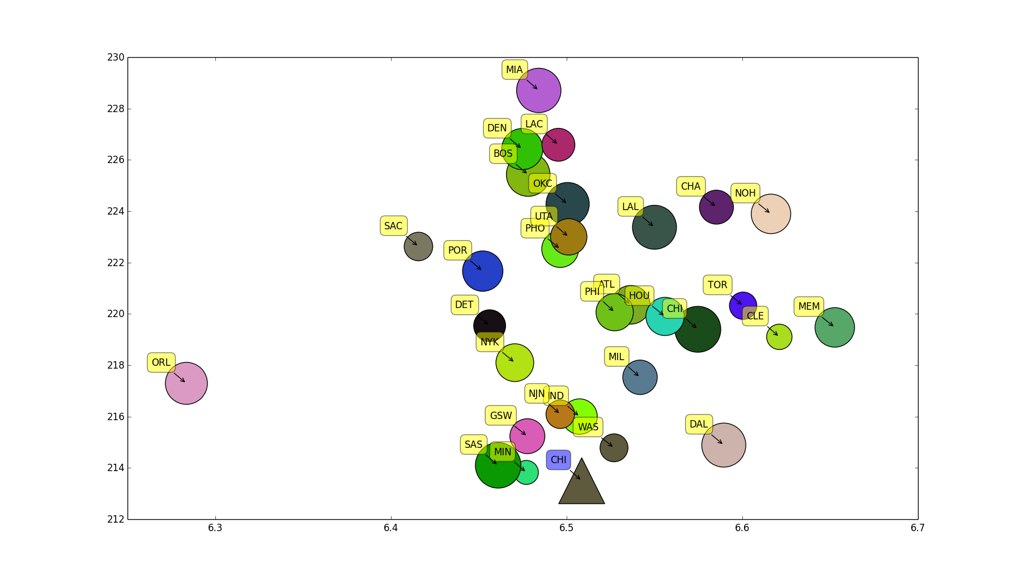
Visualization Bulls 2013

Slide 13
Conclusion
Our success rate for K-NN prediction was about 60%
Future consideration for more accuracy of K-NN prediction requires more past seasons data

