Slide 1
BCCC English service

Slide 2

Please Put Your Phones on Silent
Prepare your hearts for worship.
Thank you!

Slide 3
Bible reading 1
Copy paste here

Slide 4

Worship
Please stand up and sing if you’re comfortable

Slide 5

This is Amazing Grace
This is Amazing Grace Jeremy Riddle, Josh Farro, Phil Wickham © 2012 Phil Wickham Music (Admin. by BMG Rights Management [c/o Music Services, Inc.]) CCLI Licence No. 5485849

Slide 6
Verse 1
Who breaks the power of sin and darkness? Whose love is mighty and so much stronger? The King of glory, the King above all kings

Slide 7
Verse 1
Who shakes the whole earth with holy thunder? And leaves us breathless in awe and wonder?
The King of glory, the King above all kings

Slide 8
Chorus
This is amazing grace
This is unfailing love
That You would take my place
That You would bear my cross

Slide 9
Chorus
You laid down Your life
That I would be set free
Oh,
Jesus, I sing for All that You've done for me

Slide 10
Verse 2
Who brings our chaos back into order?
Who makes the orphans a son and daughter? The King of glory, the King of glory

Slide 11
Verse 2
Who rules the nations with truth and justice
Shines like the sun in all of its brilliance
The King of glory, the King above all kings

Slide 12
Chorus
This is amazing grace
This is unfailing love
That You would take my place
That You would bear my cross

Slide 13
Chorus
You laid down Your life
That I would be set free
Oh,
Jesus, I sing for All that You've done for me

Slide 14
Bridge
Worthy is the Lamb who was slain
Worthy is the King who conquered the grave (x3)
Worthy, worthy, worthy

Slide 15
Chorus
This is amazing grace
This is unfailing love
That You would take my place
That You would bear my cross

Slide 16
Chorus
You laid down Your life
That I would be set free
Oh,
Jesus, I sing for All that You've done for me

Slide 17
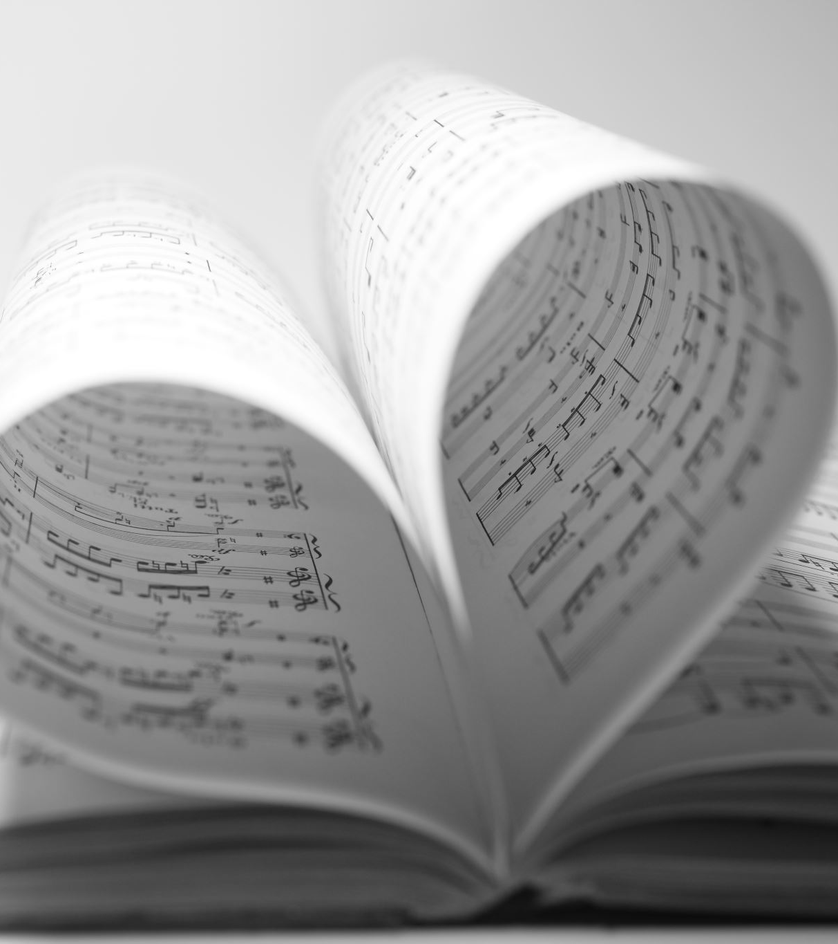
Remembrance
CCLI: Benjamin Hastings, Chris Davenport
©2017 Hillsong MP Songs (Admin. by Hillsong Music Publishing Australia)
Hillsong Music Publishing Australia
CCLI Licence No. 5485849
7102398

Slide 18
Verse 1
I take the bread of life
Broken for all my sin
Your body crucified
To make me whole again

Slide 19
Verse 2
I will recall the cup
Poured out in sacrifice
To trade this sinners’ end
For Your new covenant

Slide 20
Chorus
Hallelujah
I’ll live my life in remembrance
Hallelujah
Your promise I won’t forget

Slide 21
Verse 3
I’ll walk salvation’s road
With fear and trembling
Your way borne as my own
As Christ is formed in me

Slide 22
Chorus
Hallelujah
I’ll live my life in remembrance
Hallelujah
Your promise I won’t forget

Slide 23
Post chorus 1
If ever I should lose my way
If ever I deny Your grace
Remind me of the price You paid
Hallelujah
I’ll live in remembrance

Slide 24
Bridge
You’ve been so so good to me
You’ve been so so good to me
Oh to think where I would be
If not for You
If not for You
(x3)

Slide 25
Post chorus 2
As far as heights reach from the depths
As far as east is from the west
So far Your grace has carried me

Slide 26
Post chorus 3
Until I see You face to face
Until at last I’ve won my race
Remind me
Youʼre not finished yet

Slide 27
Tag
Hallelujah
(x3)
I’ll live in remembrance

Slide 28
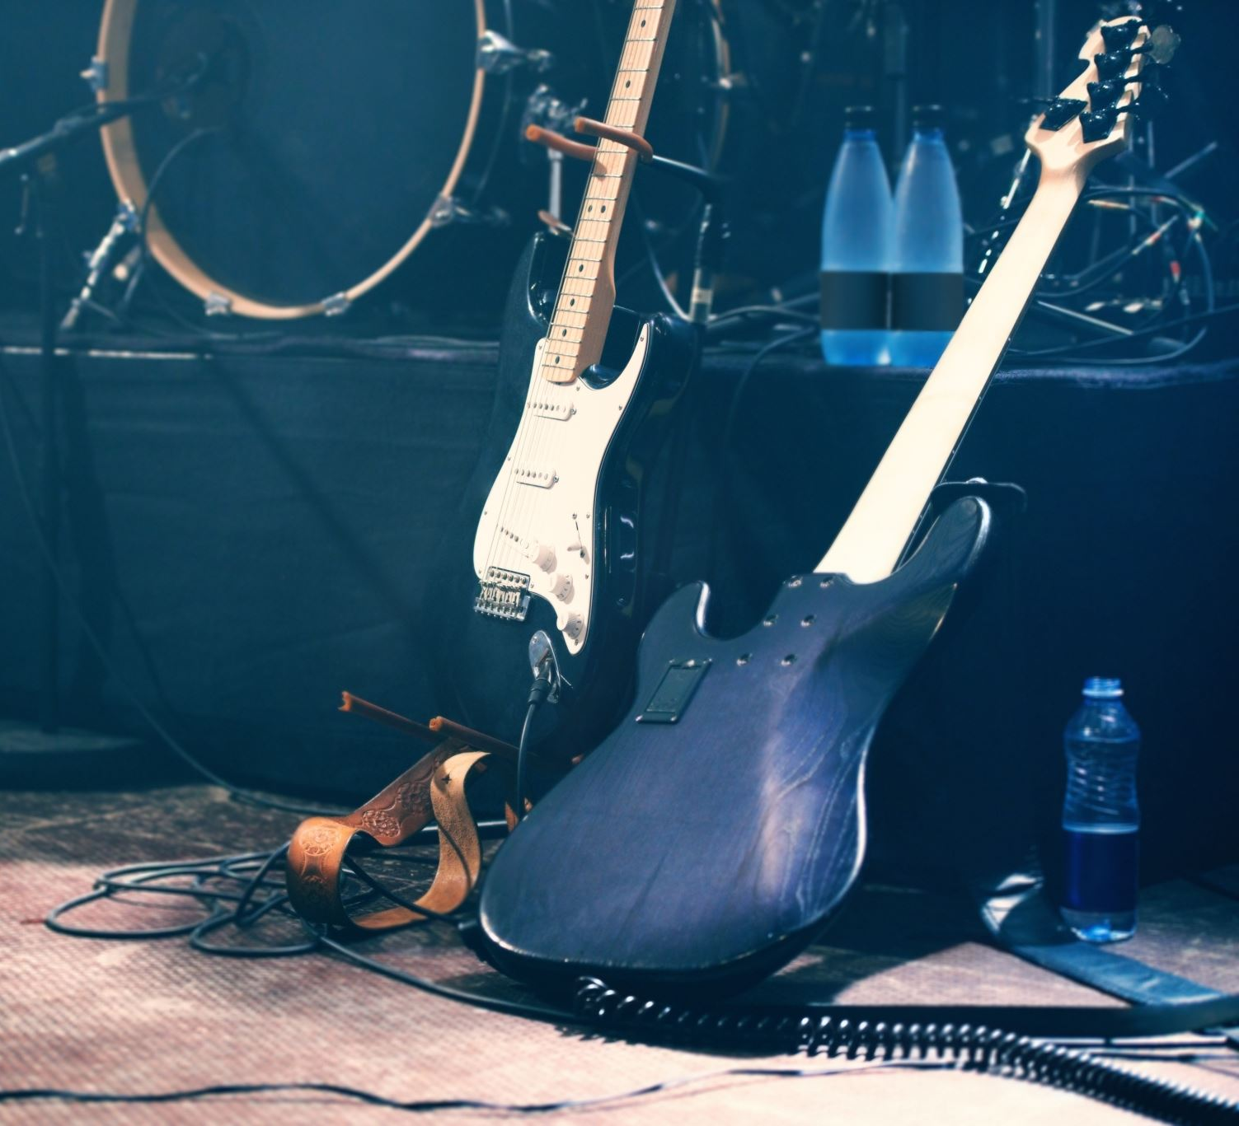
This I believe
CCLI: Ben Fielding, Matt Crocker
© 2014 Hillsong Music Publishing Australia
CCLI Licence No. 5485849
7018338

Slide 29
Verse 1
Our Father everlasting
The all creating One
God Almighty

Slide 30
Verse 1
Through Your Holy Spirit
Conceiving Christ the Son
Jesus our Saviour

Slide 31
Chorus
I believe in God our Father
I believe in Christ the Son
I believe in the Holy Spirit
Our God is three in one

Slide 32
Chorus
I believe in the resurrection
That we will rise again
For I believe in the Name of Jesus

Slide 33
Verse 2
Our Judge and our Defender
Suffered and crucified
Forgiveness is in You

Slide 34
Verse 2
Descended into darkness
You rose in glorious life
Forever seated high

Slide 35
Chorus
I believe in God our Father
I believe in Christ the Son
I believe in the Holy Spirit
Our God is three in one

Slide 36
Chorus
I believe in the resurrection
That we will rise again
For I believe in the Name of Jesus

Slide 37
Bridge
I believe in You
I believe You rose again
I believe that Jesus Christ is Lord
(x2)

Slide 38
Chorus
I believe in God our Father
I believe in Christ the Son
I believe in the Holy Spirit
Our God is three in one

Slide 39
Chorus
I believe in the resurrection
That we will rise again
For I believe in the Name of Jesus

Slide 40
Chorus 2
I believe in life eternal
I believe in the virgin birth
I believe in the saints' communion
And in Your holy Church

Slide 41
Chorus 2
I believe in the resurrection
When Jesus comes again
For I believe in the Name of Jesus

Slide 42
Chorus
I believe in God our Father
I believe in Christ the Son
I believe in the Holy Spirit
Our God is three in one

Slide 43
Chorus
I believe in the resurrection
That we will rise again
For I believe in the Name of Jesus

Slide 44
Tag
For I believe in the Name of Jesus

Slide 45

Bible Reading

Slide 46
Matthew 11:2-6
2 When John, who was in prison, heard about the deeds of the Messiah, he sent his disciples 3 to ask him, “Are you the one who is to come, or should we expect someone else?” 4 Jesus replied, “Go back and report to John what you hear and see: 5 The blind receive sight, the lame walk, those who have leprosy are cleansed, the deaf hear, the dead are raised, and the good news is proclaimed to the poor. 6 Blessed is anyone who does not stumble on account of me. ”.

Slide 47
Matthew 16:13-16
13 When Jesus came to the region of Caesarea Philippi, he asked his disciples, “Who do people say the Son of Man is?”
14 They replied, “Some say John the Baptist; others say Elijah; and still others, Jeremiah or one of the prophets.”
15 “But what about you?” he asked. “Who do you say I am?”
16 Simon Peter answered, “You are the Messiah, the Son of the living God.”

Slide 48
Announcements
Announcement
Text
Announcement
Text
Announcement
Text
Announcement
Text
Announcement
Text
Announcement
Text

Slide 49
Tithing
Account Name:
Blacktown Chinese Christian Church
BSB: 112 - 879
Account number: 4216 50263
Please put in “offering” as the reference
The tithing box is available at the back of the hall

Slide 50
Prayer points
Point
Text
Point
Text
Point
Text
Point
Text
Point
Text
Point
Text

Slide 51
Prayer and offering

Slide 52
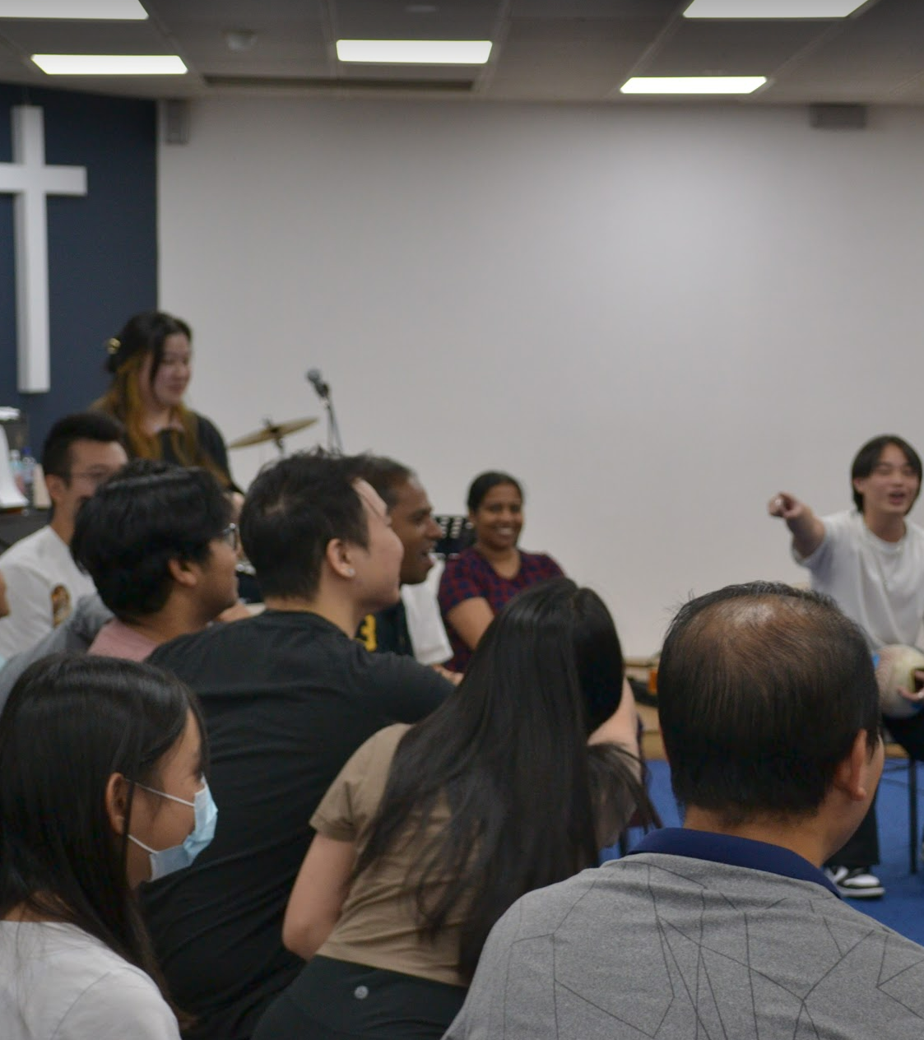
Mingle Time!

