Slide 1
BCCC English service

Slide 2

Please Put Your Phones on Silent
Prepare your hearts for worship.
Thank you!

Slide 3
Bible reading 1
Copy paste here

Slide 4

Worship
Please stand up and sing if you’re comfortable

Slide 5

Every step
CCLI
"Ian Lewis, James Ferguson
© CityAlight Music (Admin. by Integrity Music)
CCLI Licence No. 5485849"

Slide 6
Verse 1
I can sing with my whole heart,
I have all I need
In Jesus, my Saviour, my joy is complete
Onward to glory yet here I will wait
I will trust in Christ every step I take

Slide 7
Verse 2
I am sure of Your promise to guide me each day
Though some may oppose me, I won't be ashamed
Whatever I face, Lord, it won't be in vain
I will trust in Christ every step I take

Slide 8
Chorus
For all of my days, I will live for Your glory
Running with courage and faith
The prize of my journey, the joy of salvation
To meet my King face to face

Slide 9
Verse 3
So I'm looking to Jesus, perfector of faith
My heart set on heaven where treasure awaits
I'll run with endurance to finish the race
I will trust in Christ every step I take

Slide 10
Chorus
For all of my days, I will live for Your glory
Running with courage and faith
The prize of my journey, the joy of salvation
To meet my King face to face

Slide 11
Bridge
I will, I will rejoice
Whatever comes my way
God You're faithful to save

Slide 12
Bridge
I will, I will rejoice
I know that God is with me always

Slide 13
Bridge
I will, I will rejoice
Whatever comes my way
God You're faithful to save

Slide 14
Bridge
I will, I will rejoice
I know that God is with me always

Slide 15
Bridge
I will, I will rejoice
Whatever comes my way
God You're faithful to save

Slide 16
Bridge
I will, I will rejoice
I know that God is with me always

Slide 17
Chorus
For all of my days, I will live for Your glory
Running with courage and faith
The prize of my journey, the joy of salvation
To meet my King face to face

Slide 18
Tag
To meet my King face to face
To meet my King face to face

Slide 19

In control
In Control
Aodhan King, Ben Fielding
©2016 Hillsong Music Publishing Australia
CCLI Licence No. 5485849

Slide 20
Verse 1
From heaven You can hear
I know You're drawing near
As I worship

Slide 21
Verse 1
Held within Your love
The wind and waves will come
But I will stay here

Slide 22
Chorus
I lift my hands to heaven
Hear my heart surrender
I tell my soul again
You are Lord of all

Slide 23
Chorus
And though the seas are raging
You will speak and tame them
In You I find my rest
You are in control

Slide 24
Verse 2
Through valleys I will trust
Your Spirit is enough
To keep me walking

Slide 25
Verse 2
You guide my every step
Speak life to me again
Lord I need You
Oh, I need You

Slide 26
Chorus
I lift my hands to heaven
Hear my heart surrender
I tell my soul again
You are Lord of all

Slide 27
Chorus
And though the seas are raging
You will speak and tame them
In You I find my rest
You are in control

Slide 28
Bridge
I will trust in only You
No one can add to Your perfection
You're the beginning and the end
More than I can comprehend
There is no one like You
No one (x2)

Slide 29
Bridge
I will trust in only You
No one can add to Your perfection
You're the beginning and the end
More than I can comprehend
There is no one like You
Jesus

Slide 30
Chorus
I lift my hands to heaven
Hear my heart surrender
I tell my soul again
You are Lord of all

Slide 31
Chorus
And though the seas are raging
You will speak and tame them
In You I find my rest
You are in control

Slide 32
Tag
In You I find my rest
You are in control

Slide 33

I give you my heart
CCLI license number: 84092

Slide 34
Verse 1
This is my desire
To honor You
Lord, with all my heart
I worship You

Slide 35
Verse 1
All I have within me
I give You praise
All that I adore
Is in You

Slide 36
Chorus
Lord, I give You my heart
I give You my soul
I live for you alone

Slide 37
Chorus
Every breath that I take
Every moment I'm awake
Lord, have Your way in me

Slide 38
Verse 1
This is my desire
To honor You
Lord, with all my heart
I worship You

Slide 39
Verse 1
All I have within me
I give You praise
All that I adore
Is in You

Slide 40
Chorus
Lord, I give You my heart
I give You my soul
I live for you alone

Slide 41
Chorus
Every breath that I take
Every moment I'm awake
Lord, have Your way in me

Slide 42
Chorus
Lord, I give You my heart
I give You my soul
I live for you alone

Slide 43
Chorus
Every breath that I take
Every moment I'm awake
Lord, have Your way in me

Slide 44

Bible Reading

Slide 45
Revelation 21:3
3 And I heard a loud voice from the throne saying, “Look! God’s dwelling place is now among the people, and he will dwell with them. They will be his people, and God himself will be with them and be their God.

Slide 46
Announcements

Slide 47
Tithing
Account Name:
Blacktown Chinese Christian Church
BSB: 112 - 879
Account number: 4216 50263
Please put in “offering” as the reference
The tithing box is available at the back of the hall

Slide 48
Prayer points

Slide 49
Prayer and offering

Slide 50
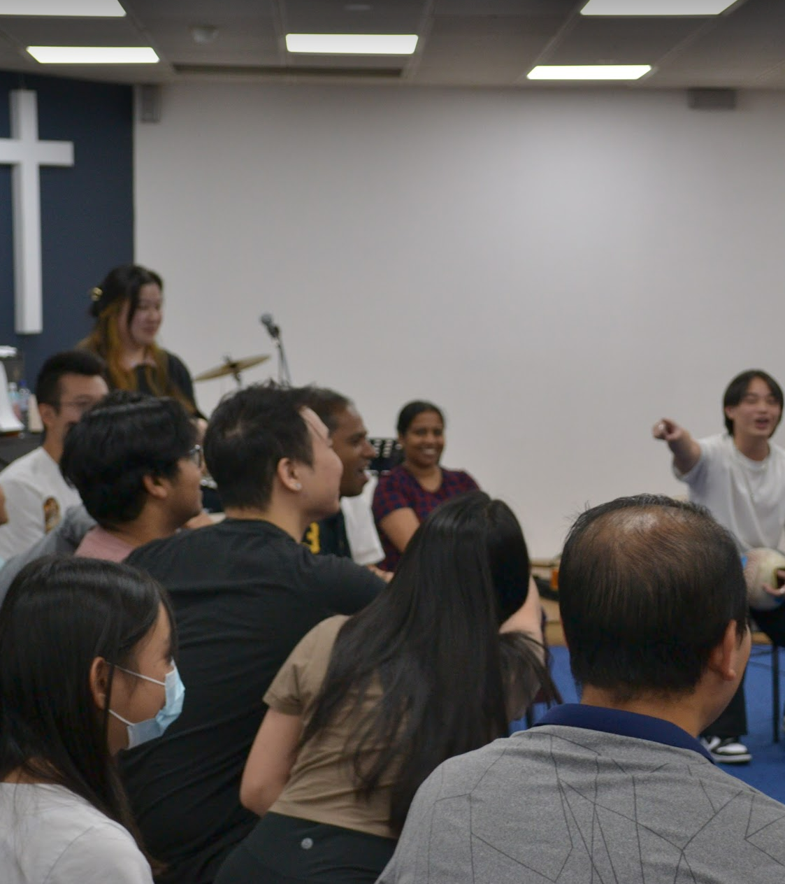
Mingle Time!

