Slide 1
BCCC English service

Slide 2

Please Put Your Phones on Silent
Prepare your hearts for worship.
Thank you!

Slide 3
Introductory bible reading
^{Usually steven does this}

Slide 4
Worship
Please stand up and sing if you’re comfortable
Replace with appropriate songs – which should be made into separate ppts for the sake of automation

Slide 5
Song 1
CCLI 1

Slide 6
Song 2
CCLI 2

Slide 7
Song 3
CCLI 3

Slide 8
Bible Reading
Replace with appropriate passage

Slide 9
2 Corinthians 11:16-33
¹⁶ I repeat: Let no one take me for a fool. But if you do, then tolerate me just as you would a fool, so that I may do a little boasting. ¹⁷ In this self-confident boasting I am not talking as the Lord would, but as a fool. ¹⁸ Since many are boasting in the way the world does, I too will boast. ¹⁹ You gladly put up with fools since you are so wise! ²⁰ In fact, you even put up with anyone who enslaves you or exploits you or takes advantage of you or puts on airs or slaps you in the face. ²¹ To my shame I admit that we were too weak for that!
Whatever anyone else dares to boast about—I am speaking as a fool—I also dare to boast about.

Slide 10
Announcements
1
2
3
New guests
Point 2
Point 3
Welcome new guests!
Point 2
Point 3
4
5
6
Leaders Training
Cleaning
Point 6
On Zoom at 8pm Monday
The (REPLACE WITH GROUP) are cleaning the bathroom
Point 6

Slide 11
Tithing
Account Name: Blacktown Chinese Christian Church
BSB: 112-879
Account: 4216 50263
(please put in “offering” in reference box detail)
The tithing box is available at the back of the hall

Slide 12
Prayer points
1
2
3
Missionaries
Point 2
Point 3
Daniel and Ester plan to leave for mission in West Asia, pray for their mission
Point 3
Point 2
4
5
Point 4
Point 5
Point 4
Point 5

Slide 13
Prayer and offering

Slide 14
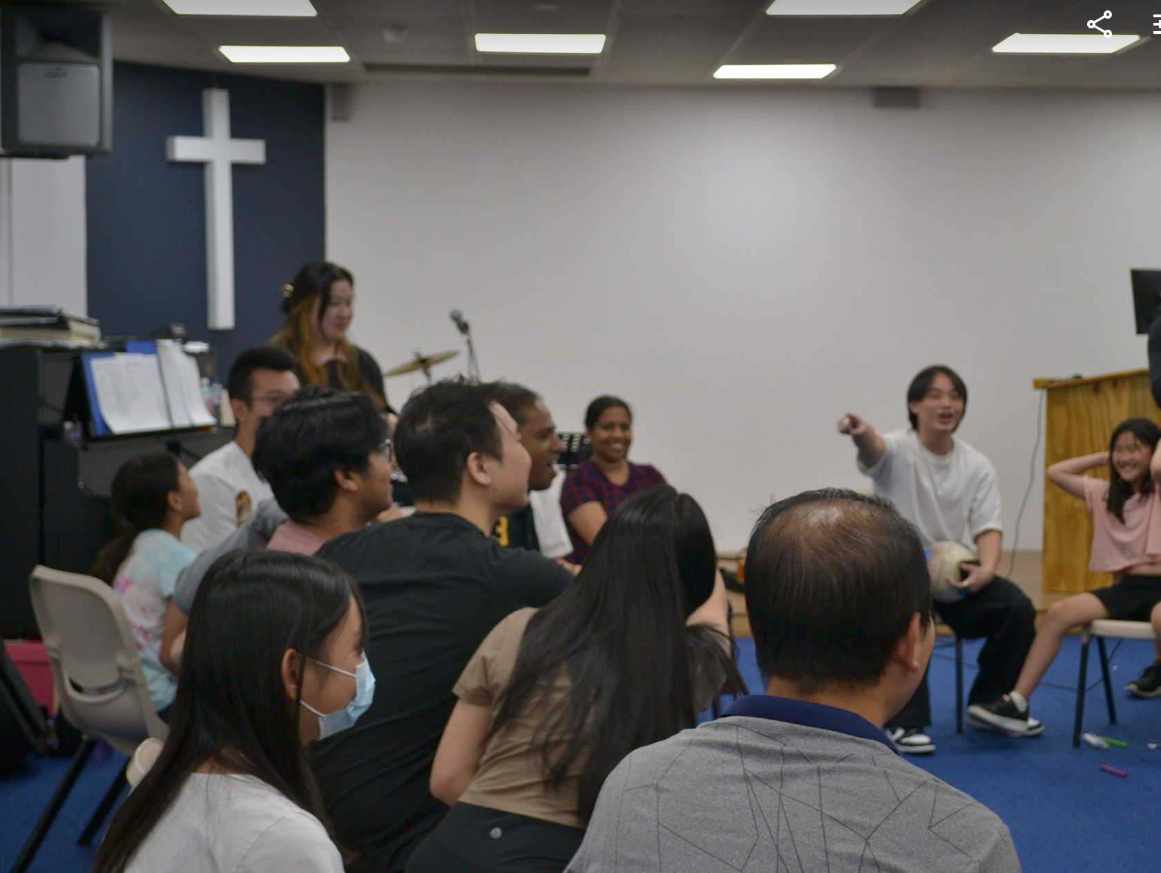
Mingle Time!

