Slide 1
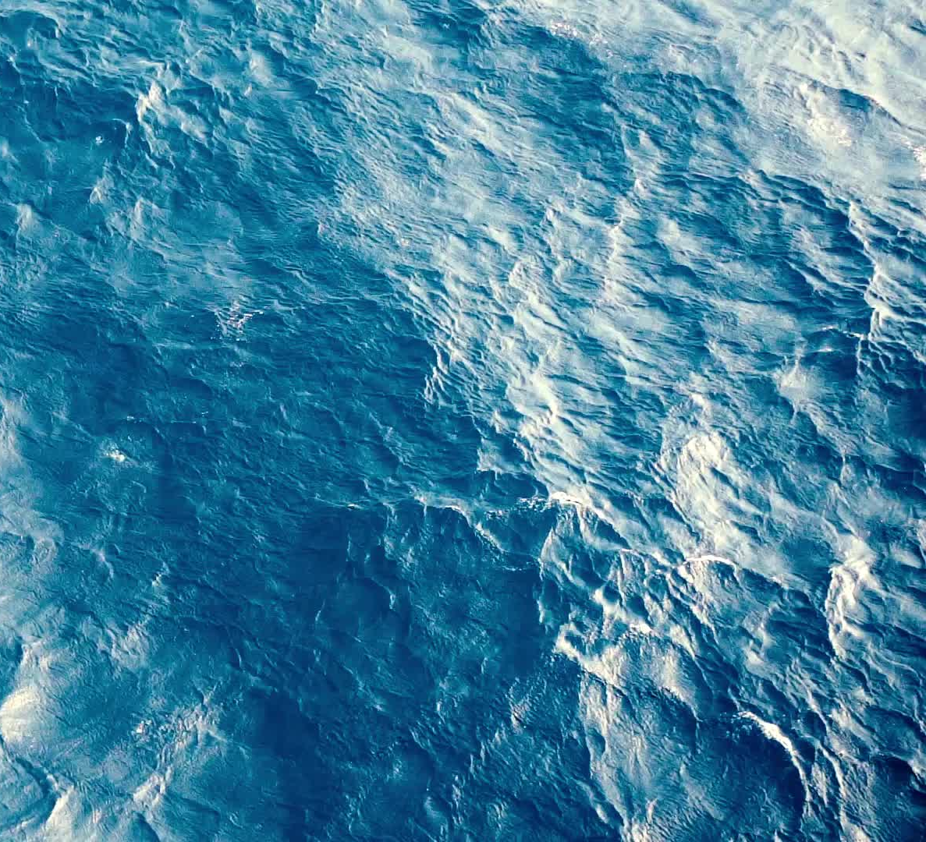
Oceans
Joel Houston, Matt Crocker, Salomon Ligthelm
© 2012 Hillsong Music Publishing Australia
CCLI Licence No. 5485849

Slide 2
Verse 1
You call me out upon the waters
The great unknown where feet may fail
And there I find You in the mystery
In oceans deep my faith will stand

Slide 3
Chorus
And I will call upon Your Name
And keep my eyes above the waves
When oceans rise

Slide 4
Chorus
My soul will rest in Your embrace
For I am Yours and You are mine

Slide 5
Verse 2
Your grace abounds in deepest waters
Your sovereign hand will be my guide
Where feet may fail and fear surrounds me
You've never failed and You won't start now

Slide 6
Chorus
And I will call upon Your Name
And keep my eyes above the waves
When oceans rise

Slide 7
Chorus
My soul will rest in Your embrace
For I am Yours and You are mine

Slide 8
Bridge
Spirit lead me where my trust is without borders
Let me walk upon the waters
Wherever You would call me

Slide 9
Bridge
Take me deeper than my feet could ever wander
And my faith will be made stronger
In the presence of my Saviour

Slide 10
Bridge
Spirit lead me where my trust is without borders
Let me walk upon the waters
Wherever You would call me

Slide 11
Bridge
Take me deeper than my feet could ever wander
And my faith will be made stronger
In the presence of my Saviour

Slide 12
Bridge
Spirit lead me where my trust is without borders
Let me walk upon the waters
Wherever You would call me

Slide 13
Bridge
Take me deeper than my feet could ever wander
And my faith will be made stronger
In the presence of my Saviour

Slide 14
Chorus
And I will call upon Your Name
And keep my eyes above the waves
When oceans rise

Slide 15
Chorus
My soul will rest in Your embrace
For I am Yours and You are mine

