Slide 1
BCCC English service

Slide 2

Please Put Your Phones on Silent
Prepare your hearts for worship.
Thank you!

Slide 3

Worship
Please stand up and sing if you’re comfortable

Slide 4

Lead me to the Cross
Joel Houston, Matt Crocker, Salomon Ligthelm
© 2012 Hillsong Music Publishing Australia
CCLI Licence No. 5485849

Slide 5
Verse 1
Savior I come
Quiet my soul, remember
Redemption's hill
Where Your blood was spilled
For my ransom

Slide 6
Pre-chorus
Everything I once held dear
I count it all as lost

Slide 7
Chorus
Lead me to the cross
Where Your love poured out
Bring me to my knees
Lord I lay me down

Slide 8
Chorus
Rid me of myself
I belong to You
Oh, lead me, lead me to the cross

Slide 9
Verse 2
You were as I
Tempted and trialed
Human
The word became flesh
Bore my sin and death
Now you're risen

Slide 10
Pre-chorus
Everything I once held dear
I count it all as lost

Slide 11
Chorus
Lead me to the cross
Where Your love poured out
Bring me to my knees
Lord I lay me down

Slide 12
Chorus
Rid me of myself
I belong to You
Oh, lead me, lead me to the cross

Slide 13
Bridge
To Your heart
To Your heart
Lead me to Your heart
Lead me to Your heart

Slide 14
Chorus
Lead me to the cross
Where Your love poured out
Bring me to my knees
Lord I lay me down

Slide 15
Chorus
Rid me of myself
I belong to You
Oh, lead me, lead me to the cross

Slide 16

In Christ alone
CCLI:
"Keith Getty, Stuart Townend
©2001 Thankyou Music (Admin. by SHOUT! Music Publishing Australia)
CCLI Licence No. 5485849"

Slide 17
Verse 1
In Christ alone my hope is found
He is my light, my strength, my song

Slide 18
Verse 1
This cornerstone, this solid ground
Firm through the fiercest drought and storm

Slide 19
Verse 1
What heights of love, what depths of peace
When fears are stilled, when strivings cease

Slide 20
Verse 1
My comforter, my all in all
Here, in the love of Christ, I stand

Slide 21
Verse 2
In Christ alone, who took on flesh
Fullness of God in helpless babe
This gift of love and righteousness
Scorned by the ones He came to save

Slide 22
Verse 2
'Til on that cross, as Jesus died
The wrath of God was satisfied
For every sin, on Him, was laid
Here, in the death of Christ, I live

Slide 23
Verse 2
'Til on that cross, as Jesus died
The wrath of God was satisfied
For every sin, on Him, was laid
Here, in the death of Christ, I live

Slide 24
Verse 3
There in the ground, His body lay
Light of the world, by darkness, slain
Then bursting forth in glorious day
Up from the grave, He rose again

Slide 25
Verse 3
And as He stands in victory
Sin's curse has lost its grip on me
For I am His and He is mine
Bought with the precious blood of Christ

Slide 26
Verse 4
And as He stands in victory
Sin's curse has lost its grip on me
For I am His and He is mine
Bought with the precious blood of Christ

Slide 27
Verse 4
No power of Hell, no scheme of man
Can ever pluck me from His hand
'Til He returns or calls me home
Here, in the power of Christ, I'll stand

Slide 28
Outro
No power of Hell, no scheme of man
Can ever pluck me from His hand
'Til He returns or calls me home
Here, in the power of Christ, I'll stand

Slide 29

Great is thy faithfulness
Public domain

Slide 30
Verse 1
Great is Thy faithfulness
O God my Father
There is no shadow of turning with Thee

Slide 31
Verse 1
Thou changest not
Thy compassionsthey fail not
As Thou hast been Thou forever wilt be.

Slide 32
Refrain
Great is Thy faithfulness!
Great is Thy faithfulness!
Morning by morning new mercies I see;

Slide 33
Refrain
All I have needed
Thy hand hath provided—
Great is Thy faithfulness
Lord, unto me!

Slide 34
Verse 2
Summer and winter, and springtime and harvest;
sun, moon, and stars in their courses above

Slide 35
Verse 2
Join with all nature in manifold witness
to Thy great faithfulness, mercy, and love.

Slide 36
Refrain
Great is Thy faithfulness!
Great is Thy faithfulness!
Morning by morning new mercies I see;

Slide 37
Refrain
All I have needed
Thy hand hath provided—
Great is Thy faithfulness
Lord, unto me!

Slide 38
Verse 3
Pardon for sin and a peace that endureth,
Thine own dear presence to cheer and to guide;

Slide 39
Verse 3
Strength for today and bright hope for tomorrow:
blessings all mine, with ten thousand beside!

Slide 40
Refrain
Great is Thy faithfulness!
Great is Thy faithfulness!
Morning by morning new mercies I see;

Slide 41
Refrain
All I have needed
Thy hand hath provided—
Great is Thy faithfulness
Lord, unto me!

Slide 42

Bible Reading

Slide 43
BIBLE READING
?

Slide 44

I will boast in Christ
I Will Boast in Christ Reuben Morgan, Scott Ligertwood © 2016 Hillsong Music Publishing Australia CCLI Licence No. 5485849

Slide 45
Verse 1
All I have because of Jesus
All this promise
Won for me

Slide 46
Verse 1
When He paid the highest ransom
Once for always
For my freedom

Slide 47
Chorus
I will boast in Christ alone
His righteousness
and not my own

Slide 48
Chorus
I will cling to Christ my hope
His mercy reigns
now and forever

Slide 49
Verse 2
Love will never lose its power
All my failures
Could not erase

Slide 50
Verse 2
Now I walk within Your favour
Grace unending
My salvation

Slide 51
Chorus
I will boast in Christ alone
His righteousness
and not my own

Slide 52
Chorus
I will cling to Christ my hope
His mercy reigns
Now and forever

Slide 53
Bridge
What can wash away my sin
Nothing but the blood of Jesus
What can make me whole again
Nothing but the blood of Jesus
(x2)
Nothing but the blood of Jesus

Slide 54
Chorus
I will boast in Christ alone
His righteousness
and not my own

Slide 55
Chorus
I will cling to Christ my hope
His mercy reigns
now and forever

Slide 56
Bridge
What can wash away my sin
Nothing but the blood of Jesus
What can make me whole again
Nothing but the blood of Jesus

Slide 57
Bridge
O precious is the flow
That makes me white as snow
No other fount I know
Nothing but the blood of Jesus
Nothing but the blood of Jesus

Slide 58
Announcements
Announcement
Text
Announcement
Text
Announcement
Text
Announcement
Text
Announcement
Text
Announcement
Text

Slide 59
Tithing
Account Name:
Blacktown Chinese Christian Church
BSB: 112 - 879
Account number: 4216 50263
Please put in “offering” as the reference
The tithing box is available at the back of the hall

Slide 60
Prayer points
Point
Text
Point
Text
Point
Text
Point
Text
Point
Text
Point
Text

Slide 61
Prayer and offering

Slide 62
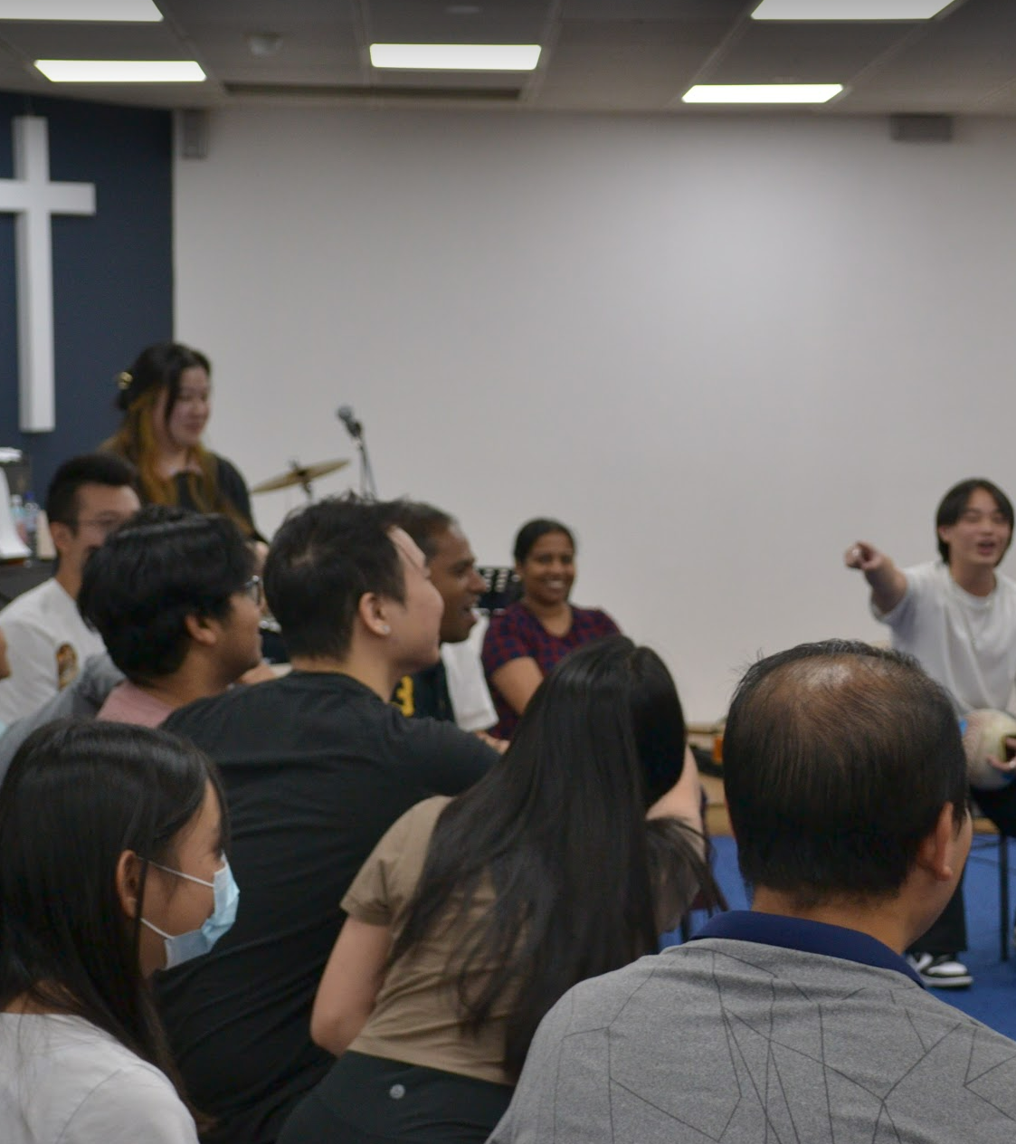
Mingle Time!

