Slide 1
BCCC English service

Slide 2

Please Put Your Phones on Silent
Prepare your hearts for worship.
Thank you!

Slide 3
Bible reading 1
Copy paste here

Slide 4

Worship
Please stand up and sing if you’re comfortable

Slide 5

Thrive
Casting Crowns

Slide 6
Verse 1
Here in this worn and weary land
Where many a dream has died
Like a tree planted by the water
We never will run dry

Slide 7
Pre chorus
So living water flowing through
God we thirst for more of You
Fill our hearts and flood our souls
With one desire

Slide 8
Chorus
Just to know You and
To make You known
We lift Your name on High
Shine like the sun make darkness
run and hide

Slide 9
Chorus
We know we were made for so
much more than ordinary lives
It's time for us to more than just survive
We were made to thrive

Slide 10
Verse 2
Into Your word we're digging deep
To know our Father's heart
Into the world we're reaching out
To show them who You are

Slide 11
Pre chorus
So living water flowing through
God we thirst for more of You
Fill our hearts and flood our souls
With one desire

Slide 12
Chorus
Just to know You and
To make You known
We lift Your name on High
Shine like the sun make darkness
run and hide

Slide 13
Chorus
We know we were made for so
much more than ordinary lives
It's time for us to more than just survive
We were made to thrive

Slide 14
Bridge
Joy Unspeakable, Faith Unsinkable
Love Unstoppable, Anything is possible
(x4)

Slide 15
Chorus
Just to know You and
To make You known
We lift Your name on High
Shine like the sun make darkness
run and hide

Slide 16
Chorus
We know we were made for so
much more than ordinary lives
It's time for us to more than just survive
We were made to thrive
We were made to thrive

Slide 17

In Christ alone
CCLI:
"Keith Getty, Stuart Townend
©2001 Thankyou Music (Admin. by SHOUT! Music Publishing Australia)
CCLI Licence No. 5485849"

Slide 18
Verse 1
In Christ alone my hope is found
He is my light, my strength, my song

Slide 19
Verse 1
This cornerstone, this solid ground
Firm through the fiercest drought and storm

Slide 20
Verse 1
What heights of love, what depths of peace
When fears are stilled, when strivings cease

Slide 21
Verse 1
My comforter, my all in all
Here, in the love of Christ, I stand

Slide 22
Verse 2
In Christ alone, who took on flesh
Fullness of God in helpless babe
This gift of love and righteousness
Scorned by the ones He came to save

Slide 23
Verse 2
'Til on that cross, as Jesus died
The wrath of God was satisfied
For every sin, on Him, was laid
Here, in the death of Christ, I live

Slide 24
Verse 2
'Til on that cross, as Jesus died
The wrath of God was satisfied
For every sin, on Him, was laid
Here, in the death of Christ, I live

Slide 25
Verse 3
There in the ground, His body lay
Light of the world, by darkness, slain
Then bursting forth in glorious day
Up from the grave, He rose again

Slide 26
Verse 3
And as He stands in victory
Sin's curse has lost its grip on me
For I am His and He is mine
Bought with the precious blood of Christ

Slide 27
Verse 4
And as He stands in victory
Sin's curse has lost its grip on me
For I am His and He is mine
Bought with the precious blood of Christ

Slide 28
Verse 4
No power of Hell, no scheme of man
Can ever pluck me from His hand
'Til He returns or calls me home
Here, in the power of Christ, I'll stand

Slide 29
Outro
No power of Hell, no scheme of man
Can ever pluck me from His hand
'Til He returns or calls me home
Here, in the power of Christ, I'll stand

Slide 30
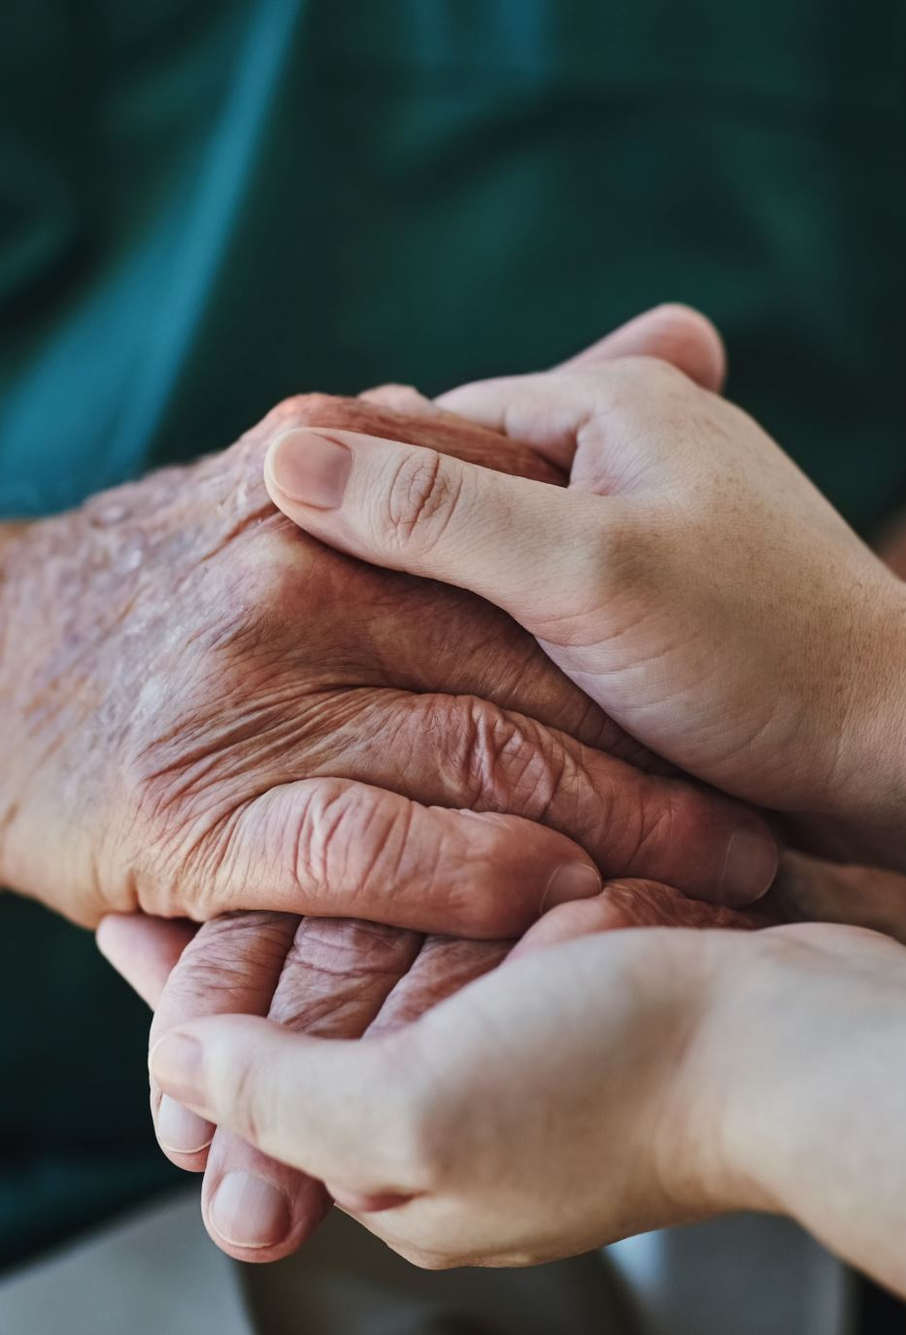
Blessed Assurance

Slide 31
Verse 1
All my attempts to be satisfied were vain and empty

Slide 32
Verse 1
Until the moment You rescued me and Your love filled me
My soul sings, now my soul sings

Slide 33
Chorus
What blessed assurance
I've found in You, I've found in You
I won't be shaken, I will not be moved

Slide 34
Chorus
How steadfast Your strong hand
Is keeping me, is keeping me
I won't be shaken, I will not be moved
O blessed assurance

Slide 35
Verse 2
No other love that I've ever known compares to You, God
No other love that I've ever found has done what You've done
My soul sings, now my soul sings

Slide 36
Chorus
What blessed assurance
I've found in You, I've found in You
I won't be shaken, I will not be moved

Slide 37
Chorus
How steadfast Your strong hand
Is keeping me, is keeping me
I won't be shaken, I will not be moved
O blessed assurance

Slide 38
Bridge
Ever my anchor, ever my strength
Ever my portion, and all I need
Ever my healing, ever my hope
Ever the truth that leads me home
That leads me home

Slide 39
Chorus
What blessed assurance
I've found in You, I've found in You
I won't be shaken, I will not be moved

Slide 40
Chorus
How steadfast Your strong hand
Is keeping me, is keeping me
I won't be shaken, I will not be moved
O blessed assurance

Slide 41

Bible Reading

Slide 42

1 Kings 8:10-1
10 When the priests withdrew from the Holy Place, the cloud filled the temple of the Lord.
11 And the priests could not perform their service because of the cloud, for the glory of the Lord filled his temple.

Slide 43
Announcements
Cleaning
Young adults are on cleaning duty! 🧽
Baptism ceremony
Occurs 24th December
Children’s church camp
Please talk to Joyce or Andy if you're interested in serving 24th Jan - 26th Jan
Photography 📷
Please get that signed for photos!

Slide 44
Tithing
Account Name:
Blacktown Chinese Christian Church
BSB: 112 - 879
Account number: 4216 50263
Please put in “offering” as the reference
The tithing box is available at the back of the hall

Slide 45
Prayer points
Israel Palestine
Pray for peace and the conflict.
Worship team
Pray that the worship team remembers God as their focus
Unwell members
Pray that the Lord can heal and protect them
New visitors
That they come to Christ and act as ambassadors for Christ

Slide 46
Prayer and offering

Slide 47
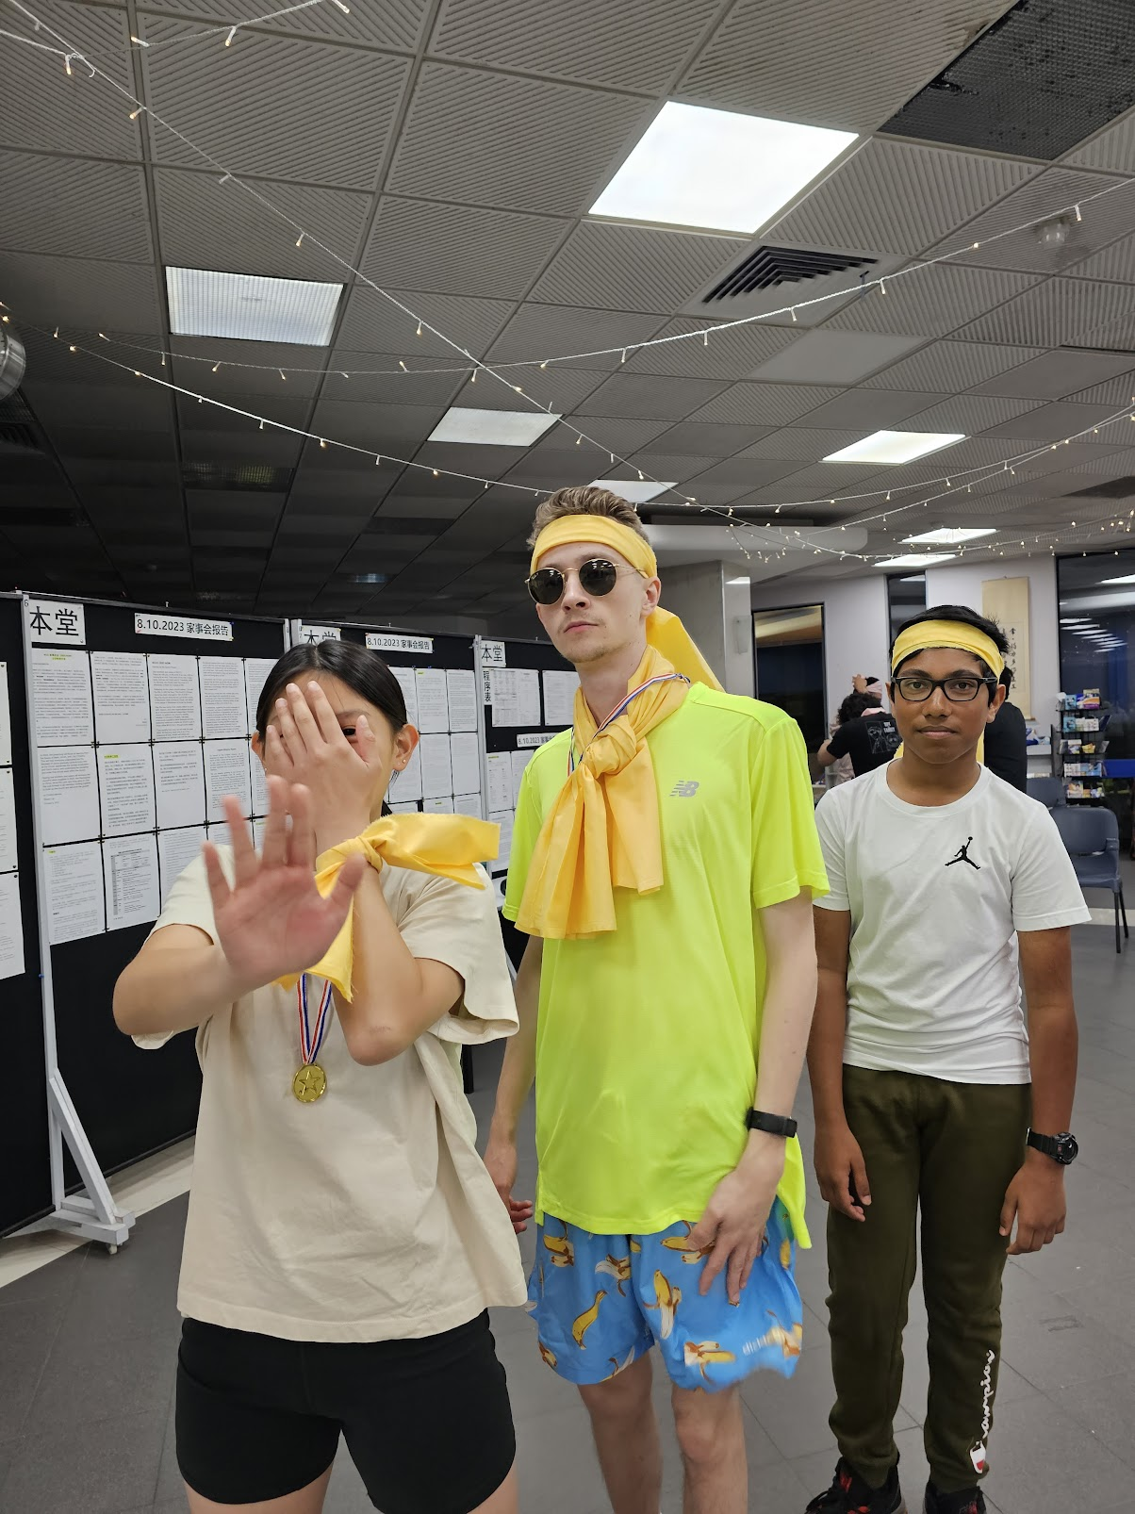
Mingle Time!

