Slide 1
BCCC English service

Slide 2

Please Put Your Phones on Silent
Prepare your hearts for worship.
Thank you!

Slide 3
Bible reading 1
Copy paste here

Slide 4

Worship
Please stand up and sing if you’re comfortable

Slide 5
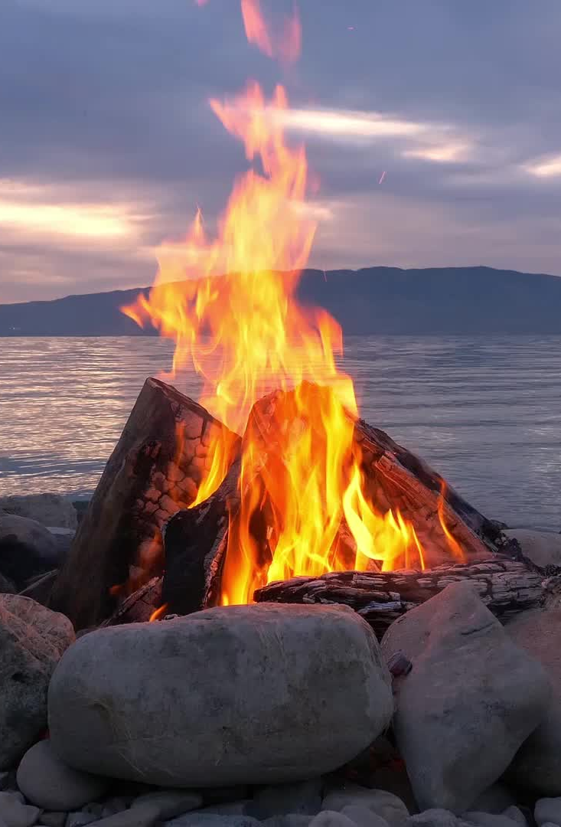
Start a fire

Slide 6
Verse 1
This world can be cold and bitter
Feels like we're in the dead of winter
Waiting on something better
But am I really gonna hide forever?

Slide 7
Verse 1
Over and over again
I hear Your voice in my head
Let Your light shine,
let Your light shine
for all to see

Slide 8
Chorus
Start a fire in my soul
Fan the flame and make it grow
So there’s no doubt or denying

Slide 9
Chorus
Let it burn so brightly
That everyone around can see
That it’s You, that it’s You that we need
Start a fire in me

Slide 10
Verse 2
You only need a spark to start a whole blaze
It only takes a little faith
Let it start right here in this city
So these old walls will never be the same

Slide 11
Verse 2
Over and over again
I hear Your voice in my head
They need to know
I need to go
Spirit won't You fall on my heart now

Slide 12
Chorus
Start a fire in my soul
Fan the flame and make it grow
So there’s no doubt or denying

Slide 13
Chorus
Let it burn so brightly
That everyone around can see
That it’s You, that it’s You that we need
Start a fire in me

Slide 14
Bridge
You are the fire You are the flame
You are the light on the darkest day

Slide 15
Bridge
We have the hope we bear Your name
We carry the news that You have come to save
Only You can save
Only You can save

Slide 16
Chorus
Start a fire in my soul
Fan the flame and make it grow
So there’s no doubt or denying

Slide 17
Chorus
Let it burn so brightly
That everyone around can see
That it’s You, that it’s You that we need
Start a fire in me

Slide 18
Bridge
You are the fire You are the flame
You are the light on the darkest day

Slide 19
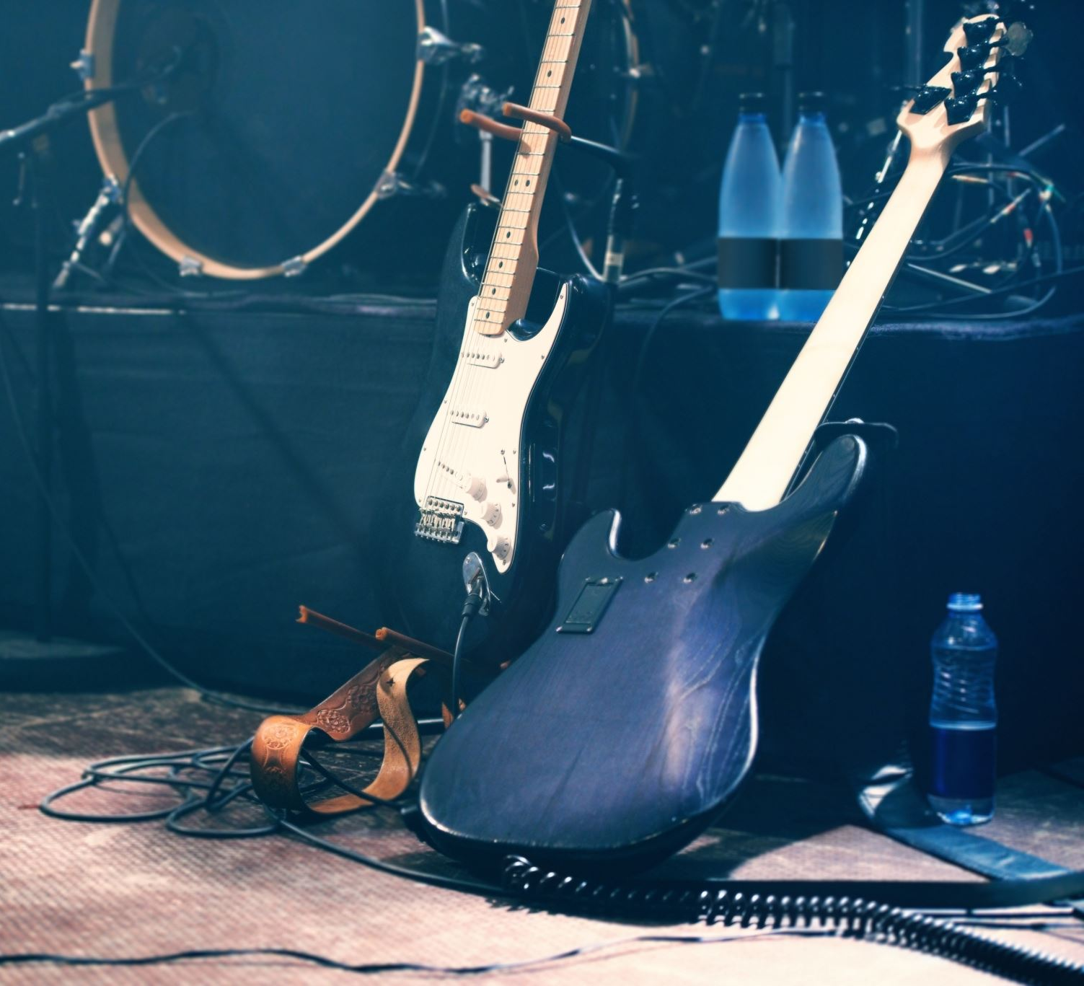
This I believe
CCLI: Ben Fielding, Matt Crocker
© 2014 Hillsong Music Publishing Australia
CCLI Licence No. 5485849
7018338

Slide 20
Verse 1
Our Father everlasting
The all creating One
God Almighty

Slide 21
Verse 1
Through Your Holy Spirit
Conceiving Christ the Son
Jesus our Saviour

Slide 22
Chorus
I believe in God our Father
I believe in Christ the Son
I believe in the Holy Spirit
Our God is three in one

Slide 23
Chorus
I believe in the resurrection
That we will rise again
For I believe in the Name of Jesus

Slide 24
Verse 2
Our Judge and our Defender
Suffered and crucified
Forgiveness is in You

Slide 25
Verse 2
Descended into darkness
You rose in glorious life
Forever seated high

Slide 26
Chorus
I believe in God our Father
I believe in Christ the Son
I believe in the Holy Spirit
Our God is three in one

Slide 27
Chorus
I believe in the resurrection
That we will rise again
For I believe in the Name of Jesus

Slide 28
Bridge
I believe in You
I believe You rose again
I believe that Jesus Christ is Lord
(x2)

Slide 29
Chorus
I believe in God our Father
I believe in Christ the Son
I believe in the Holy Spirit
Our God is three in one

Slide 30
Chorus
I believe in the resurrection
That we will rise again
For I believe in the Name of Jesus

Slide 31
Chorus 2
I believe in life eternal
I believe in the virgin birth
I believe in the saints' communion
And in Your holy Church

Slide 32
Chorus 2
I believe in the resurrection
When Jesus comes again
For I believe in the Name of Jesus

Slide 33
Chorus
I believe in God our Father
I believe in Christ the Son
I believe in the Holy Spirit
Our God is three in one

Slide 34
Chorus
I believe in the resurrection
That we will rise again
For I believe in the Name of Jesus

Slide 35
Tag
For I believe in the Name of Jesus

Slide 36

Man of Sorrows
"Brooke Ligertwood, Matt Crocker
© 2012 Hillsong Music Publishing Australia
CCLI Licence No. 5485849"

Slide 37
Verse 1
Man of sorrows, Lamb of God
By His own betrayed
The sin of man and wrath of God
Has been on Jesus laid

Slide 38
Verse 2
Silent as He stood accused
Beaten, mocked, and scorned
Bowing to the Father's will
He took a crown of thorns

Slide 39
Chorus
Oh, that rugged cross, my salvation
Where Your love poured out over me
Now my soul cries out, Hallelujah
Praise and honour unto Thee

Slide 40
Verse 3
Sent of heaven God's own Son
To purchase and redeem
And reconcile the very ones
Who nailed Him to that tree

Slide 41
Chorus
Oh, that rugged cross, my salvation
Where Your love poured out over me
Now my soul cries out, Hallelujah
Praise and honour unto Thee

Slide 42
Bridge
Now my debt is paid
It is paid in full
By the precious blood
That my Jesus spilled

Slide 43
Bridge
Now the curse of sin
Has no hold on me
Whom the Son sets free
Oh, is free indeed

Slide 44
Bridge
Now my debt is paid
It is paid in full
By the precious blood
That my Jesus spilled

Slide 45
Bridge
Now the curse of sin
Has no hold on me
Whom the Son sets free
Oh, is free indeed

Slide 46
Chorus
Oh, that rugged cross, my salvation
Where Your love poured out over me
Now my soul cries out, Hallelujah
Praise and honour unto Thee

Slide 47
Verse 4
See the stone is rolled away
Behold the empty tomb
Hallelujah, God be praised
He's risen from the grave

Slide 48
Chorus
Oh, that rugged cross, my salvation
Where Your love poured out over me
Now my soul cries out, Hallelujah
Praise and honour unto Thee

Slide 49
Tag
Praise and honour unto Thee

Slide 50

Bible Reading

Slide 51
John 7:1-34
Jesus Goes to the Festival of Tabernacles
After this, Jesus went around in Galilee. He did not want to go about in Judea because the Jewish leaders there were looking for a way to kill him. 2 But when the Jewish Festival of Tabernacles was near, 3 Jesus’ brothers said to him, “Leave Galilee and go to Judea, so that your disciples there may see the works you do. 4 No one who wants to become a public figure acts in secret. Since you are doing these things, show yourself to the world.” 5 For even his own brothers did not believe in him. 6 Therefore Jesus told them, “My time is not yet here; for you any time will do. 7 The world cannot hate you, but it hates me because I testify that its works are evil. 8 You go to the festival. I am not going up to this festival, because my time has not yet fully come.” 9 After he had said this, he stayed in Galilee. 10 However, after

Slide 52
John 7:1-34
his brothers had left for the festival, he went also, not publicly, but in secret. 11 Now at the festival the Jewish leaders were watching for Jesus and asking, “Where is he?” 12 Among the crowds there was widespread whispering about him. Some said, “He is a good man.” Others replied, “No, he deceives the people.” 13 But no one would say anything publicly about him for fear of the leaders. Jesus Teaches at the Festival 14 Not until halfway through the festival did Jesus go up to the temple courts and begin to teach. 15 The Jews there were amazed and asked, “How did this man get such learning without having been taught?” 16 Jesus answered, “My teaching is not my own. It comes from the one who sent me. 17 Anyone who chooses to do the will of God will find out whether my teaching comes from God or whether I speak on my own. 18 Whoever speaks on their own does so to gain personal glory, but he who seeks the glory

Slide 53
John 7:1-34
of the one who sent him is a man of truth; there is nothing false about him. 19 Has not Moses given you the law? Yet not one of you keeps the law. Why are you trying to kill me?” 20 “You are demon-possessed,” the crowd answered. “Who is trying to kill you?” 21 Jesus said to them, “I did one miracle, and you are all amazed. 22 Yet, because Moses gave you circumcision (though actually it did not come from Moses, but from the patriarchs), you circumcise a boy on the Sabbath. 23 Now if a boy can be circumcised on the Sabbath so that the law of Moses may not be broken, why are you angry with me for healing a man’s whole body on the Sabbath? 24 Stop judging by mere appearances, but instead judge correctly.” Division Over Who Jesus Is 25 At that point some of the people of Jerusalem began to ask, “Isn’t this the man they are trying to kill? 26 Here he is, speaking publicly, and they are

Slide 54
John 7:1-34
not saying a word to him. Have the authorities really concluded that he is the Messiah? 27 But we know where this man is from; when the Messiah comes, no one will know where he is from.” 28 Then Jesus, still teaching in the temple courts, cried out, “Yes, you know me, and you know where I am from. I am not here on my own authority, but he who sent me is true. You do not know him, 29 but I know him because I am from him and he sent me.” 30 At this they tried to seize him, but no one laid a hand on him, because his hour had not yet come. 31 Still, many in the crowd believed in him. They said, “When the Messiah comes, will he perform more signs than this man?” 32 The Pharisees heard the crowd whispering such things about him. Then the chief priests and the Pharisees sent temple guards to arrest him. 33 Jesus said, “I am with you for only a short time,

Slide 55
John 7:1-34
and then I am going to the one who sent me. 34 You will look for me, but you will not find me; and where I am, you cannot come.”

Slide 56
Announcements
Announcement
Text
Announcement
Text
Announcement
Text
Announcement
Text
Announcement
Text
Announcement
Text

Slide 57
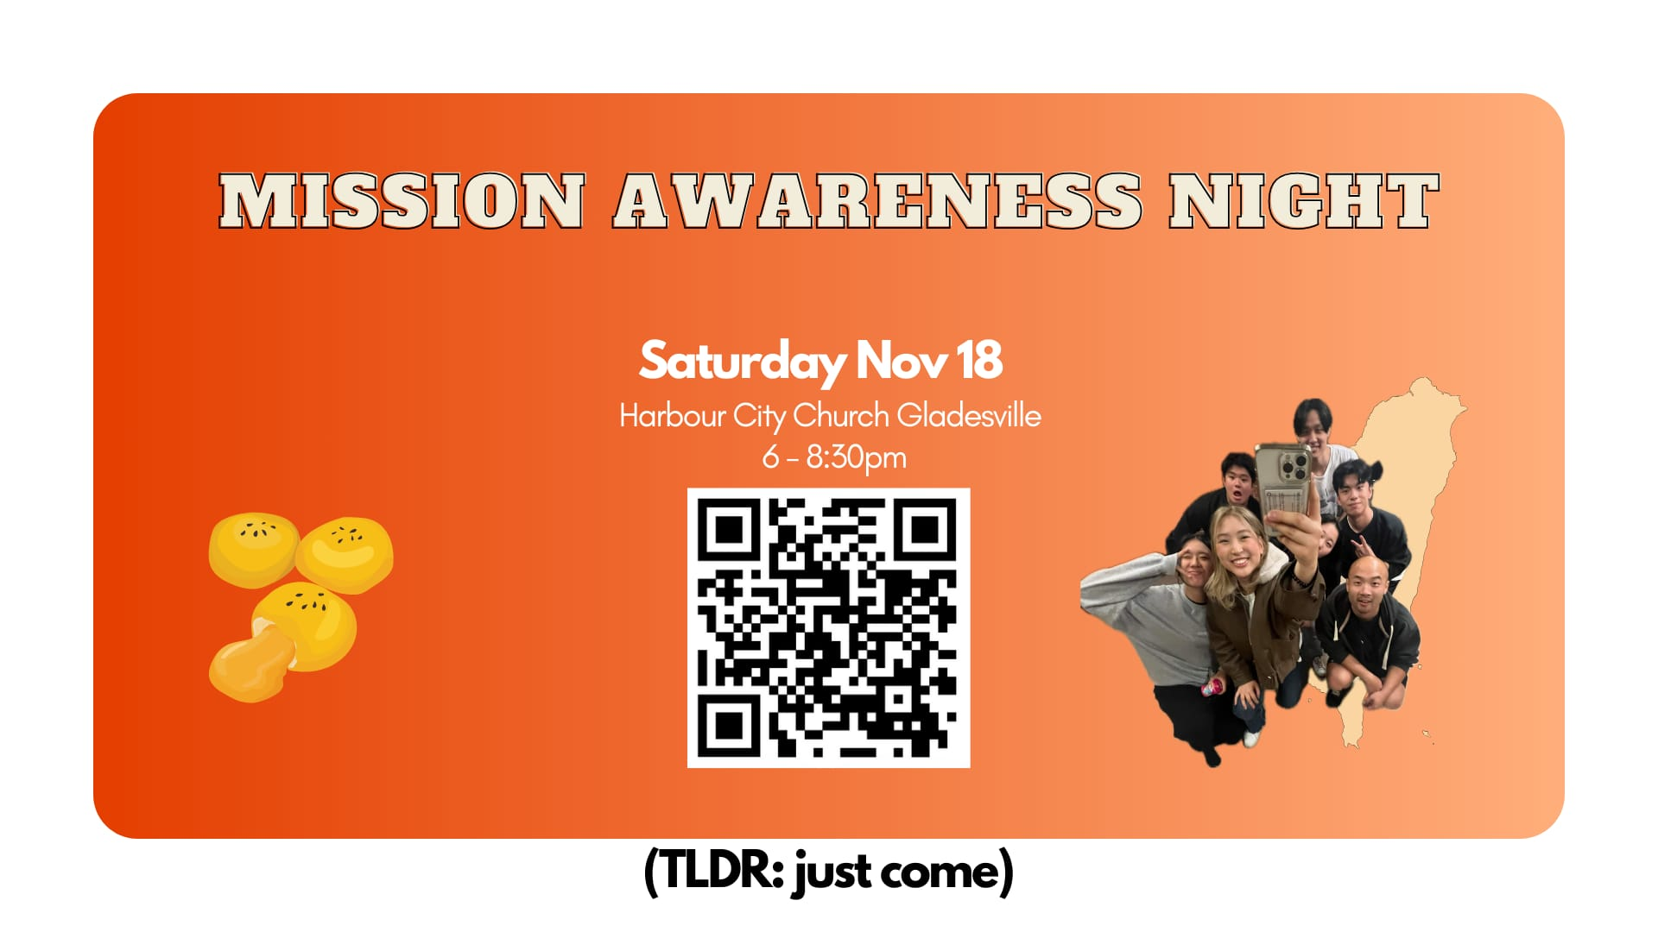

Slide 58
Tithing
Account Name:
Blacktown Chinese Christian Church
BSB: 112 - 879
Account number: 4216 50263
Please put in “offering” as the reference
The tithing box is available at the back of the hall

Slide 59
Prayer points
Point
Text
Point
Text
Point
Text
Point
Text
Point
Text
Point
Text

Slide 60
Prayer and offering

Slide 61
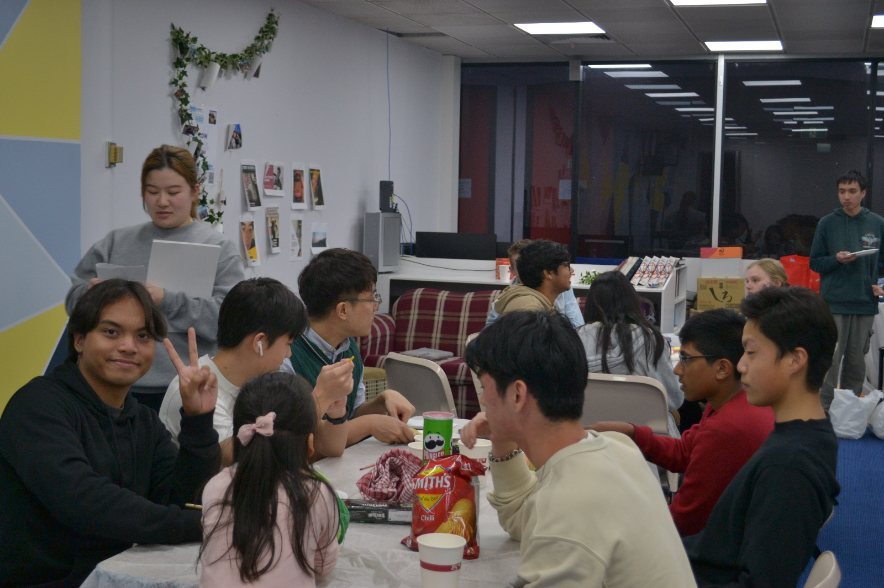
Mingle Time!

