Slide 1
BCCC English service

Slide 2

Please Put Your Phones on Silent
Prepare your hearts for worship.
Thank you!

Slide 3
Bible reading 1
Copy paste here

Slide 4

Worship
Please stand up and sing if you’re comfortable

Slide 5

Thrive
Casting Crowns

Slide 6
Verse 1
Here in this worn and weary land
Where many a dream has died
Like a tree planted by the water
We never will run dry

Slide 7
Pre chorus
So living water flowing through
God we thirst for more of You
Fill our hearts and flood our souls
With one desire

Slide 8
Chorus
Just to know You and
To make You known
We lift Your name on High
Shine like the sun make darkness
run and hide

Slide 9
Chorus
We know we were made for so
much more than ordinary lives
It's time for us to more than just survive
We were made to thrive

Slide 10
Verse 2
Into Your word we're digging deep
To know our Father's heart
Into the world we're reaching out
To show them who You are

Slide 11
Pre chorus
So living water flowing through
God we thirst for more of You
Fill our hearts and flood our souls
With one desire

Slide 12
Chorus
Just to know You and
To make You known
We lift Your name on High
Shine like the sun make darkness
run and hide

Slide 13
Chorus
We know we were made for so
much more than ordinary lives
It's time for us to more than just survive
We were made to thrive

Slide 14
Bridge
Joy Unspeakable, Faith Unsinkable
Love Unstoppable, Anything is possible
(x4)

Slide 15
Chorus
Just to know You and
To make You known
We lift Your name on High
Shine like the sun make darkness
run and hide

Slide 16
Chorus
We know we were made for so
much more than ordinary lives
It's time for us to more than just survive
We were made to thrive
We were made to thrive

Slide 17

In Christ alone
CCLI:
"Keith Getty, Stuart Townend
©2001 Thankyou Music (Admin. by SHOUT! Music Publishing Australia)
CCLI Licence No. 5485849"

Slide 18
Verse 1
In Christ alone my hope is found
He is my light, my strength, my song

Slide 19
Verse 1
This cornerstone, this solid ground
Firm through the fiercest drought and storm

Slide 20
Verse 1
What heights of love, what depths of peace
When fears are stilled, when strivings cease

Slide 21
Verse 1
My comforter, my all in all
Here, in the love of Christ, I stand

Slide 22
Verse 2
In Christ alone, who took on flesh
Fullness of God in helpless babe
This gift of love and righteousness
Scorned by the ones He came to save

Slide 23
Verse 2
'Til on that cross, as Jesus died
The wrath of God was satisfied
For every sin, on Him, was laid
Here, in the death of Christ, I live

Slide 24
Verse 2
'Til on that cross, as Jesus died
The wrath of God was satisfied
For every sin, on Him, was laid
Here, in the death of Christ, I live

Slide 25
Verse 3
There in the ground, His body lay
Light of the world, by darkness, slain
Then bursting forth in glorious day
Up from the grave, He rose again

Slide 26
Verse 3
And as He stands in victory
Sin's curse has lost its grip on me
For I am His and He is mine
Bought with the precious blood of Christ

Slide 27
Verse 4
And as He stands in victory
Sin's curse has lost its grip on me
For I am His and He is mine
Bought with the precious blood of Christ

Slide 28
Verse 4
No power of Hell, no scheme of man
Can ever pluck me from His hand
'Til He returns or calls me home
Here, in the power of Christ, I'll stand

Slide 29
Outro
No power of Hell, no scheme of man
Can ever pluck me from His hand
'Til He returns or calls me home
Here, in the power of Christ, I'll stand

Slide 30

O Praise The Name (Anástasis)
CCLI: Benjamin Hastings, Dean Ussher, Marty Sampson
© 2015 Small City Music (Admin. by Music Services, Inc.)
Hillsong Music Publishing Australia
CCLI Licence No. 5485849
7037787
This Photo by Unknown Author is licensed under CC BY-NC-ND

Slide 31
Verse 1
I cast my mind to Calvary
Where Jesus bled and died for me
I see His wounds, His hands, His feet
My Saviour on that cursed tree

Slide 32
Verse 2
His body bound and drenched in tears
They laid Him down in Joseph's tomb
The entrance sealed by heavy stone
Messiah still and all alone

Slide 33
Chorus
O praise the Name of the Lord, our God
O praise His Name forevermore
For endless days we will sing Your praise
Oh Lord, oh Lord, our God

Slide 34
Verse 3
Then on the third at break of dawn
The Son of heaven rose again
O trampled death, where is your sting?
The angels roar for Christ the King

Slide 35
Chorus
O praise the Name of the Lord, our God
O praise His Name forevermore
For endless days we will sing Your praise
Oh Lord, oh Lord, our God

Slide 36
Verse 4
He shall return in robes of white
The blazing sun shall pierce the night
And I will rise among the saints
My gaze transfixed on Jesus' face

Slide 37
Chorus
O praise the Name of the Lord, our God
O praise His Name forevermore
For endless days we will sing Your praise
Oh Lord, oh Lord, our God
(x2)

Slide 38
Tag
Oh Lord, oh Lord, our God

Slide 39

Bible Reading

Slide 40
Luke 1:67-80 (Zechariah’s Song )
67 His father Zechariah was filled with the Holy Spirit and prophesied: 68 “Praise be to the Lord, the God of Israel, because he has come to his people and redeemed them. 69 He has raised up a horn of salvation for us in the house of his servant David 70 (as he said through his holy prophets of long ago), 71 salvation from our enemies and from the hand of all who hate us— 72 to show mercy to our ancestors and to remember his holy covenant, 73 the oath he swore to our father Abraham: 74 to rescue us from the hand of our enemies, and to enable us to serve him without fear 75 in holiness and righteousness before him all our days. 76 And you, my child, will be called a prophet of the Most High; for you will go on before the Lord to prepare the way for him, 77 to give his people the knowledge of salvation through the forgiveness of their sins, 78 because of the tender mercy of our God, by which the rising sun will come to us from heaven 79 to shine on those living in darkness and in the shadow of death, to guide our feet into the path of peace. ” 80 And the child grew and became strong in spirit; and he lived in the wilderness until he appeared publicly to Israel.

Slide 41
Announcements
Announcement
Text
Announcement
Text
Announcement
Text
Announcement
Text
Announcement
Text
Announcement
Text

Slide 42
Tithing
Account Name:
Blacktown Chinese Christian Church
BSB: 112 - 879
Account number: 4216 50263
Please put in “offering” as the reference
The tithing box is available at the back of the hall

Slide 43
Prayer points
Point
Text
Point
Text
Point
Text
Point
Text
Point
Text
Point
Text

Slide 44
Prayer and offering

Slide 45
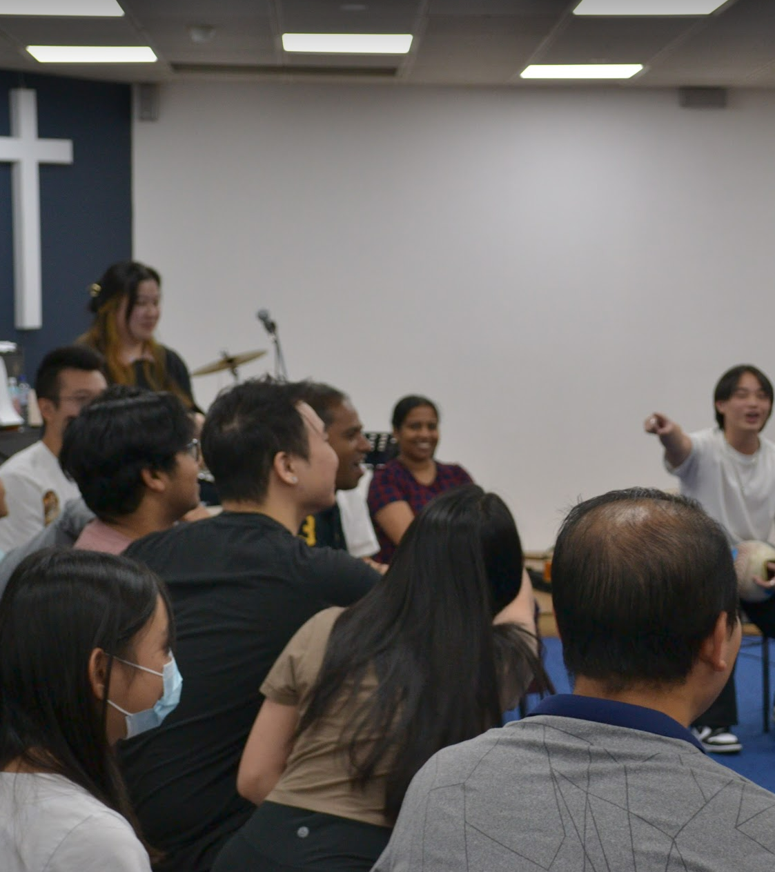
Mingle Time!

