Slide 1
BCCC English service

Slide 2

Please Put Your Phones on Silent
Prepare your hearts for worship.
Thank you!

Slide 3
Bible reading 1
Copy paste here

Slide 4

Worship
Please stand up and sing if you’re comfortable

Slide 5
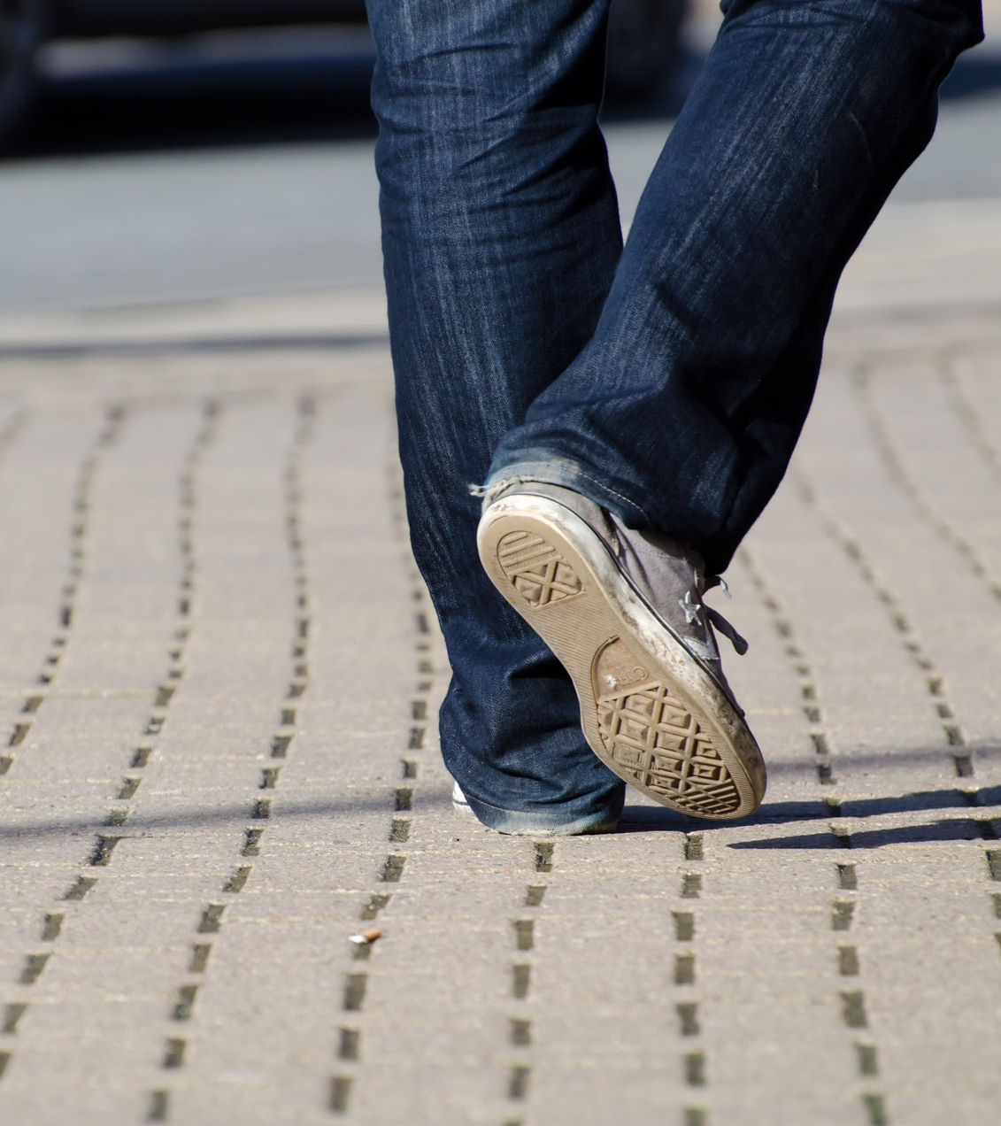
Every step
CCLI
"Ian Lewis, James Ferguson
© CityAlight Music (Admin. by Integrity Music)
CCLI Licence No. 5485849"

Slide 6
Verse 1
I can sing with my whole heart,
I have all I need
In Jesus, my Saviour, my joy is complete
Onward to glory yet here I will wait
I will trust in Christ every step I take

Slide 7
Verse 2
I am sure of Your promise to guide me each day
Though some may oppose me, I won't be ashamed
Whatever I face, Lord, it won't be in vain
I will trust in Christ every step I take

Slide 8
Chorus
For all of my days, I will live for Your glory
Running with courage and faith
The prize of my journey, the joy of salvation
To meet my King face to face

Slide 9
Verse 3
So I'm looking to Jesus, perfector of faith
My heart set on heaven where treasure awaits
I'll run with endurance to finish the race
I will trust in Christ every step I take

Slide 10
Chorus
For all of my days, I will live for Your glory
Running with courage and faith
The prize of my journey, the joy of salvation
To meet my King face to face

Slide 11
Bridge
I will, I will rejoice
Whatever comes my way
God You're faithful to save

Slide 12
Bridge
I will, I will rejoice
I know that God is with me always

Slide 13
Bridge
I will, I will rejoice
Whatever comes my way
God You're faithful to save

Slide 14
Bridge
I will, I will rejoice
I know that God is with me always

Slide 15
Bridge
I will, I will rejoice
Whatever comes my way
God You're faithful to save

Slide 16
Bridge
I will, I will rejoice
I know that God is with me always

Slide 17
Chorus
For all of my days, I will live for Your glory
Running with courage and faith
The prize of my journey, the joy of salvation
To meet my King face to face

Slide 18
Tag
To meet my King face to face
To meet my King face to face

Slide 19

Build my life
CCLI: CCLI: Brett Younker, Karl Martin, Kirby Kaple, Matt Redman, Pat Barrett
© 2016 Martin, Karl Andrew (Admin. by Sentric Music)
Bethel Music Publishing (Admin. by SHOUT! Music Publishing Australia)
Capitol CMG Genesis (Admin. by SHOUT! Music Publishing Australia)
Housefires Sounds (Admin. by SHOUT! Music Publishing Australia)
Kaple Music (Admin. by SHOUT! Music Publishing Australia)
Said And Done Music (Admin. by SHOUT! Music Publishing Australia)
sixsteps Music (Admin. by SHOUT! Music Publishing Australia)
Thankyou Music (Admin. by SHOUT! Music Publishing Australia)
Vamos Publishing (Admin. by SHOUT! Music Publishing Australia)
worshiptogether.com songs (Admin. by SHOUT! Music Publishing Australia)
CCLI Licence No. 5485849
7070345

Slide 20
Verse 1
Worthy of every song we could ever sing
Worthy of all the praise we could ever bring

Slide 21
Verse 1
Worthy of every breath we could ever breathe
We live for You
Oh, we live for You

Slide 22
Verse 2
Jesus, the Name above every other name
Jesus, the only One who could ever save

Slide 23
Verse 2
Worthy of every breath we could ever breathe
We live for You
We live for You

Slide 24
Chorus
Holy, there is no one like You, there is none beside You
Open up my eyes in wonder and

Slide 25
Chorus
Show me who You are and fill me with Your heart
And lead me in Your love to those around me

Slide 26
Verse 3
Jesus, the name above every other name
Jesus, the only One who could ever save

Slide 27
Verse 3
Worthy of every breath we could ever breathe
We live for You
Oh we live for You

Slide 28
Chorus
Holy, there is no one like You, there is none beside You
Open up my eyes in wonder

Slide 29
Chorus
Show me who You are and fill me with Your heart
And lead me in Your love to those around me

Slide 30
Bridge
And I will build my life upon Your love, it is a firm foundation
And I will put my trust in You alone and I will not be shaken
(x2)

Slide 31
Chorus
Holy, there is no one like You, there is none beside You
Open up my eyes in wonder and

Slide 32
Chorus
Show me who You are and fill me with Your heart
And lead me in Your love to those around me

Slide 33
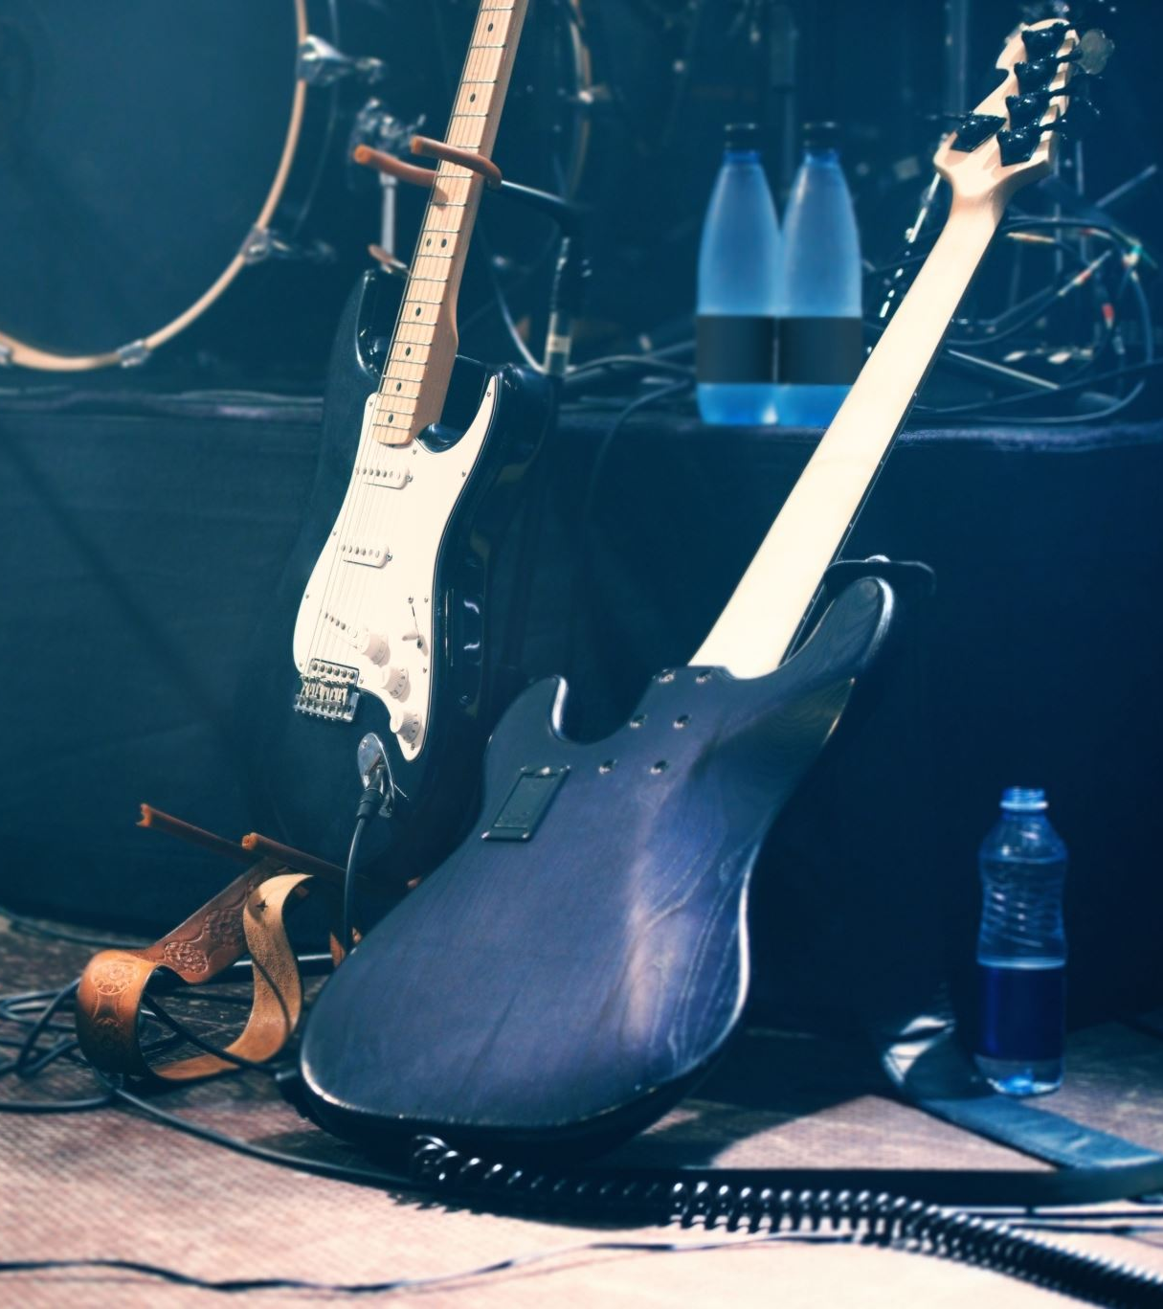
This I believe
CCLI: Ben Fielding, Matt Crocker
© 2014 Hillsong Music Publishing Australia
CCLI Licence No. 5485849
7018338

Slide 34
Verse 1
Our Father everlasting
The all creating One
God Almighty

Slide 35
Verse 1
Through Your Holy Spirit
Conceiving Christ the Son
Jesus our Saviour

Slide 36
Chorus
I believe in God our Father
I believe in Christ the Son
I believe in the Holy Spirit
Our God is three in one

Slide 37
Chorus
I believe in the resurrection
That we will rise again
For I believe in the Name of Jesus

Slide 38
Verse 2
Our Judge and our Defender
Suffered and crucified
Forgiveness is in You

Slide 39
Verse 2
Descended into darkness
You rose in glorious life
Forever seated high

Slide 40
Chorus
I believe in God our Father
I believe in Christ the Son
I believe in the Holy Spirit
Our God is three in one

Slide 41
Chorus
I believe in the resurrection
That we will rise again
For I believe in the Name of Jesus

Slide 42
Bridge
I believe in You
I believe You rose again
I believe that Jesus Christ is Lord
(x2)

Slide 43
Chorus
I believe in God our Father
I believe in Christ the Son
I believe in the Holy Spirit
Our God is three in one

Slide 44
Chorus
I believe in the resurrection
That we will rise again
For I believe in the Name of Jesus

Slide 45
Chorus
I believe in God our Father
I believe in Christ the Son
I believe in the Holy Spirit
Our God is three in one

Slide 46
Chorus
I believe in the resurrection
That we will rise again
For I believe in the Name of Jesus

Slide 47
Chorus 2
I believe in life eternal
I believe in the virgin birth
I believe in the saints' communion
And in Your holy Church

Slide 48
Chorus 2
I believe in the resurrection
When Jesus comes again
For I believe in the Name of Jesus

Slide 49
Chorus
I believe in God our Father
I believe in Christ the Son
I believe in the Holy Spirit
Our God is three in one

Slide 50
Chorus
I believe in the resurrection
That we will rise again
For I believe in the Name of Jesus
For I believe in the Name of Jesus
For I believe in the Name of Jesus

Slide 51
Outro – (Behold)
My God
He who was and is to come
Prepare the way
Until the work on earth is done

Slide 52
Outro – (Behold)
Watch as the clouds He rides swing low
Lift up the sound
As He makes our praise His throne
Behold the Lord our God will lead us home

Slide 53

Bible Reading

Slide 54
Nehemiah 2:11-20
¹¹ I went to Jerusalem, and after staying there three days 12 I set out during the night with a few others. I had not told anyone what my God had put in my heart to do for Jerusalem. There were no mounts with me except the one I was riding on. 13 By night I went out through the Valley Gate toward the Jackal Well and the Dung Gate, examining the walls of Jerusalem, which had been broken down, and its gates, which had been destroyed by fire. 14 Then I moved on toward the Fountain Gate and the King’s Pool, but there was not enough room for my mount to get through; 15 so I went up the valley by night, examining the wall. Finally, I turned back and reentered through the Valley Gate. 16 The officials did not know where I had gone or what I was doing, because as yet I had said nothing to the Jews or the priests or nobles or officials or any others who would be doing the work. 17 Then I said to them, “You see the trouble we are in: Jerusalem lies in ruins, and its gates have been burned with fire. Come, let us rebuild the wall of Jerusalem, and we will no longer be in disgrace. ” 18 I also told them about the gracious hand of my God on me and what the king had said to me.

Slide 55
Nehemiah 2:11-20
They replied, “Let us start rebuilding. ” So they began this good work. 19 But when Sanballat the Horonite, Tobiah the Ammonite official and Geshem the Arab heard about it, they mocked and ridiculed us. “What is this you are doing?” they asked. “Are you rebelling against the king?” 20 I answered them by saying, “The God of heaven will give us success. We his servants will start rebuilding, but as for you, you have no share in Jerusalem or any claim or historic right to it. ”.

Slide 56
Announcements
Announcement
Text
Announcement
Text
Announcement
Text
Announcement
Text
Announcement
Text
Announcement
Text

Slide 57
Tithing
Account Name:
Blacktown Chinese Christian Church
BSB: 112 - 879
Account number: 4216 50263
Please put in “offering” as the reference
The tithing box is available at the back of the hall

Slide 58
Prayer points
Point
Text
Point
Text
Point
Text
Point
Text
Point
Text
Point
Text

Slide 59
Prayer and offering

Slide 60
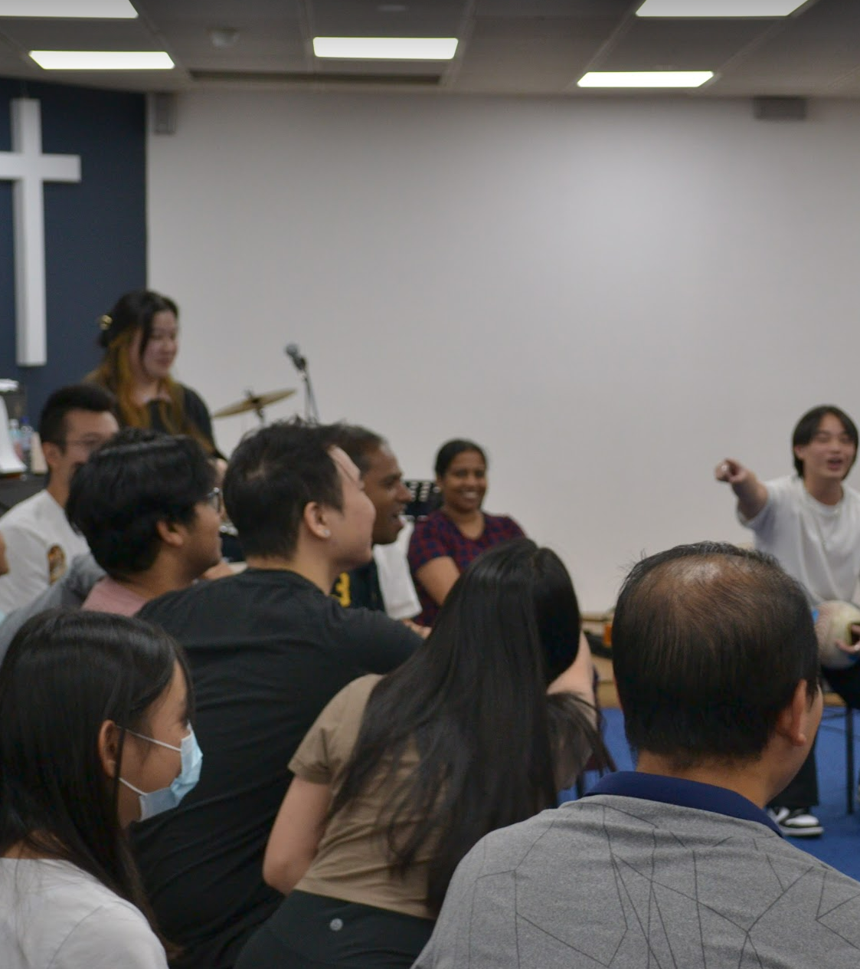
Mingle Time!

