Slide 1
BCCC English service

Slide 2

Please Put Your Phones on Silent
Prepare your hearts for worship.
Thank you!

Slide 3

Worship
Please stand up and sing if you’re comfortable

Slide 4

This is Amazing Grace
This is Amazing Grace Jeremy Riddle, Josh Farro, Phil Wickham © 2012 Phil Wickham Music (Admin. by BMG Rights Management [c/o Music Services, Inc.]) CCLI Licence No. 5485849

Slide 5
Verse 1
Who breaks the power of sin and darkness? Whose love is mighty and so much stronger? The King of glory, the King above all kings

Slide 6
Verse 1
Who shakes the whole earth with holy thunder? And leaves us breathless in awe and wonder?
The King of glory, the King above all kings

Slide 7
Chorus
This is amazing grace
This is unfailing love
That You would take my place
That You would bear my cross

Slide 8
Chorus
You laid down Your life
That I would be set free
Oh,
Jesus, I sing for All that You've done for me

Slide 9
Verse 2
Who brings our chaos back into order?
Who makes the orphans a son and daughter? The King of glory, the King of glory

Slide 10
Verse 2
Who rules the nations with truth and justice
Shines like the sun in all of its brilliance
The King of glory, the King above all kings

Slide 11
Chorus
This is amazing grace
This is unfailing love
That You would take my place
That You would bear my cross

Slide 12
Chorus
You laid down Your life
That I would be set free
Oh,
Jesus, I sing for All that You've done for me

Slide 13
Bridge
Worthy is the Lamb who was slain
Worthy is the King who conquered the grave (x3)
Worthy, worthy, worthy

Slide 14
Chorus
This is amazing grace
This is unfailing love
That You would take my place
That You would bear my cross

Slide 15
Chorus
You laid down Your life
That I would be set free
Oh,
Jesus, I sing for All that You've done for me

Slide 16
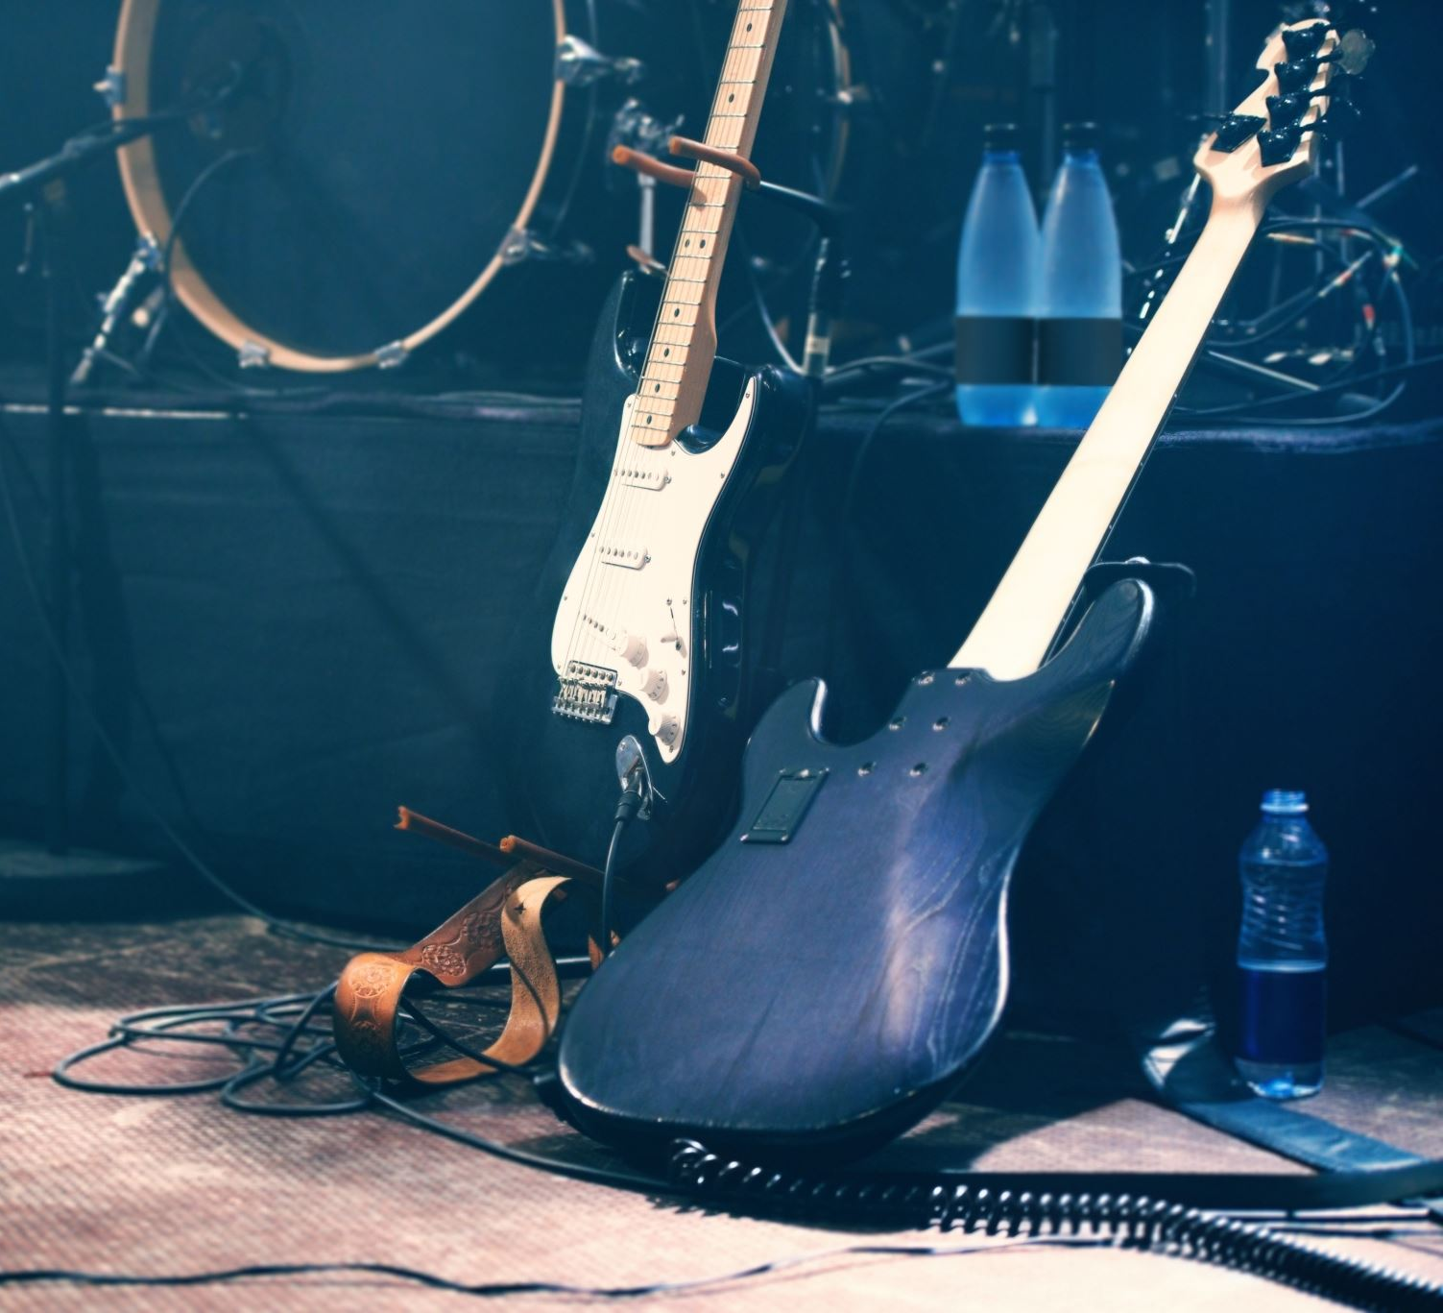
Hosanna
Tim Hughes
© 2000 Thankyou Music (Admin. by SHOUT! Music Publishing Australia)
CCLI Licence No. 5485849

Slide 17
Verse 1
I see the King of Glory
Coming on the clouds with fire
The whole earth shakes, the whole earth shakes

Slide 18
Verse 1
I see His love and mercy
Washing over all our sin
The people sing, the people sing

Slide 19
Chorus
Hosanna, Hosanna
Hosanna in the highest
Hosanna, Hosanna
Hosanna in the highest

Slide 20
Verse 2
I see a generation
Rising up to take their place
With selfless faith, with selfless faith

Slide 21
Verse 2
I see a near revival
Stirring as we pray and seek
We're on our knees, we're on our knees

Slide 22
Chorus
Hosanna, Hosanna
Hosanna in the highest
Hosanna, Hosanna
Hosanna in the highest

Slide 23
Bridge
Heal my heart and make it clean
Open up my eyes to the things unseen
Show me how to love like You have loved me

Slide 24
Bridge
Break my heart for what breaks Yours
Everything I am for Your kingdom's cause
As I walk from earth into eternity

Slide 25
Chorus
Hosanna, Hosanna
Hosanna in the highest
Hosanna, Hosanna
Hosanna in the highest

Slide 26
Chorus
Hosanna, Hosanna
Hosanna in the highest
Hosanna, Hosanna
Hosanna in the highest

Slide 27
Tag
Hosanna in the highest
Hosanna in the highest

Slide 28

Who you say I am
CCLI:"Ben Fielding, Reuben Morgan
© 2017 Hillsong Music Publishing Australia
CCLI Licence No. 5485849"

Slide 29
Verse 1
Who am I that the highest King
Would welcome me
I was lost but He brought me in
Oh His love for me
Oh His love for me

Slide 30
Chorus
Who the Son sets free
Oh is free indeed
I'm a child of God
Yes I am

Slide 31
Verse 2
Free at last, He has ransomed me
His grace runs deep
While I was a slave to sin
Jesus died for me
Yes He died for me

Slide 32
Chorus
Who the Son sets free
Oh is free indeed
I'm a child of God
Yes I am

Slide 33
Chorus
In my Father's house
There's a place for me
I'm a child of God
Yes I am

Slide 34
Bridge I am chosen, not forsaken
I am who You say I am You are for me, not against me
I am who You say I am

Slide 35
Bridge I am chosen, not forsaken
I am who You say I am You are for me, not against me
I am who You say I am
I am who You say I am

Slide 36
Chorus
Who the Son sets free
Oh is free indeed
I'm a child of God
Yes I am

Slide 37
Chorus
In my Father's house
There's a place for me
I'm a child of God
Yes I am

Slide 38

Bible Reading

Slide 39
Romans 9: 23-25
23 What if he did this to make the riches of his glory known to the objects of his mercy, whom he prepared in advance for glory— 24 even us, whom he also called, not only from the Jews but also from the Gentiles? 25 As he says in Hosea: “I will call them ‘my people’ who are not my people; and I will call her ‘my loved one’ who is not my loved one”

Slide 40
Announcements
Announcement
Text
Announcement
Text
Announcement
Text
Announcement
Text
Announcement
Text
Announcement
Text

Slide 41
Tithing
Account Name:
Blacktown Chinese Christian Church
BSB: 112 - 879
Account number: 4216 50263
Please put in “offering” as the reference
The tithing box is available at the back of the hall

Slide 42
Prayer points
Point
Text
Point
Text
Point
Text
Point
Text
Point
Text
Point
Text

Slide 43
Prayer and offering

Slide 44
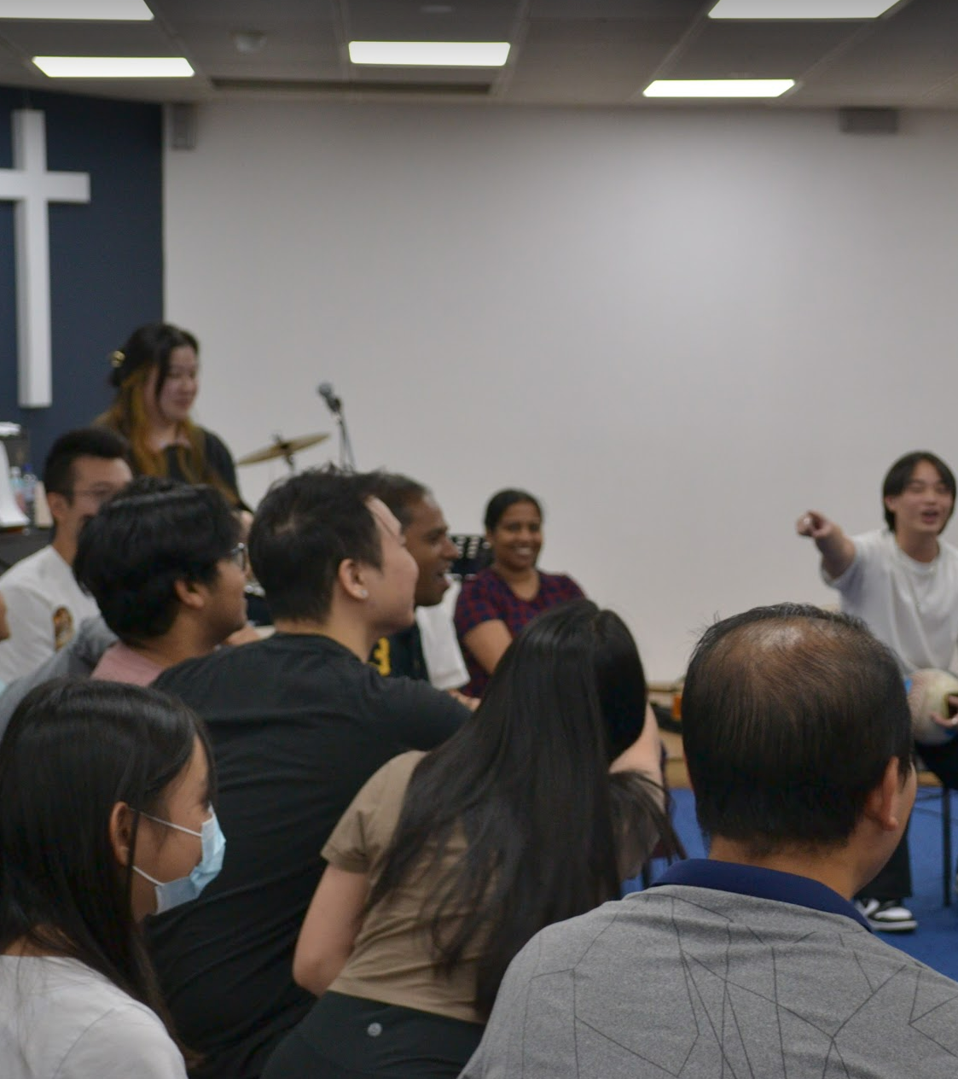
Mingle Time!

