Slide 1
BCCC English service

Slide 2

Please Put Your Phones on Silent
Prepare your hearts for worship.
Thank you!

Slide 3
Bible reading 1
Copy paste here

Slide 4

Worship
Please stand up and sing if you’re comfortable

Slide 5
Song 1
CCLI

Slide 6
Song 1i
CCLI

Slide 7
Song 1ii
CCLI

Slide 8

Bible Reading

Slide 9
BOOK CHAPTER VERSES
^{Copy paste}

Slide 10
Announcements
Announcement
Text
Announcement
Text
Announcement
Text
Announcement
Text
Announcement
Text
Announcement
Text

Slide 11
Tithing
Account Name:
Blacktown Chinese Christian Church
BSB: 112 - 879
Account number: 4216 50263
Please put in “offering” as the reference
The tithing box is available at the back of the hall

Slide 12
Prayer points
Point
Text
Point
Text
Point
Text
Point
Text
Point
Text
Point
Text

Slide 13
Prayer and offering

Slide 14
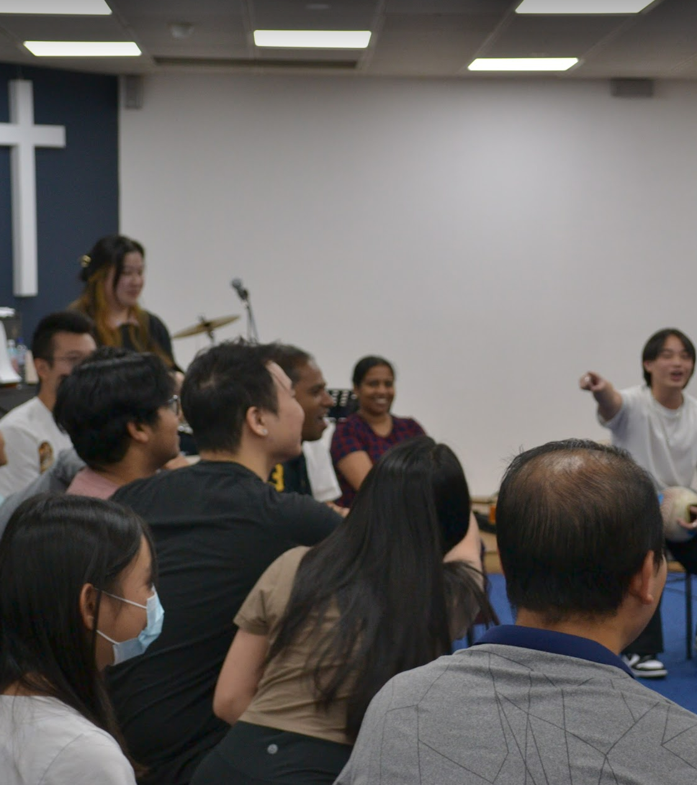
Mingle Time!

