Slide 1
BCCC English service

Slide 2

Please Put Your Phones on Silent
Prepare your hearts for worship.
Thank you!

Slide 3

Worship
Please stand up and sing if you’re comfortable

Slide 4

Man of Sorrows
"Brooke Ligertwood, Matt Crocker
© 2012 Hillsong Music Publishing Australia
CCLI Licence No. 5485849"

Slide 5
Verse 1
Man of sorrows, Lamb of God
By His own betrayed
The sin of man and wrath of God
Has been on Jesus laid

Slide 6
Verse 2
Silent as He stood accused
Beaten, mocked, and scorned
Bowing to the Father's will
He took a crown of thorns

Slide 7
Chorus
Oh, that rugged cross, my salvation
Where Your love poured out over me
Now my soul cries out, Hallelujah
Praise and honour unto Thee

Slide 8
Verse 3
Sent of heaven God's own Son
To purchase and redeem
And reconcile the very ones
Who nailed Him to that tree

Slide 9
Chorus
Oh, that rugged cross, my salvation
Where Your love poured out over me
Now my soul cries out, Hallelujah
Praise and honour unto Thee

Slide 10
Bridge
Now my debt is paid
It is paid in full
By the precious blood
That my Jesus spilled

Slide 11
Bridge
Now the curse of sin
Has no hold on me
Whom the Son sets free
Oh, is free indeed

Slide 12
Bridge
Now my debt is paid
It is paid in full
By the precious blood
That my Jesus spilled

Slide 13
Bridge
Now the curse of sin
Has no hold on me
Whom the Son sets free
Oh, is free indeed

Slide 14
Chorus
Oh, that rugged cross, my salvation
Where Your love poured out over me
Now my soul cries out, Hallelujah
Praise and honour unto Thee

Slide 15
Verse 4
See the stone is rolled away
Behold the empty tomb
Hallelujah, God be praised
He's risen from the grave

Slide 16
Chorus
Oh, that rugged cross, my salvation
Where Your love poured out over me
Now my soul cries out, Hallelujah
Praise and honour unto Thee

Slide 17
Tag
Praise and honour unto Thee

Slide 18

In Christ alone
CCLI:
"Keith Getty, Stuart Townend
©2001 Thankyou Music (Admin. by SHOUT! Music Publishing Australia)
CCLI Licence No. 5485849"

Slide 19
Verse 1
In Christ alone my hope is found
He is my light, my strength, my song

Slide 20
Verse 1
This cornerstone, this solid ground
Firm through the fiercest drought and storm

Slide 21
Verse 1
What heights of love, what depths of peace
When fears are stilled, when strivings cease

Slide 22
Verse 1
My comforter, my all in all
Here, in the love of Christ, I stand

Slide 23
Verse 2
In Christ alone, who took on flesh
Fullness of God in helpless babe
This gift of love and righteousness
Scorned by the ones He came to save

Slide 24
Verse 2
'Til on that cross, as Jesus died
The wrath of God was satisfied
For every sin, on Him, was laid
Here, in the death of Christ, I live

Slide 25
Verse 2
'Til on that cross, as Jesus died
The wrath of God was satisfied
For every sin, on Him, was laid
Here, in the death of Christ, I live

Slide 26
Verse 3
There in the ground, His body lay
Light of the world, by darkness, slain
Then bursting forth in glorious day
Up from the grave, He rose again

Slide 27
Verse 3
And as He stands in victory
Sin's curse has lost its grip on me
For I am His and He is mine
Bought with the precious blood of Christ

Slide 28
Verse 4
And as He stands in victory
Sin's curse has lost its grip on me
For I am His and He is mine
Bought with the precious blood of Christ

Slide 29
Verse 4
No power of Hell, no scheme of man
Can ever pluck me from His hand
'Til He returns or calls me home
Here, in the power of Christ, I'll stand

Slide 30
Outro
No power of Hell, no scheme of man
Can ever pluck me from His hand
'Til He returns or calls me home
Here, in the power of Christ, I'll stand

Slide 31
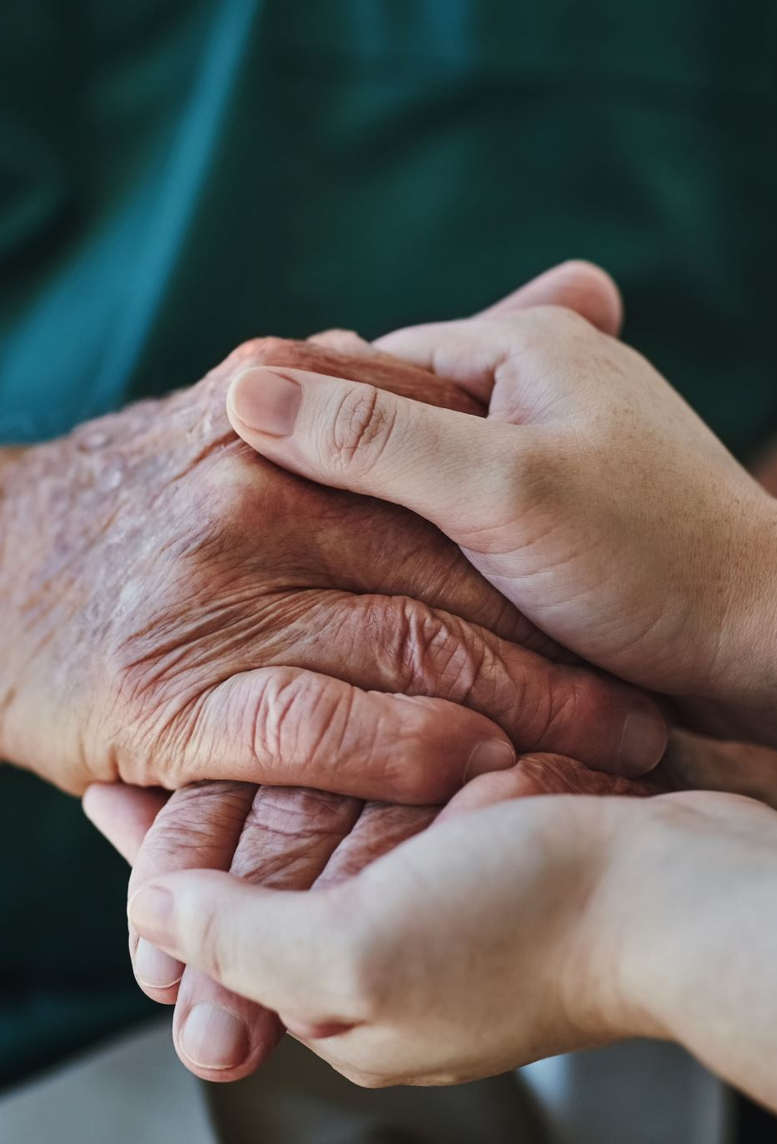
Blessed Assurance
CityAlight

Slide 32
Verse 1
All my attempts to be satisfied were vain and empty

Slide 33
Verse 1
Until the moment You rescued me and Your love filled me
My soul sings, now my soul sings

Slide 34
Chorus
What blessed assurance
I've found in You, I've found in You
I won't be shaken, I will not be moved

Slide 35
Chorus
How steadfast Your strong hand
Is keeping me, is keeping me
I won't be shaken, I will not be moved
O blessed assurance

Slide 36
Verse 2
No other love that I've ever known compares to You, God
No other love that I've ever found has done what You've done
My soul sings, now my soul sings

Slide 37
Chorus
What blessed assurance
I've found in You, I've found in You
I won't be shaken, I will not be moved

Slide 38
Chorus
How steadfast Your strong hand
Is keeping me, is keeping me
I won't be shaken, I will not be moved
O blessed assurance

Slide 39
Bridge
Ever my anchor, ever my strength
Ever my portion, and all I need
Ever my healing, ever my hope
Ever the truth that leads me home
That leads me home

Slide 40
Chorus
What blessed assurance
I've found in You, I've found in You
I won't be shaken, I will not be moved

Slide 41
Chorus
How steadfast Your strong hand
Is keeping me, is keeping me
I won't be shaken, I will not be moved
O blessed assurance

Slide 42

Bible Reading

Slide 43
2 Corinthians 17-20
17 Therefore, if anyone is in Christ, the new creation has come: The old has gone, the new is here! 18 All this is from God, who reconciled us to himself through Christ and gave us the ministry of reconciliation: 19 that God was reconciling the world to himself in Christ, not counting people’s sins against them. And he has committed to us the message of reconciliation. 20 We are therefore Christ’s ambassadors, as though God were making his appeal through us. We implore you on Christ’s behalf: Be reconciled to God.

Slide 44
Announcements

Slide 45
Tithing
Account Name:
Blacktown Chinese Christian Church
BSB: 112 - 879
Account number: 4216 50263
Please put in “offering” as the reference
The tithing box is available at the back of the hall

Slide 46
Prayer points

Slide 47
Prayer and offering

Slide 48
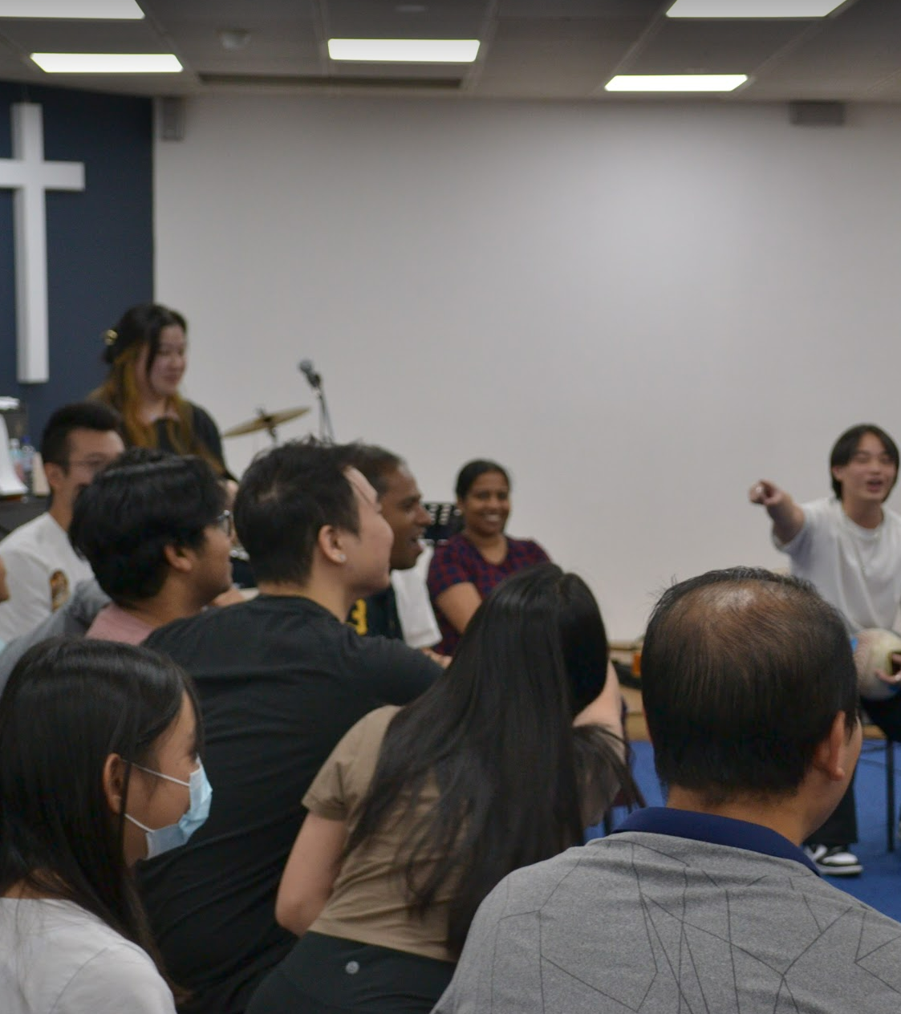
Mingle Time!

