Slide 1
Renewable Power Generation Time Series Forecast
Zheng YANG
July 27, 2021

Slide 2
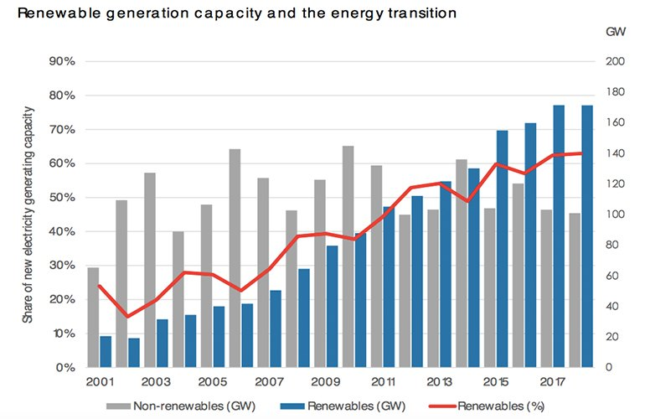

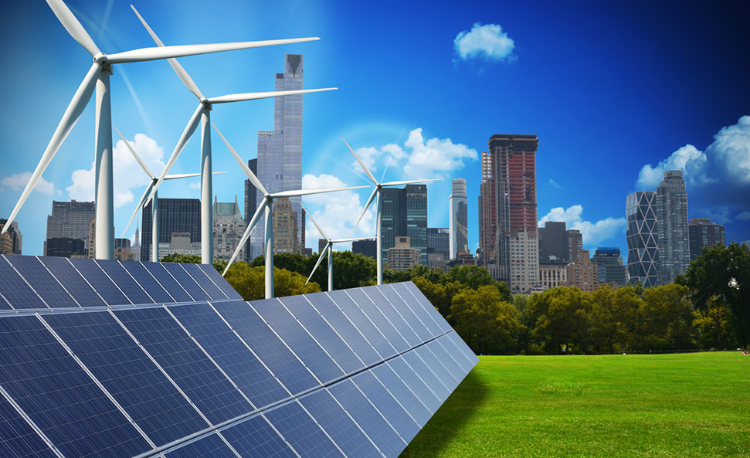
Figure. World renewable generation capacity and energy transition trend
Figure. Examples of solar photovoltaic panels

Slide 3
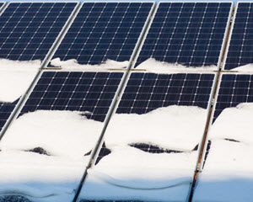
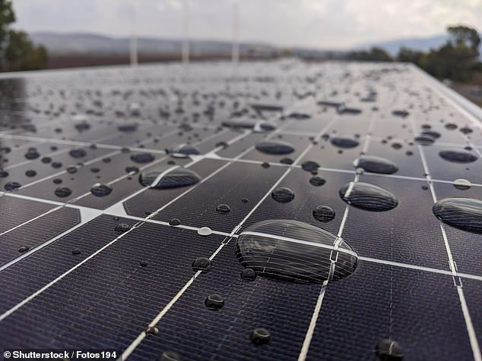
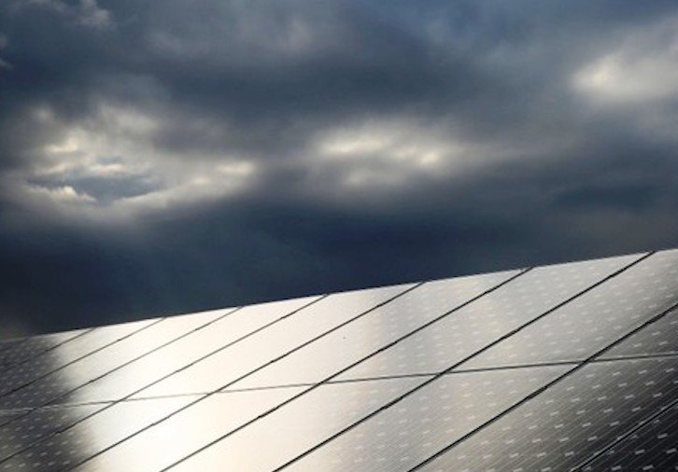
Renewable power production depends on the environment conditions (e.g., snow, high temperature, cloud) and is intermittent and uncertain in nature.
To better anticipate the performance of renewable systems;
To better calculate the Return on Investment (ROI) of renewable assets and electricity bills;
To better integrate renewable power with existing power grids;
To better dispatch other power systems (fossil-fuel based) when no sunshine or wind;
Forecast renewable power production at different spatial and temporal scales!

Slide 4

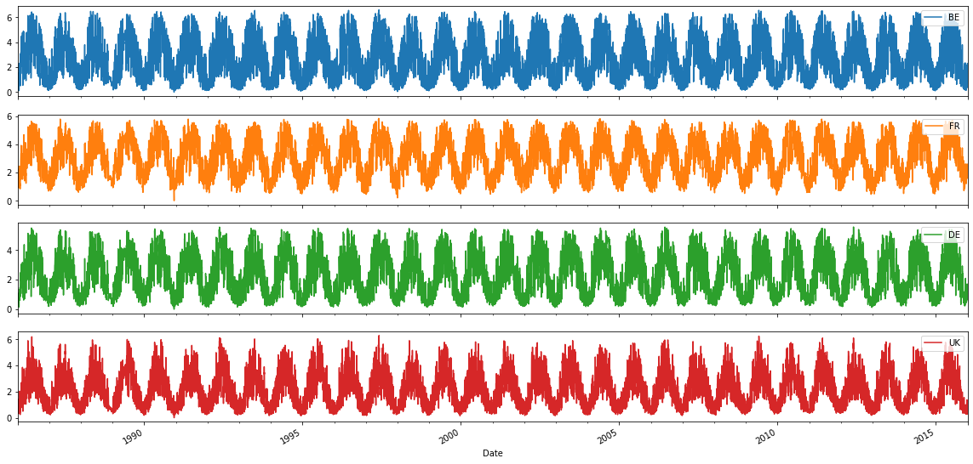
EMHIRES dataset Part II: Solar power generation
Published by European Commission, Joint Research Center
262,968 rows, 40 columns
Hourly from 1986-01-01 to 2015-12-31
35 countries in European Union
Link: https://setis.ec.europa.eu/publications/relevant-reports/emhires-dataset-part-ii-solar-power-generation
Belgium
France
Germany
United Kingdom

Slide 5
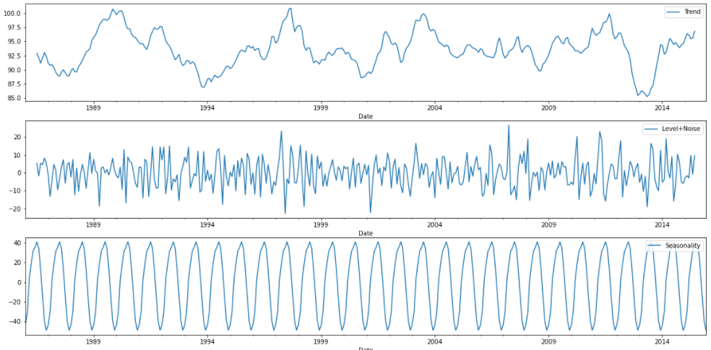
Figure. Decomposition of time series for French power generation time series
French solar PV power generation time series can be decomposed to:
Seasonality, Trend, Level + noise.

Slide 6
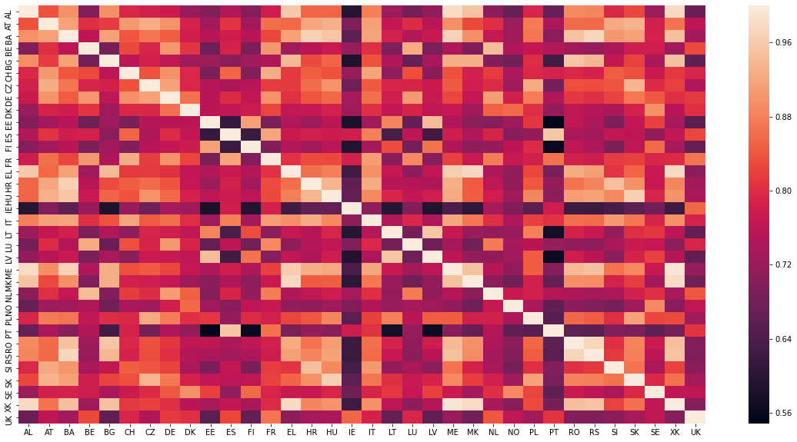
Figure. Correlation among power generation time series of different countries
There are potentials to integrate spatial-temporal characterization into feature engineering and algorithm development for forecasting

Slide 7
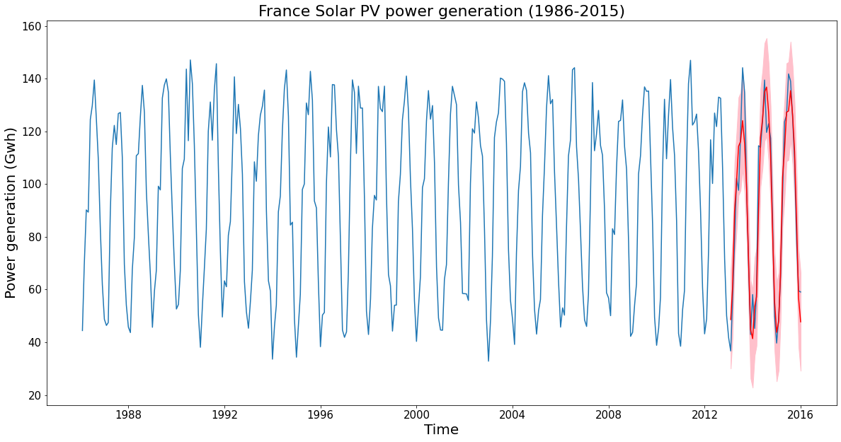
Preliminary analysis:
Augmented Dicky-Fuller test for stationarity;
Use ACF and PACF to select model orders (BIC);
Use SARIMA model to make one-step-ahead forecast (36 months);
Visualize predicted mean values and confidence intervals;

Slide 8
Next steps:
develop models to integrate machine learning (e.g. RNN) with time series to forecast the solar power generation for short term and long term;
feature engineering to integrate accurate representation of the spatial and temporal characterization of solar sources;
evaluate the impacts of meteorological and climate variability on the solar power generation;
quantify the relationships among different countries in terms of power generation time series;
develop on-line learning capability to continuously learn from past data;

Slide 9
Thank You!

