Slide 1

Renewable Power Production Forecast
Zheng YANG
March 2, 2021

Slide 2
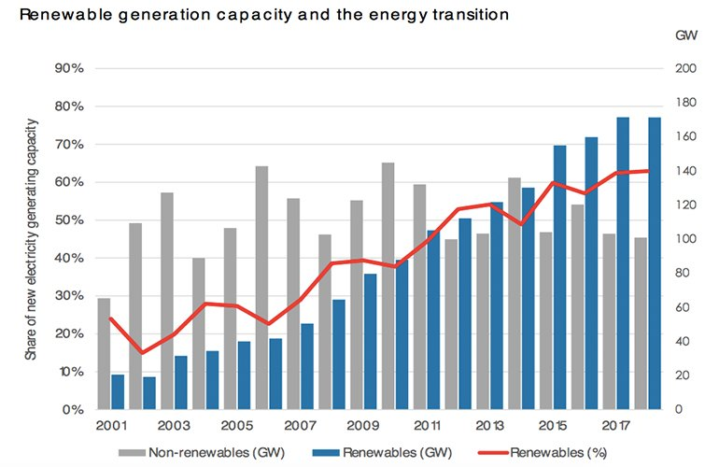


Figure. World renewable generation capacity and energy transition trend
Figure. Examples of solar photovoltaic panels

Slide 3
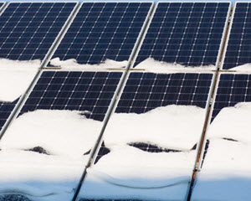
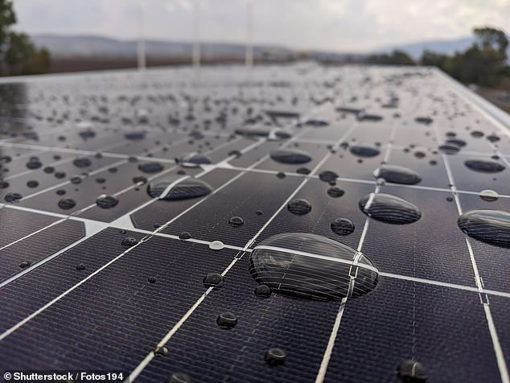

Renewable power production depends on the environment conditions (e.g., snow, high temperature, cloud) and is stochastic and uncertain in nature.
To better analyze the characteristics and performance of renewable systems;
To avoid either overstating or downplaying the possible role of renewable in the further energy transition:
Renewable power production data analytics and forecast algorithms

Slide 4

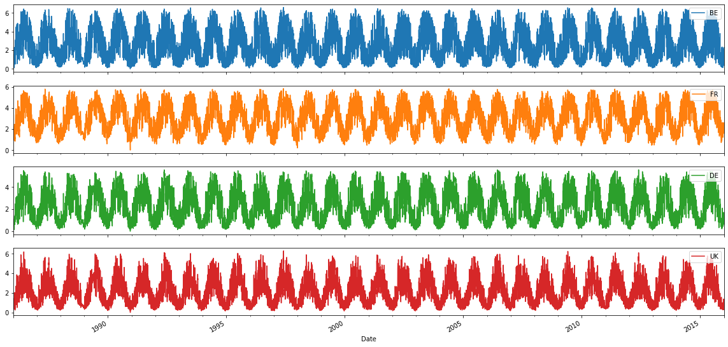
EMHIRES dataset Part II: Solar power generation
Published by European Commission, Joint Research Center
262,968 rows, 40 columns
Hourly from 1986-01-01 to 2015-12-31
35 countries in European Union
Link: https://setis.ec.europa.eu/publications/relevant-reports/emhires-dataset-part-ii-solar-power-generation
Belgium
France
Germany
Germany

Slide 5
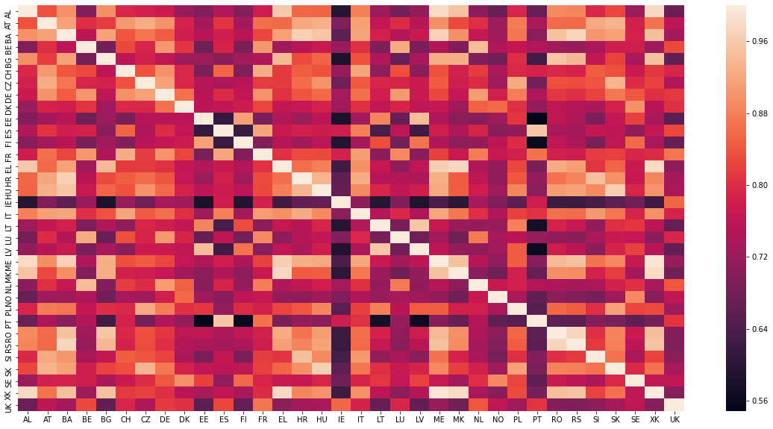
Figure. Correlation among power generation time series of different countries
There are potentials to integrate spatial-temporal characterization into feature engineering and algorithm development for forecasting

Slide 6
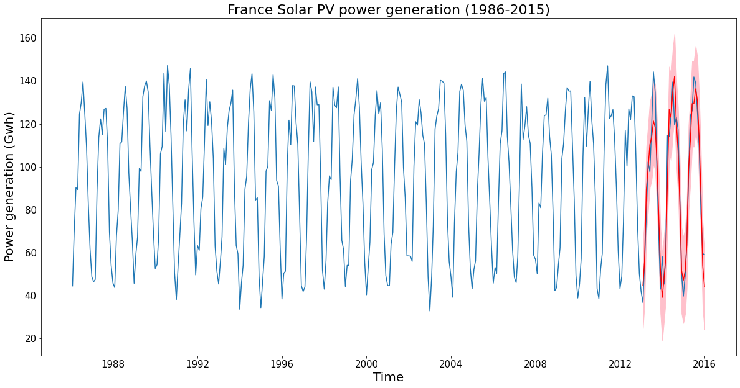
Preliminary analysis:
Augmented Dicky-Fuller test for staionality
Use ACF and PACF to select model orders (BIC)
Use SARIMA model to make one-step-ahead forecast (36 months)
Visualize predicted mean values and confidence intervals

Slide 7
Next steps:
1) develop models to forecast the solar power generation for short term and long term;
2) feature engineering to integrate accurate representation of the spatial and temporal characterization of solar sources;
3) evaluate the impacts of meteorological and climate variability on the solar power generation;
4) quantify the relationships among different countries in terms of power generation time series;
5) develop on-line learning capability to continuously learn from past data;

Slide 8
Thank You!

