Slide 1
Key Finder
Sopanha Phan

Slide 2
What is Key Finder?
It is a short range device that you could attached to your key. Which allow you to locate your key more easily.
It also allow you to send a text message to your phone from the device.

Slide 3
Purpose of the Project
Educational purpose
Learning experience

Slide 4
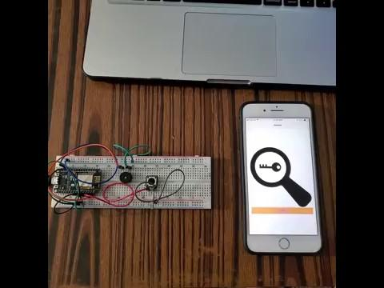
Demo of The Prototype

Slide 5
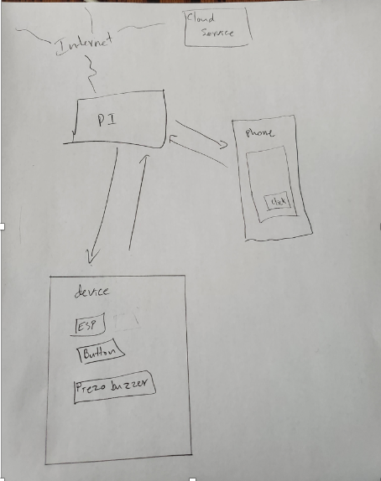
Block Diagram
The PI is connecting to the internet, which eventually go to the cloud server.
Both phone and device are connected to the Raspberry PI. Which allow each one to communicate between each other.

Slide 6
Resources & Technology
Python
MQTT
Arduino
Twilio
NGROK
Native Script Playground
Raspberry PI
ESP controller
Phone
Flask

Slide 7
Thank You!

