Slide 1


Royal University of Phnom Penh
Faculty of Engineering
RFID Authorized Access with RC522 &ATMEGA328
Course: Electronic System Design, Semester 1 of 4th year
Instructor : Chan Tola
Students: AN Panharith, Siet Sophort, Mean Sareth,
Sam Sarom, Chim Socheat, and Phan Theara

Slide 2
Contents
Objective
Main components
Methodology
Experiment
Result and Demo
Application

Slide 3
I. Objective
Creating a RFID authorized access
Two features of verifications, RFID tag and passcode.
The information of accesses was preferred to display
on a 16x2 LCD.

Slide 4
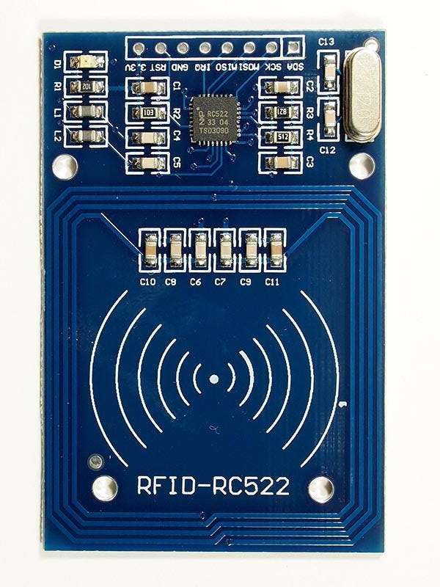
II. Main Components
Working current：13—26mA/ DC 3.3V
Standby current：10-13mA/DC 3.3V
sleeping current：<80uA
peak current：<30mA
resistance: 614Ω
Working frequency：13.56MHz
Card reading distance ：0～60mm（mifare1 card）
Max. SPI speed: 10Mbit/s

Slide 5
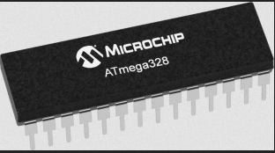
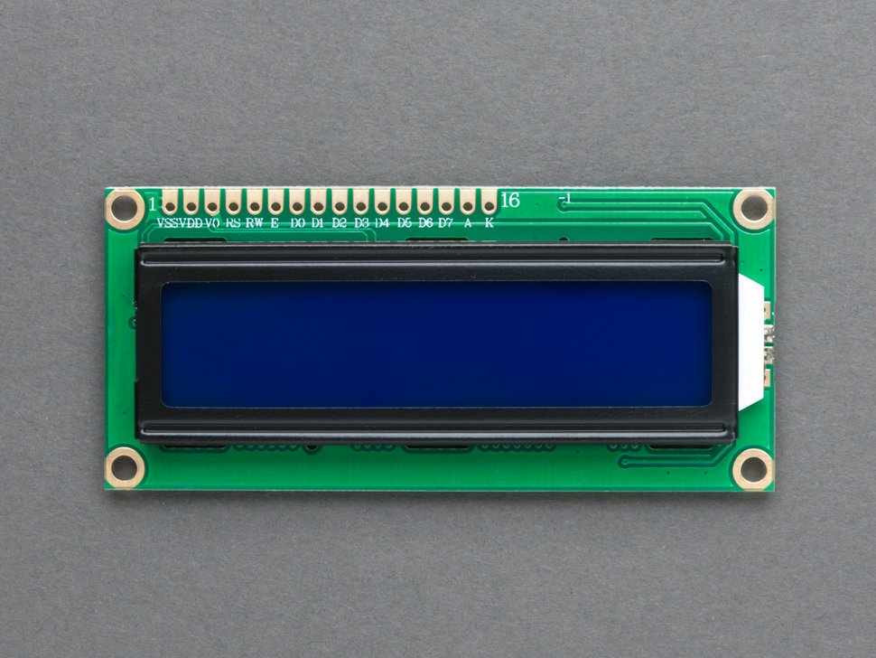
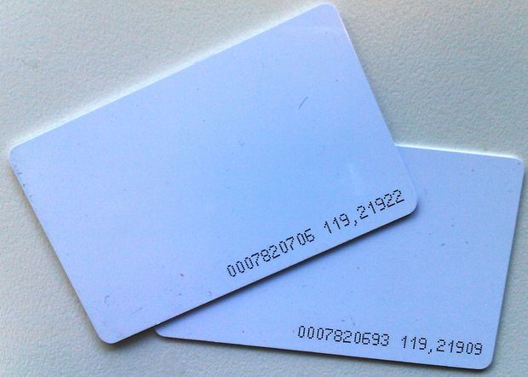
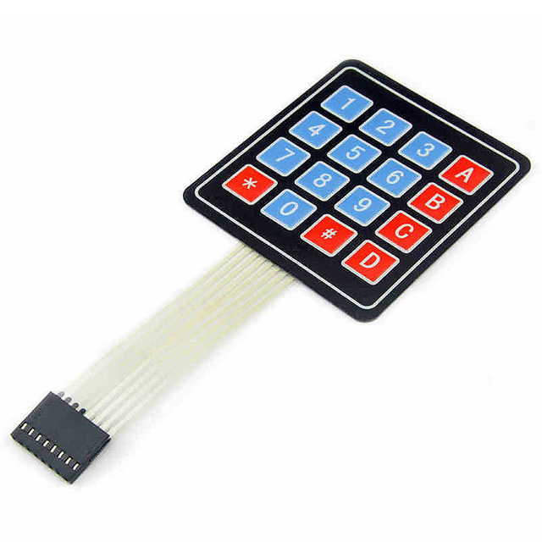
II. Main Components

Slide 6
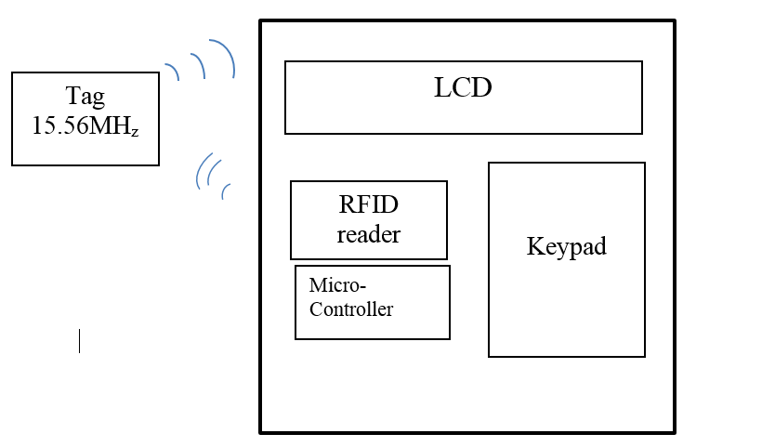
III. Methodology
Physical work

Slide 7
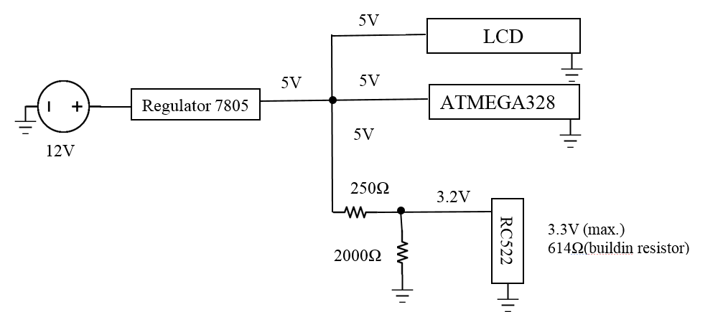
III. Methodology
Power supply schematic

Slide 8
III. Methodology
Power supply schematic

Slide 9
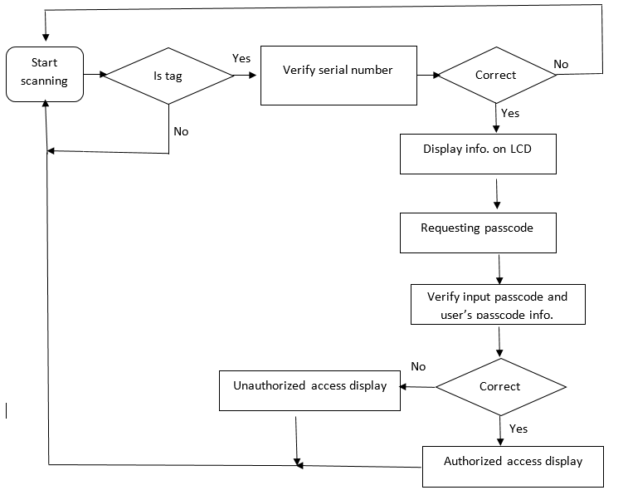
III. Methodology
Flow chart of the code

Slide 10
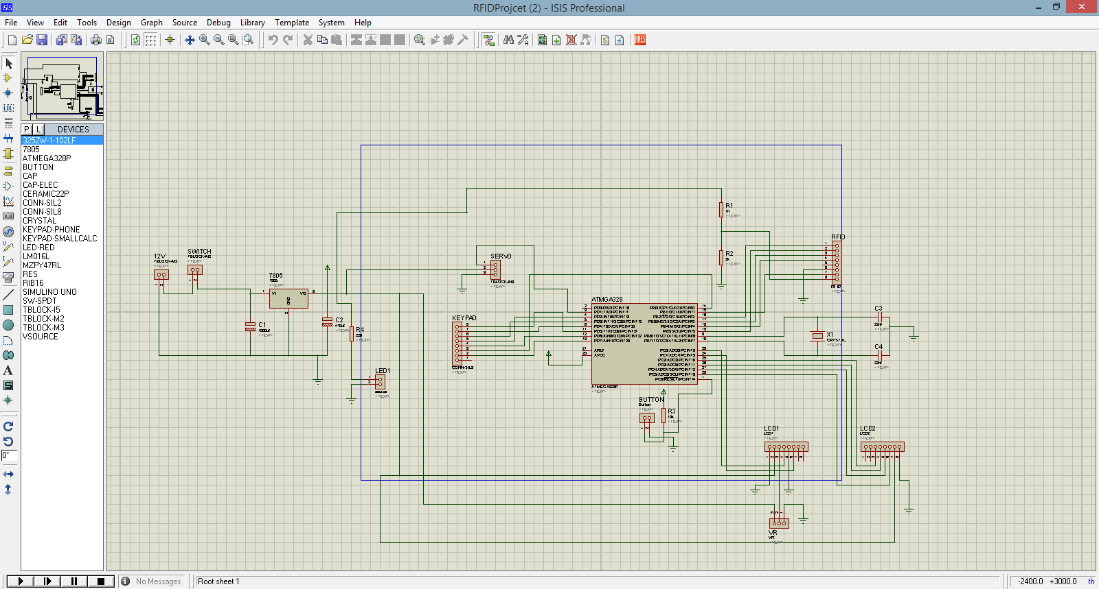
IV. Experiment
Schematic design in ISIS 7 Professional

Slide 11
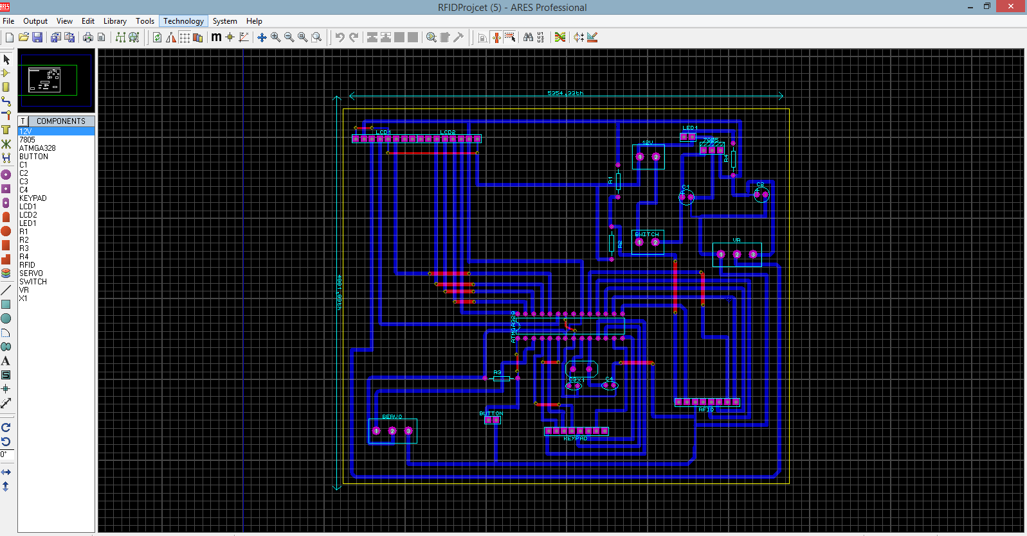
IV. Experiment
PCB layout design in ARES Professional

Slide 12

IV. Experiment
Coding
Keypad.h to code with keypad module
RFID.h to instruct the RC522 reader
LiquidCrystal.h for instructions of
displaying function on the 16x2 LCD

Slide 13
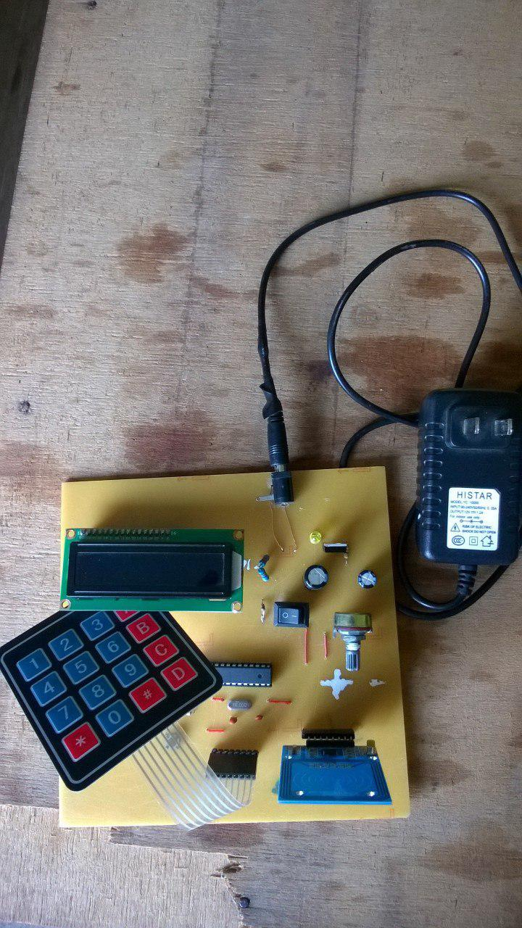
V. Result and Demo
the circuit board without case

Slide 14
V. Result and Demo
the circuit board without case

Slide 15
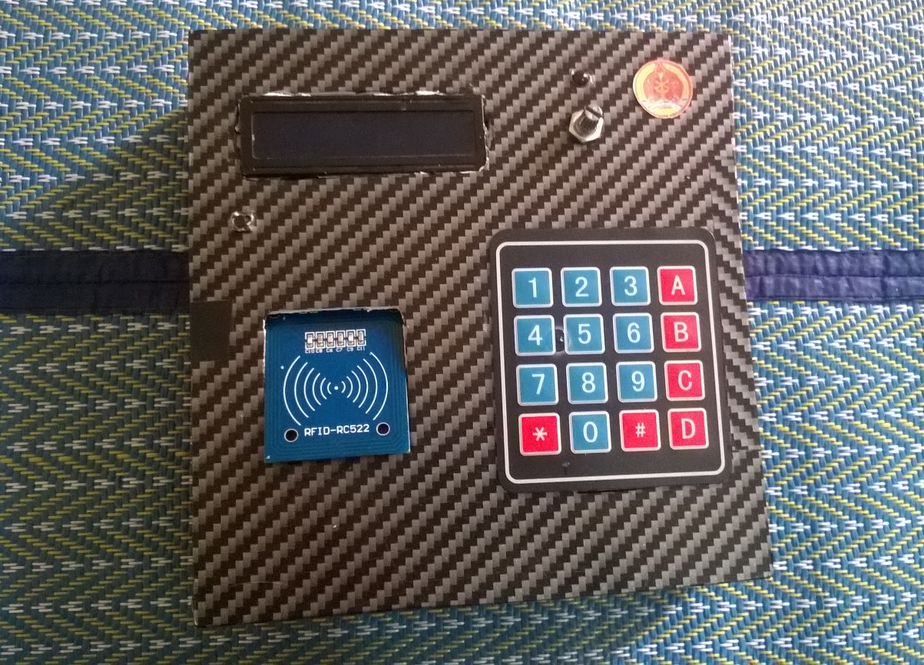
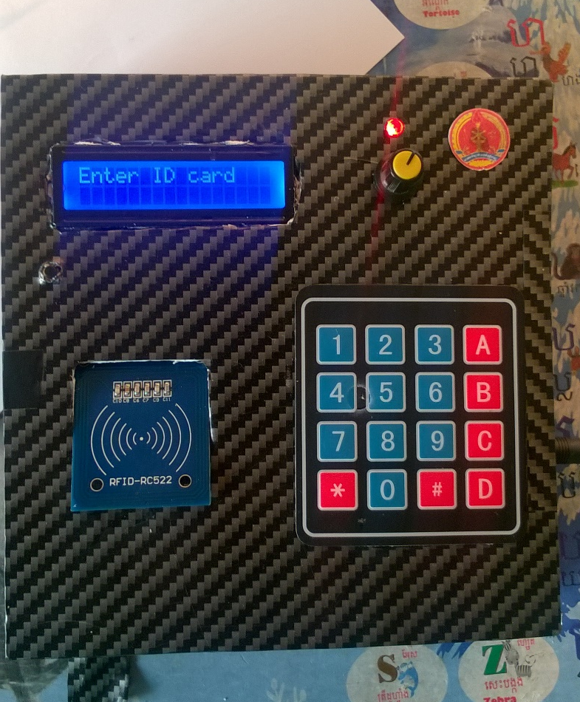
V. Result and Demo
Final product

Slide 16
V. Result and Demo
Demo could be found on Youtube with the link
https://www.youtube.com/watch?v=YfOiHcA_ld0

Slide 17
VI. Conclusion
RFID AA offers two features of authorized verifications described above.
It contributes to engineers who wish to integrate this product into
other applications.
For example doors’ locking/unlocking.

Slide 18
References
[1] How RFID Works and How to Make an Arduino based RFID Door Lock. Available at
http://howtomechatronics.com/tutorials/arduino/rfid-works-make-arduino-based-rfid-door-lock/
[2] Product data sheet COMPANY PUBLIC, MFRC522 Standard performance
MIFARE and NTAG frontend, Rev. 3.9, 27 April 2016
[3] RFID. Available at https://en.wikipedia.org/wiki/Radio-frequency_identification
http://www.instructables.com/id/Arduino-RFID-Reader-MFRC522-Turorial/
[4] 13.56MHZ RFID/NFC CARD. Available at https://www.adafruit.com/product/359
[5] How to make a PCB. Available online at https://maker.pro/education/how-to-design-pcbs
[6] From Arduino to a Microcontroller on a Breadboard. Available online at
https://www.arduino.cc/en/Tutorial/ArduinoToBreadboard
[7] Voltage divider. Available online at
https://learn.sparkfun.com/tutorials/voltage-dividers

Slide 19


