Slide 1
Bank Telemarketing Analysis
Herbert Pan
Notes:
My project is going to be helping a European bank to predict their telemarketing outcome

Slide 2
Main Objective
Better understanding of its customer
Increase campaign effectiveness to maximize conversion
Notes:
So there are 2 main objectives for this project
1st, To help our client to have a better understanding of its customer
2nd, Increase campaign effectiveness to increase conversion
which will focus on conversion

Slide 3
Data Set
≈45,000 Rows
17 Features
Target:
Yes, they will subscribe or purchase the product
No, they will not subscribe or purchase the product
Demography | Financial Info | Sales Call Info
Age | Default | Contact method
Job | Overall balance | Date and time of contact
Marital Status | House | Call duration
Education | Mortgage | Number of contact for current campaign
 |  | Number of previous calls
 |  | Previous call outcome
 |  | Result
Notes:
So the data set are divided into 3 main categories
Demography
Financial info
Sales call info
Approximatly 45000 rows
17 features
So my target prediction will be
Yes, they will subscribe or purchase the product
or
No, they will not subscribe or purchase the product

Slide 4
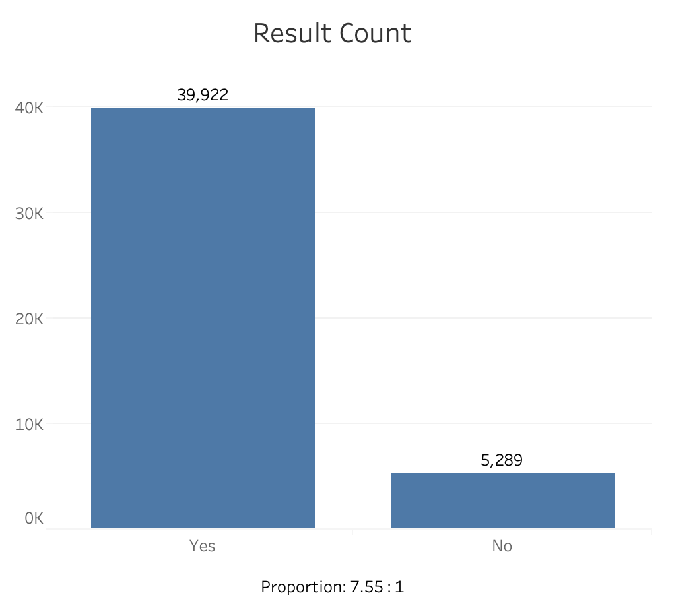
Exploratory Data Analysis
Notes:
During my EDA I found my data is highly unbalanced
This is the results of calls for the raw data
and as you can see, for every "No" that existed, there are 7.55 yes.

Slide 5
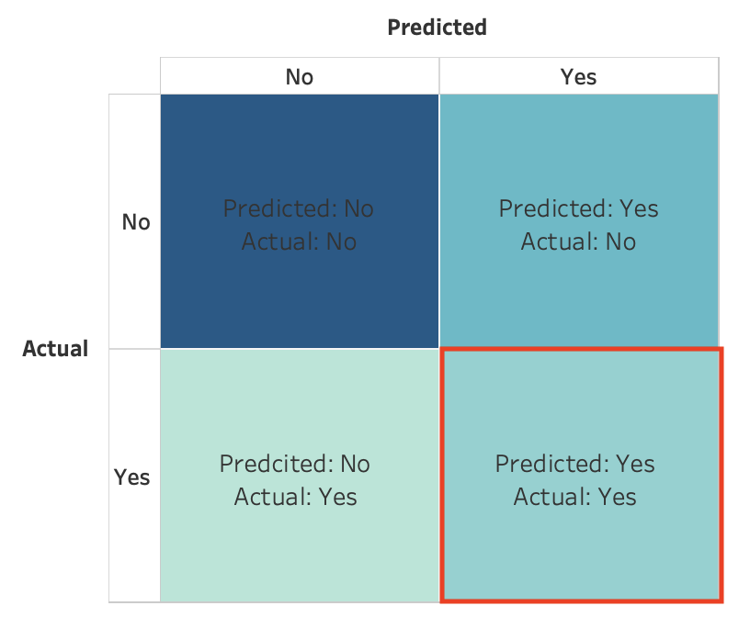
Model
Notes:
[FN, TN]
[FP, TP]
Since one of our main goal was to increase campaign effectiveness to maximize conversion
So in model selection, we will be focusing on using the confusing matrix to finding the model that will give us the best result in True Positive
which will be the case where the sales call had a positive outcome and our model correctly predicted the positive outcome
AND we ended up using Logistic Regression with Polynomial Features

Slide 6
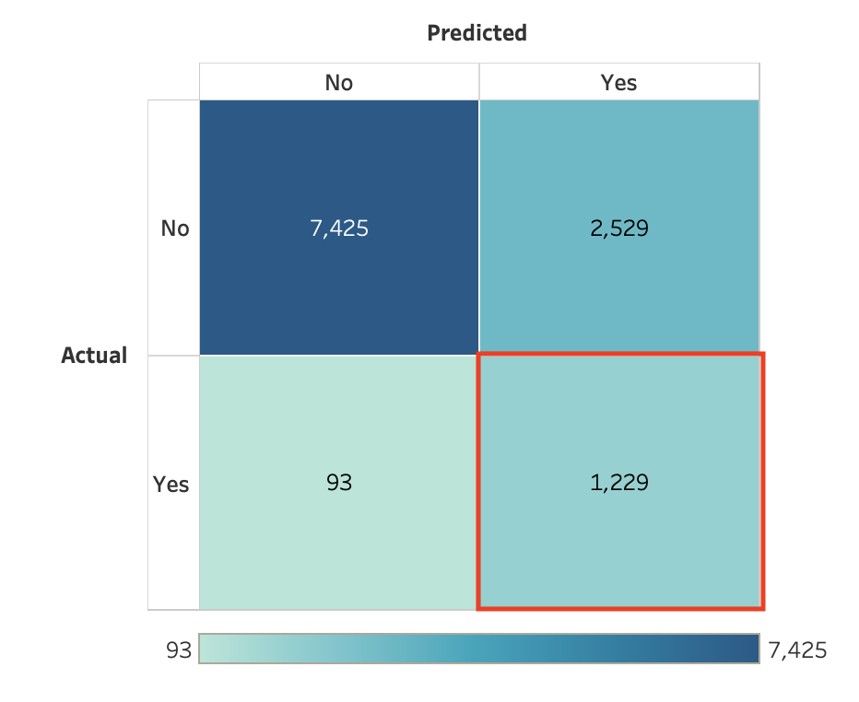
Model Result
Recall: 0.94
Notes:
[FN, TN]
[FP, TP] = 1322
The model result, the model actually did really well
it predicted approximately 1200 correct out of 1300
However, our model actually doesn’t provide us with the best precision or accuracy score
but it did provided us with the best recall and True Positive
All the other models were just getting a bunch of false negative

Slide 7
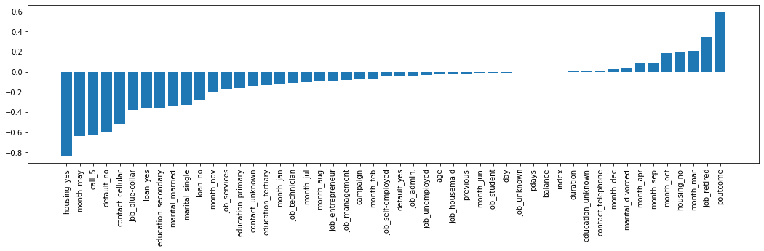
Feature insights
Notes:
So couple take away for our bank
Focus on the
Customer who had a positive outcome on a previous campaign
Customer who are retired
Customer who don’t own a house
Make sure all the dialers are working hard during the month
March, April, September and October

Slide 8
Thank you!

