Slide 1
How Can We Improve Our Products?
Herbert Pan
panherbert@gmail.com
Notes:
Back in my product management days, one of the most popular questions that gets asked is ”how can we improve our products?”
Before,
First, we will recommend, because pricing is the obvious driver for sales, the lower your price is the more you sell.
Second, we will scan thru some of the customer reviews and their competitor’s marketing activities then revert those information to our vendors.
Now,
With everything that we learn here in Metis, we will able to make better recommendation and increase conversion.

Slide 2
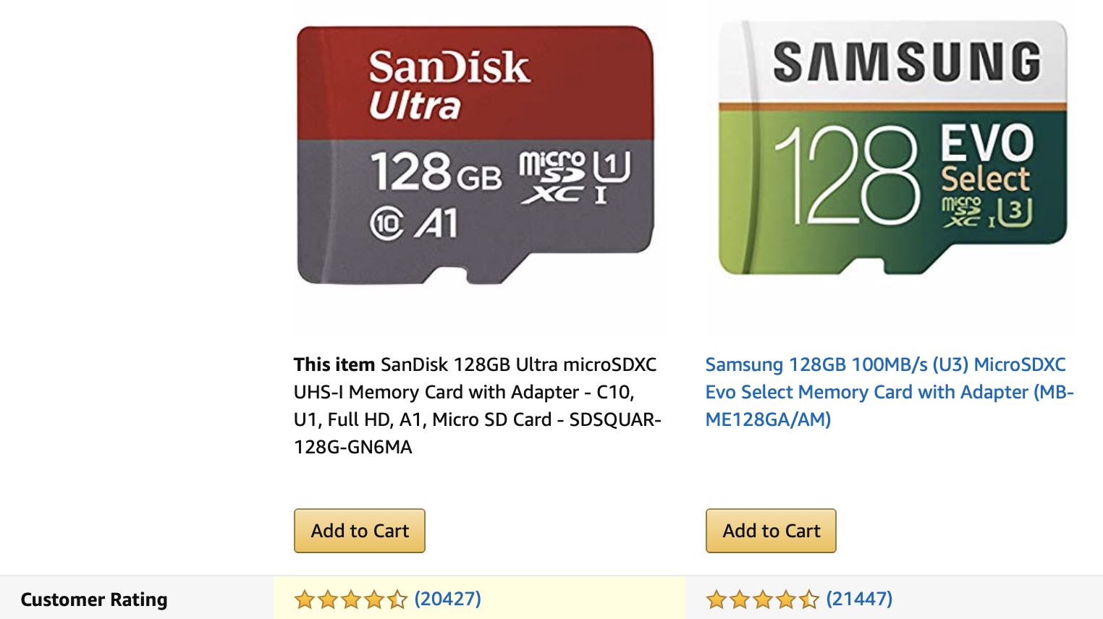
The approach to make better recommendation
Notes:
I decided to scrape Amazon reviews
Reason being that Amazon accumulate the most reviews ANYWHERE. It out reviewed Newegg approximately 200 to 1
And with a lot of data, it will come with a lot of insights

Slide 3
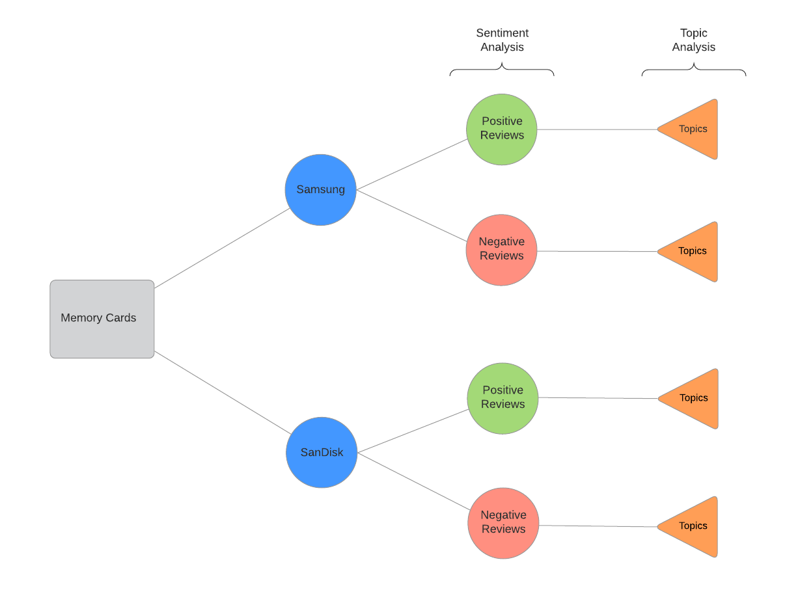
Methodology
Notes:
So here I am targeting SanDisk and Samsung’s memory cards
And split by sentiments
Then split by topics

Slide 4
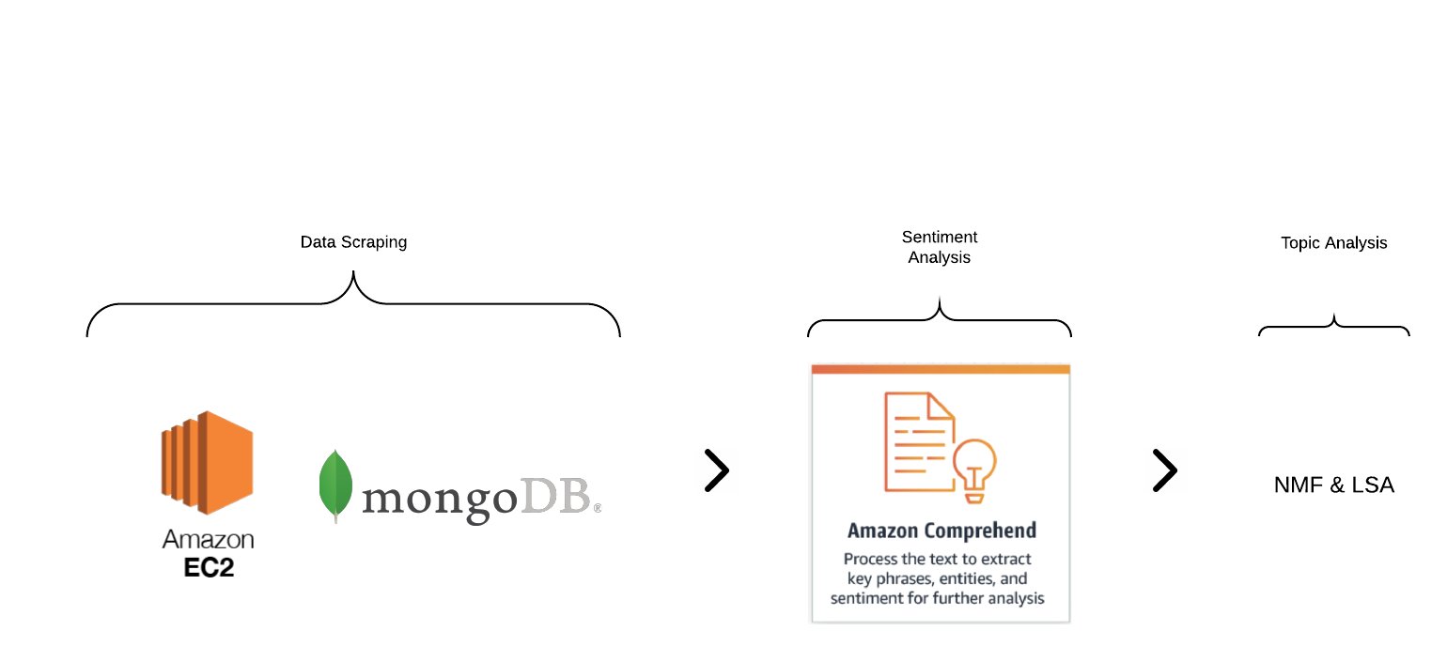
How did we get there?
Notes:
Local Machine and an EC2 instance running for a couple hours
To scrape all the data
Second EC2 instance with MongoDB
To store the data
Then we used a service provided by Amazon that is called Amazon Comprehend to analyze the sentiment of each review that we gathered.
So basically we are making an API call with the review and they will Amazon will spit back the analyzed result
The Final step will be to use NMF and LSA to look at the topics

Slide 5
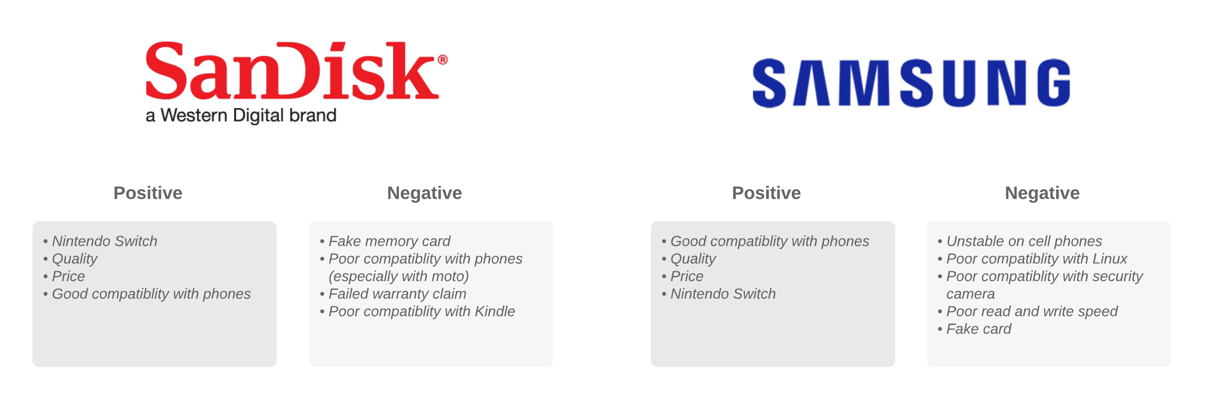
Results: Topics

Slide 6
Thank you
Herbert Pan
panherbert@gmail.com
Notes:
Back in my product management days, one of the very popular question that gets asked is ”how can we improve our products?”
Before,
First, we will say pricing, because pricing is the obvious driver for sales, the lower your price is the more you sell.
Second, we will scan thru some of the customer reviews and their competitor’s marketing activities then revert those information to our vendors.
Now,
With everything that we learn here in Metis, we will able to make better recommendation and increase conversion.

