Slide 1
Reproduction of Wang et al. 2017

Slide 2
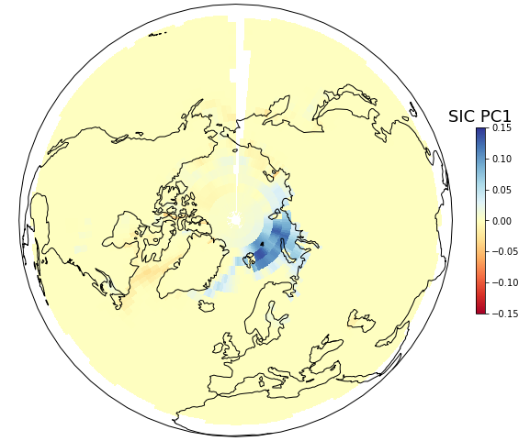
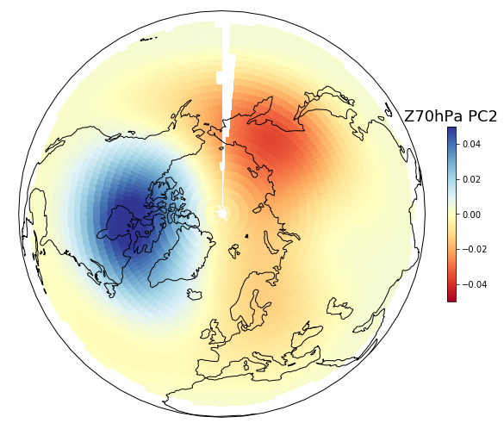

Slide 3

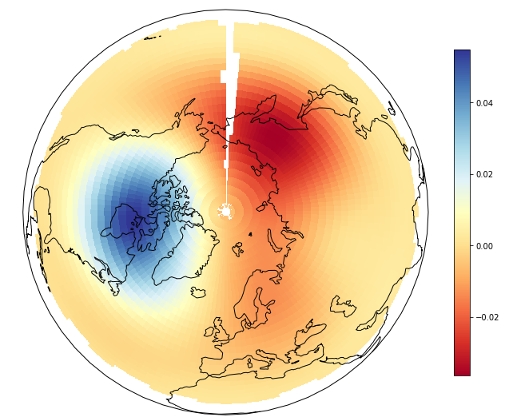
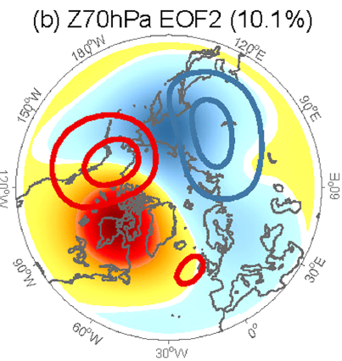

Slide 4

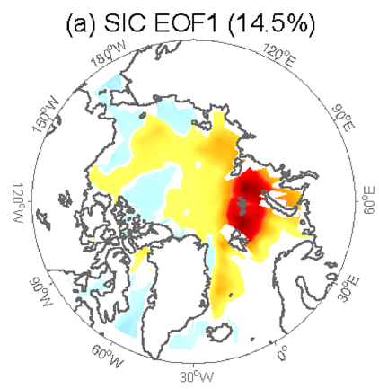
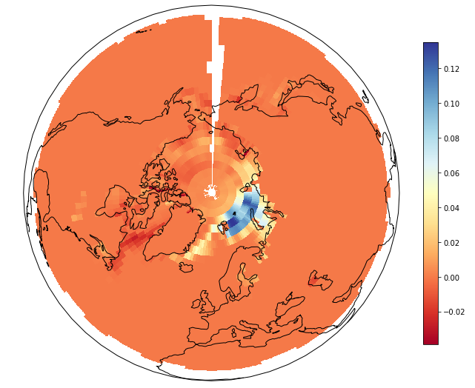

Slide 5
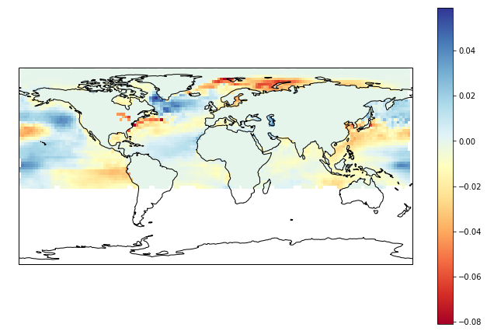

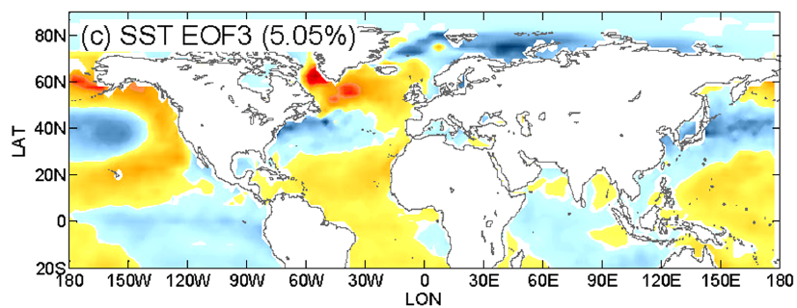

Slide 6
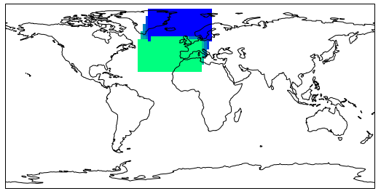
NAO regions according to definition

Slide 7
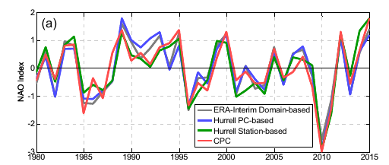
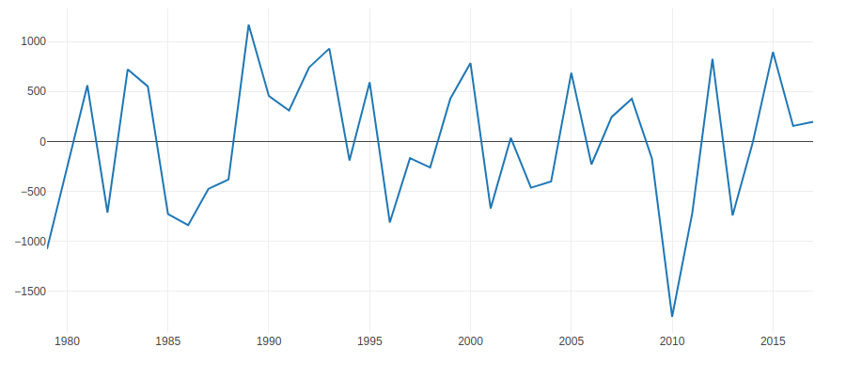
NAO (Wang et al.)
NAO (David)

Slide 8
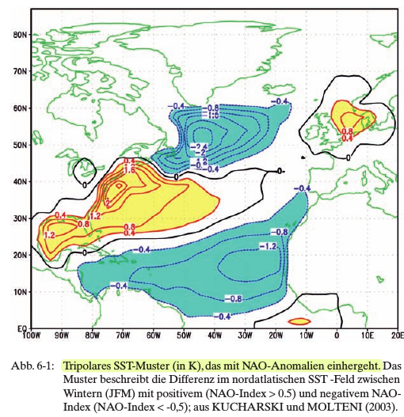
Add a new region: Norther Atlantic SST
(PROMET, 2008)

Slide 9
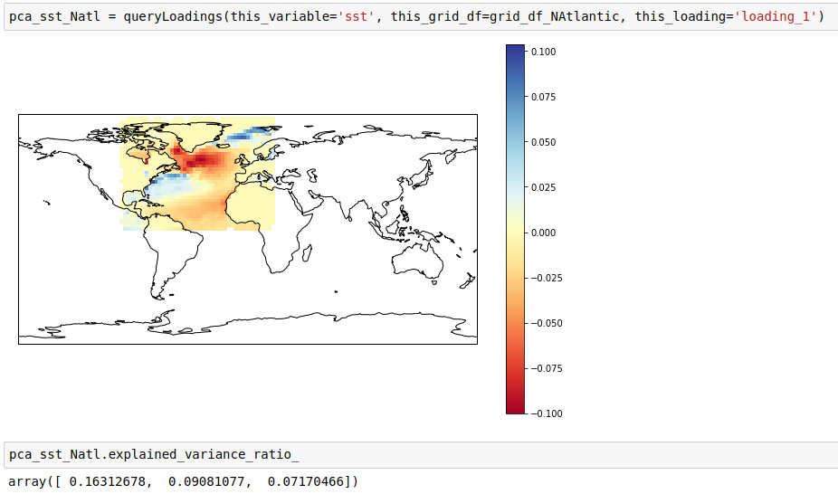

Slide 10
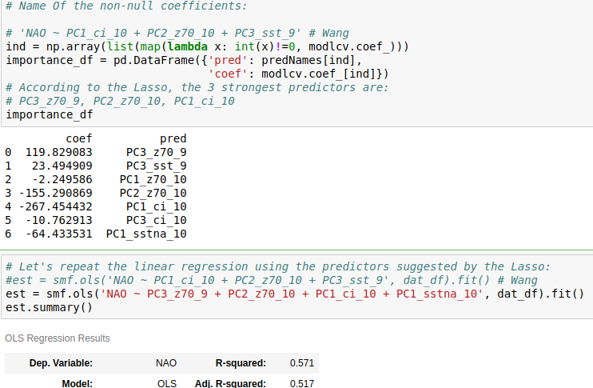
Using Northern Atlantic SST does improve the regression:

Slide 11
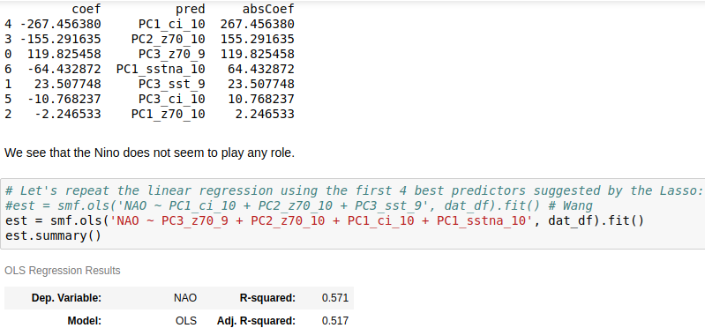
General Lasso selection:
era-int_NAO_prediction.ipynb

Slide 12
Stations

Slide 13
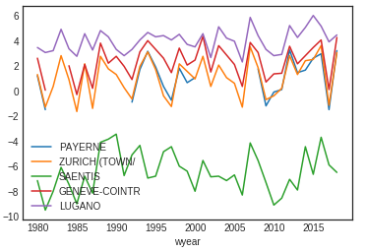
Inserted stations in
ghcnm_data.ipynb
Exploration in
station_exploration.ipynb
Station Anomalies
See SwissRe guidelines:
P. 47: "If the trend in the weather index data is against SRCSGMI, apply detrending on calculated weather index values"
i.e., the index itself is detrended, not the original observations!
p.49: For HDD call and put options, NO detrending is applied. The historical period is (!!) the last 10 years period.
This means, we can take advantage of the global temperature trend and use the year index as predictor later.

