Slide 1

Personalized Learning Path Scheduler: A Multimodal Approach Using Deep Generative Models and Quantum Optimization
BATCH: C2
Guided by : Dr. P.V.S. Lakshmi Jagadamba
Head of the department, Department of CSE
TEAM MEMBERS
Veera Kalyani Hema Tayaru Padala (322103210169) Teegireddy Sujitha (322103210158)
Relli Gopikanjali (322103210132) Pani Siri (322103210182)
Department of Computer Science and Engineering
GAYATRI VIDYA PARISHAD COLLEGE OF ENGINEERING FOR WOMEN

Slide 2
ABSTRACT
Personalized learning platforms face challenges in adapting dynamically to student behaviors, integrating multimodal resources, and managing study schedules alongside academic deadlines. This project proposes a Personalized Learning Path Scheduler to address these limitations. The learning module generates adaptive study roadmaps using Transformer-based generative models with adversarial training and delivers multimodal content including text, videos, and quizzes. To enhance personalization, a Quantum Kernel Support Vector Machine (QSVM) is employed for cognitive load detection, enabling improved classification of mastery and struggling states in high-dimensional learning data. The planner module integrates Natural Language Processing (NLP) pipelines to automatically extract tasks and deadlines. It employs Constraint Programming Satisfiability (CP-SAT) solvers for large-scale scheduling while selectively applies the Quantum Approximate Optimization Algorithm (QAOA) for small-scale optimization problems where quantum simulators can demonstrate efficiency within hardware constraints. A multi-agent architecture coordinates subject-specific learning agents and a planner agent to provide holistic personalization, adaptive learning, and conflict-free scheduling. This work establishes a practical yet forward-looking framework that unites classical efficiency with quantum innovation, paving the way for the next generation of adaptive and intelligent education systems.
Keywords: Personalized learning, multimodal Artificial Intelligence (AI), cognitive load detection, Quantum Kernel Support Vector Machine (QSVM), Constraint Programming Satisfiability (CP-SAT) solver, Quantum Approximate Optimization Algorithm (QAOA), multi-agent systems, higher education.

Slide 3
INTRODUCTION
Revolutionizing Learning & Planning – AI-powered hybrid framework designed to personalize study paths and optimize schedules.
Bridging the Gap – Overcomes limitations of traditional learning platforms by adapting to student behavior and balancing study with deadlines.
Generative AI & Transformers – Creates adaptive study roadmaps, personalized modules, and multimodal learning resources.
Quantum-Enhanced Learning – Uses Quantum Kernel Support Vector Machine(QSVM) for accurate cognitive load detection, distinguishing mastery from struggling states.
Smart Scheduling – Combines classical Constraint Programming Satisfiability (CP-SAT) solver for large-scale tasks with Quantum Approximate Optimization Algorithm (QAOA) for small-scale scheduling optimization.
Multi-Agent Coordination – Learning agents and a planner agent collaborate to ensure holistic personalization and conflict-free study plans.
Actionable Insights – Provides dashboards on coverage, weak areas, quiz accuracy, and time management for continuous improvement.
Modern Tech Integration – Built with Flutter for frontend, FastAPI for backend, and PostgreSQL/Firebase for data storage using AI frameworks, quantum simulators (Qiskit/PennyLane), and scalable open-source datasets Open University Learning Analytics Dataset (OULAD) and Project Scheduling Problem Library (PSPLIB).

Slide 4
LITERATURE SURVEY
S. No | Title & Authors | Published Journal and Year | Dataset Used | Approach | Outcome | Limitations
1 | Multimodal Adaptive Learning Systems using Transformers — Changzhi Sun, Shijie Huang, Banghui Sun, Shiwei Chu | EEE Transactions on Learning Technologies, IEEE, 2022 | Educational interaction logs, student activity datasets | Cognitive graph–based path planning and recommendation system | Transformer-based generative modeling and adversarial training | Limited generalization across diverse populations
2 | Cognitive State Recognition with Quantum Machine Learning — Kavitha S.S., Kaulgud N. | Quantum Machine Intelligence, Springer, 2021 | Simulated cognitive signals and open EEG datasets | Machine learning algorithms for optimization of recommendation systems | Quantum kernel methods (QSVM) | Limited scalability; dependent on simulators
3 | Intelligent Tutoring Systems with Multi-Agent Models — Peng H., Ma S., Spector J.M. | ACM Transactions on Intelligent Systems and Technology, ACM, 2020 | Student assessment and task datasets | Multimodal ML models to analyze distraction and peer influence | Multi-agent coordination with reinforcement learning | Requires extensive computational resources
4 | Hybrid Quantum Annealing Heuristic Method for Solving Job Shop Scheduling Problem — Krzysztof Kurowski, Jan Węglárz, Mateusz Subocz, Rafał Różycki, Grzegorz Waligóra | Computational Science – ICCS 2020, Springer, 2020 | FT06 benchmark dataset, tested on D-Wave 2000Q | AI-driven approaches for building personalized learning pathways | Hybrid quantum annealing combined with classical heuristics for JSSP | Limited scalability; NISQ hardware restrictions; performance degrades with larger problem sizesLacks multimodal robustness and advanced optimization

Slide 5
Existing System
1.Traditional Learning Management Systems
Examples: Moodle, Blackboard, Canvas
Features:
Course content management
Assignment submission
Limitations:
Static and linear content delivery
One-size-fits-all learning paths
Minimal personalization
No AI or quantum optimization
2.AI-Powered Learning Platforms
Examples: Duolingo, Khan Academy, Coursera
Features:
Basic adaptive learning paths
Progress tracking and quizzes
Limitations:
Limited personalization
No real-time cognitive load detection
No optimized scheduling
No quantum computing integration

Slide 6
Existing System
3.Quantum Computing in Education (Emerging)
Current Status:
Mostly research-based
Limited real-world deployment
Focus Areas:
Optimization and scheduling
Quantum machine learning
Examples:
IBM Quantum Education
D-Wave research initiatives
Limitations:
No classroom-level applications
Not integrated with learning platforms
4.Task Management & Planning Tools
Examples: Google Calendar, Notion, Todoist
Features:
Task tracking and reminders
Limitations:
No learning intelligence
Manual task entry
No AI or quantum optimization

Slide 7
Existing System
5.Hybrid Learning Systems
Examples: BYJU’S, Unacademy
Features:
Video-based lessons
Practice tests and assessments
Limitations:
Limited personalization
Static learning schedules
No advanced AI or quantum optimization

Slide 8
Proposed System
1. System Overview
A next-generation intelligent learning platform that integrates:
Generative AI for personalized learning content
Quantum Computing for optimized scheduling and personalization
Multi-Agent Systems for intelligent coordination
Adaptive Learning based on cognitive load detection
2. Core Modules
Learning Module
Personalized learning roadmap generation
Transformer-based content creation
Multi-format learning (text, videos, quizzes)
Cognitive load detection using Quantum Kernel SVM
Planner Module
QAOA-based smart scheduling
Deadline-aware task prioritization
NLP-based automatic task extraction
Intelligent reminders and alerts

Slide 9
Proposed System
3.Key Features & Expected Outcomes
Key Features
Quantum-optimized study schedules
AI-driven personalized learning paths
Real-time learning adaptation
Automated task and time management
Expected Outcomes
Improved learning efficiency
Reduced study time
Better workload balance
Data-driven decision support

Slide 10
Requirements
1. Functional Requirements
User Management
Users can register using email/password or OAuth providers
Users can create and manage multiple learning agents
Role-based access control (Student, Instructor, Admin)
Learning Module
Generate personalized learning roadmaps
Provide adaptive content based on learner performance
Deliver multi-format content (text, video, quizzes)
Support assessments with automated grading
Planning Module
Automatically extract tasks from multiple sources
Generate optimized daily and weekly schedules
Send intelligent reminders and notifications
Analytics & Reporting
Track and visualize learning progress
Provide performance insights and recommendations
Generate downloadable reports

Slide 11
Requirements
2. Non-Functional Requirements
Performance
Support up to 10,000 concurrent users
API response time under 500 ms for 95% of requests
Scheduling optimization completed within 5 seconds
Security
Data encryption using TLS 1.3 and AES-256
Compliance with GDPR and FERPA standards
Periodic security audits and testing
Scalability
Horizontal scalability for increased load
Database replication and sharding support
Modular quantum components
Usability
Web and mobile application support

Slide 12
Requirements
3. Technical Requirements
Frontend
React 18+ with TypeScript
Redux Toolkit for state management
Material-UI for responsive design
Progressive Web App (PWA) support
Backend
Node.js 18+ with Express
Python 3.9+ for AI/ML services
JWT-based authentication
Database & Storage
MongoDB for document storage
Cloud object storage (e.g., S3)
AI / ML
PyTorch for deep learning
Hugging Face Transformers for NLP
Scikit-learn for classical ML
Quantum Computing
Qiskit and PennyLane frameworks
QAOA for scheduling optimization
Quantum SVM for classification tasks

Slide 13
Requirements
4. Hardware Requirements
Development
Minimum 16 GB RAM (32 GB recommended)
Multi-core processor
20 GB free disk space
Production
Cloud-based Kubernetes infrastructure
Access to quantum computing platforms
CDN and load balancers for scalability
5. Integration Requirements
Email services
Calendar integration

Slide 14
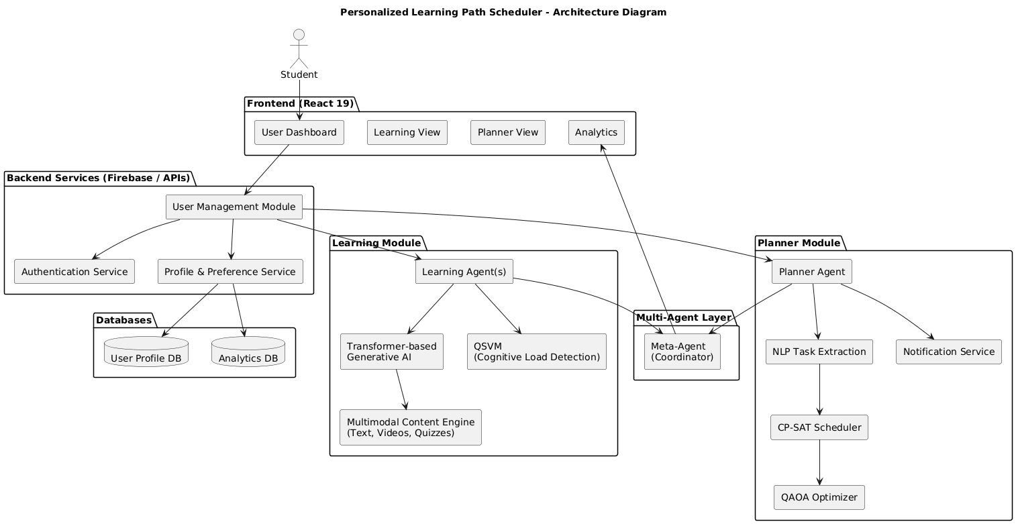
ARCHITECTURE

Slide 15
MODULES
USER MANAGEMENT
Handles user registration and login
Creates and maintains learner profiles
Stores preferences and learning progress
Shares user data with learning and scheduling modules
Secures session handling and
e-mail verification
LEARNER MODULE
Creates subject specific learning agents for each topic
Generates personalized learning paths
Provides study materials like notes, quizzes and flash cards
Supports multi-modal content
Adapts content based on progress and cognitive state
Creates subject specific learning agents for each topic
COGNITIVE LOAD DETECTION
Analyzes learner behaviour and performance data
Classifies learners into mastery or struggling states
Supports adaptive learning and scheduling
Monitors learner focus and engagement

Slide 16
MODULES
TASK AND DEADLINE
EXTRACTION
Scans e-mails, extract tasks, deadlines, adds them to scheduler and notifies user
Extracts deadlines using date and time recognition techniques
Assigns priority and urgency levels
Identifies assignment submissions, tasks
OPTIMIZATION
Adds both learning sessions and tasks into single scheduling space
Optimizes the schedule to avoid overlaps between study sessions and tasks
Selects the best possible time slots based on availability and workload
6. ANALYTICS AND DASHBOARD
Tracks learner progress and performance
Visualizes learning trends and completion status
Identifies missed tasks and schedule deviations
Provides learning progress and completion rate analysis

Slide 17
ALGORITHMS
Multi-Agent System
A distributed system architecture where multiple autonomous agents operate independently while coordinating through a central Meta-Agent.
How it is used :
Each subject (OS, ML, DLD) is implemented as an independent learning agent
Each agent maintains:
Learning roadmap
Progress state
Difficulty level
A Meta-Agent aggregates outputs from all agents to build a global learner profile
Where it is used: Learner Module
Why it is used:
Enables subject-wise personalization
Prevents interference between different subjects
Scales efficiently when new subjects are added

Slide 18
ALGORITHMS
2. Transformer-Based Learning Path Generation
A deep learning sequence-generation algorithm based on self-attention mechanisms.
How it is used
Inputs: subject name, timeframe
Transformer generates:
Ordered topic sequence
Daily learning goals
Difficulty progression (easy → medium → advanced)
Self-attention captures topic dependencies and prerequisites
Where it is used
Learner Module (Roadmap / Learning Path Generation)
Why it is used
Handles complex topic dependencies
Adapts learning paths dynamically
More flexible and intelligent than rule-based planning

Slide 19
ALGORITHMS
Quantum Kernel Support Vector Machine (QSVM).
A hybrid Machine Learning and Quantum Kernel SVM (QSVM) model used to classify learner cognitive load levels from behavioral data.
How it is used
Behavioral features are collected:
Time spent on content
Video replays
Quiz failures
Pauses and skips
Features are mapped to a high-dimensional space using quantum feature mapping
QSVM classifies learner state as:
Low load
Optimal load
High load
Where it is used
Cognitive Load Detection Module
Why it is used
Cognitive load data is high-dimensional and non-linear
QSVM provides better separation than classical SVM
Prevents learner overload and burnout

Slide 20
ALGORITHMS
4. Natural Language Processing (NLP) pipeline
An NLP-based pipeline that uses NER and temporal parsing to extract tasks and deadlines from unstructured text and convert them into structured scheduling data.
How it is used
Gmail messages are scanned
NER extracts entities such as:
Assignment names
Exam titles
Project tasks
Date parsing algorithms convert phrases like:
“next Friday”
“by 5 PM” into exact timestamps
Where it is used
Task & Deadline Extraction Module
Why it is used
Academic messages are unstructured text
Enables automatic task and deadline extraction
Eliminates manual task entry

Slide 21
ALGORITHMS
5. Quantum Approximate Optimization Algorithm (QAOA)
A hybrid quantum-classical optimization algorithm designed for combinatorial optimization problems.
How it is used
Learning sessions and extracted tasks are encoded as binary scheduling variables
Constraints include:
No overlap between learning and tasks
Deadline satisfaction
Workload balance
QAOA minimizes a cost Hamiltonian to generate an optimal schedule
Where it is used
Optimization Module (Scheduler)
Why it is used
Scheduling with multiple constraints is NP-hard
QAOA efficiently finds near-optimal schedules
Scales better than greedy or brute-force methods

Slide 22
IMPLEMENTATION

Slide 23
OUTPUT SCREENS

Slide 24
BASE PAPER
Title: Personalized learning path planning for higher education based on deep generative models and quantum machine learning: a multimodal learning analysis method integrating transformer, adversarial training and quantum state classification
Authors: Changzhi Sun, Shijie Huang, Banghui Sun, Shiwei Chu
Published Year: 2025
Publisher: Springer Nature
Dataset Used: Simulated multimodal education datasets
Algorithms:
Transformers with Adversarial training for adaptive learning content generation
Quantum State Classification for detecting cognitive states of students
Advantages:
Enables multimodal, adaptive learning
Enhances cognitive state detection with quantum methods
Limitations:
Complex integration
High computational requirements

Slide 25
BASE PAPER
Title: Application of quantum approximate optimization algorithm to job shop scheduling problem
Authors: Krzysztof Kurowski, Tomasz Pecyna, Mateusz Slysz, Rafał Różycki, Grzegorz Waligóra, Jan Węglarz
Published Year: 2023
Publisher: Elsevier
Dataset Used: Benchmark scheduling datasets (Job-Shop Scheduling, Max-Cut)
Algorithms:
Quantum Approximate Optimization Algorithm (QAOA)
Classical Constraint Solvers for baseline results
Advantages:
Improves scheduling efficiency for specific tasks
Demonstrates practical use of quantum-classical methods
Limitations:
Dependent on quantum simulation or hardware
Limited scalability

