Slide 1
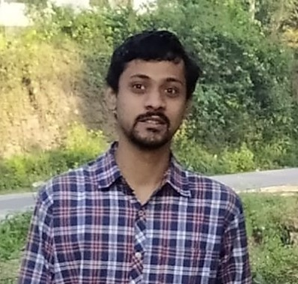
INTRODUCTION - Panindra.Mysorekar
Started my career at TCS in July 2019
Presently on SharePoint Applications for Honeywell Projects.
3 Microsoft Certifications (AZ-900,DA-100 ,PL-900)
5 Gems
Instrumentation Engineer from Mumbai University .
Passionate about Data Science and Machine Learning .
Pursuing PGDML Course @ IIIT,Bangalore on the UPgrad Platform .
Career Goal : Build a Career in Data Science and Machine Learning

Slide 2
Problem Statement
Customer Recall
The Company has provisioned eCommerce We bSites and wants to understand what investments can be made to improve the user experience in the Product.
Product Viability
Too Many Products increases the Risk of unused inventory and increases cost of Marketing
Customer Retention
User Preferences
Cost of acquiring customers is higher then retaining an existing customer .New Customers must be acquired but retaining the old customer helps increasing customer base and valuation of the company
The Company wants to make investments in the right technology framework

Slide 3
Data MODELING
S1
S2
S3
S4
Data Acquisition
Building Schema
Problem Mapping
MILESTONE
Data acquired from multiple sources helps in understanding Customer Sentiment
Data Dictionary creation to understand relationships.
Relevance of Available Data in defining a Solution Workflow
Recommendations to the Product Teams to improve customer retention and Product viability

Slide 4
Data Flow
UserTable
UserID
Signup_date
User_Segement
Aggregation<User_ID>
No_of_days_Visited_7_Days
Aggregation<User_ID>
No_of_Products Viewed in 15 Days
Feature Merge
Create DF by Inner Join
Aggregation<User_ID>
User Vintage (User Retention)
VistorLogs
UserID
VisitDate
ProductID
Activity
Browser
OS
City
Country
WebClient
Aggregation<User_ID>
Most Viewed Products in 15 Days
Aggregation<User_ID>
Most Active OS
Aggregation<User_ID>
Recently Viewed Product
Aggregation<User_ID>
Pageloads In Last 7 Days
Aggregation<User_ID>
Clicks Last 7 Days

Slide 5
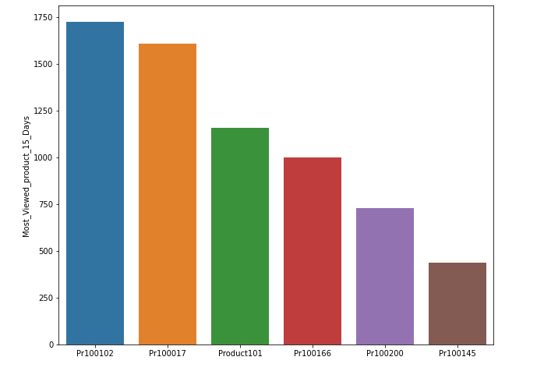
Product Popularity

Slide 6
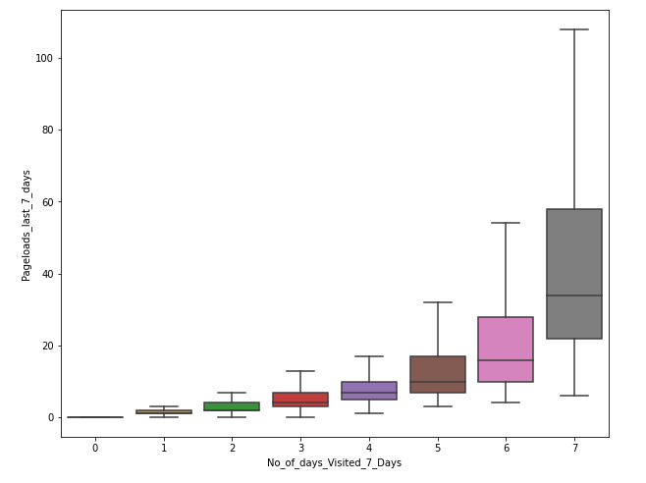
User Behavior

Slide 7
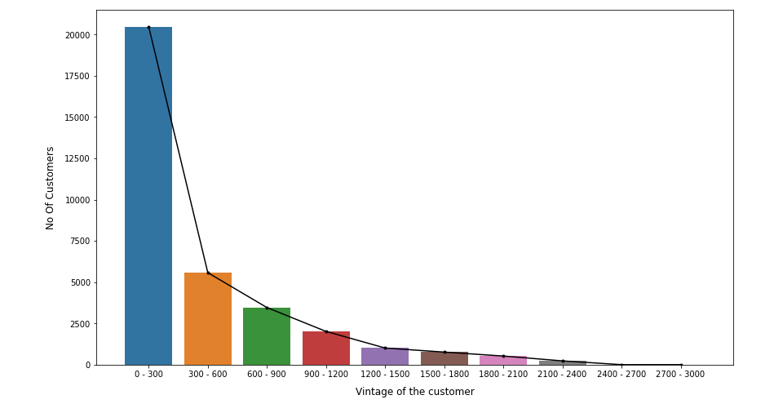
User Behavior

Slide 8
Observations
Company carries over 2043 Products
Pr100017 seems to have Highest Hits
Company must focus on products by popularity and improve Visibility on Web Searches by buying Google Keywords
User Base is over 34000
Around 22000 users have signed up in less than1 year
Old Customer has been acquired about 8 years ago
Average Customer Retention is about 203 days
Recommendation : The Company will have to work on Customer Retention which can result in higher sales
Technology Preference
Users are Still using WEB Apps on Windows (>20K)
Android (>9k)
This indicates the application not be App Friendly or you have legacy users or needs improvement on Apps Interfaces to improve Customer Experience

