Slide 1
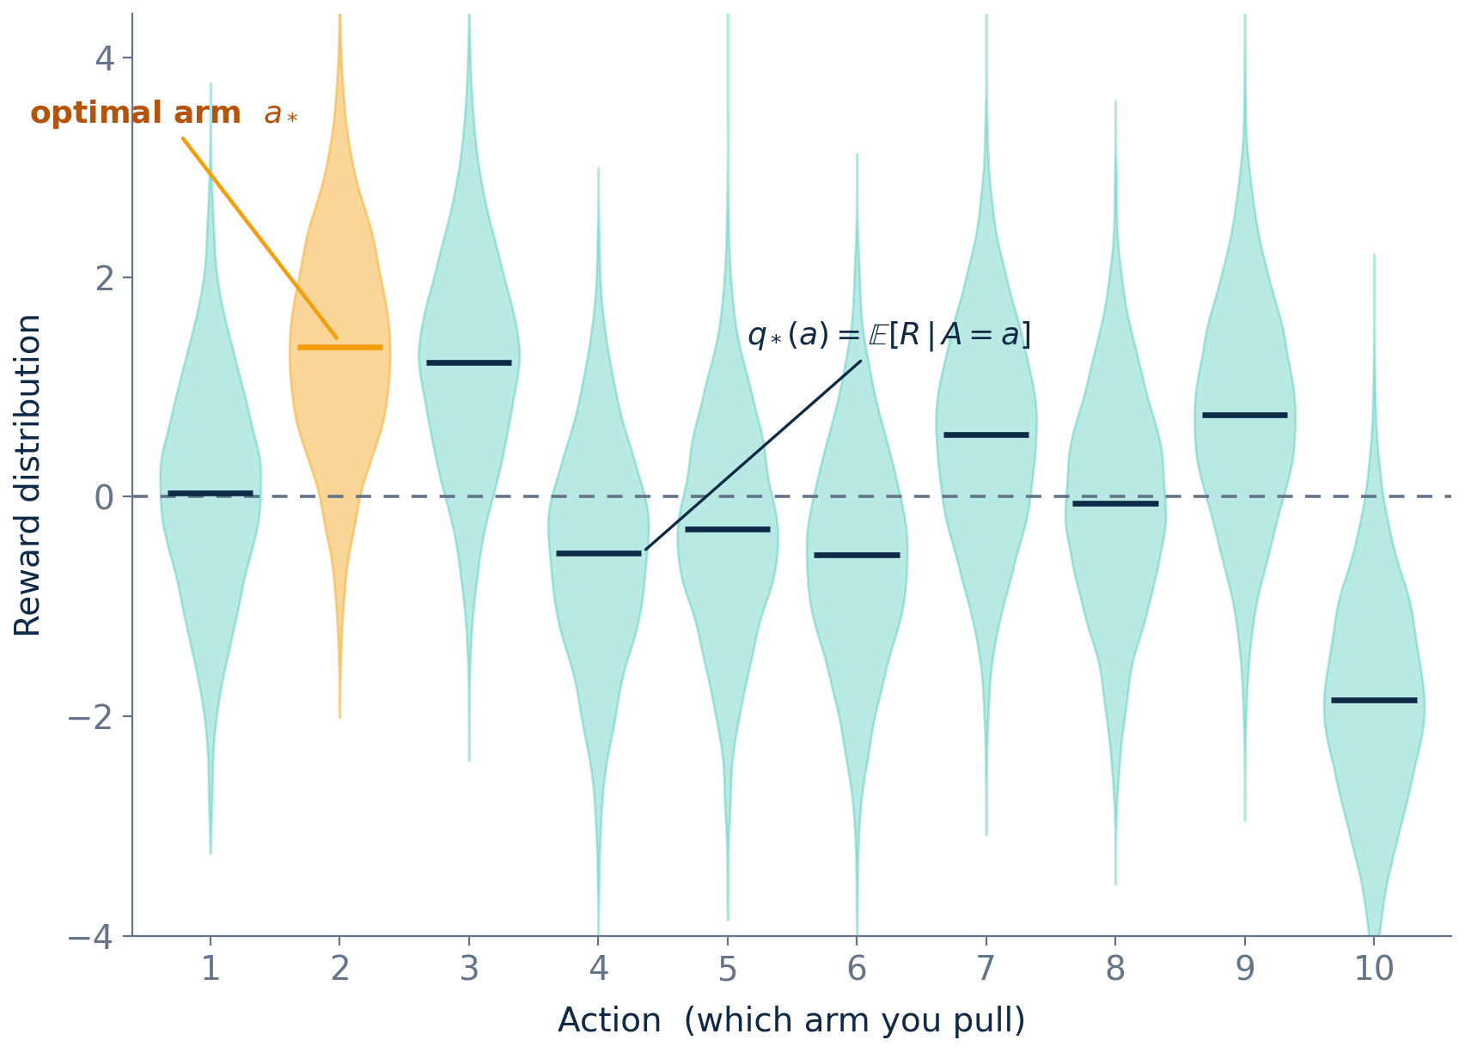
FOUNDATIONS
The K-Armed Bandit
What you're given
K arms; pulling arm a returns a reward Rₜ.
Each arm has a fixed but unknown reward distribution.
Its mean q∗(a) = E[Rₜ | Aₜ = a] is what you'd love to know.
You only see the reward you collected — never the others.
Goal: maximize total reward over many pulls.
The catch
q∗(a) is hidden. You must estimate it from noisy rewards while you act — so pulling an arm to learn (explore) competes with pulling the best-looking arm to earn (exploit).
Each arm's reward is a noisy draw; the bar marks its true value q∗(a). Arm a∗ has the highest mean — but you don't know that yet.
Notes:
The k-armed bandit is the simplest sequential decision problem and the gateway to RL. There are k arms; each pull of arm a returns a reward drawn from a fixed but unknown distribution with mean q*(a). The agent never sees the rewards of arms it didn't pull, so it must estimate q*(a) from its own noisy experience. Point to the violins: that spread is the stochasticity of rewards. The horizontal bar is the true mean q*(a). The amber arm is the optimal arm a* with the highest mean reward 1.36 in this draw — but the agent doesn't know which one it is. That sets up the central tension we'll spend the lecture on: explore to learn the means vs. exploit the arm that currently looks best.

Slide 2
PART 2 — BANDIT BASICS
Estimate each action's value, one pull at a time.
Sample mean estimate:
Q̂ (a) = ( sum of rewards from a ) ÷ ( # pulls of a )
Equivalent incremental update — no need to store all data:
Q̂_new(a) = Q̂_old(a) + α · ( r − Q̂_old(a) )
new estimate = old estimate + step size · prediction error
α = 1/n → exact running average α = constant → exponentially-weighted average (adapts to change)
6

Slide 3
PART 3 — EXPLORATION
ε-greedy: explore randomly, exploit greedily.
Algorithm
With probability 1 − ε :
choose argmax_a Q̂(a) (exploit)
With probability ε :
choose a uniformly at random (explore)
ε = 0.1
Pros
Cons
Dead simple
Strong baseline
Hard to beat at small scale
Explores blindly
Keeps trying bad actions forever (unless ε decays)
Ignores uncertainty
7

