Slide 1
A HIGH PERFORMANCE VOLTAGE SAG DETECTION ALGORTHIM for a Dynamic Voltage Restorer (DVR)
By:
D.Asha Jyothi(158W5A0217)
P.Anil(148W1A02A3)
Under the Guidance of:
S.ManmadhaRao,
Assistant Professor

Slide 2
Abstract:
Power quality is one of the major concerns in the era of power system. Power quality problem occurred due to nonstandard voltage, current or frequency, that result in a failure of end user equipment. To overcome this problem, Dynamic Voltage Restorer (DVR) is used, which eliminate voltage sag and swell in the distribution line, it is efficient and effective power electronic device. The size of DVR is small, cost is low and fast dynamic response to the disturbance. By injecting an appropriate voltage, the DVR restores a voltage waveform and ensures constant load voltage. The compensating signals are determined dynamically based on the difference between desired and measured values. The DVR is consisting of VSC, Booster transformer, Filter and Energy storage devices. This paper describe different compensation control technique used for compensate the voltage of the distribution line.

Slide 3
Power Quality:
The term power quality refers to the maintaining a sinusoidal waveform of bus voltages at rated voltage and frequency.
Power Quality problems encompass a wide range of disturbances such as voltage sags/swells, flicker, harmonics distortion, impulse transient, and interruptions.

Slide 4
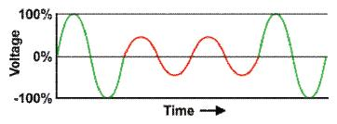
VOLTAGE SAG:
As per IEEE standards a voltage sag or voltage dip is a short duration reduction in rms voltage which can be caused by a short circuit. Voltage sag happens when the rms voltage decreases between 10 to 90% of nominal voltage, for durations of 0.5 cycle to 1 min.
Causes for voltage sag
Sudden increase in loads
short circuits
faults

Slide 5
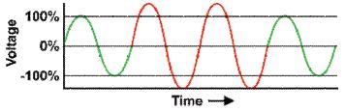
VOLTAGE SWELL:
As per IEEE standards a voltage swell is a momentary increase in the power-frequency voltage delivered by the mains, outside of the normal tolerances, with a duration of more than one cycle and less than a few seconds.
Causes for voltage swell
Sudden reduction in loads.
Energizing a large capacitor bank.
Switching off large inductive loads.

Slide 6
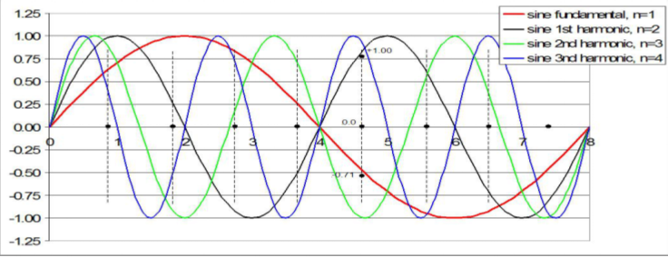
Harmonics:
As per IEEE standards harmonics are defined as sinusoidal voltages or currents that are whole multiple of the frequency at which the supply system is design to operate.Odd harmonics in the system causes distortion in the output.

Slide 7
Compensation methods for power quality issues
Series compensation
Shunt compensation
Series and Shunt compensation

Slide 8
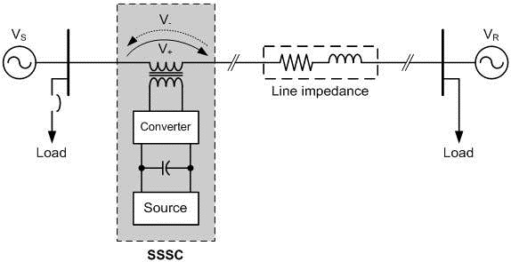
Series Compensation:
series compensation can mainly used for boosting the receiving end voltage,increase in transmission capability and reduction in losses.
In series compensation only voltage profile of the system is improved.

Slide 9
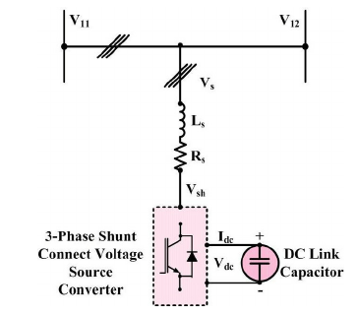
Shunt Compensation:
Shunt compensation is used for injection of current at the point and provide reactive power to the system.
Shunt compensation is used to improve the power factor.
Example for shunt compensation is D- Statcom

Slide 10
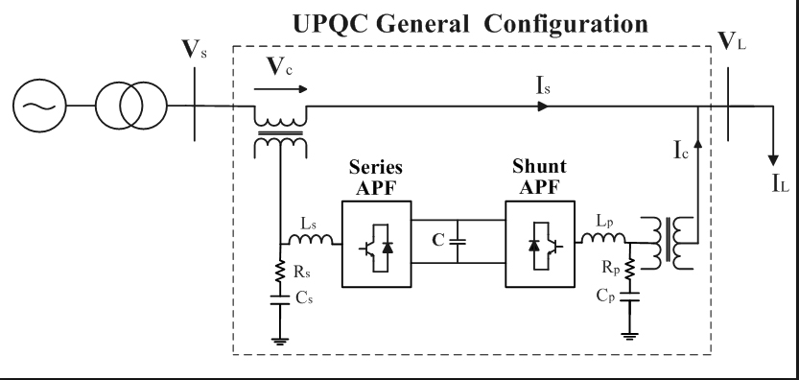
Series and Shunt compensation:
In this series and shunt compensation method both voltage and current can be improved in the system.
example for series and shunt compensation is upqc.

Slide 11
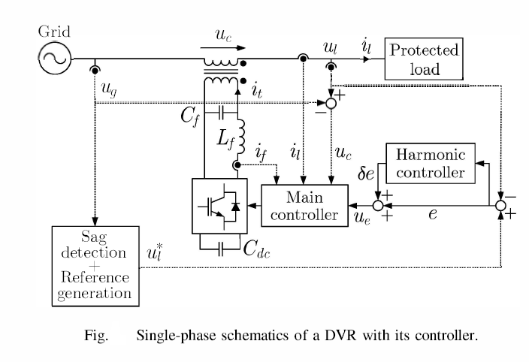
Dynamic Voltage Restorer(DVR):
The Vsc is connected in series with the grid with an LC filter (Lf and Cf) and a coupling transformer.
The DC-link capacitor is called Cdc. The load voltage (Ul) is controlled in closed-loop to provide high-quality input voltage to the sensitive load. A PLL is used to synchronize the DVR with the grid voltage and to estimate the grid frequency, which is required for the sag detection algorithm.

Slide 12
Inverter:
Multilevel inverters are three types:
Diode clamped multilevel inverter
Flying capacitors multilevel inverter
Cascaded H- bridge multilevel inverter
This topology consists of series of power conversion cells and power can be easily scaled.
The combination of capacitors and switches pair is called an H-bridge and gives the separate input DC voltage for each H-bridge.
It consists of H-bridge cells and each cell can provide the three different voltages like zero, positive DC and negative DC voltages.

Slide 13
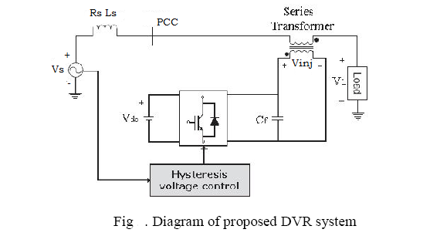
Hysteresis controller:
The hysteresis controller mainly requires two voltage signals, one is from supply side voltage signal and another is from booster transformer which is voltage injected by dynamic voltage restorer.
The controller compares these two signals and according to these signals switching pattern is established.

Slide 14
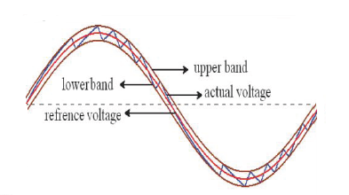
The control technique applied in this paper is based on voltage error and is non linear control method.
It consists of a comparison between the output voltage and the tolerance limits around the reference voltage, While the output voltage is between upper limit and lower limit , no switching occurs and when the output voltage increases to the upper limit (lower band) the output voltage is decrease(increase).

Slide 15
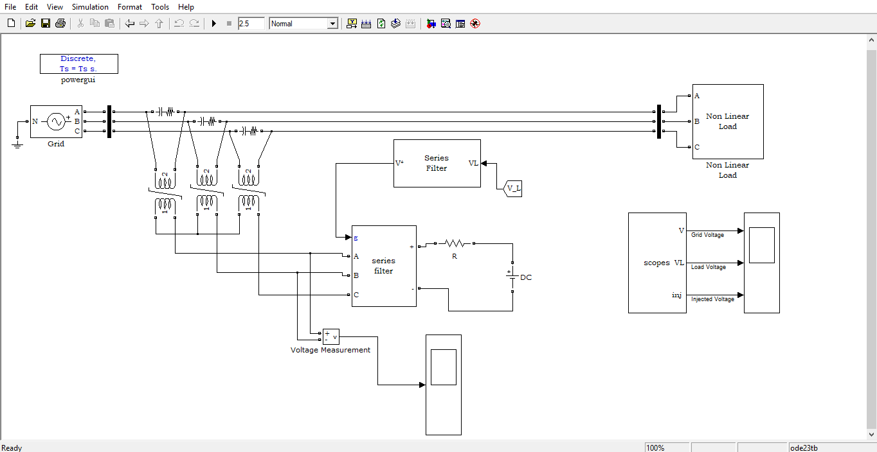
SIMULINK MODEL:

Slide 16
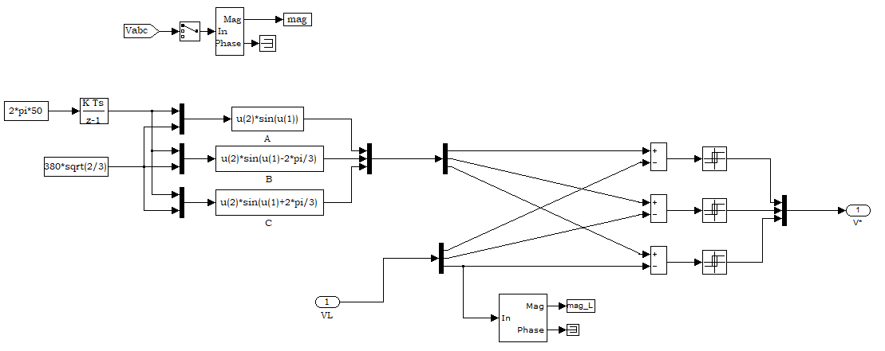
CONTROL CIRCUIT:

Slide 17
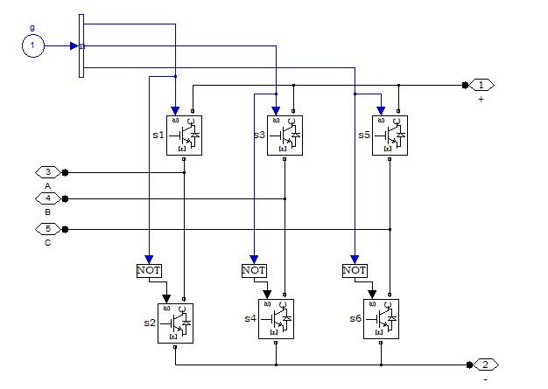
THREE LEVEL INVETER:

Slide 18
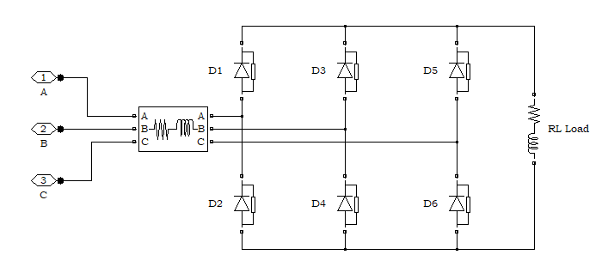
Non linear loads:

Slide 19
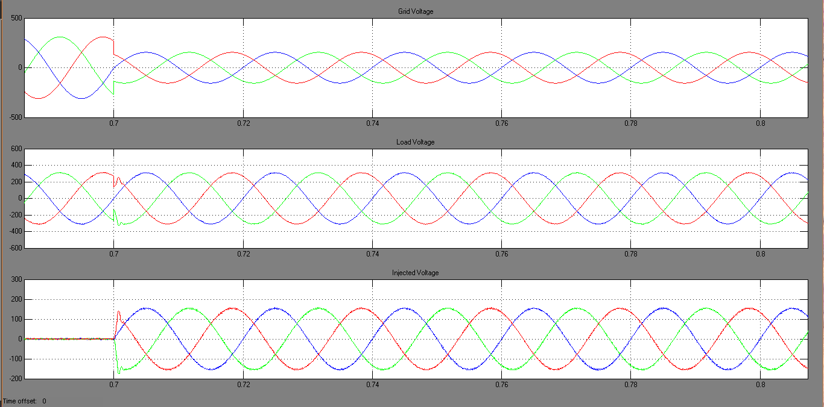
VOLTAGE SAG:

Slide 20
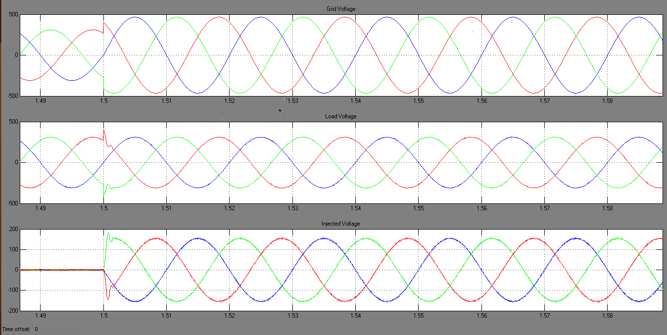
VOLTAGE SWELL:

Slide 21
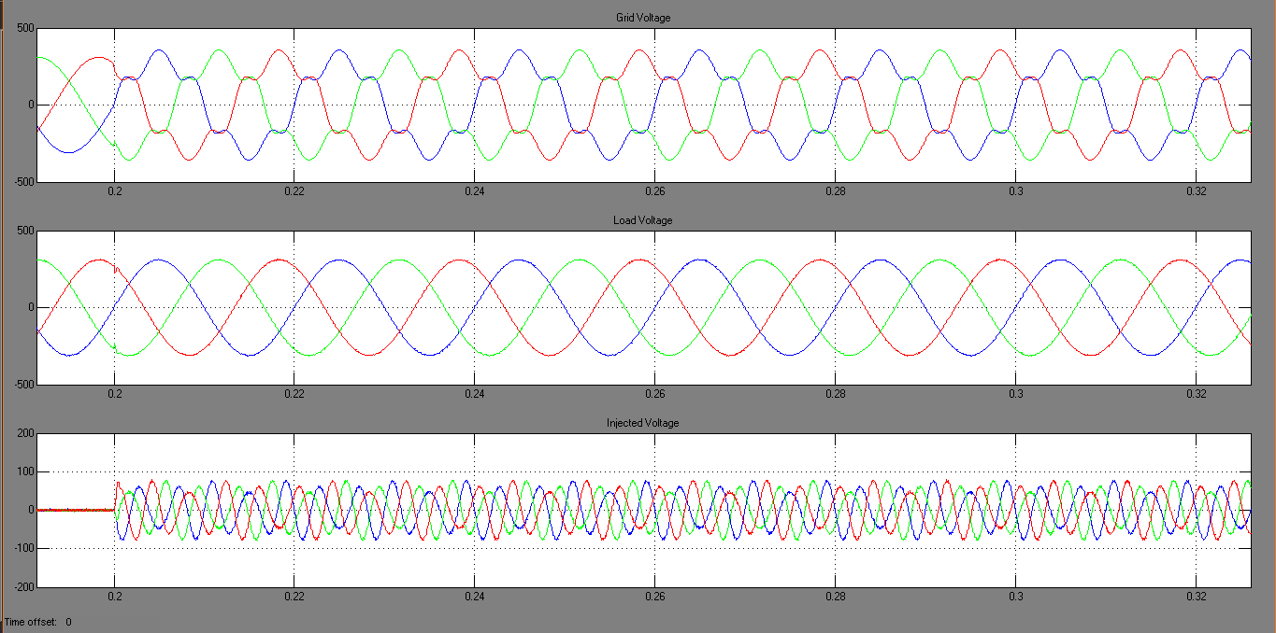
HARMONICS:

Slide 22
REFERENCES:
[1] Tarek I El-Shennawy, Abdel-Mon’em Moussa, Mahmoud A El-Gammal and Amr Y Abou-Ghazala “A Dynamic Voltage Restorer for Voltage Sag Mitigation in a Refinery with Induction Motors Loads” 2010 Science
[2]Chellali Benchaiba,Brahim Ferdi “Voltage Quality Improvement Using DVR” Electrical Power Quality and Utilization,Journal Vol.XIV no.1,2008
[3]Shairul Wizmar Wahab and Alia Mohd Yusof “Voltage Sag and mitigation Using Dynamic Voltage Restorer (DVR) System” Faculty of Electrical Engg,University Of Malaysia
[4]Brice J Quirl,Brain K Johnsom,Senior member IEEE “ Mitigation of voltage sags with phase jump using Dynami Voltage Restorer”
[5]Paosan Boonchaiam and Nadarajah Mothulananthan “Understanding Dynamic Voltage Restorers through MATLAB simulation” Electrical Power system Management ,enerfy Field of Studey,Asian Institute of Technology,Thailand

Slide 23
[7] Mehmet Tumay ,Ahmet Teke , K Cagatay Baymdr and M Ugras Cuma “Simuation and Modelling of a Dynamic Voltage Restorer” Departmetn of Electrical and Electronics Engg. Turkey available from
http://www.emo.org.tr/ekler/ee5605917626676_ek.pdf
[8] ELECTROTEK Concepts, Voltage Sag Studies Date : 10/03/2009
http://www.electrotek.com/voltsag.htm
[9] C S Chang, Y.S. Ho, P.C. Lo “Voltage Quality Enhancement with Power Electronics Based Devices.
[10] Glanny M Ch Mangindaan, M Ashari Mauridhi HP “Control of Dynamic Voltage Restorer For Voltage Sag Mitigation” ICTS 2008 available from
[11] IEEE Standard 1159-1995 “IEEE Recommended Practice for Monitoring Electric
Power Quality.Published 1995.
[12] Richard P. Bingham “Sags and Swells” available from
http://www.dranetz-bmi.com/pdf/sags-swells.pdf
[13] Nita R. Patne, Krishna L. Thakre “Factor Affecting Characteristics Of Voltage Sag Due to Fault in the Power System” Vol. 5, No.1, May2008, 171-182, Serbian Journal Of Electrical engineering.
[14] Alexander Eigels Emanuel, John A. McNeill “Electric Power Quality”. Annu. Rev. Energy Environ 1997.22:263-303.
[15] Mohd Izhwan Muhammad, Norman Mariun, Mohd Amran Mohd Radzi “ Effects Of Power Quality to the Industries” 11-12 December 2007, Malaysia
[16] Narain G. Hingorani, “Introducing custom power” IEEE spectrum, June 1995 pg.41-48.

Slide 24
[17] C. Zhan, V.K. Ramachandramurthy, A.Arulampalam, C.Fitzzer, M.Barnes, N.Jenkins, “Control of a battery supported dynamic voltage restorer”, IEEE proceedings on Transmission and Distribution, Vol.149 (No.5), Sep. 2002, pg.533-542.
[18] P.T. Nguyen, Tapan K. Saha, “Dynamic Voltage Restorer against balanced and unbalanced voltage sags: Modelling and simulation”. IEEE transactions on Power Delivery, 2004, pg1-6.
[19] G. Ramtharan, S.G. Abeyratne, A.Atputharajah,”Constant frequency control of an active power filter”, National Science Foundation, Sri Lanka, 2006,34(1)pg.21-28
[20] Kasuni Perera, Arualpalam Atputharajah, Sanath Alahakoon, Daniel Salomonsson “Automated Control Technique for a Single Phase Dynamic Voltage Restorer” December 15-17, 2006, Colombo, Sri-Lanka.
[21] W. Raithmayr, P. Daehler, M. Eichler, G. Lochner, EricJohn, Kevin Chan “Customer Reliability Improvement with a DVR or a DUPS” ABB Industires AG

Slide 25


