Slide 1
Academic Performance Analysis
Submitted By
Anil Pavuluru -2782551
Ajay Patwari - 2803705
Shanmukh sai Rayapati - 2788976
Yashwanth Ranjith Macha - 2796520
Submitted To
Dr. Alexandra Harner

Slide 2
Abstract:
In this, we mainly focus on the analysis of the students’ performance in academics not only external exams, but also the overall academic performance of each and every student. We segregate and calculate the performance of students using data. We then predict the performance of the students who are going to pass and fail based on previous result and also the predicted marks of a student using algorithm namely Linear Regression and SVM algorithm. In this project, we mainly focus on the analysis of the students’ performance and then predict the results through them using training data and then test data of academics not only external exams, but also the overall academic performance of each and every student.

Slide 3
Existing System:
In this paper, a dashboard is created for University Examination Result Analysis System. It determines the post and pre requirements as well as the processes of the University examination system. Depending on the result generated by the university a dashboard is created. In this paper analyzed the B.Sc. Data to create dashboard for decision-making. This study will help the universities and colleges to focus on critical subject, students’ performance on course wise, and subject wise. Subject and cumulative subject marks of course are considered for analysis.it has very low level of granularity having Theory, IA and Practical marks separately.
Disadvantages:
It only analyses the results of University exams only and not considers about the internal exams held in the institutions.
It does not contain any security mechanisms.

Slide 4
Proposed System:
We are creating a distributed application in which both internal and external academic performance of a student is considered for analyzing the performance of student. We collect, segregate and perform analysis on the acquired data using data mining techniques. Here we provide access to students to view their results of assignment, internal and external examinations. And the Administrator is given the access to update, delete and add user data and add, update and delete the users and generate report which can be viewed by users and professors. In order to predict the performance, we use classification techniques.
Advantages:
We can access it from different computers.
No need of manually calculating and producing the result analysis.

Slide 5
Requirements:
SOFTWARE REQUIREMENTS:
• Operating System : Windows XP/Windows 7/8/10
• Scripting languages : Python
• Python Packages : Numpy, Pandas, Matplotlib
• Tools : Visual studio code, Xampp 4.3
HARDWARE REQUIREMENTS:
• Processor : Intel Pentium Inside
• RAM : minimum 1 GB
• Secondary Storage : minimum 160 GB
• Key Board : Standard Windows Keyboard
• Mouse : Two or Three Button Mouse

Slide 6
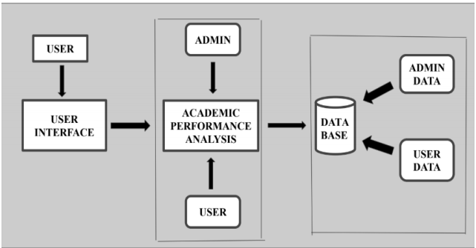
System Architecture:

Slide 7
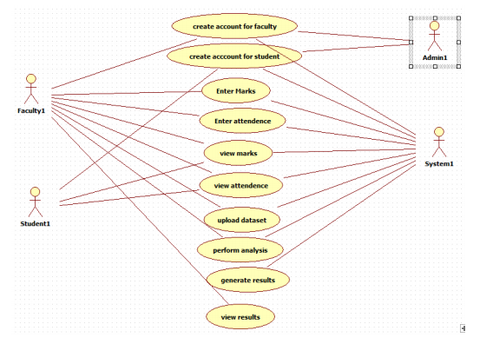
Use case Diagram:

Slide 8

HTML
It is easy to learn and easy to use.
It is platform-independent.
Images, videos, and audio can be added to a web page.
Hypertext can be added to the text.
It is a markup language.

Slide 9
Django
Excellent Documentation.
Python Web-framework.
High Scalability.
Versatile in Nature.
Offers High Security.
Thoroughly Tested.
Provides Rapid Development.

Slide 10
Python
Easy-to-learn − Python has few keywords, simple structure, and a clearly defined syntax. This allows the student to pick up the language quickly.
Interactive Mode − Python has support for an interactive mode which allows interactive testing and debugging of snippets of code.
Databases − Python provides interfaces to all major commercial databases.
Scalable − Python provides a better structure and support for large programs than shell
scripting.

Slide 11

Client-server architecture

Slide 12
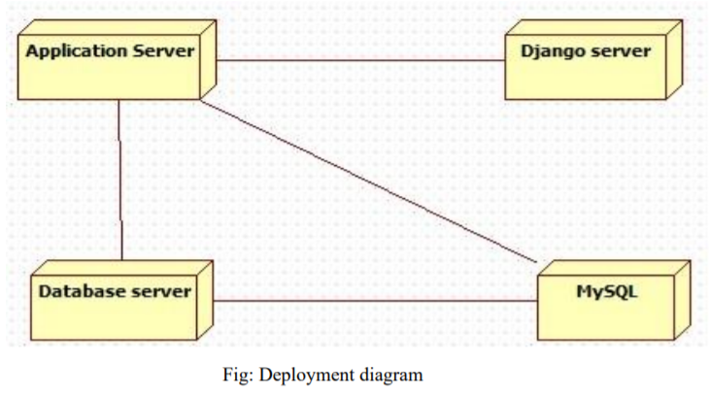

Slide 13
What is Machine Learning Algorithms?
Machine learning (ML) is the study of computer algorithms that can improve automatically through experience and by the use of data.
Which kind of algorithm works best (supervised, unsupervised, classification, regression, etc.) depends on the kind of problem you’re solving, the computing resources available, and the nature of the data.
Machine learning is an important component of the growing field of data science. Through the use of statistical methods, algorithms are trained to make classifications or predictions.

Slide 14
Linear Regression
It is a machine learning algorithm based on supervised learning. It performs a regression task.
It is used to estimate real values (cost of houses, number of calls, total sales etc.) based on continuous variable(s).
It establish relationship between independent and dependent variables by fitting a best line. This best fit line is known as regression line and represented by a linear equation Y= a *X + b

Slide 15
Support Vector Machine Algorithm:
It is a supervised machine learning algorithm which can be used for both classification or regression challenges.
In the SVM algorithm, we plot each data item as a point in n-dimensional space (where n is number of features you have) with the value of each feature being the value of a particular coordinate.
The idea of SVM is simple: The algorithm creates a line or a hyperplane which separates the data into classes.

Slide 16
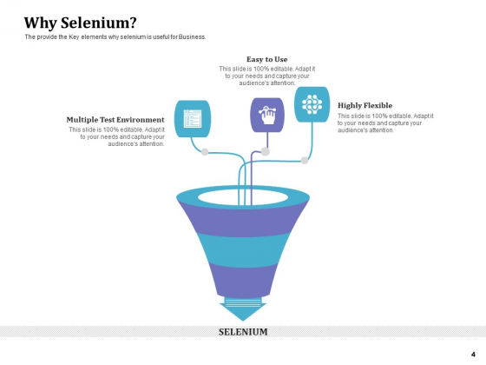

Slide 17
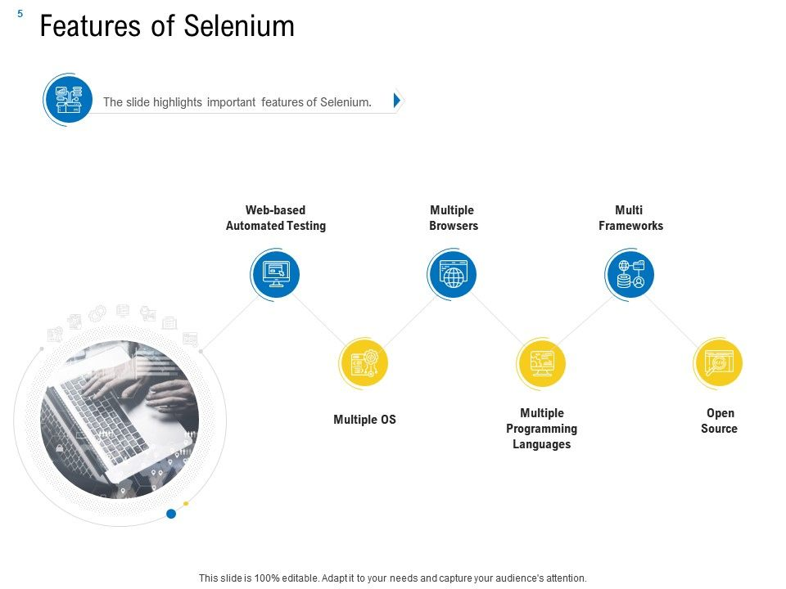

Slide 18
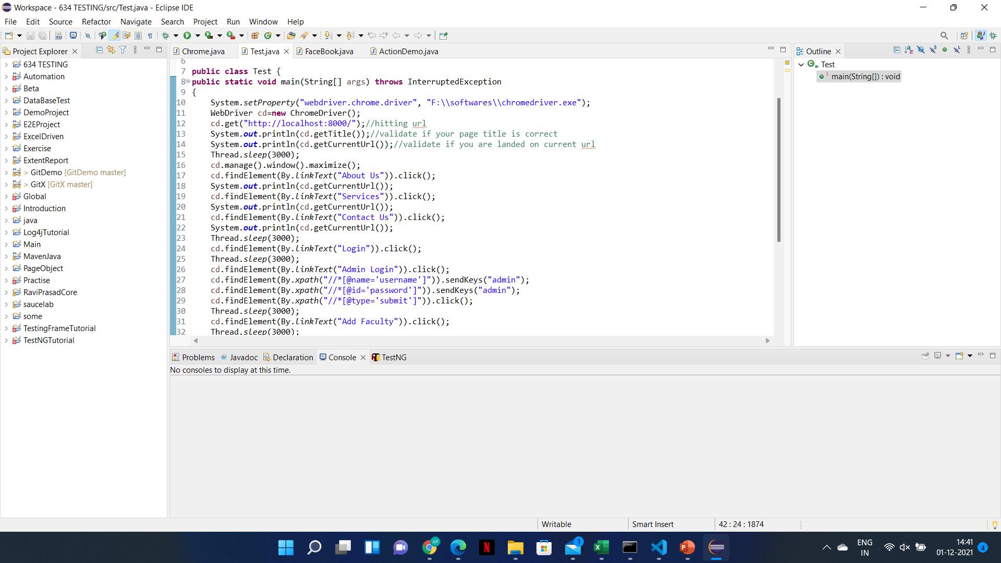

Slide 19
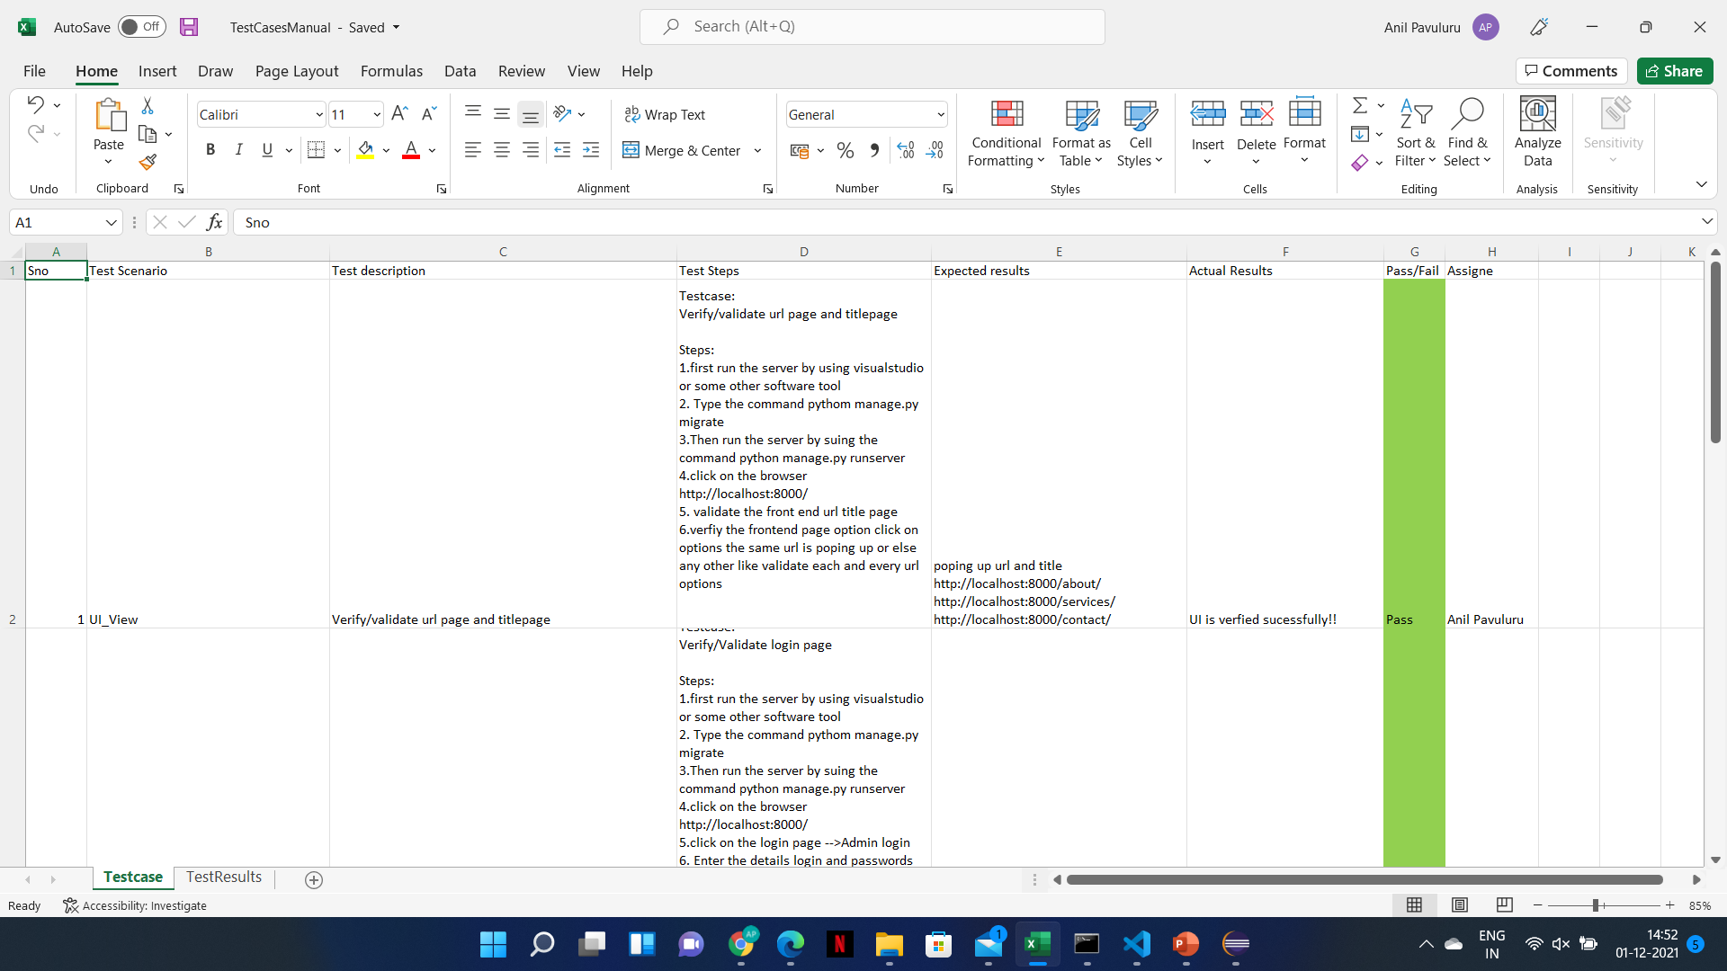

Slide 20
Conclusion:
This prediction algorithm serves as a good benchmark to monitor the progression of student’s performance in higher institution. It also enhances the decision making by academic instructors to monitor the candidate’s performance semester by semester by improving on the future academic results in the subsequence academic session. Thus, with the help of this Prediction algorithm the instructors develop a good understanding of how well or how poorly the students in their classes will perform so instructors can take proactive measures to improve student learning

Slide 21
Thank You

