Slide 1
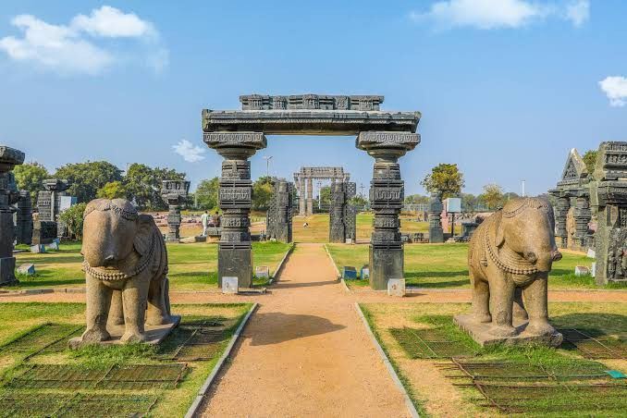

Slide 2

PROVIDING INSIGHTS TO TOURISM DEPARTMENT OF TELANGANA GOVERNMENT

Slide 3
PROBLEM STATEMENT
Telangana is one of India’s leading states and has published its tourism data under its open data policy.
As a Data Analyst, find the patterns in the given data, do additional research, and give data-informed recommendations to the Telangana government which can be used to increase their revenue by improving administrative operations.

Slide 4
DATA HIGHLIGHTS
Total Districts
33
Total Domestic Visitors
Total Foreign Visitors
356.34 Million
1 Million

Slide 5
Top 10 Districts Visited
DOMESTIC
FOREIGN
**Numbers indicated are in Millions**

Slide 6
Domestic Districts (CAGR)
TOP 3
BOTTOM 3

Slide 7
Foreign Districts (CAGR)
TOP 3
BOTTOM 3

Slide 8
Peak and Low months (Hyderabad)
DOMESTIC
FOREIGN
**Numbers are indicted as Millions**

Slide 9
Top & Bottom 3 districts with domestic-foreign tourist ratio
Top 3
Bottom 3

Slide 10
Tourist to Population Footfall Ratio
DOMESTIC
FOREIGN

Slide 11


Hyderabad’s Average Growth Rate
DOMESTIC
FOREIGN
-14 %
27 %

Slide 12
Hyderabad’s Domestic (Visitors vs Revenue Forecast 2025)
Revenue Insight considering each domestic user spend 1200/-
**Numbers are indicted as Billions**

Slide 13
Hyderabad’s Foreign (Visitors vs Revenue Forecast 2025)
Revenue Insight considering each foreign user spend 5200/-
**Numbers are indicted as Billions**

Slide 14
THANKING YOU

