Slide 1

Capstone Project
Prediction of potential client for personal Loan
By -
Panjab Singh

Slide 2
Content
Problem Statement
Methodology
EDA & Data preprocessing
Training Models
Models Summary
Feature Importance
Conclusion

Slide 3
Problem Statement
A popular bank in USA is offering personal loans and they have a team who is involved in cold calling people to identify prospective customers. Cold calling is a process of getting data from any source and calling prospect leads rigorously just to understand if anybody is interested to avail loan from the bank. This process is rigorous, Time & cost consuming. The bank is now planning to optimize the cost involved in cold-calling. We have to analyze the customer’s data to identify potential leads.
Objective
To analyze the data and build a machine learning model that predicts the potential clients for personal loan.

Slide 4
Feature Description
Cust_ID - Unique Customer ID
Gender - Gender of the applicant
DOB - Date of Birth of the applicant
LeadCreationDate - Date on which Lead was created
City_Code - Anonymised Code for the City
City_feature - Anonymised City Feature
Employee_No - Anonymised Code for the Employer
Employer_type1 - Anonymised Employer Feature
Employer_type2 - Anonymised Employer Feature
Income - Monthly Income in Dollars
Existing_bank_code - Anonymised Customer Bank Code
ExistingBankType - Anonymised Bank Feature
Contacted - Contact Verified (Y/N)
Source - Categorical Variable representing source of lead
Source_Cat - Type of Source
Existing_EMI - EMI of Existing Loans in Dollars
Loan_Amount - Loan Amount Requested
Loan_Period - Loan Period (Years)
Interest_Rate - Interest Rate of Submitted Loan Amount
EMI - EMI of Requested Loan Amount in dollars
Feature1 - Anonymized Categorical variable with multiple levels
Approved (Target) - Whether a loan is Approved or not

Slide 5
Methodology
Data reading using pandas library
EDA & data preprocessing
Missing value Imputation , Duplicated entries
Univariate & bi-variate Analysis using matplotlib , seaborn library
Multicollinearity test
Label encoding,Standardization
Model Training
Logistic regression
SVM
Random Forest
KNN
Model Evaluation
Accuracy , F1 score , Recall , Precision , Roc curve
Models accuracy comparison
Plot of train test accuracy using matplotlib

Slide 6
EDA & Preprocessing

Slide 7
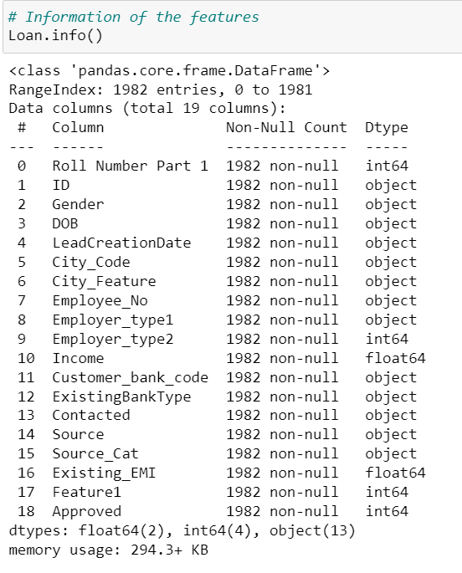
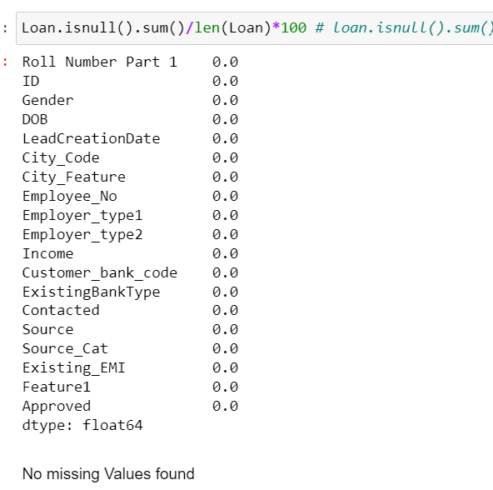
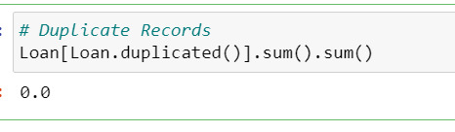
Data Information

Slide 8
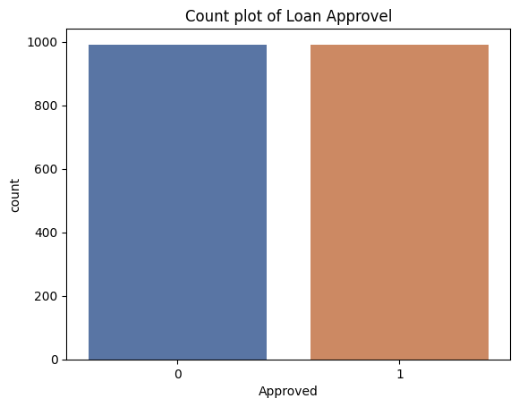
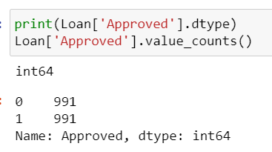
Target variable - Approved (0,1)

Slide 9
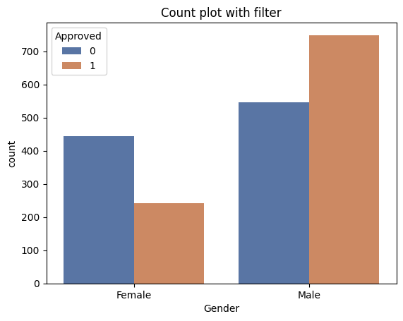
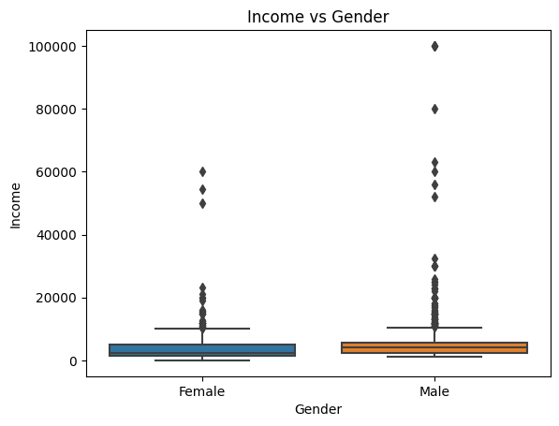
Gender

Slide 10
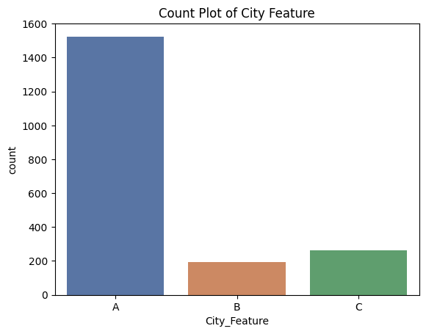
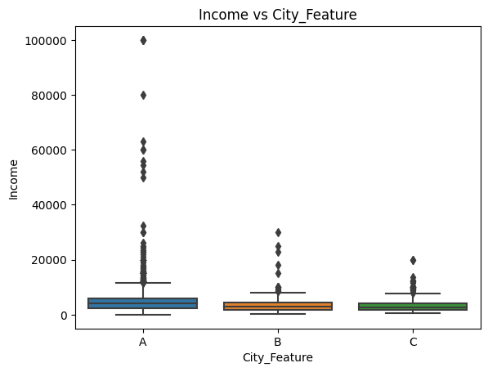
City Feature

Slide 11
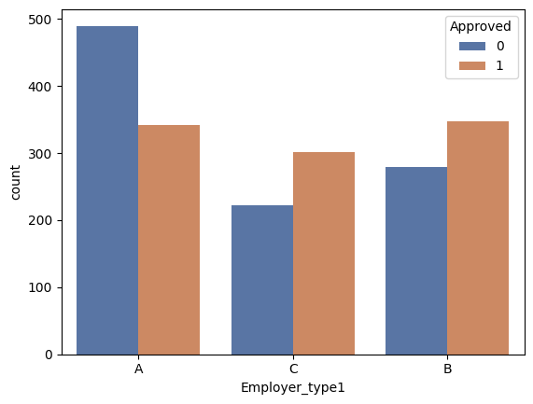
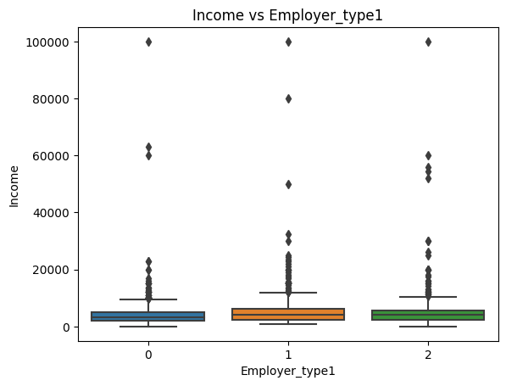
Employe Type1

Slide 12
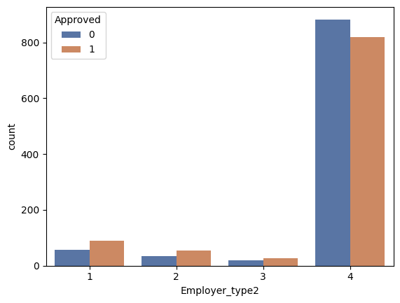
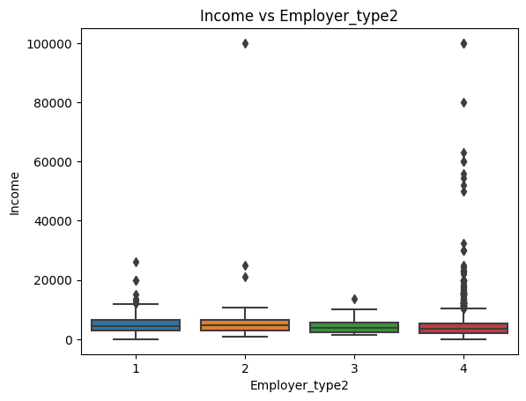
Employe type2

Slide 13
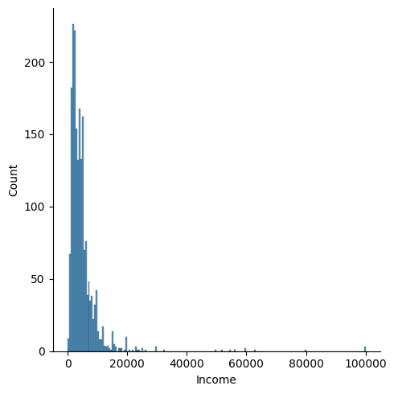
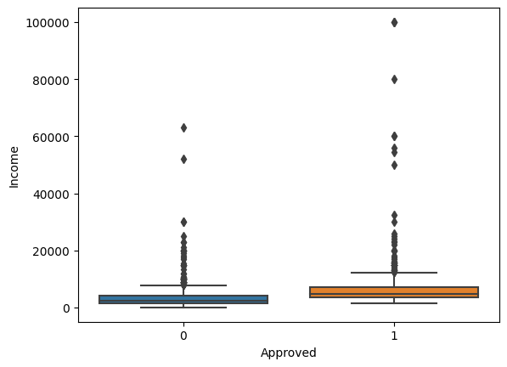
Income

Slide 14
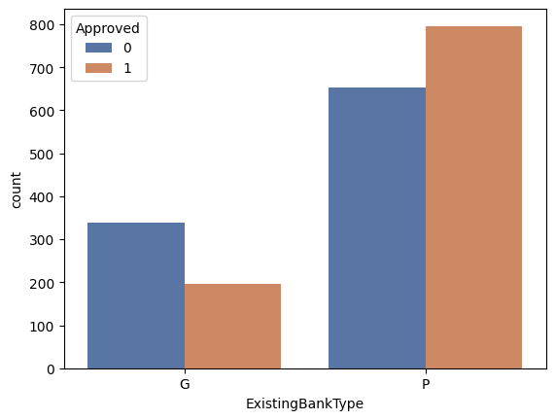
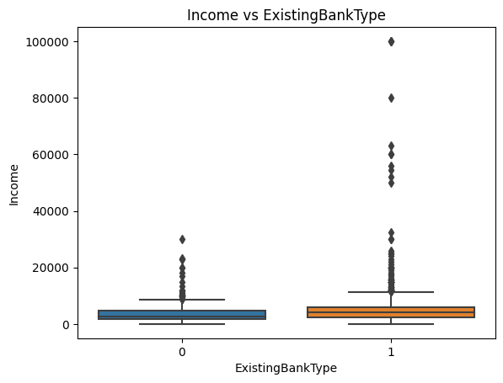
Existing Bank Type

Slide 15
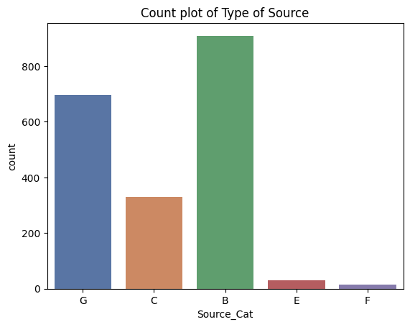
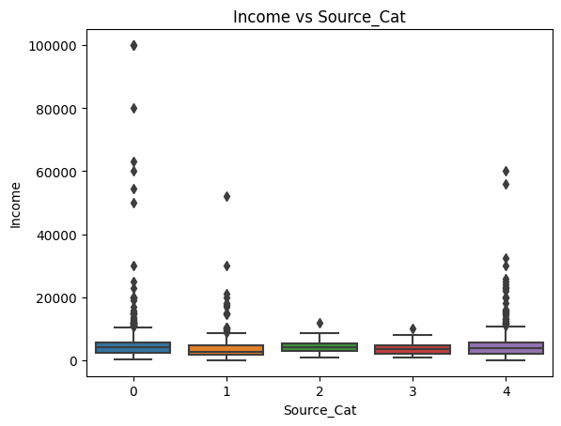
Type of Source

Slide 16
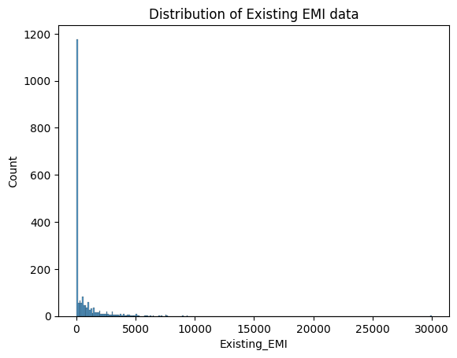
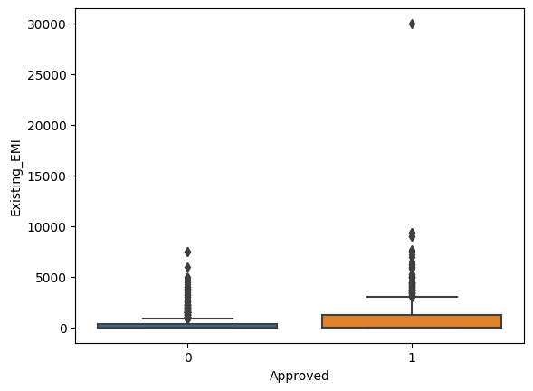
Existing EMI

Slide 17
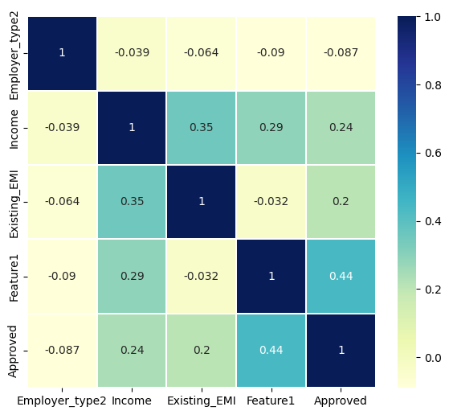
Correlation Matrix

Slide 18
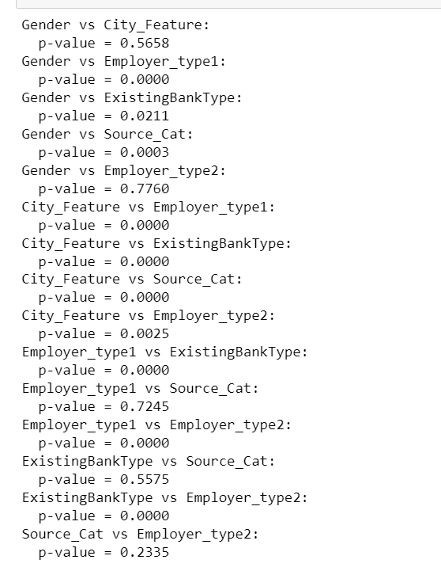
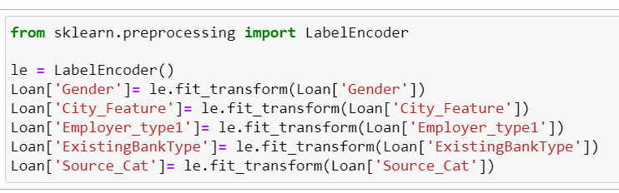
Label encoding & Multicollinearity
A low p-value (less than 0.05) suggests that there may be a significant association between the two variables, and therefore, there may be multicollinearity between them.

Slide 19
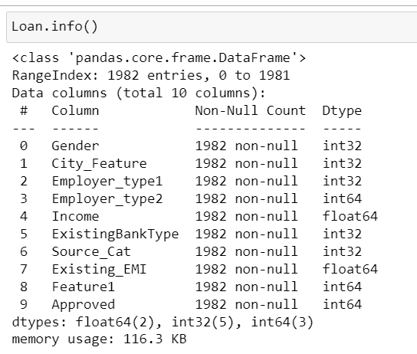
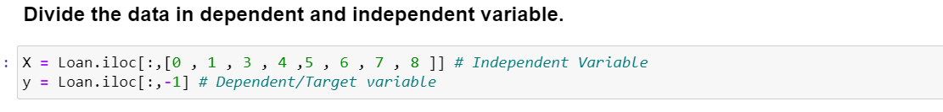
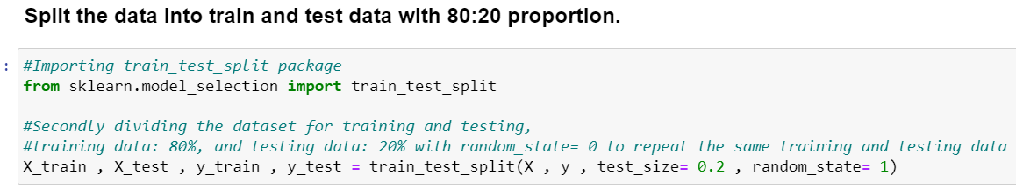
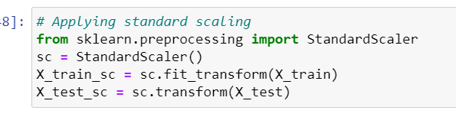
Selected data

Slide 20
Predictive Analysis (Classification)

Slide 21
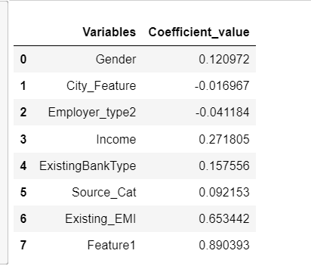
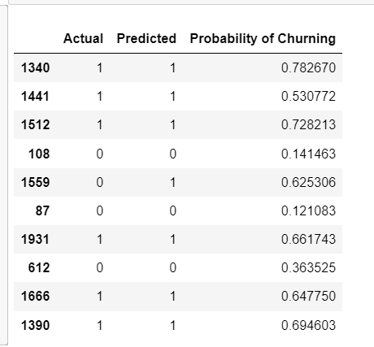
Logistic Regression
Accuracy=74

Slide 22
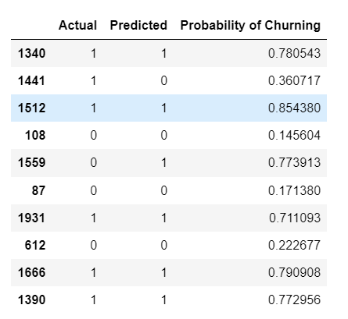
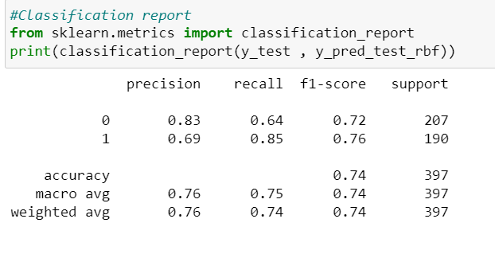
SVM
Accuracy = 74 %

Slide 23
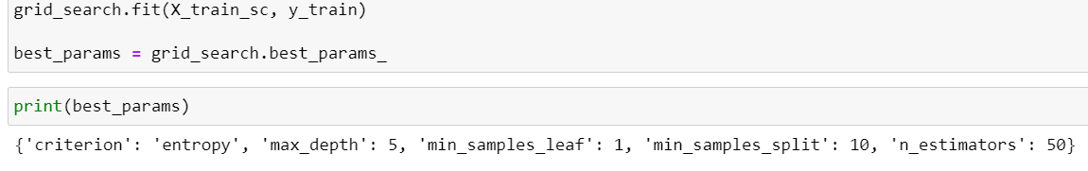
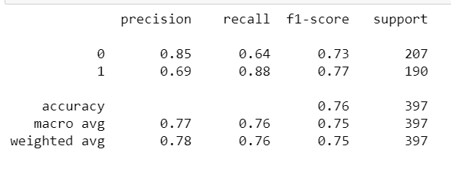
Random Forest
Accuracy - 76

Slide 24
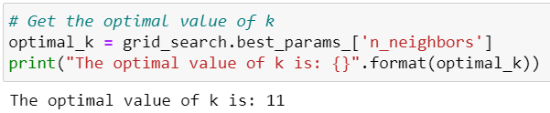
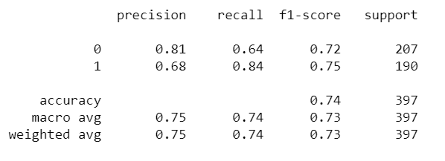
KNN
Accuracy - 74

Slide 25
Model Summary

Slide 26
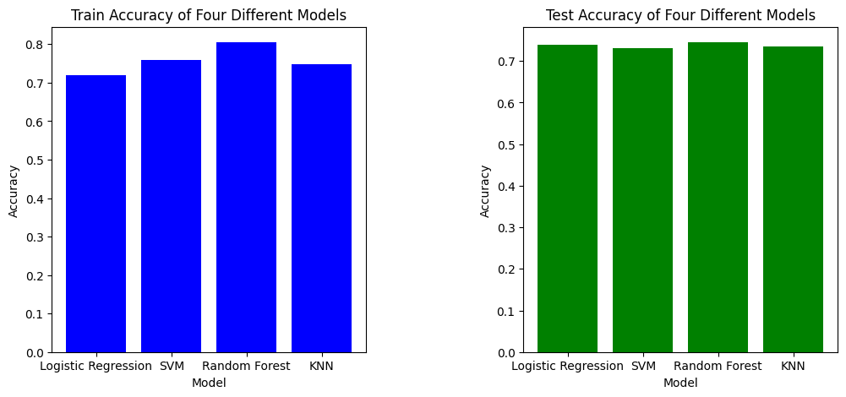
Accuracy comparison

Slide 27
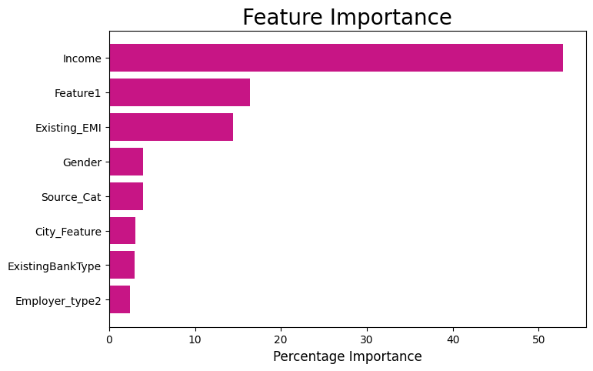
RF Feature Importance

Slide 28
Conclusion

Slide 29
The Loan Approved dataset was analyzed using four classification models, including Logistic Regression, Support Vector Machine, Random Forest and KNN. Among these models, the Random Forest model demonstrated the best performance in terms of accuracy, with an accuracy rate of 76%.
However, it is important to note that the model's accuracy is not perfect, and there may be other factors beyond the dataset's features that could influence loan approval decisions. Additionally, the model's performance should be further evaluated on unseen data to ensure that it can generalize well.

Slide 30
Thank you!

