Slide 1

SmartDoc
Namana Vineesha
Panja Tulasi
Mosalikanti Sita Varshini
Gadey Sravani

Slide 2
Introduction
Now-a-days everyone is busy with their works, they don’t even have time to go to the hospital to book an appointment and wait until their appointment.
We are here with Hospital Appointment Booking System - “SmartDoc”.
This website allows the patient to book his appointment online as per his schedule and necessity.

Slide 3
Technologies
Frontend :
Angular
HTML
CSS
Bootstrap
JavaScript
Backend :
RestAPI
Hibernate
MySQL
Apache Tomcat

Slide 4
Modules
Patient - Book Appointment
Patient – Previous Records
Patient – Reports
Doctor – Accept/Cancel Appointments
Doctor – Search Patient Records
Assistant – Upload Reports

Slide 5
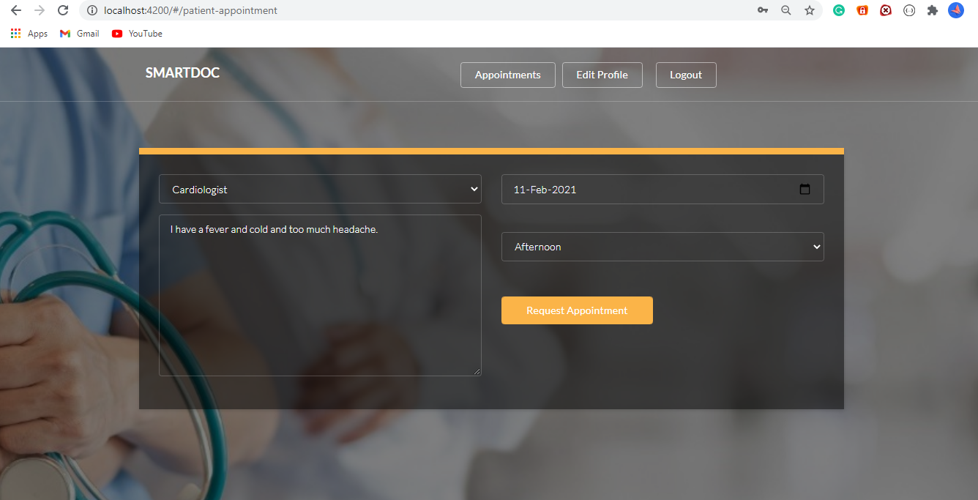
Patient – Book Appointment

Slide 6
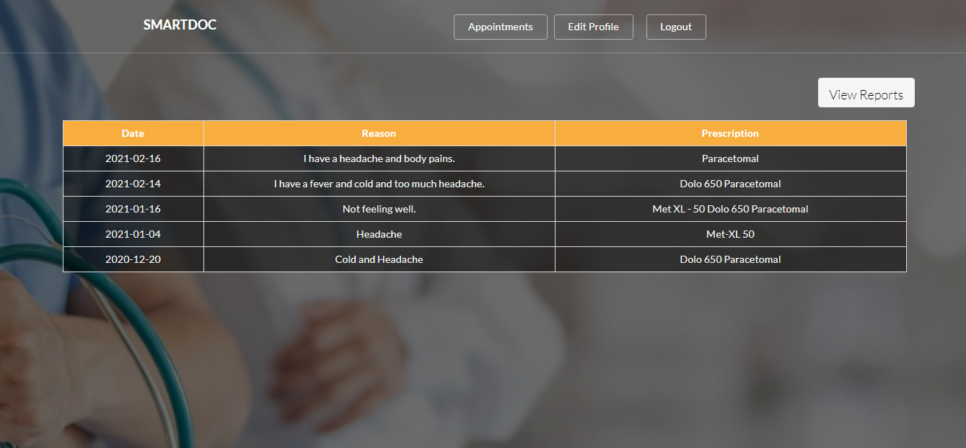
Patient – Previous Records

Slide 7
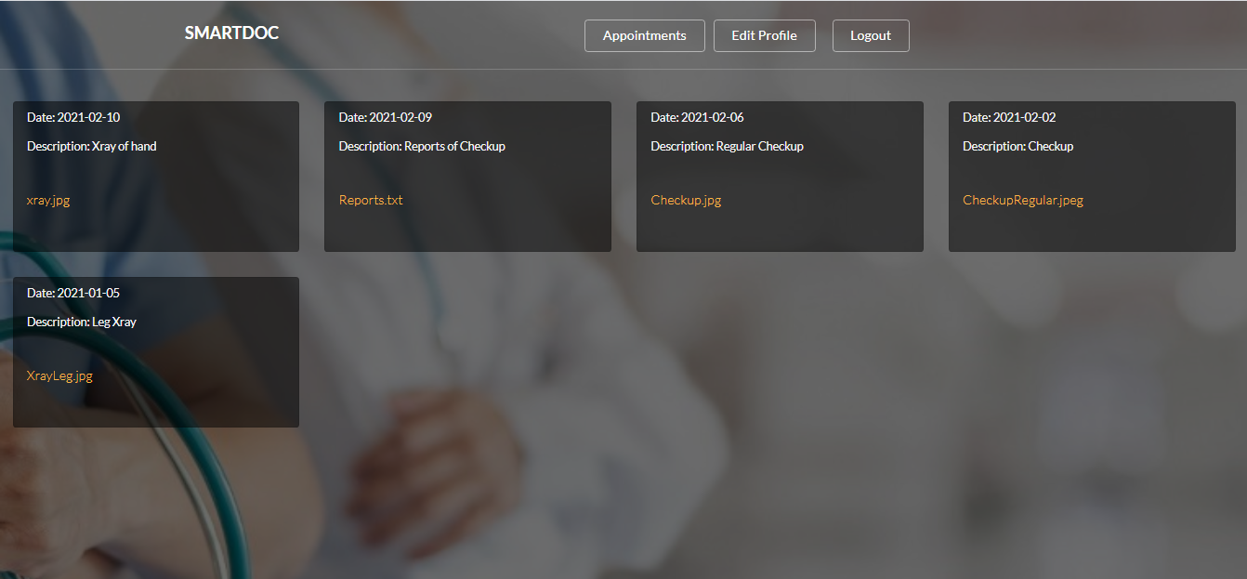
Patient – Reports

Slide 8
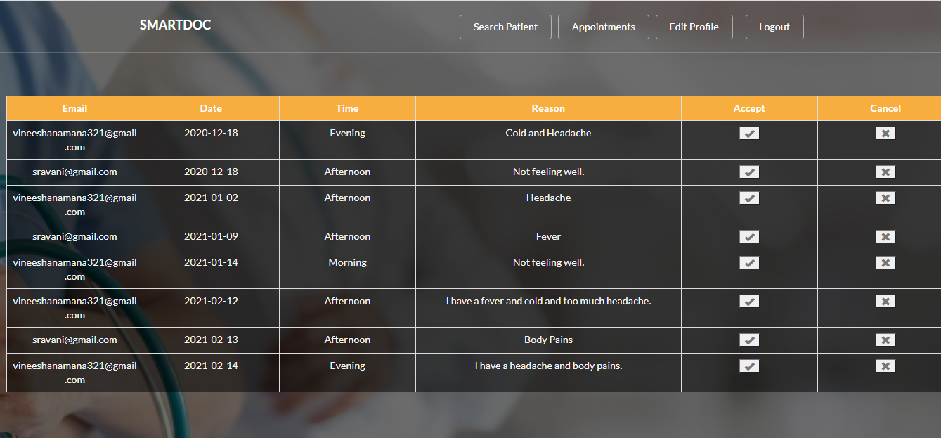
Doctor – Accept/Cancel Appointments

Slide 9
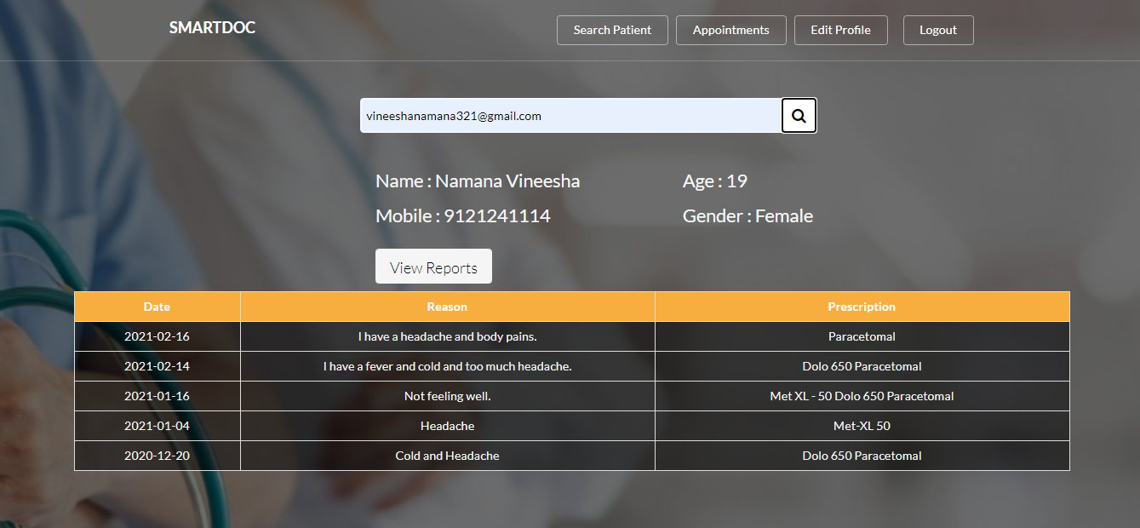
Doctor – Search Patient Records

Slide 10
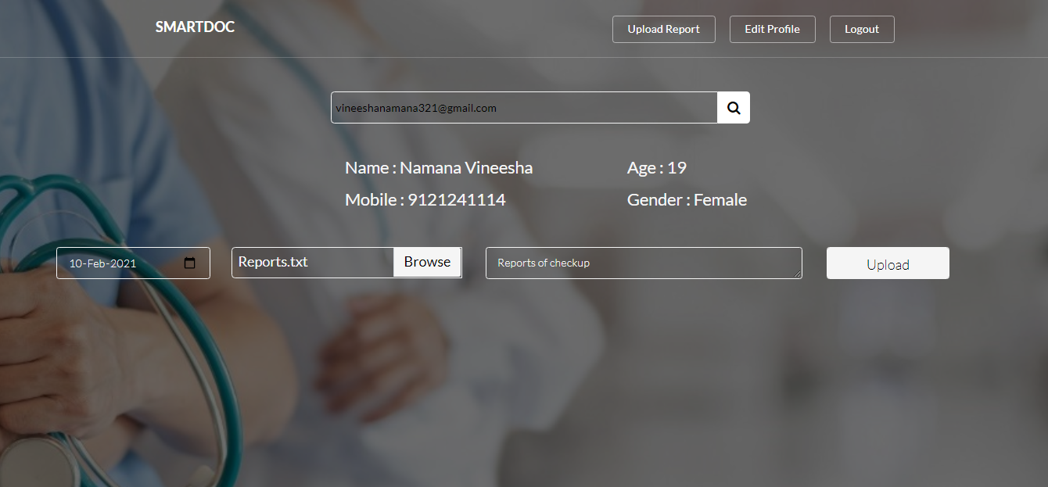
Assistant – Upload Report

Slide 11
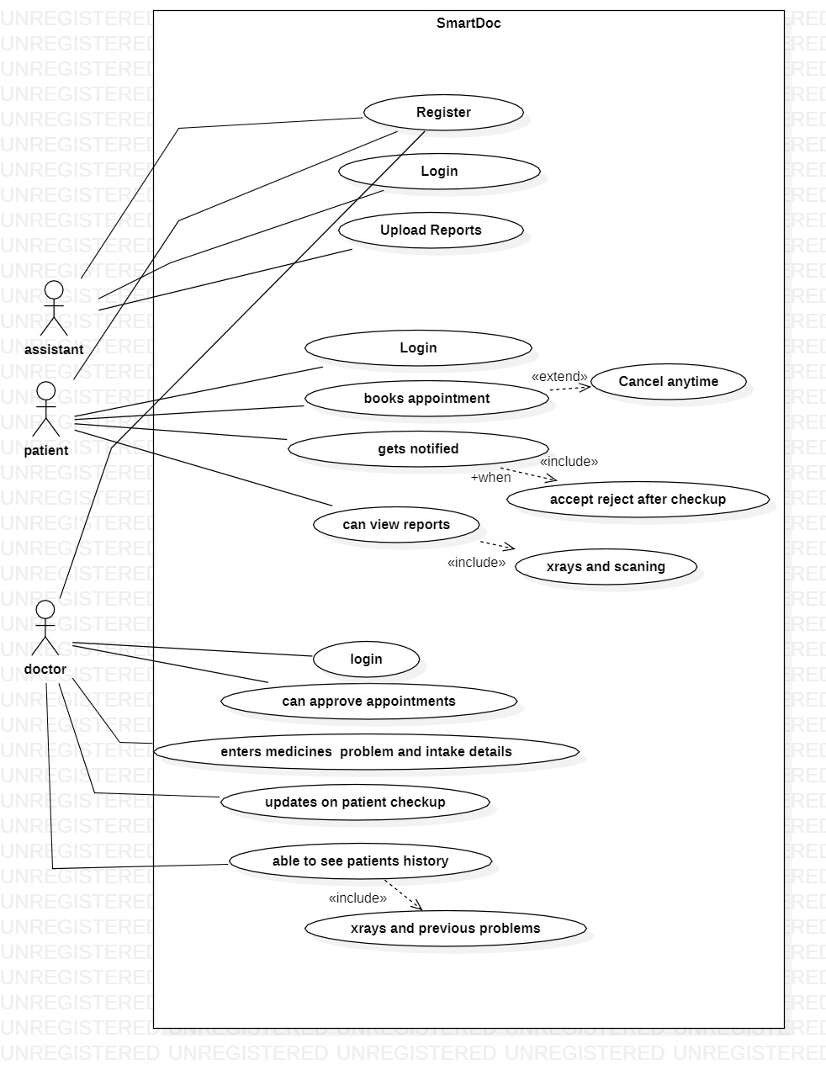
Use Case Diagram

Slide 12
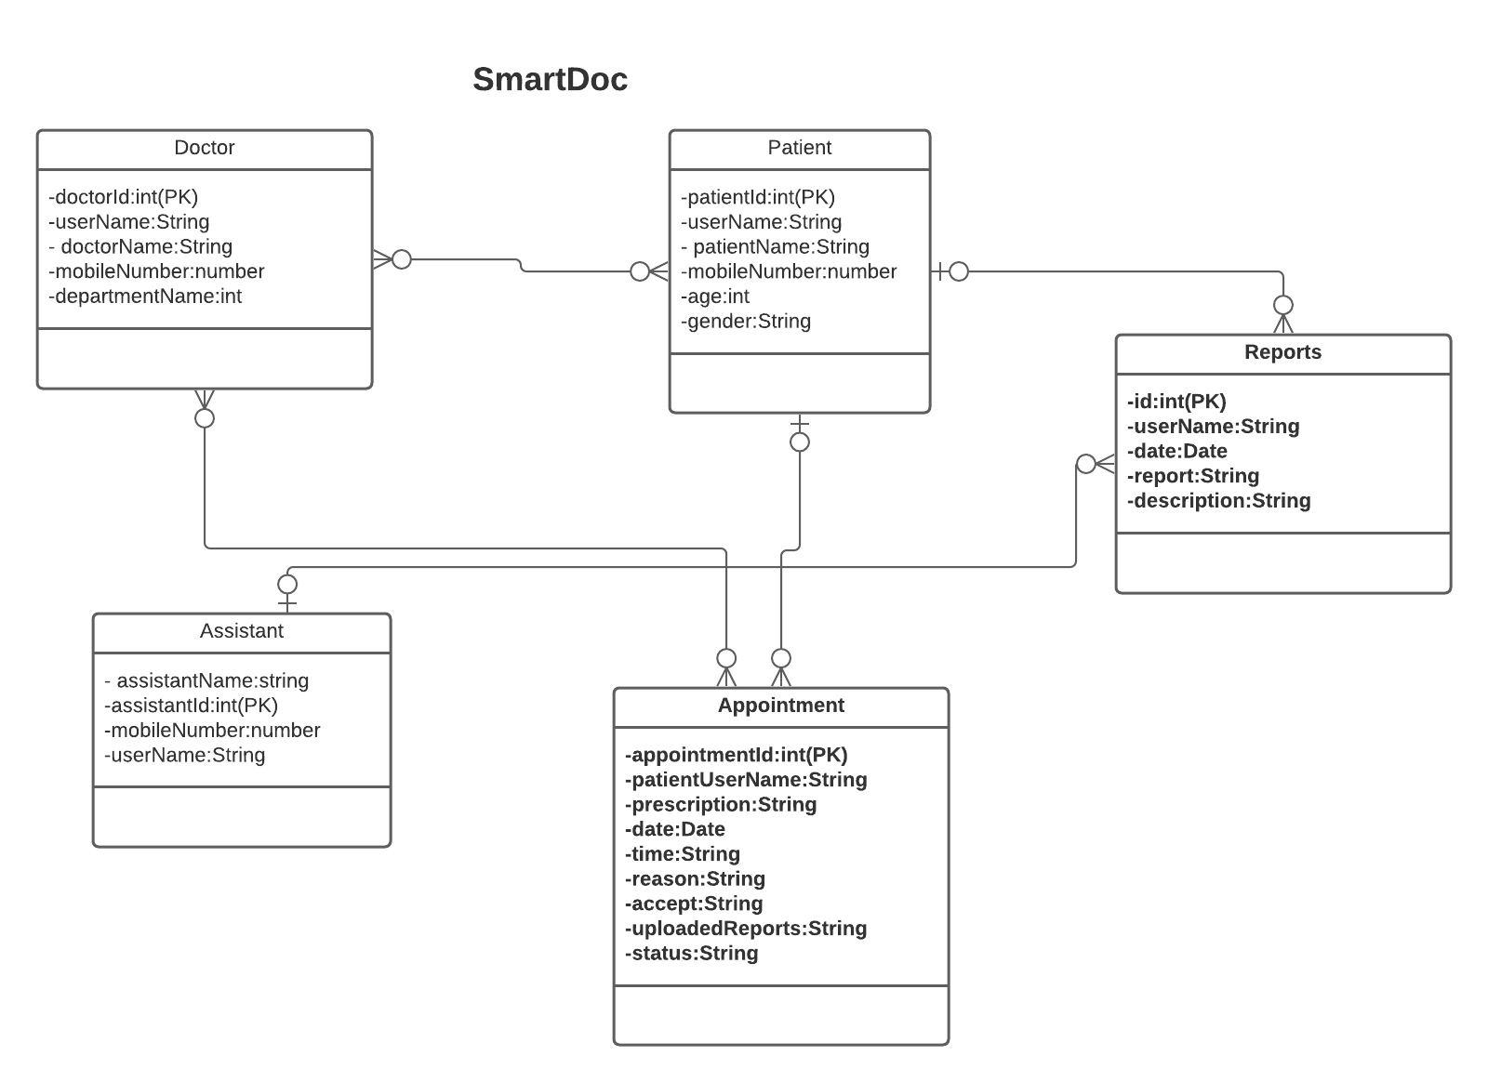
ER Diagram

Slide 13
Challenges Faced
Faced many issues with JavaScript code inside HTML.
Writing methods in TypeScript.
Connecting Angular to RestAPI and RestAPI to MySQL.

Slide 14
Challenges Overcome
Team Work.
With the help of our Trainers
Mr. Pasha
Mr. Harsha
Searching in Google, StackOverflow & YouTube.

Slide 15
THANK YOU

