Slide 1
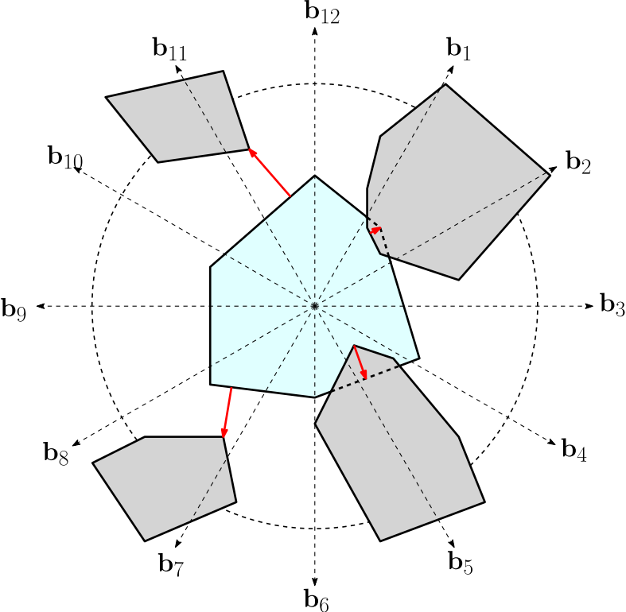
Predicting Initialization Effectiveness for Trajectory Optimization
Jia Pan and Zhuo Chen and Pieter Abbeel
EECS, University of California, Berkeley
Goal: Predict whether a trajectory optimization motion planning algorithm can find a collision-free solution using a given initial trajectory
Approach: Formulate as a two-class classification problem on initial trajectories
Prior work on trajectory optimization was sensitive to the choice of initial guesses and may get stuck in local optima that are not collision-free
Design features that capture the obstacle distribution locally around a robot’s trajectory and can generalize across different tasks
Results show that the machine learning based prediction can accurately predict a trajectory’s effectiveness as an initialization on different tasks in various benchmarks
Features capturing the local obstacle distribution: signed distances between a robot link and obstacles are summarized along discretized directions

