Slide 1
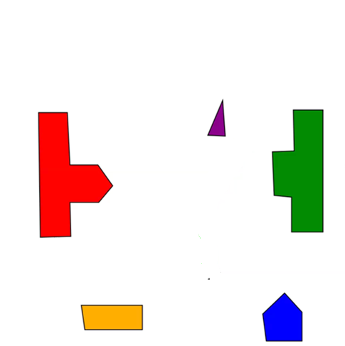

initial
initial
goal
goal
Workspace
Configuration space

