Slide 1
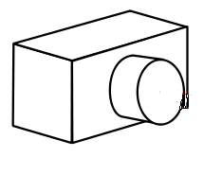
Camera
pixel
Image Space
Ray Packet 1
Ray Packet 2

