Slide 1
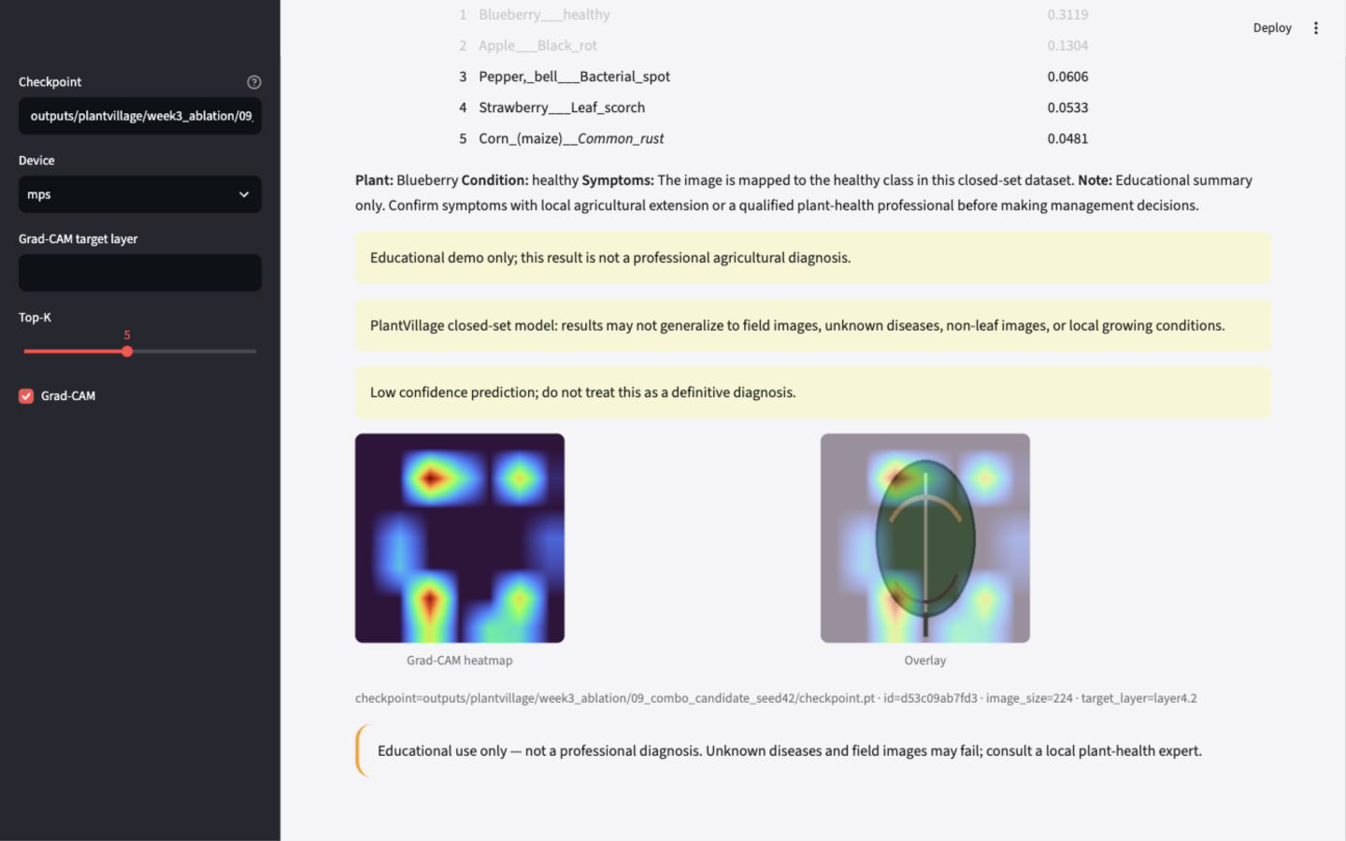
RESEARCH DEMO · PLANTVILLAGE
Evidence before
diagnosis.
Reproducible classifier, explainability audit, deployable demo, and an exploratory VLM boundary test.
Educational closed set · not field diagnosis
Evidence map: docs/week7_evidence_map.md
01
Notes:
5-minute talk track: Open with the gap between a compelling disease demo and a credible evidence chain. This project is intentionally presented as a research and educational system, not a crop doctor.
10-minute talk track: Frame the communication job: make every result traceable, keep the controlled-dataset boundary visible, and treat the attractive product moment as the end of an evidence chain rather than the starting point.
Integrity reminder: cite the evidence path on the slide and do not extend these results to field diagnosis.

Slide 2
CLASSIFIER-FIRST SYSTEM
The model is only one link in the evidence chain.
VERIFIED CLASSIFIER MAIN LINE
Data
Audit
Train
Evaluate
Explain
Serve
split · EDA
shared protocol
metrics · speed
Grad-CAM
Top-5 · demo
BOUNDED CONTEXT
Shared labels · preprocessing · evidence trail
The classifier remains complete without the VLM.
VLM
Exploratory
Secondary branch—not part of the classifier proof chain.
Architecture contract: docs/week7_showcase_architecture.md
02
Notes:
5-minute talk track: Walk the verified classifier main line from audited data through serving, then point down to the amber VLM branch as a bounded exploratory extension rather than the next pipeline stage.
10-minute talk track: Explain the stable interfaces. Training, evaluation, inference, and Streamlit reuse label and preprocessing contracts, so the classifier proof chain is complete at Serve. Only then introduce the dashed amber VLM branch: it consumes bounded classifier context, remains exploratory, and does not replace or extend the classifier evidence claim.
Integrity reminder: cite the evidence path on the slide and do not extend these results to field diagnosis.

Slide 3
DATA AUDIT
The official split is useful—and not entity isolated.
227
Safe interpretation
overlapping leaf_id values across train and test
Strong official-split results support controlled comparisons.
They do not prove leakage-free entity separation or field generalization.
Evidence: reports/data_audit.md · outputs/plantvillage/audit.json
03
Notes:
5-minute talk track: Lead with the 227 overlap finding. It changes the wording of every downstream metric without making the official split useless for model comparison.
10-minute talk track: Describe the audit process and distinction between sample-level and entity-level isolation. The safe conclusion is comparative performance under the published split, not real-field reliability or strict leakage freedom.
Integrity reminder: cite the evidence path on the slide and do not extend these results to field diagnosis.

Slide 4
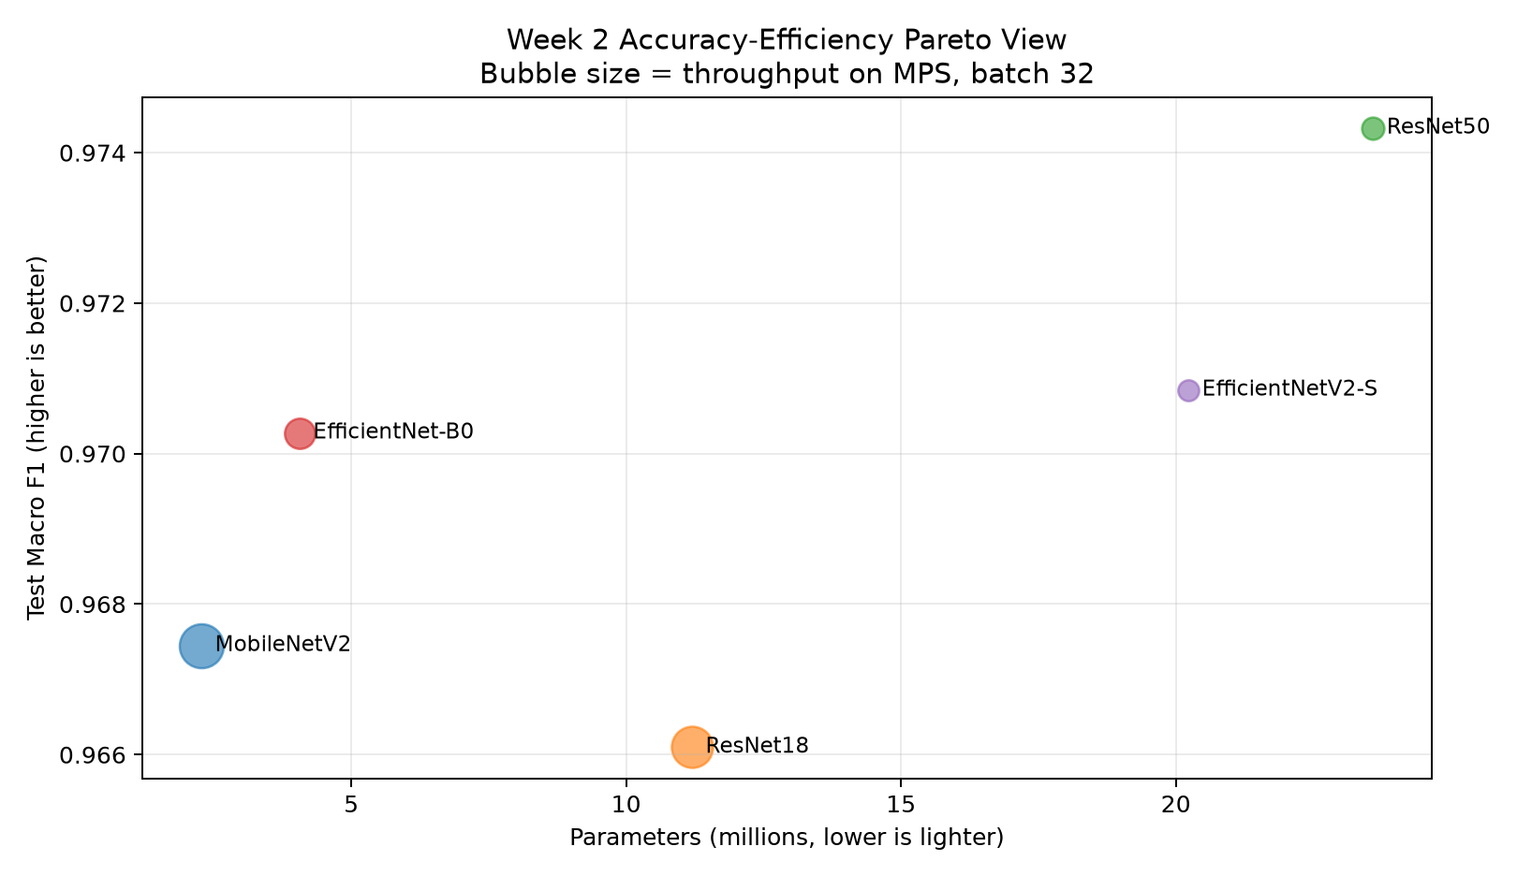
WEEK 2 BENCHMARK
Accuracy and deployability need different winners.
ResNet50
0.9830
best accuracy candidate
MobileNetV2
2.27M · 0.31G
lightweight deployment candidate
Evidence: reports/week2_benchmark_progress.md · official split, shared protocol
04
Notes:
5-minute talk track: Use the Pareto view to show why one model cannot answer both research accuracy and lightweight deployment questions.
10-minute talk track: ResNet50 reached 0.9830 test accuracy and 0.9743 Macro F1. MobileNetV2 offered 2.27 million parameters, 0.31G FLOPs, and measured batch-32 MPS throughput of 644.3 images per second excluding preprocessing.
Integrity reminder: cite the evidence path on the slide and do not extend these results to field diagnosis.

Slide 5
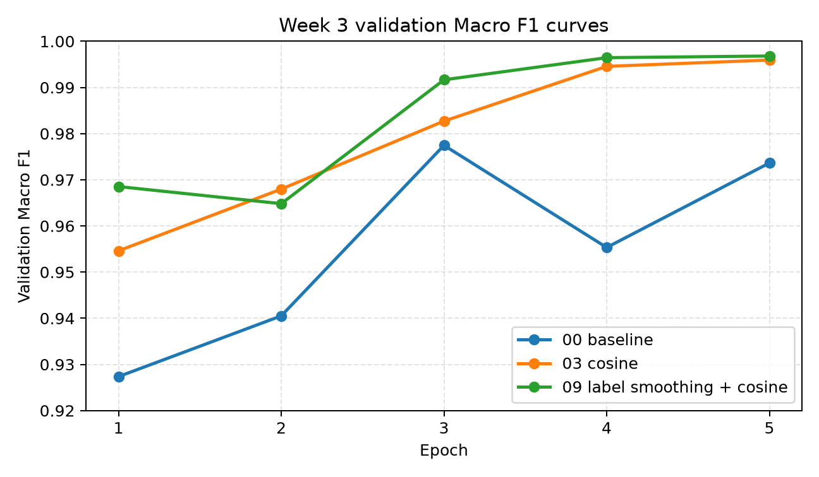
WEEK 3 DECISION
Controlled ablation selected the final classifier.
0.9953
Test Accuracy
0.9941
Macro F1
ResNet50 + Label Smoothing + Cosine Scheduler
Evidence: reports/week3_final_model_decision.md · seed 42 · official split
05
Notes:
5-minute talk track: Show that the final model was selected by a controlled ablation program rather than by a single lucky score.
10-minute talk track: The selected ResNet50 combines label smoothing and a cosine schedule. Accuracy 0.9953 and Macro F1 0.9941 are a seed-42 official-split result and inherit the documented split limitation.
Integrity reminder: cite the evidence path on the slide and do not extend these results to field diagnosis.

Slide 6
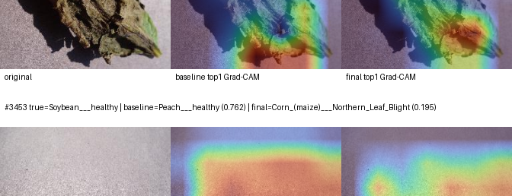
WEEK 4 EXPLAINABILITY
Grad-CAM shows relevance, not causality.
24
fixed samples
Localization aid
≠ causal proof
Evidence: reports/week4_consistency_audit.md · 24 fixed Grad-CAM samples
06
Notes:
5-minute talk track: Compare baseline and final attention patterns while keeping the interpretation boundary explicit: the heatmap shows relevance to a prediction, not a causal biological explanation.
10-minute talk track: The Week 4 atlas fixes 24 samples across correct and incorrect, high- and low-confidence groups. It also includes error analysis, attention review, and reproducibility checks so attractive examples are not cherry-picked.
Integrity reminder: cite the evidence path on the slide and do not extend these results to field diagnosis.

Slide 7
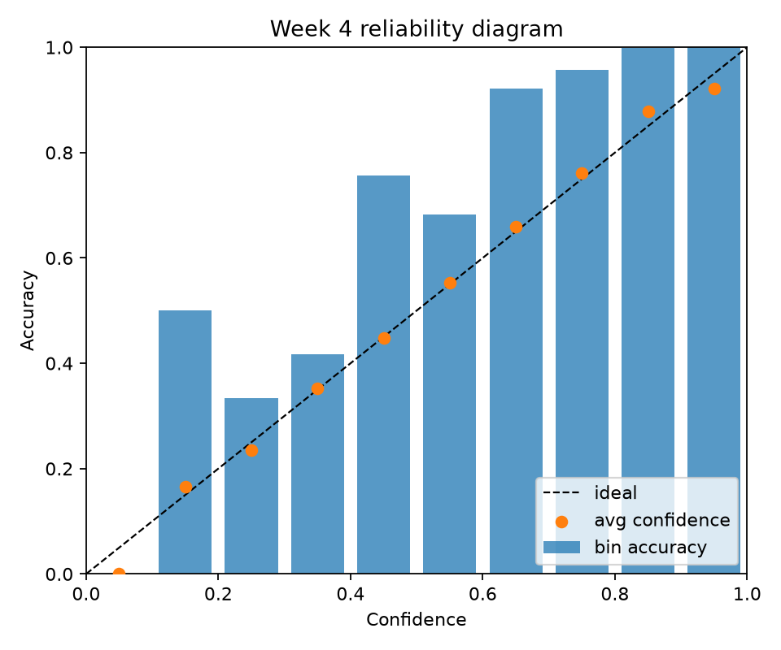
CALIBRATION
High accuracy still needs confidence auditing.
0.0965
ECE
0.3348
MCE
0.0140
Brier
Top-label calibration only
Evidence: reports/week4_calibration.md · outputs/plantvillage/week4_explainability/calibration.json
07
Notes:
5-minute talk track: Use the reliability diagram to separate correctness from confidence quality. High accuracy does not guarantee well-calibrated probabilities.
10-minute talk track: Report ECE 0.0965, MCE 0.3348, and Brier 0.0140 as top-label calibration metrics. This is not full multiclass calibration and should not be presented as a guarantee for high-stakes decisions.
Integrity reminder: cite the evidence path on the slide and do not extend these results to field diagnosis.

Slide 8
WEEK 5 DEMO
The same serving layer powers the product moment.
Top-5
probabilities with shared labels
Grad-CAM
fixed-example evidence path
129.8 ms
Apple container fixed-example total
Evidence: outputs/plantvillage/week5_demo/container_e2e.json · one sample, not a benchmark
08
Notes:
5-minute talk track: Connect engineering evidence to the product experience: the same serving layer drives the local app and Apple container flow with Top-5 and Grad-CAM.
10-minute talk track: The 129.8 millisecond figure is one CPU-only Apple container fixed-example total, not a latency distribution. Keep the educational closed-set warning visible and avoid MPS claims inside the container.
Integrity reminder: cite the evidence path on the slide and do not extend these results to field diagnosis.

Slide 9
WEEK 6 QWEN3-VL SMOKE
Prompt constraints reduced format risk, not disease ambiguity.
Original
0/15
Short
10/15
Choice
11/15
Few-shot choice
11/15
1/5
Condition best
Evidence: reports/week6_vlm_prompt_compare.md · 5 images / 15 questions · MLX 4-bit smoke
09
Notes:
5-minute talk track: Show the progression from unconstrained to choice-based prompts. Format compliance and risk-word flags improved, but condition recognition stayed weak.
10-minute talk track: Original scored 0 of 15, short 10 of 15, choice 11 of 15, and few-shot choice 11 of 15. Plant and health-status questions drove the gains; disease condition remained at best 1 of 5.
Integrity reminder: cite the evidence path on the slide and do not extend these results to field diagnosis.

Slide 10
PROTOTYPE SAFETY
A safe assistant knows when to stop.
Educational summary
SUMMARY
bounded classifier context
High-risk refusal
STOP
no pesticide or dosage advice
Low-confidence refusal
PAUSE
uncertainty stays visible
Out-of-scope refusal
BOUNDARY
non-leaf input is rejected
Evidence: reports/week6_vlm_assistant.md · outputs/plantvillage/week6_vlm/vlm_assistant_demo.json
10
Notes:
5-minute talk track: Treat refusal as a capability, not an error. The prototype only summarizes bounded educational evidence when confidence and scope allow it.
10-minute talk track: Walk through the four tested actions: educational summary, high-risk refusal, low-confidence refusal, and out-of-scope refusal. It does not provide pesticide, dosage, regulatory, or professional diagnostic guidance.
Integrity reminder: cite the evidence path on the slide and do not extend these results to field diagnosis.

Slide 11
EVIDENCE LEDGER
Verified, smoke-tested, and pending are different states.
VERIFIED
SMOKE-TESTED
PENDING
Classifier pipeline
Qwen3-VL prompts
LoRA / QLoRA
Benchmark + ablation
Safety-bounded assistant
Manual VQA audit
Grad-CAM + calibration
5-image VQA comparison
Field validation
Local/container demo
MLX 4-bit inference
Entity-isolated study
Status source: TASKS.md · docs/week7_evidence_map.md
11
Notes:
5-minute talk track: Pause on the distinction between verified, smoke-tested, and pending. This vocabulary prevents a pipeline check from becoming an inflated research claim.
10-minute talk track: Classification, explainability, and demo work have direct evidence. Qwen and the assistant are smoke-tested prototypes. LoRA, per-entry manual VQA audit, field validation, and an entity-isolated study remain pending.
Integrity reminder: cite the evidence path on the slide and do not extend these results to field diagnosis.

Slide 12
WEEK 8 HANDOFF
Credible AI needs
evidence and limits.
Reproduce.
Audit.
Release honestly.
Next: clean-environment reproduction · artifact audit · final publication decision
Handoff: TASKS.md · docs/artifact-index.md · reports/week7_public_release_check.md
12
Notes:
5-minute talk track: Close by resolving the opening: the strongest contribution is the evidence chain and the discipline to state its limits.
10-minute talk track: Week 8 should add no major feature. Reproduce in a clean environment, audit public artifacts and claims, correct any drift, and make a deliberate release decision without overstating field or VLM capability.
Integrity reminder: cite the evidence path on the slide and do not extend these results to field diagnosis.

