Slide 1

Capstone Project
Airbnb Bookings Analysis
By
Data Science Trainee, AlmaBetter
Bengaluru, India
Siddhartha Pasayat
Pankaj Beldar

Slide 2

Airbnb, as in “Air Bed and Breakfast,” is a service that allows property owners to rent out their spaces/condos to travelers looking for a place to stay.
Airbnb was started in 2008 by Brian Chesky and Joe Gebbia, based in San Francisco California.The platform is accessible via website and mobile app.
Introduction
Key Takeaways
Peer to Peer (Economy Model)
Customization(Experiences)

Slide 3
Since 2008, guests and hosts have used Airbnb to expand on traveling possibilities and present a more unique, personalized way of experiencing the world.
These millions of listings generate a lot of data - data that can be analyzed and used for security, business decisions, understanding of customers' and providers' (hosts) behavior and performance on the platform, guiding marketing initiatives, implementation of innovative additional services.
Problem Statement
Key Takeaways
Customer/Hosts Behaviour
Marketing Initiatives
Additional Services

Slide 4
DataSets
id
unique listing id
neighbourhood_group
group of area
Key Takeaways
name
represents accommodation
neighbourhood
area under neighbourhood group
48895 x 16
Null values:
a) name = 16
b) host_name = 21
c) last_reviews = 10052
d) reviews_per_month= 10052
host_id
unique id for hosts
latitude
location of listing
longitude
location of listing
host_name
registered name for hosts
minimum _nights
minimum nights stay required for single visit
reviews _per_month
ratings received per month
price
price of listing
number_of_reviews
total rating count of listings
last_reviews
last review given
availability_365
Number of days for which host is available in a year
room_type
3 unique rooms
calculated_host_listing_counts
total number of listings registered under hosts

Slide 5
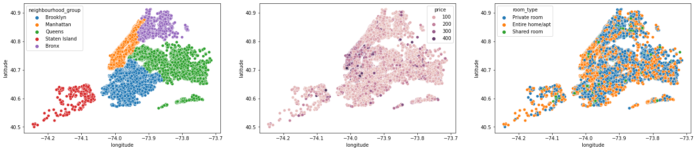
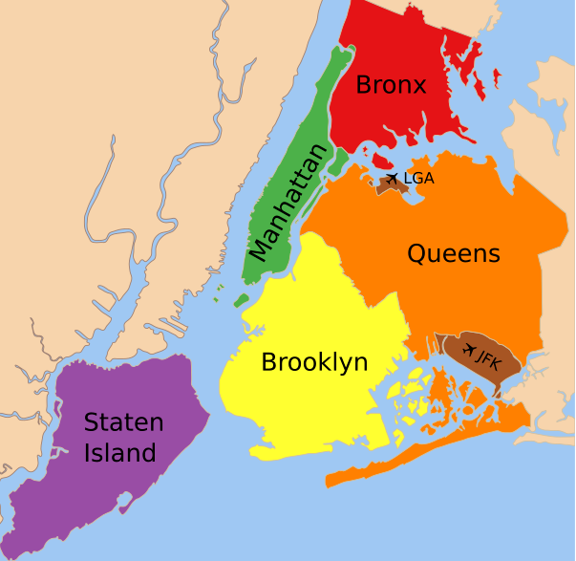
New York City Map
Key Takeaways
Location of various neighbourhood
Demographic distribution
Area wise presence

Slide 6
Which is the prefered location according to average best price?
Where are most of the hosts located?
The highest and lowest rent paying locations by customers
Most Popular/demanded host based on reviews and availability 365 days
Establishing relation between neighbourhood group and availability of rooms.
Which are the top hosts, neighbourhoods, neighbourhood groups based on their turnover?
Room type selection based on price, availability on 365 days.
Top ten neighbourhood based on listing price.
Distribution of properties based on Mandatory stays.
Type of Visit based on Mandatory stay allowed for single booking.
Objectives
Key Takeaways
Customer/Hosts Behaviour
Marketing Initiatives
Additional Services

Slide 7
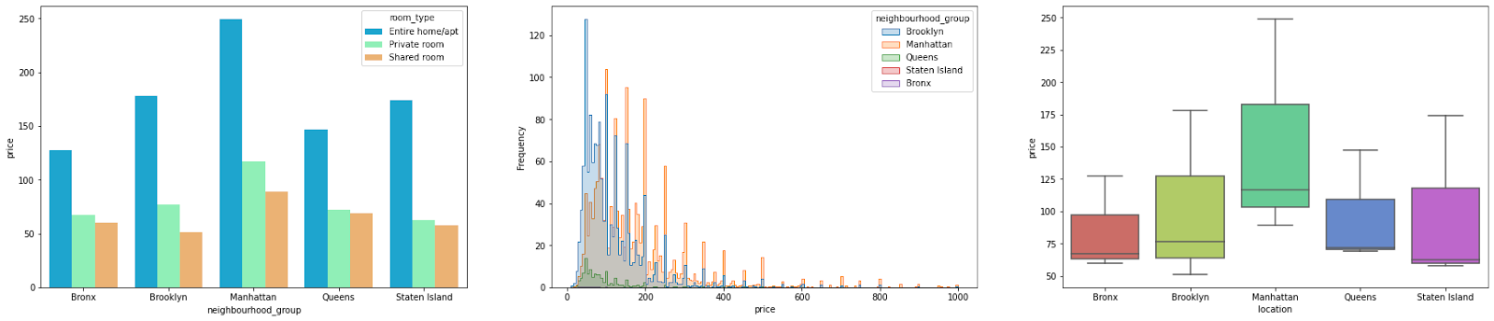
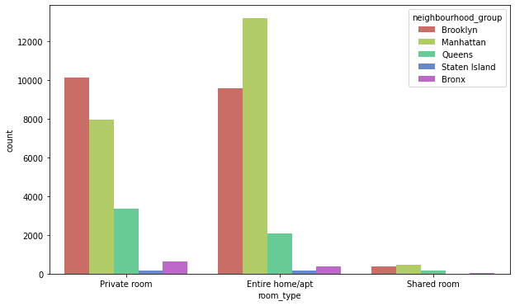
Which is the preferred location according to average best price?
Key Takeaways
Manhattan is the preferred location based on Pricing and Frequency of Customer Visit
Manhattan is preferred in all type of rooms.
Manhattan prices are higher as compared to other place.
Entire Home/Appt. are higher in Manhattan.
Private rooms are higher in Brooklyn.
Shared rooms are higher in Manhattan.

Slide 8
Why Manhattan?
Key Takeaways
Southern of Manhattan and Northern of Brooklyn mostly has expensive properties.
Manhattan has the maximum number of high price region.
Private rooms and Apartments are mostly preferred by customers over shared.
Manhattan has highest Private /Entire Apt rooms in combination followed by Brooklyn.

Slide 9
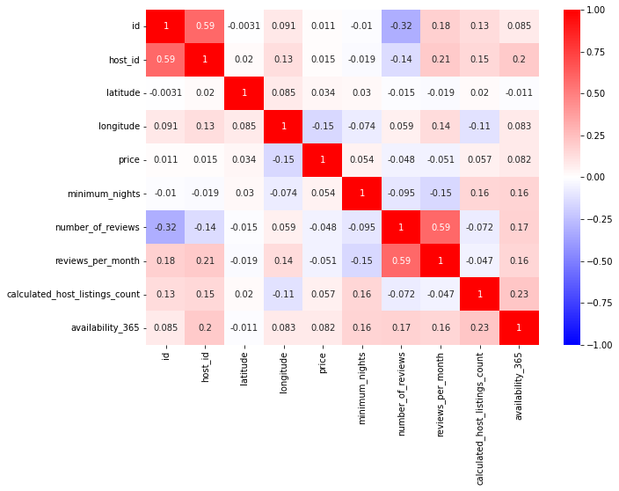
Correlation Matrix
Key Takeaways
High correlation number means high correlation between two variables.
Number_of_reviews and reviews_per_month has correlation of 0.59(high).
Host_id and minimum_nights has correlation of -0.019(low)

Slide 10
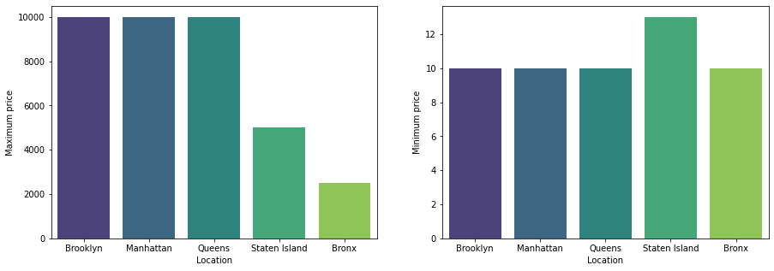
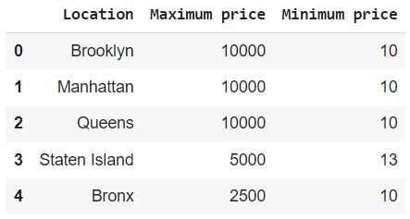
Highest and Lowest property prices and locations
Key Takeaways
Customers pay highest tariff of 10,000 USD in Brooklyn, Manhattan and Queens.
Customers pay lowest tariff of 10 USD in Brooklyn, Manhattan,Queens and Bronx.

Slide 11
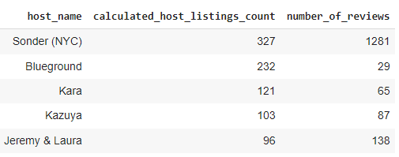
Most popular Hosts based on reviews and availability
Key Takeaways
Most popular hosts are :
Sonder,
Blueground,
Kara,
Kazuya,
Jeremy & Laura

Slide 12
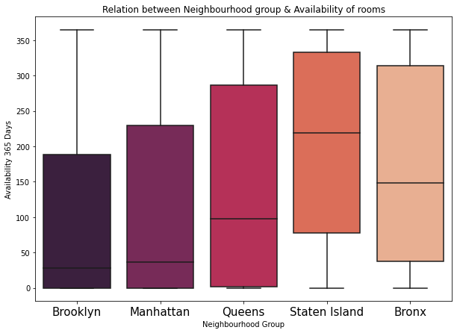
Relation between Neighbourhood group and availability of rooms
Key Takeaways
Staten Island has the highest availability of rooms over 365 days followed by Bronx.
Brooklyn and Manhattan seems to be very much occupied during the season.

Slide 13
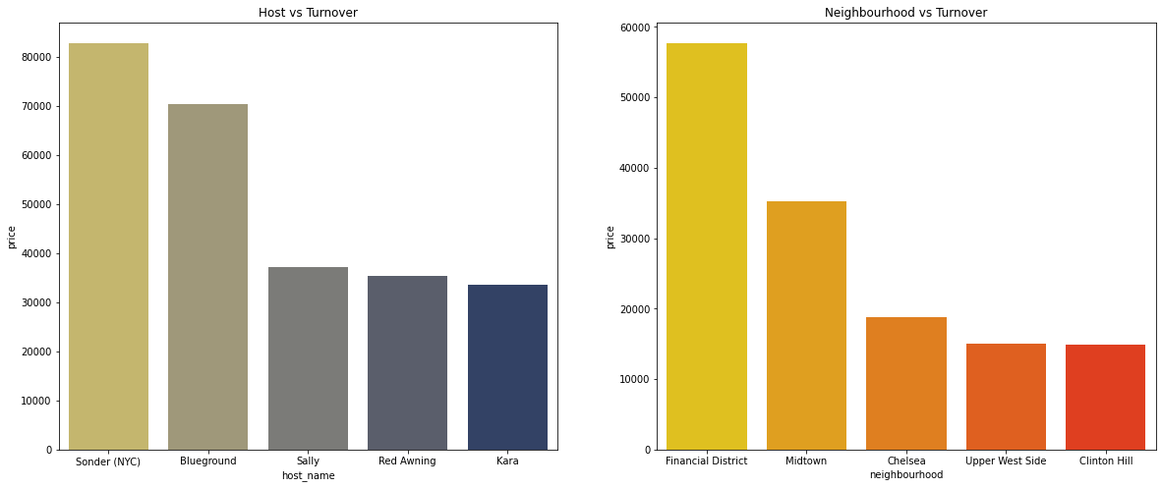
Top Hosts, Neighbourhood based on their turnover
Key Takeaways
Top 5 hosts based on Turnover are:
a) Sonder
b)Blueground
c)Sally
d)Red Awning
e)Kara
Top 5 neighbourhood based on Turnover are :
a) Financial District
b) Midtown
c) Chelsea
d)Upper West Side
e) Clinton Hill

Slide 14
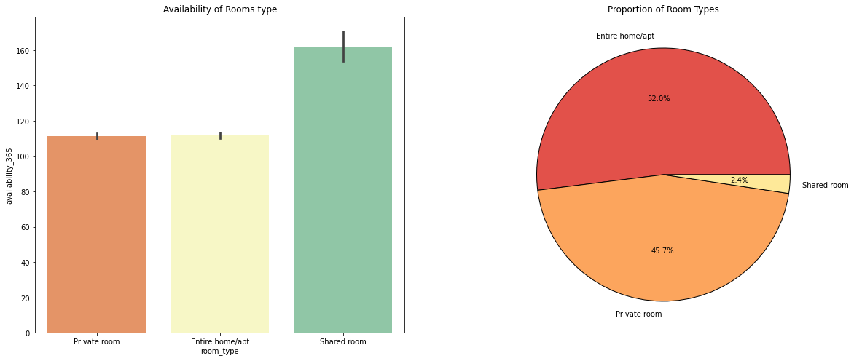
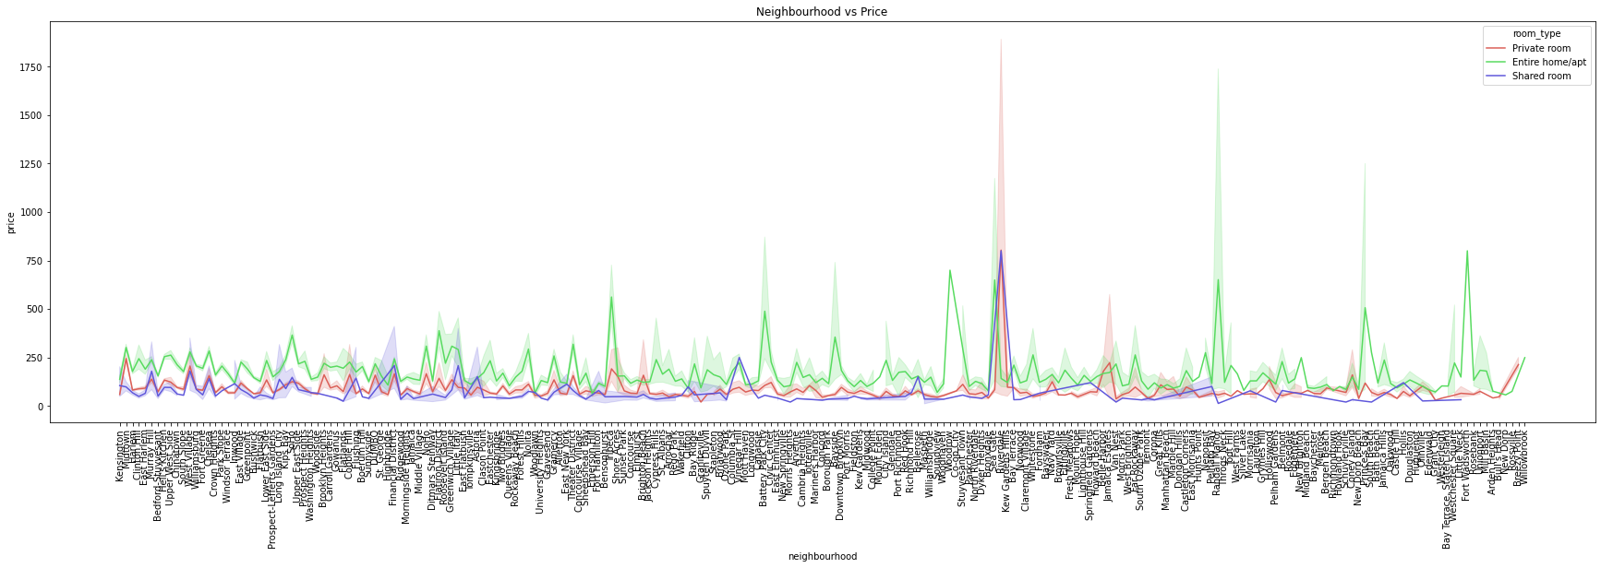
Room type selection based on price
Key Takeaways
Shared rooms are availables for most of the times as compared to private and entire home/ apartment
Room type distribution :
a) Entire Home/Apt - 52%
b) Private Room - 45.7%
c) Shared Room - 2.4%
Price of Entire Home/apt is usually higher as compared to Private rooms and Shared ones.

Slide 15
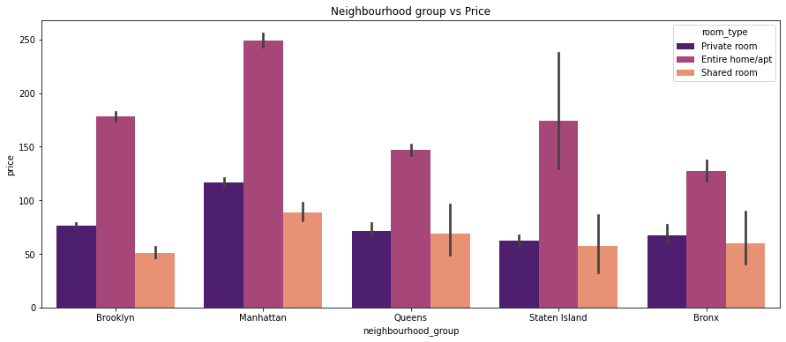
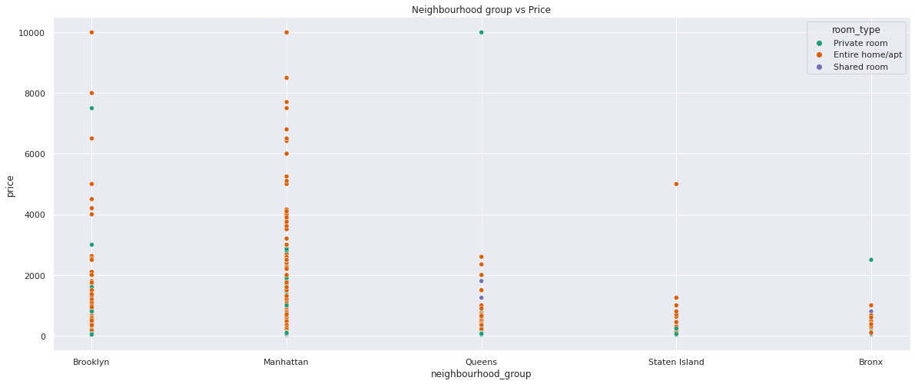
Room type selection based on price [Contd.]
Key Takeaways
Manhattan and Brooklyn are posh areas with high end properties available.
The high end properties are mostly Entire Home/Apt.

Slide 16
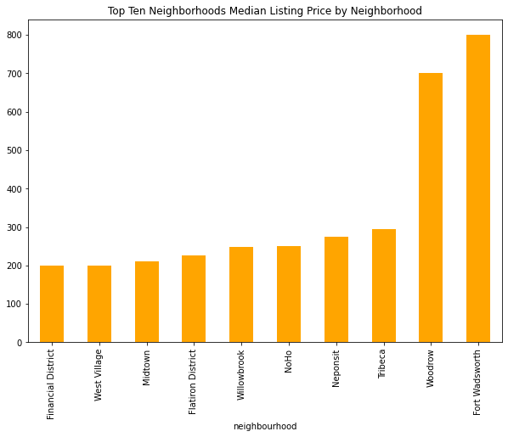
Top Neighbourhood based on listing price.
Key Takeaways
Fort Wadsworth and Woodrow are the top neighbourhood based on listing price by a huge margin than their contemporaries.
They belong to Staten Island neighbourhood

Slide 17
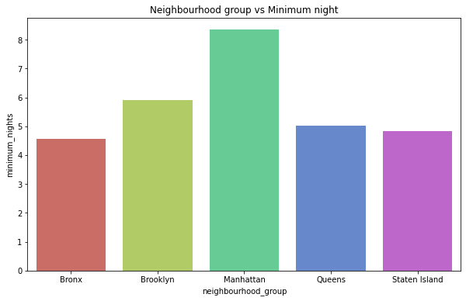
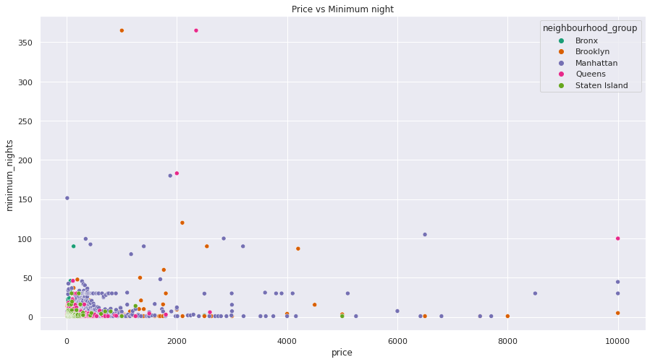
Distribution of neighbourhoods based on Mandatory stay allowed for a single booking
Key Takeaways
Most hosts allow Mandatory stay for less than 5 days.
Manhattan has higher requirement for Mandatory stay followed by Brooklyn and Queens.
Customers prefer to stay in places where mandatory stay is minimum and budget friendly.
Manhattan has a highest range of offerings both in terms of higher mandatory stay and expensive listed properties.

Slide 18
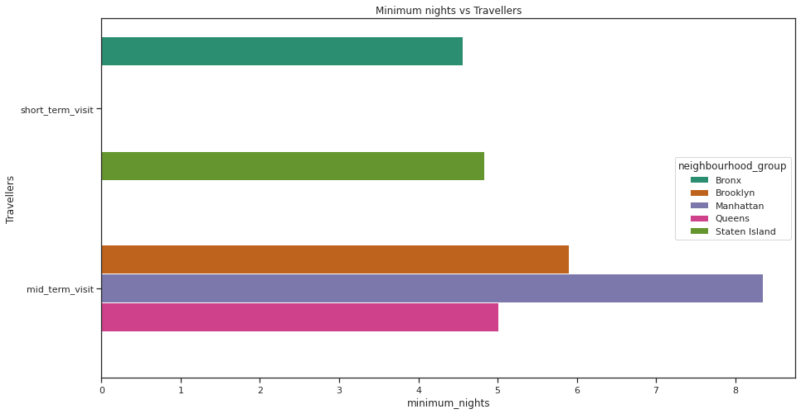
Types of Visit based on Mandatory stay allowed for a single booking
Key Takeaways
On the basis of hosts allowing minimum mandatory stay Manhattan, Queens and Brooklyn hosts prefer customers having a minimum 'Mid-term visit' whereas hosts in Bronx and Staten Island prefer customers having a minimum 'Short-term visit'.
Bronx and Staten Island can be preferred for shorter stays over other neighbourhoods making it budget friendly to some extent.
Manhattan and Brooklyn being posh areas and the implementation of higher mandatory stays for single booking will make these trips/visits expensive.
Short Term Visit - Upto 5 Days
Mid Term Visit - Upto 90 Days
Long Term Visit - More than 90 Days

Slide 19
Datasets have limiting attributes to classify various categories of properties.
Customer experiential and Category wise ratings for Hosts seemed to be missing which could have played an important role in identifying Star Hosts.
A lot of guest information were missing like Purpose of Visit, Number of Guests, which could have given a sense of understanding about the relation of customer footfall and neighbourhoods.
Key attributes of properties like Number of Beds, Closets, Bathrooms, Gym, Sauna, Property Age, Distances from nearest Hospitals, Shopping Complexes, Airport, Station were missing.
Limitations & Scope of Improvement
Key Takeaways
Key attributes related to Property
Key attributes related to customer experience with Hosts
Key attributes related to Guests

Slide 20
Manhattan and Brooklyn are the posh areas in NY as there is maximum footfall and properties based on prices and listings are are on the higher side.
Manhattan and Brooklyn have the highest number of hosts.
Manhattan has highest number of Private rooms and Entire House/Apt. in culmination followed by Brooklyn.
Highest accommodations of 10,000 USD are available in Manhattan, Brooklyn and Queens.
Most popular hosts are Sonder, Blueground ,Kara to name a few based on number of reviews and calculated host listing counts.
Staten Island seems more available for booking throughout the year compared to other neighbourhoods.
Conclusion
Key Takeaways
Manhattan and Brooklyn are the posh areas of NYC having high end homes and and maximum number of hosts renting out spaces.
Staten Island seems more available for booking throughout the year .

Slide 21
Sonder,Blueground ,Sally are some of the top hosts based on their turnover.
Financial District, Midtown, Chelsea are some of the top neighbourhood based on their turnover.
Shared rooms are mostly available over other room types and Entire Home /Apt which has the highest proportion of room share are mostly on the expensive ends.
Fort Wadsworth and Woodrow are expensive neighbourhood based on median listed price belonging to Staten Island.
Most hosts allow a minimum 5 nights mandatory stay for single booking but the average increases in case of Manhattan, Brooklyn and Queens.
Bronx and Staten Island are mostly preferred for Shorter visits and onwards and others are for slightly longer stays.
Conclusion [Contd.]
Key Takeaways
Sonder and Blueground seems to be the most popular hosts in terms of reviews received , properties listed and turnover generated.
Financial District which is the buzz of Manhattan has high turnover from properties listed.
Staten Island though has fewer properties but the median listing price is more in its neighbourhood. Fort Wadsworth and Woodrow.
Most hosts allow less than 5 days mandatory stay.The average is higher in Manhattan, Brooklyn and Queens.

Slide 22
Manhattan being the star neighbourhood we can roll down a lot of festive offers encouraging longer stays during Christmas and coming up with loyalty cards for frequent visitors which can also work for Brooklyn and Queens.
The star hosts should be incentivised to encourage them to maintain the properties and services as per the company standards.
Staten Island and Bronx can have discounts encouraging students to stay for a longer period.It can also have frequent check in cards for people from low income groups visiting regularly by offering good incentives and coupons.
Some local tours can be clubbed during longer visits encouraging customers to stay longer and prefer their stays.
Marketing Initiative
Key Takeaways
Festive Offers and Loyalty Cards
Discounts and Frequent Check In Cards
Incentivising Hosts
Local tours and experiences

Slide 23

Travel Like a Human
EDA Capstone Project
Thank You

