Slide 1
PyBaMM SPM Beginning of Life Model

Slide 2
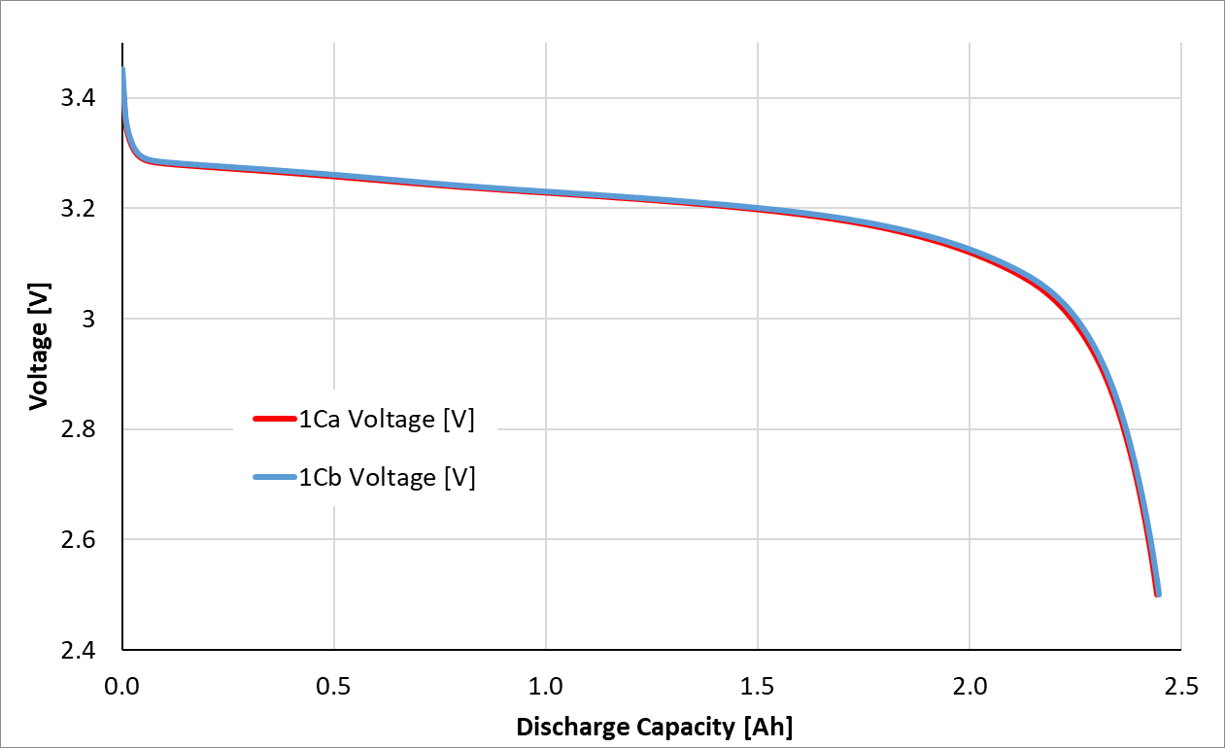
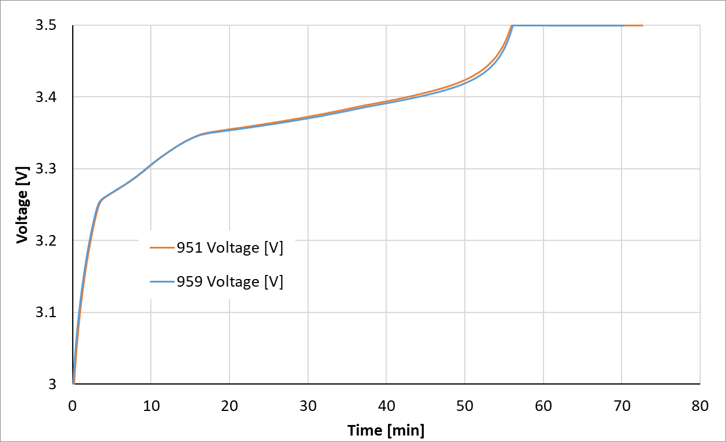
Dataset: 95K dataset

Slide 3
SPM Model development
params.update(
{
"Positive electrode delithiation OCP [V]": pybamm.input.parameters.lithium_ion.Prada2013.LFP_ocp_Afshar2017_delithiation,
"Positive electrode lithiation OCP [V]": pybamm.input.parameters.lithium_ion.Prada2013.LFP_ocp_Afshar2017_lithiation,
"Negative electrode lithiation OCP [V]": pybamm.input.parameters.lithium_ion.Prada2013.graphite_LGM50_ocp_Chen2020_lithiation,
"Negative electrode delithiation OCP [V]":pybamm.input.parameters.lithium_ion.Prada2013.graphite_LGM50_ocp_Chen2020_delithiation,
"Negative electrode thickness [m]": 3.4e-05*1.22,
"Initial concentration in negative electrode [mol.m-3]": (0.81 * 30555*0.9),
"Maximum concentration in negative electrode [mol.m-3]": 30555*1.1,
"Negative particle diffusivity [m2.s-1]": 3e-13,
}
)
Parameter set: Prada 2013
model = pybamm.lithium_ion.SPM(
{
"open-circuit potential": ("current sigmoid", "current sigmoid"),
}
)
params = pybamm.ParameterValues("Prada2013")

Slide 4
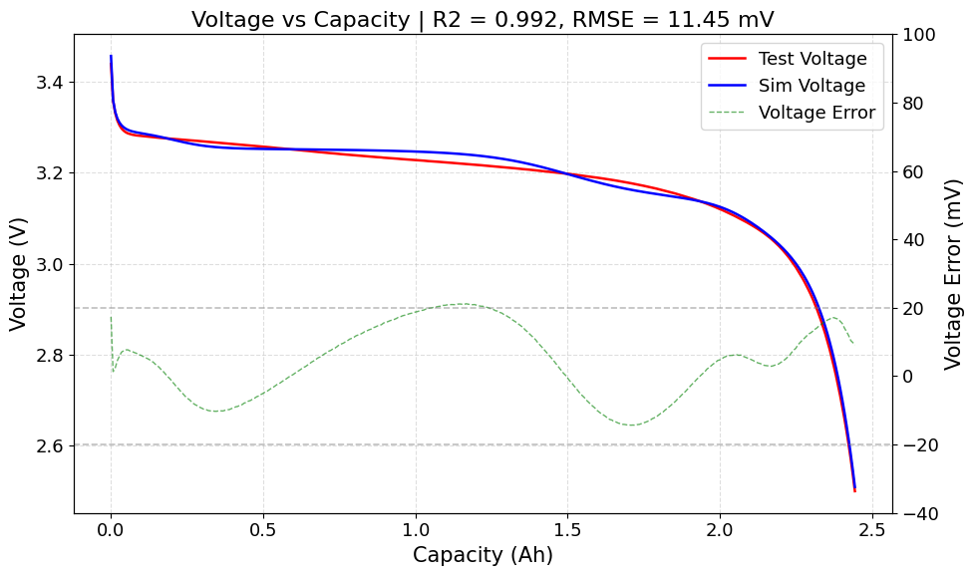
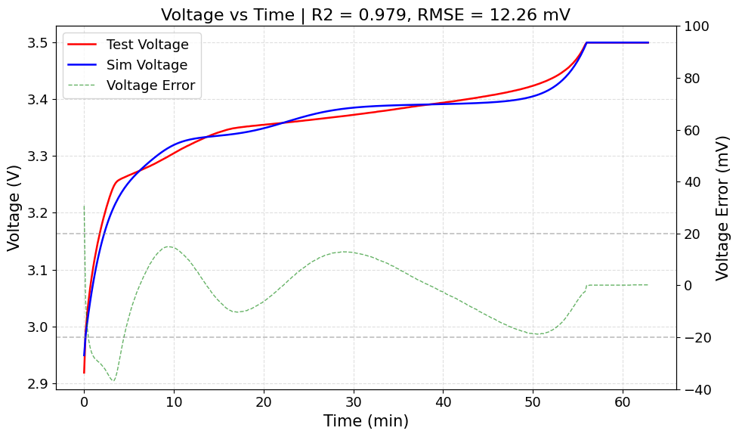
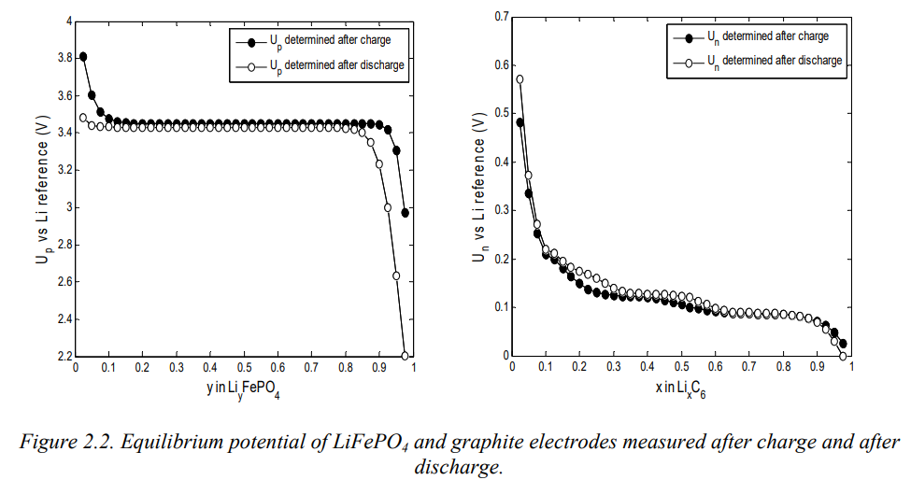
SPM Model development
params.update({
"Negative electrode lithiation OCP [V]": pybamm.input.parameters.lithium_ion.Prada2013.graphite_LGM50_ocp_Chen2020_lithiation,
"Negative electrode delithiation OCP [V]":pybamm.input.parameters.lithium_ion.Prada2013.graphite_LGM50_ocp_Chen2020_delithiation,
"Positive electrode delithiation OCP [V]": pybamm.input.parameters.lithium_ion.Prada2013.LFP_ocp_Afshar2017_delithiation,
"Positive electrode lithiation OCP [V]":pybamm.input.parameters.lithium_ion.Prada2013.LFP_ocp_Afshar2017_lithiation,
})

Slide 5
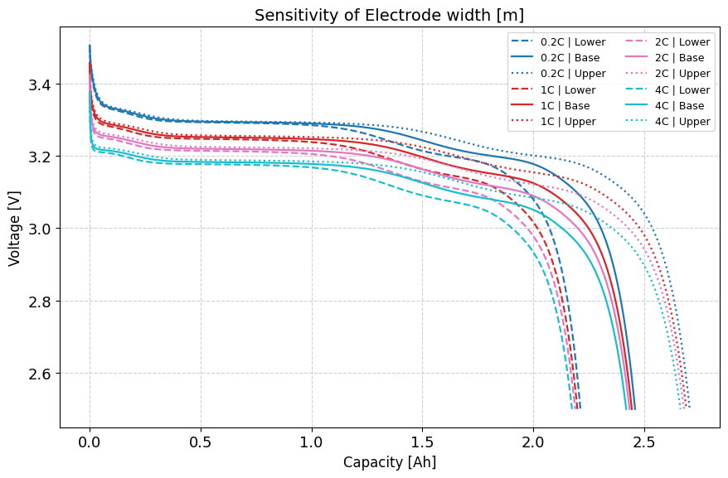
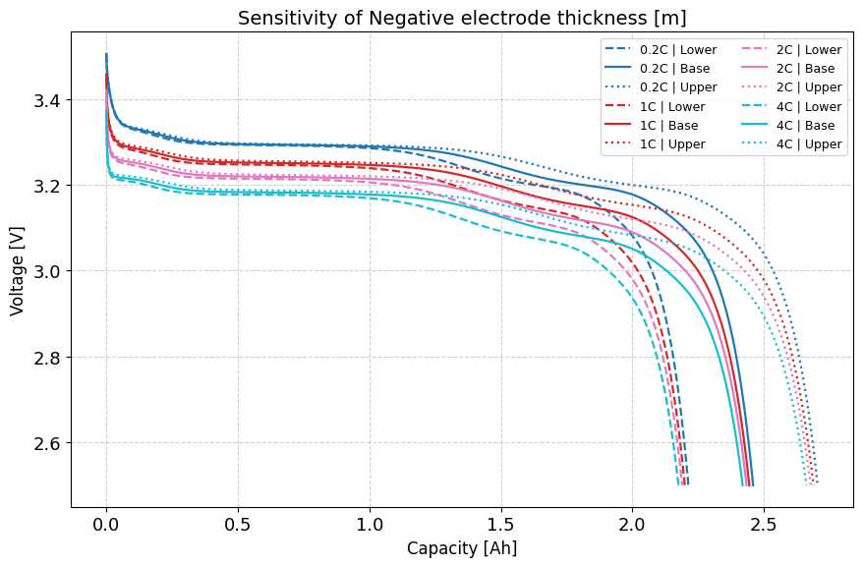
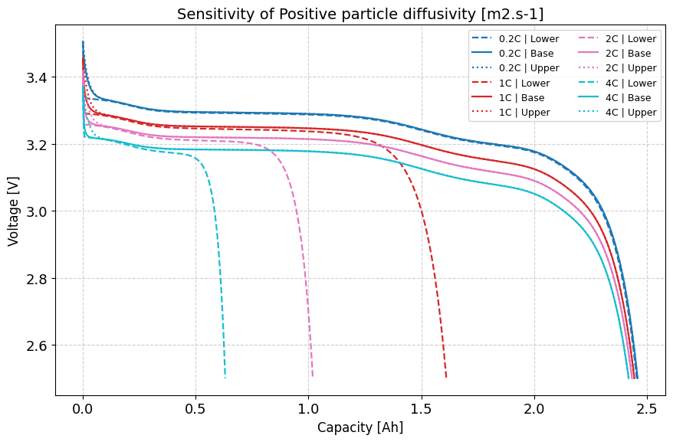
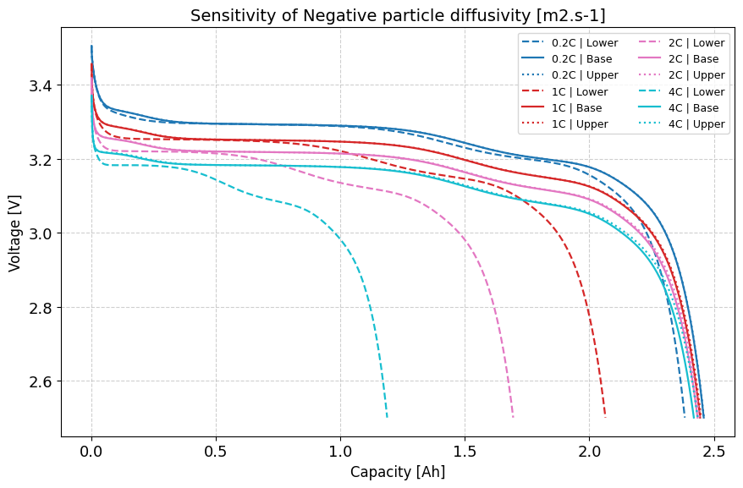
Parameter sensitivity analysis

Slide 6
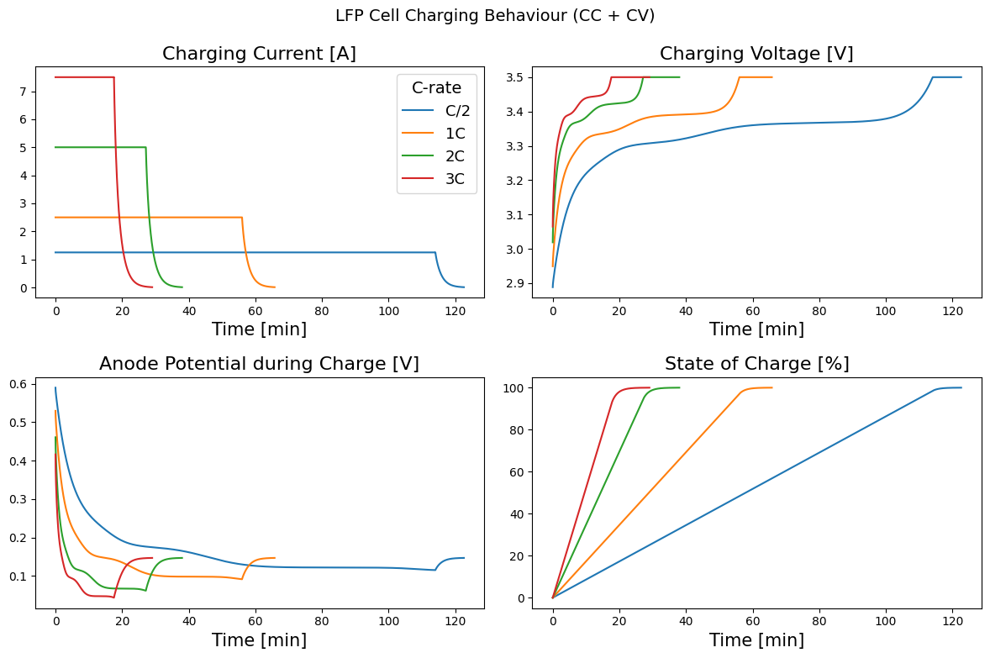
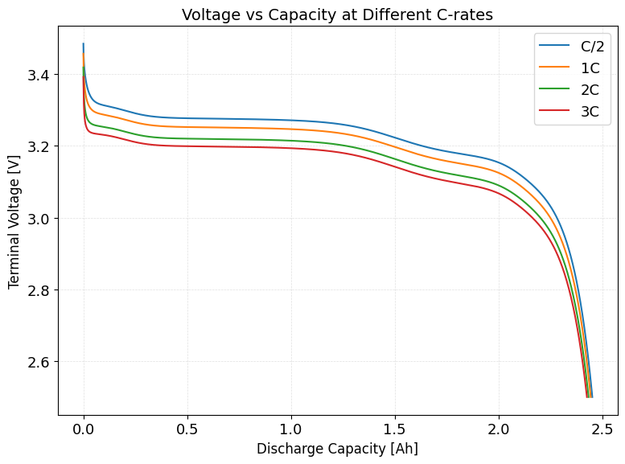
Cell performance at various C-rates

Slide 7
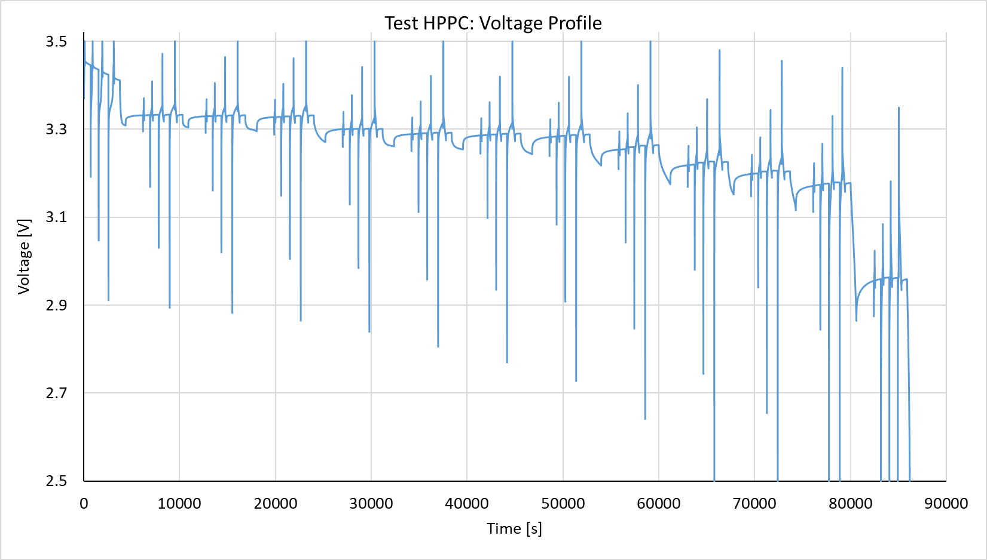
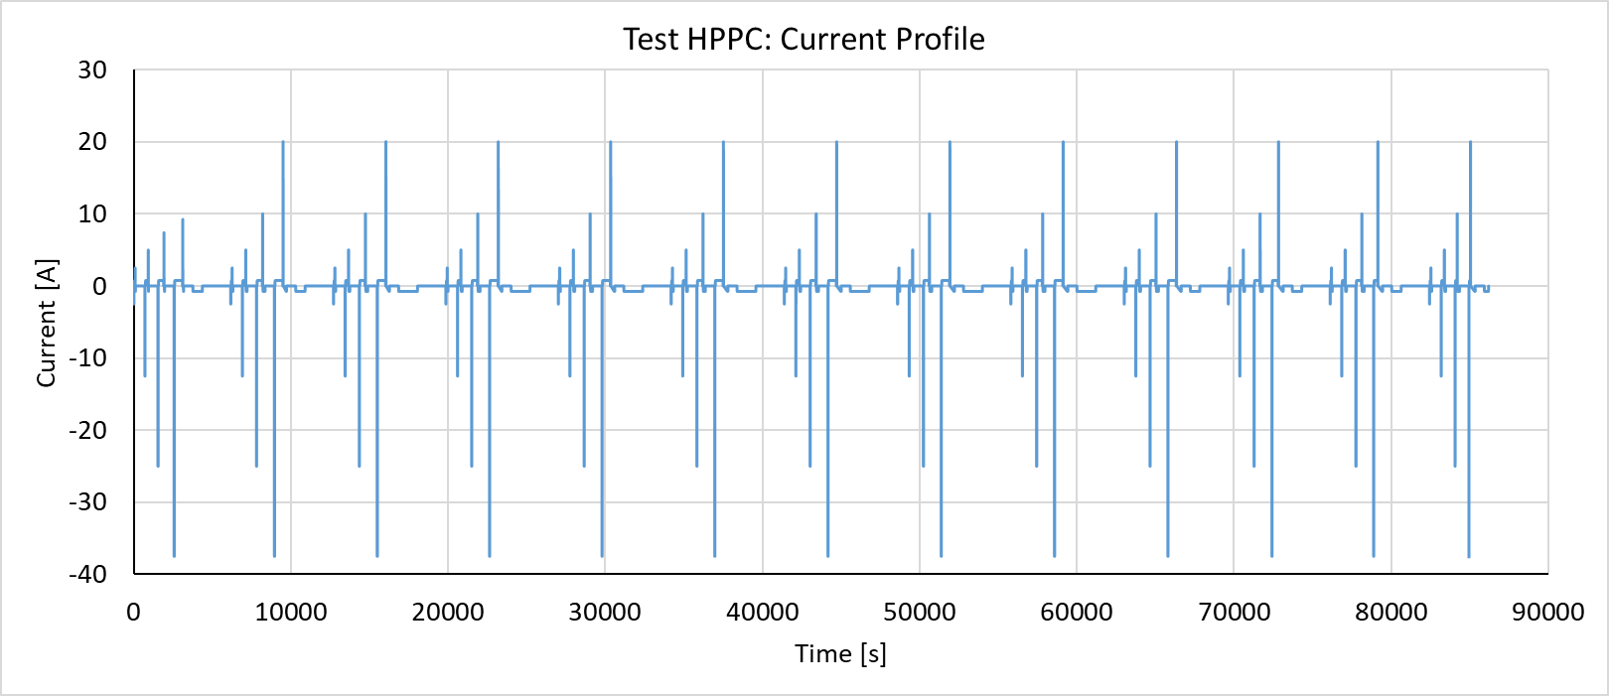
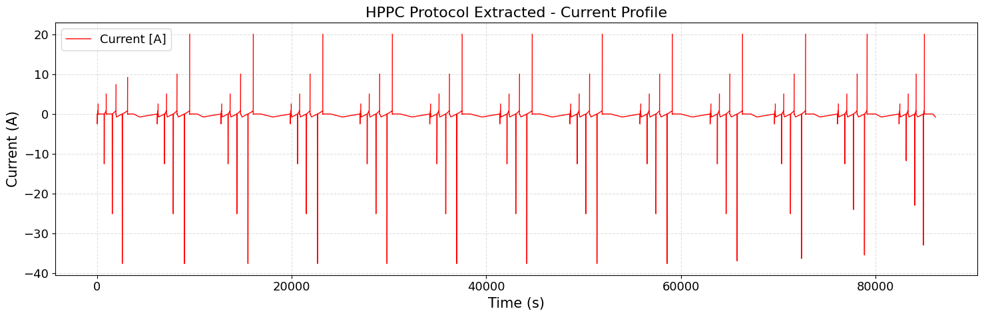
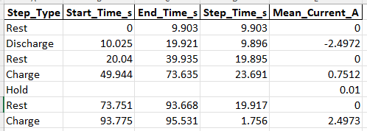
Model Validation: HPPC_951.csv
exp = pybamm.Experiment([
(f"Discharge at {C} for 10 hours or until 2.5V (1 second period)",
"Rest for 30 minutes (60 seconds period)",
f"Charge at {C} until 3.5V (1 second period)",
"Hold at 3.5V until 0.01A (1 second period)",)])

Slide 8
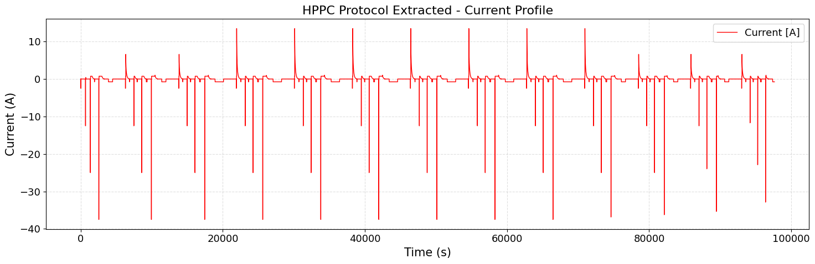
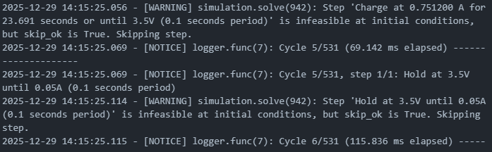
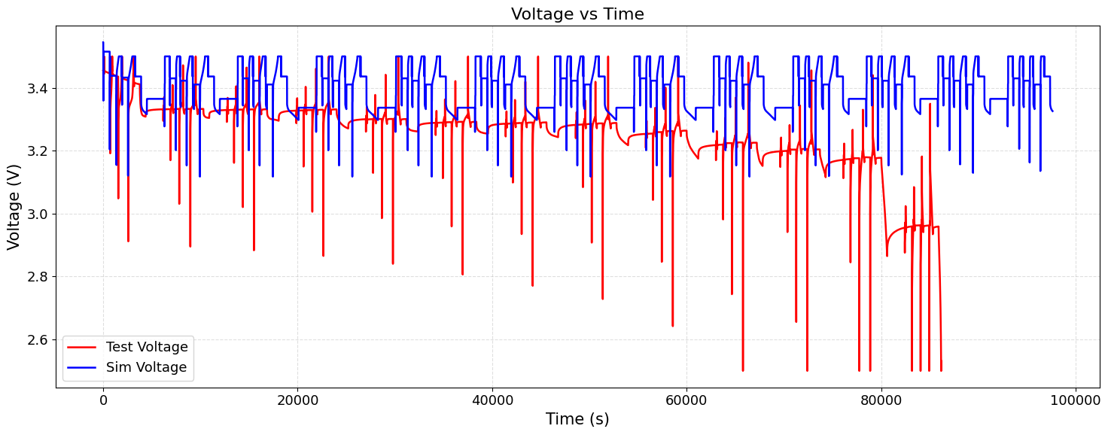
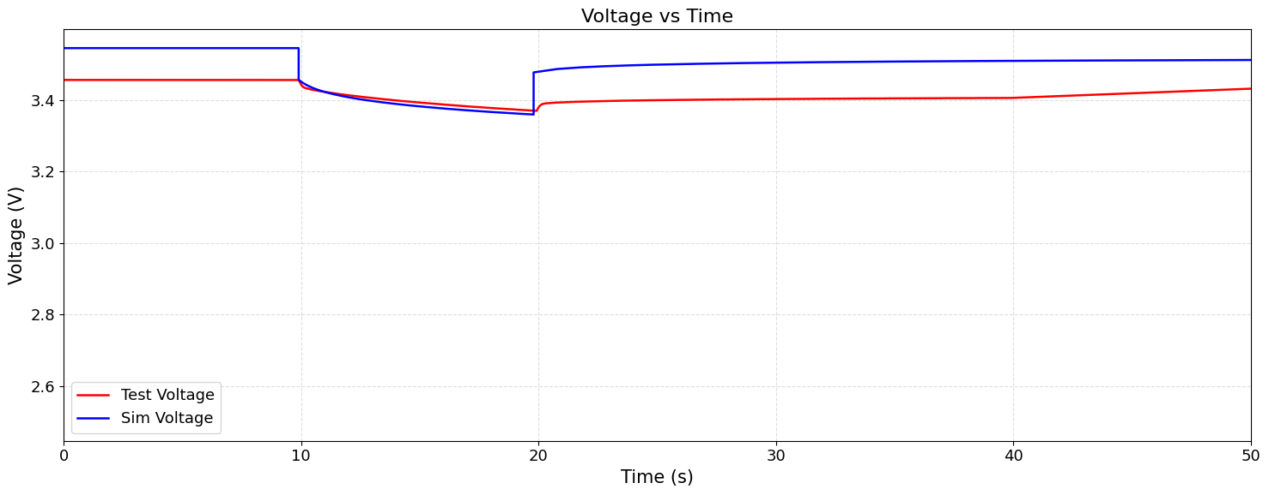
HPPC Protocol Implementation in PyBaMM
Primary reasons:
The HPPC protocol could not be reconstructed accurately, with several repeating discharge pulses missing from the available data.
The constant-voltage (CV) operating mode is not accurately represented in the current model implementation.
The model has not been validated across multiple C-rates due to the unavailability of experimental data; consequently, the voltage response is expected to improve once such validation is performed.

Slide 9
HPPC Protocol Implementation in PyBaMM
Parametrization (BOL):
Capacity test data (Voltage profile @ lower C-rate)
Performance data Voltage and Temperature @ various C-rates and various ambient conditions
HPPC Voltage Profile can be produced with a good accuracy

Slide 10
Thank You

