Slide 1
Diabetes
Dr. Pankaj Yadav
BSBE Department
IIT Jodhpur
Pratik Goyal (B18BB024)
Piyush Mathur (B18BB021)

Slide 2
Diabetes Mellitus
Commonly just called Diabetes
A disorder which results in too much sugar in the blood
Symptoms:
Increased thirst and hunger
Weight loss
Fatigue and blurred vision
Slow healing wounds
Risk factors:
Obesity
High blood pressure
Smoking and alcohol
Lack of sleep
Long term effect:
Heart and kidney disease
Nerve damage
Stroke
Might lead to death

Slide 3
Diabetes Mellitus
Mainly classified into three types:
Type 1 Diabetes:
Mostly found in children and adolescents
Little or no Insulin production
Autoimmune disease
Affected by hereditary
Daily dose of Insulin is required
Type 2 Diabetes
Most common type (90%)
Usually occurs in adulthood
Body is incapable of responding to Insulin
Overweight and obese people are at higher risk
Healthy lifestyle, exercise and healthy diet needed
Gestational Diabetes
Develops in some women when they are pregnant
Usually disappears after pregnancy
Might lead to Type 2 Diabetes later in life

Slide 4
Insulin
An Anabolic Hormone
Helps in maintaining the glucose concentration in the blood
Produced by the beta cells of Pancreas
Beta cells are very sensitive to the amount of glucose in the bloodstream
Beta cells sense the Glucose level and stimulate the insulin secretion accordingly
Insulin signals the cells to absorb the available glucose
As glucose level decreases, beta cells respond by secreting less insulin
Pancreas secretes 40-50 units of Insulin everyday

Slide 5
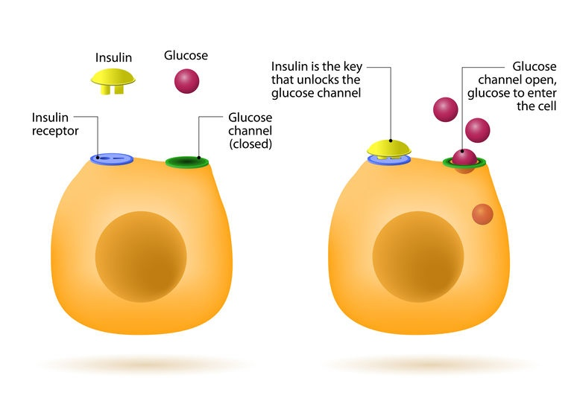
How Insulin Works?
Lock and Key model

Slide 6
How Insulin Works?
Food
Glucose
Absorption by Stomach and Small intestine
Glucose is absorbed by the cells
Beta cell senses it and secretes insulin
Glucose concentration in blood rises
Cells convert Glucose into energy/ glycogen/ fat as per the need
Glucose in blood decreases
Beta cells sense it and decreases the insulin secretion

Slide 7
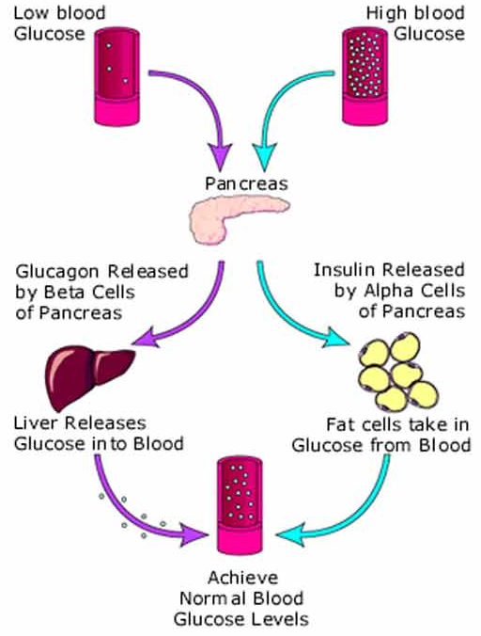
Regulation of glucose level

Slide 8
Type 1 Diabetes
The whole cause is unknown although risk factors have been identified
Multifactorial disease
The risk is increased by certain variants of HLA-DQA1, HLA-DQB1, and HLA-DRB1 genes
They are part of a family called HLA complex
This HLA complex helps immune system distinguish between body’s own proteins from foreign proteins
It is an autoimmune disorder
Inappropriate immune response to beta cells impairs them
No insulin production

Slide 9
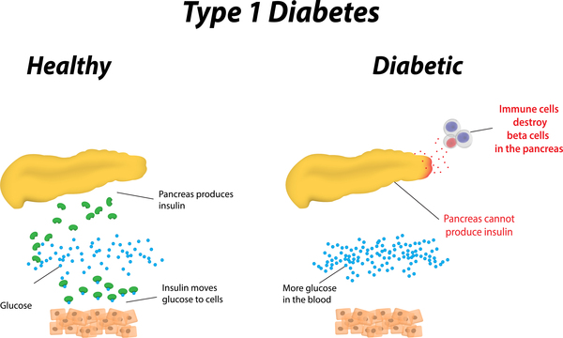
Type 1 Diabetes

Slide 10
Genetics of Type 1 Diabetes
Major susceptibility locus maps to HLA class II genes at chromosome 6p21
HLA-DRB1
HLA-DQB1
More than 50 non-HLA-susceptibility genes have been confirmed
INS genes
PTPN22 gene on 1p13
CTLA4 gene on 2q33
IL2RA gene on 10p15
These genes are found to inhibit T cells activation

Slide 11
Type 1 Diabetes
Not everyone has a family history
High risk is there when people inherits risk factors from both the parents
HLA risk genotypes + Family History
One out of Five
HLA risk genotypes + No Family History
One out of Twenty
Some viruses might activate type 1 in people who are susceptible
Measles
Mumps
Rotavirus
Coxsackie virus B (CVB)
Common observed Patterns

Slide 12
Type 1 Diabetes
At present, lifelong insulin therapy is the only treatment available
Genetics currently does not play any role in the treatment
Environmental risk factors are thought to act as either ‘initiators’ or ‘accelerators’
Being breastfed as a baby may lower the chance
Early introduction to Cow’s milk proteins is a risk factor
Triggered by cold environment
Whites have relatively higher rate
Common observed Patterns

Slide 13
Type 2 Diabetes
Caused by a combination of genetic and lifestyle factors
Smoking, Poor diet, Physical inactivity and Obesity
Combination of some genetic variations determine the risk of developing this disorder
More than 50 candidate genes are identified
Major ones include
PPARγ
ABCC8
KCNJ11
CALPN10
Factors first cause immune resistance
This leads to more secretion of insulin by Beta cells
Over time, Beta cells become less able to respond to blood sugar changes.
Ultimately leading to insulin shortage, causing high blood sugar levels
Notes:
Fuck you

Slide 14
Genetics of Type 2 Diabetes
PPARγ (peroxisome proliferator-activated receptor-γ)
Important in adipocyte and lipid metabolism
A target for the hypoglycemic drugs
One form of the PPARγ gene (Pro) decreases insulin sensitivity
CAPN10 (calpain 10)
Calpains are a family of calcium-activated neutral nonlysosomal proteases
Implicated in many cellular functions
Intracellular signal transduction, neuronal funtctions and cytoskeletal rearrangements
They are proposed to have a role in downregulation of insulin receptor substrate

Slide 15
How T2D Occurs?
Genetics and lifestyle cause insulin resistance in cells
Beta cells sense high glucose level
For a long time, high glucose level in blood and high insulin secretion by Beta cells
Beta cells secrete more and more insulin to bring glucose level to normal
Beta cells’ sensitivity for glucose level in blood decreases
Insulin shortage occurs
Body not able to reduce sugar levels effectively

Slide 16
Genetics of Type 2 Diabetes
ABCC8 (ATP binding cassette, subfamily C, member 8) and KCNJ11 (potassium channel, inwardly rectifying subfamily J, member 11)
ABCC8 encodes the high-affinity sulfonylurea receptor (SUR1) subunit
KCNJ11 encodes the Kir6.2 subunit
SUR1 is coupled to the Kir6.2 subunit
Both genes are part of the ATP-sensitive potassium channel
Plays a key role in regulating the release of hormones, such as insulin and glucagon, in the beta cell
ABCC8 and KCNJ11 are only 4.5 kb apart
KCNJ11 (Lys) and ABCC8 (Ala) forms of genes have been associated with T2D

Slide 17
Gestational Diabetes
Develops in some women during pregnancy and disappears after childbirth
Body is unable to make extra insulin needed during pregnancies
Occurs in around 5% of all pregnancies
All women gains weight and develops insulin resistance
Women who can not make enough insulin to overcome insulin resistance
Occurs during second or third trimester
High increase in rate because of overweight and obesity in women of childbearing age
Eating healthy food, medication and exercise helps
Might develop in T2D later in life

Slide 18
References
Genetics and Diabetes
https://ghr.nlm.nih.gov/condition/type-1-diabetes#genes
https://www.medicalnewstoday.com/articles/317468.php#type-2
Type 2 diabetes
Genetics of Type 1 Diabetes
Genetics of Type 1 Diabetes: What's Next?
Variants in the Calpain-10 Gene Predispose to Insulin Resistance and Elevated Free Fatty Acid Levels
Type 1 Diabetes
Genetic risk factors for type 1 diabetes
Diabetes mellitus: The epidemic of the century
β Cell Dysfunction Versus Insulin Resistance
Obesity and Type 2 Diabetes in Children
Symptoms & Causes of Gestational Diabetes
Gestational diabetes: A clinical update

Slide 19
THANK YOU

