Slide 1
Smart Interactive Mirror System
Prepared By :-
Aniket pawar
Ruchika Satras
Priyanka chinChwade
Rohit palekar

Slide 2
Introduction
Smart mirror is basically a mirror which provides the information which we need in our day-to-day life, as weather report ,real time news, date and time, etc.
The mirror has a LCD screen at the back which will be showing all the information.
The mirror provides a functional, user friendly and interactive UI to its user for accessing their social sites, messengers, etc.
In Smart mirror we have implemented a personal assistant so we can interreact with the mirror and the user
We have written the code for this application in python language

Slide 3
What is smart mirror
A smart mirror is a two-way mirror with an electronic display behind the glass. The display can show the viewer different kind of information in the form of widget, such as weather, time, date , and news update

Slide 4
PROBLEM STATEMENT
The major problem of any existing mirror is displaying just the object in front of it or just the human face without having to interact with them.
There are plethora's of Smart Mirrors in existence by now. Mostly, developed to display time, date, and weather-related information.
The world we live in today has become a place of the fiercest competition, whether it is in sports, entertainment, or the job market.
But you will hardly find all these features in a single Smart Mirror. Especially in India, this concept has not made strides yet. Also, human detection system is not implemented into Smart Mirrors on a large scale. By implementing human detection module, one can get instant control along with that can save electricity.

Slide 5
How does a smart mirror work
A smart mirror is an arrangement of a display behind a two-way mirror Only the light from the display screen is visible on
The other side If you dim the screen brightness, you’ll be able to see your own reflection in it. At the same time, the images or video displayed on the screen can also be seen by you
Which it will listen to commands and there is speaker from which it will give its response. Smart mirror have the some capabilities like showing date and time

Slide 6
Requirement specifications
We have used for our project:
A two way mirror panel
Monitor
A desktop application to display the targeted functionalities of the product.

Slide 7
The Functionalities
The mirror has the following functionalities as of today:
Time and Date
Weather Report
Greeting
Latest news
The possibilities of the information to display on the mirror though is endless so the functionality of our project is quite progressive and flexible

Slide 8
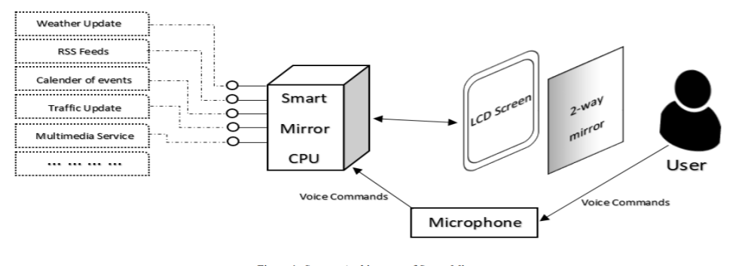
ARCHITECTURAL BLOCK DIAGRAM

Slide 9
Result

Slide 10
Conclusion

Slide 11
Thank you

