Slide 1

Investment Advisor Bot
By: Michael, Pankaj, Blandine and Omar

Slide 2

TABLE OF CONTENTS
Investment Portfolio Model
Overview
01
02
BOT Generation
04
Product Overview
05
02
Lambda Function
03

Slide 3
Overview of Portfolio Advisor
Created a set of Portfolios and analyzed the performance applying various machine learning prediction Model using Sagemaker Studio.
Using the endpoints generated from Sagemaker, Created an API function to invoke the endpoint to get the Predicted values from the model.
Used lambda function to power the Investment Advisor bot.
Built and Optimized Portfolio depending on the customer inputs.
Advised Customers of the expected returns generated from Predictions from Machine Learning.

Slide 4
Data Extraction and Manipulation Tools
Data Collection: Yahoo Finance
Existing Python Libraries: Matplotlib, Pandas, Numpy, Hvplot, Plotly, SKlearn, StandardScaler
New Libraries: yfinance, pandas_datareader.
Sagemaker, Sagemaker predictor, Lambda, Lex.

Slide 5
Investment Portfolio Modeling
Gathered Data of Equities, Bitcoins, and Bonds using yahoo Finance and calculated the actual returns
Generated the Buy and Sell signals depending on the Simple and Exponential Moving averages.
Compare the Actual and strategy returns.
Trained the Data and fit the model using Sagemaker.
The training and the testing data were saved in S3 buckets and the endpoint were generated.
The data was trained using Sagemaker, Logistic regression and SVM Model.
Predicted the Strategy returns and generated the predicted labels and returns.

Slide 6
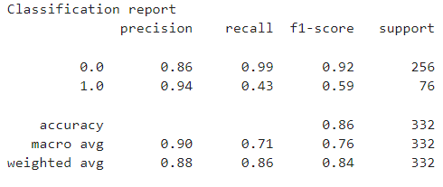
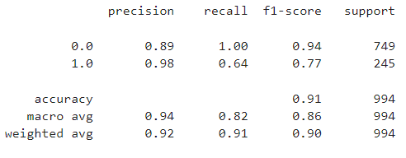
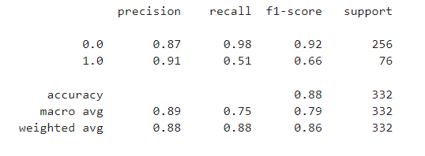
Model Comparison
SPY (S&P 500)
Sagemaker Model
SPY (S&P 500)
Logistic Regression Model
SPY (S&P 500)
SVM Model

Slide 7
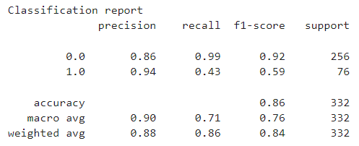
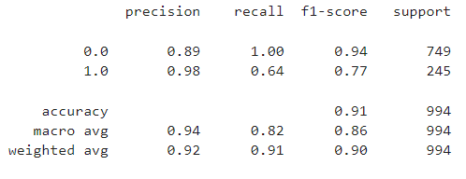
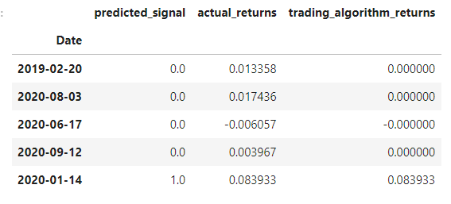
Model Comparison
BTC (Bitcoin)
Sagemaker Model
BTC (Bitcoin)
Logistic Regression Model
BTC (Bitcoin)
SVM Model

Slide 8
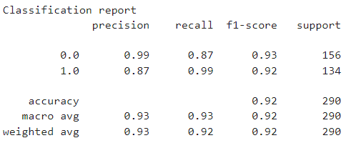
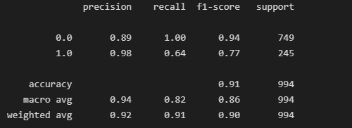
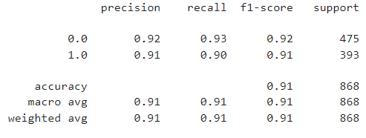
Model Comparison
AGG (Bloomberg Aggregate Bond Index)
Sagemaker Model
AGG (Bloomberg Aggregate Bond Index)
Logistic Regression Model
AGG (Bloomberg Aggregate Bond Index)
SVM Model

Slide 9
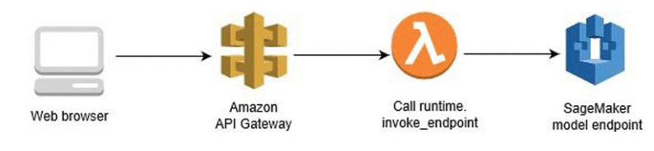
FRAMEWORK

Slide 10
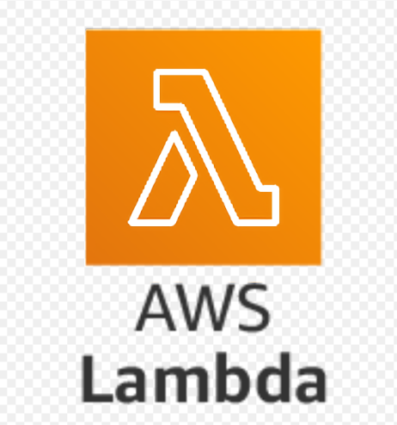
Lambda Function
AWS Lambda is an event-driven, serverless computing platform provided by Amazon as a part of Amazon Web Services.
The lambda function was used to power the Amazon Lex bot.

Slide 11
BOT Generation
We used the lambda functions to link the Sagemaker endpoints with the Lex Robo advisor.
We created a function that analyses the risk levels and performs a validation on them before it passes the parameters to Lex for final response.
The bot will fit the investor’s risk tolerance and optimize the portfolio based on the set of conditions.

Slide 12
Product overview

Slide 13
Challenges
Creating a machine learning model using various stocks as predicting returns for each stock was time consuming. Hence we used US stock index which represents the best stocks.
Invoking the endpoint from Lambda function and performing data manipulation in Lambda function.
.
Fetching live data and continuously running the model to improve Machine learning.

Slide 14
Future updates
Use more input features to train the data for better Predictions.
Use the customer inputs data for Machine learning to customize customer experience.
Enabling bot to take more inputs from customers such as investment horizon and other investment goals.
Use response card and greetings message to further enhance customer experience.
Deploy the bot to various channels such as facebook and instagram.

Slide 15
Conclusions
An investment advisor bot would help to reduce the human interaction and answer basic investment related queries.
A machine learning bot can advise better based on data, keeping the emotions aside.
The bot can serve many customers at the same time and provide customized recommendations.

Slide 16


