Slide 1
Weekly Project Governance Report
19 February 2026

Slide 2
Executive Summary
Overall Completion: nan%
Schedule Variance: 0
Effort Variance: 0
High Risks: 0
SPI: 0 | CPI: 0
Overall Health: Green

Slide 3
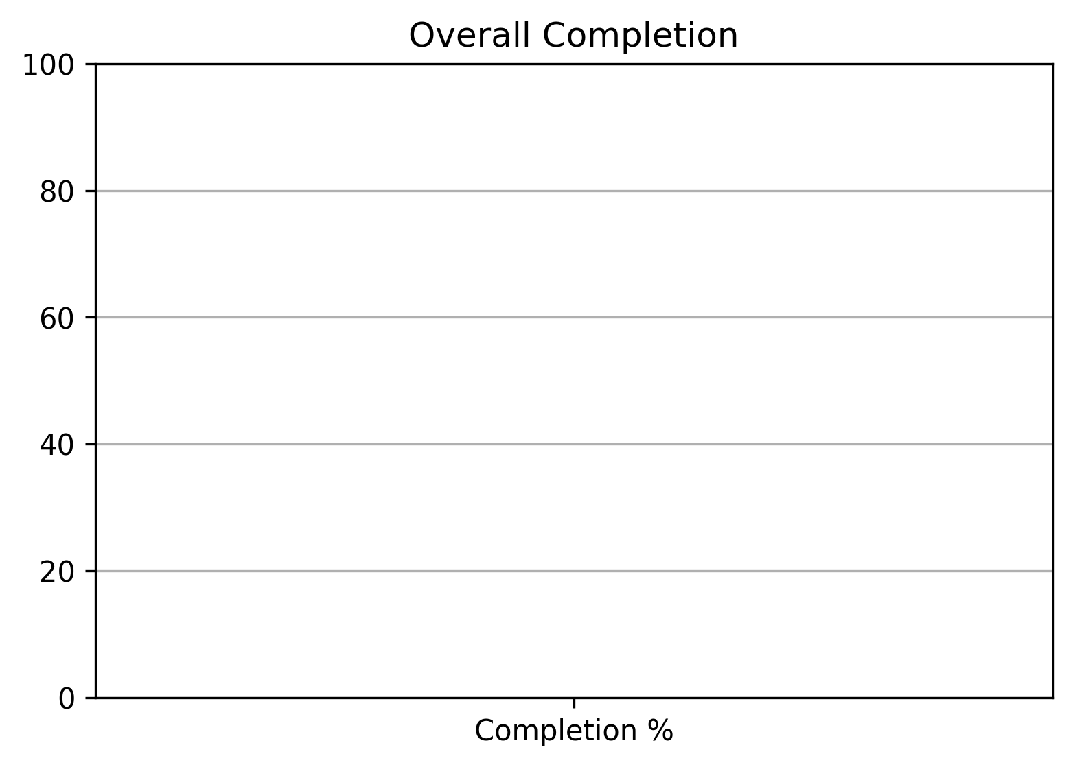
Completion Overview

Slide 4
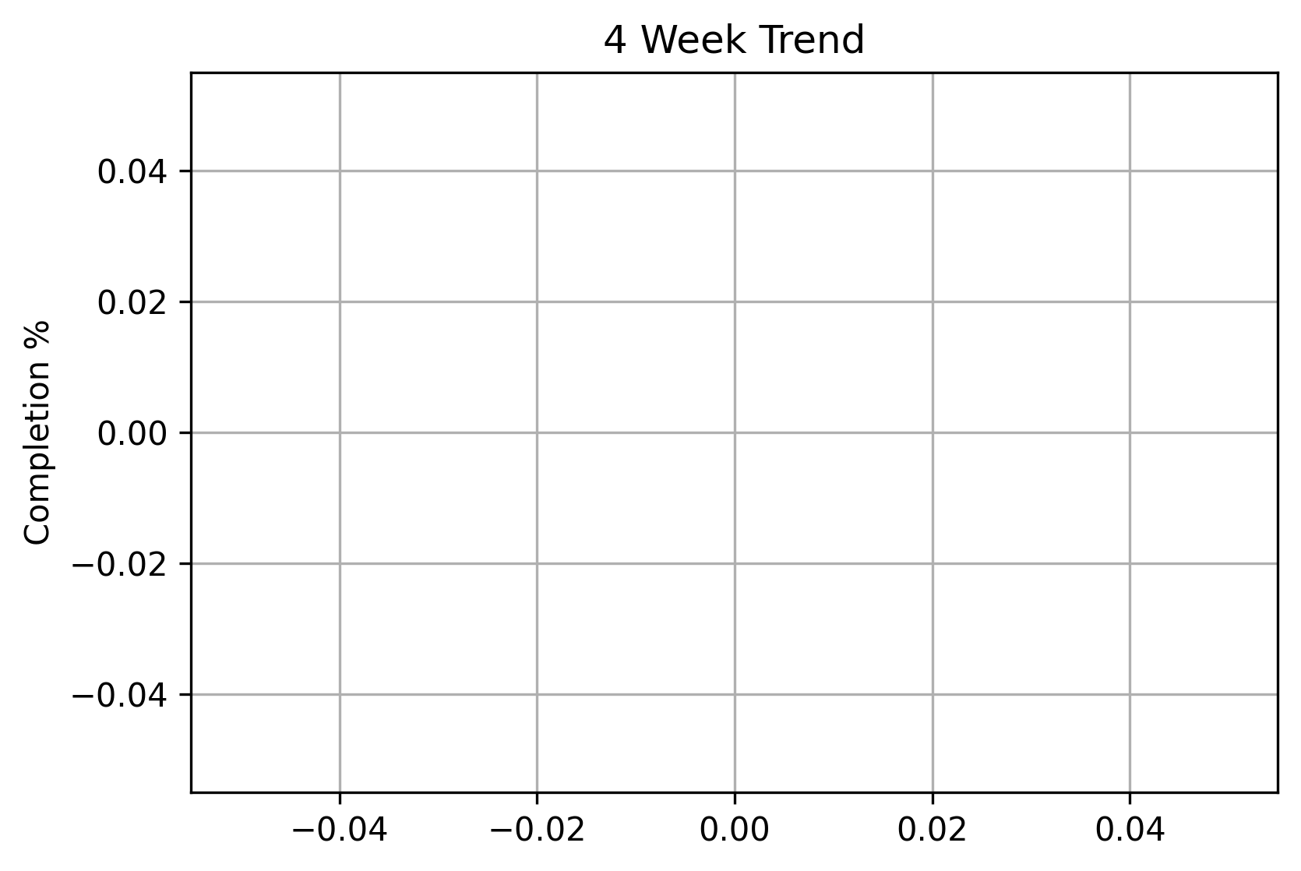
Trend Overview

