Slide 1
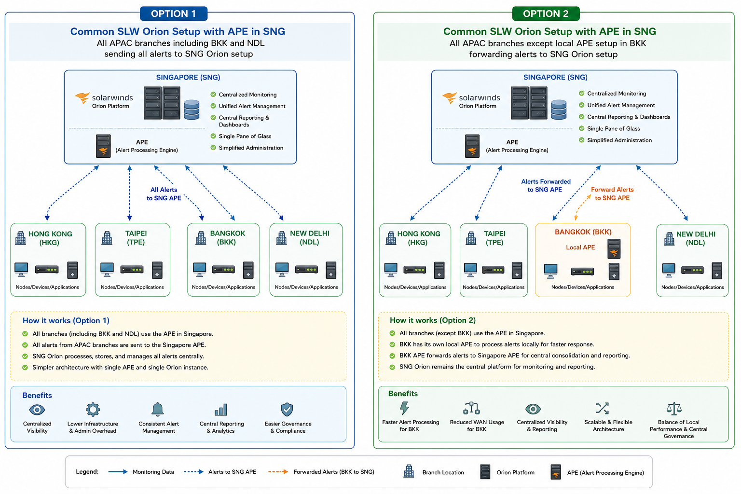
APAC SolarWinds Orion Architecture Options
Centralized Singapore APE vs. Bangkok local APE with centralized SNG Orion
Decision focus: operational resilience, WAN dependency, scalability, cost, governance and alert-processing performance
APAC SolarWinds Orion – Architecture Assessment
1

Slide 2
Executive Summary
Both options can provide centralized APAC monitoring; the key trade-off is simplicity vs. local resilience/performance.
OPTION 1 — Single SNG APE
OPTION 2 — BKK Local APE
• All APAC branches, including BKK and NDL, send alerts to the Singapore APE.
• Single processing and administration model.
• Lowest infrastructure footprint and operational complexity.
• Strongest dependency on WAN connectivity to Singapore.
• Best fit where WAN is reliable and alert latency is not business-critical.
• All branches except BKK use the Singapore APE.
• BKK processes alerts locally and forwards them to Singapore Orion.
• Improves local alert-processing resilience and reduces BKK dependency on WAN for initial processing.
• Adds infrastructure, monitoring, patching and support overhead.
• Best fit where BKK has material latency/WAN constraints or requires local autonomy.
APAC SolarWinds Orion – Architecture Assessment
2

Slide 3
Option 1 — Pros & Cons
Centralized architecture with one APE in Singapore
PROS
WHEN TO PREFER OPTION 1
• Single APE and Orion architecture — simplest to design and operate.
• Centralized alert processing, reporting and administration.
• Lower infrastructure and licensing/support footprint.
• Consistent monitoring configuration across APAC.
• Easier governance, backup, DR and lifecycle management.
• Stable and resilient APAC WAN with predictable latency.
• Alert volumes are moderate and centrally manageable.
• No regulatory or operational requirement for local alert processing.
• Organization prioritizes standardization and lower TCO.
• SNG can be engineered as HA and protected with robust DR.
CONS
• WAN connectivity becomes critical for branch-to-SNG alert delivery.
• Potential alert-processing delay during WAN degradation.
• SNG APE is a common dependency for all APAC branches.
• BKK/NDL have less local processing autonomy.
• Future branch growth increases load and network dependency on SNG.
APAC SolarWinds Orion – Architecture Assessment
3

Slide 4
Option 2 — Pros & Cons
Local BKK APE with centralized SNG Orion monitoring and reporting
PROS
WHEN TO PREFER OPTION 2
• BKK can process alerts locally during WAN degradation.
• Lower dependency on SNG for immediate local alert processing.
• Potentially faster local event ingestion and response.
• Architecture can scale by adding local APEs only where justified.
• Central SNG Orion remains the governance and reporting layer.
• BKK has unreliable/high-latency WAN connectivity to SNG.
• Local alert-processing continuity is operationally important.
• BKK has materially higher event volume.
• There is a credible future need for additional regional/local APEs.
• Business accepts additional infrastructure and support overhead.
CONS
• Additional APE infrastructure and operational cost in BKK.
• Requires separate patching, monitoring, backup and lifecycle management.
• More complex troubleshooting and configuration synchronization.
• Forwarding path from BKK APE to SNG remains important for central visibility.
• Risk of configuration drift between local and central environments.
APAC SolarWinds Orion – Architecture Assessment
4

Slide 5
Risk Assessment
Relative risk profile assuming equivalent Orion/APE HA engineering
Risk
Option 1
Option 2
Primary concern
WAN dependency
HIGH
MEDIUM
Branch-to-SNG connectivity / packet loss
Central processing dependency
HIGH
MEDIUM
SNG APE availability
Infrastructure complexity
LOW
MEDIUM/HIGH
Additional BKK APE
Configuration drift
LOW
MEDIUM
Multiple APE configurations
Local outage resilience
MEDIUM
LOW
BKK local processing continuity
Operational support effort
LOW
MEDIUM
Additional platform to operate
Scalability
MEDIUM
HIGH
Local APEs can be added selectively
Risk conclusion: Option 1 has lower complexity but higher concentration/WAN risk; Option 2 trades complexity for local resilience.
APAC SolarWinds Orion – Architecture Assessment
5

Slide 6
Risk Mitigation Plan
Controls that materially reduce the key risks for either architecture
CONTROLS FOR BOTH OPTIONS
OPTION-SPECIFIC MITIGATIONS
• Deploy Orion/APE in HA or resilient VM design where supported.
• Define alert buffering/queueing behavior for temporary connectivity loss.
• Implement network QoS and monitoring for latency, packet loss and jitter.
• Set alert-volume thresholds and capacity monitoring for APE/Orion.
• Standardize configuration, naming, polling templates and escalation rules.
• Back up Orion/APE configuration and test restoration periodically.
• Create operational runbooks for WAN outage, APE failure and alert backlog.
• Integrate monitoring of the monitoring platform itself.
• Option 1: engineer redundant WAN paths from BKK/NDL to SNG where practical.
• Option 1: validate maximum acceptable alert delay during WAN impairment.
• Option 2: use centralized configuration governance for BKK APE.
• Option 2: monitor BKK-to-SNG forwarding health and backlog.
• Option 2: define local APE HA/DR expectations before production.
• Option 2: establish patch/version parity controls to prevent drift.
APAC SolarWinds Orion – Architecture Assessment
6

Slide 7
Decision Framework & Recommendation
Use measurable criteria rather than architecture preference alone.
RECOMMENDED DECISION CHECKS
PROVISIONAL RECOMMENDATION
• WAN latency / packet loss: If consistently low → Option 1 | If unstable/high → Option 2
• BKK alert criticality: Normal → Option 1 | Immediate local processing required → Option 2
• Event volume: Moderate → Option 1 | High/growing materially → Option 2
• Operational model: Centralized team → Option 1 | Regional/local support → Option 2
• TCO priority: Minimize → Option 1 | Resilience/scalability → Option 2
• Future regional expansion: Limited → Option 1 | Multiple local APE candidates → Option 2
• Start with OPTION 1 if APAC WAN is demonstrably resilient and BKK does not require local alert processing.
• Select OPTION 2 if BKK has significant WAN risk, high alert volume, or a business requirement for local continuity.
• Before final decision, run a 2–4 week baseline of BKK/SNG latency, packet loss, alert volume and peak event rates.
• Define a quantified threshold for when a local APE is justified.
APAC SolarWinds Orion – Architecture Assessment
7

Slide 8
Implementation & Validation Roadmap
A short proof-of-design can validate the architecture before full APAC rollout.
1. Baseline
2. Capacity
3. PoC
Measure WAN latency, loss, jitter, bandwidth and alert volumes for all branches.
Size SNG Orion/APE and, if applicable, BKK APE against peak event rates.
Test alert ingestion, forwarding, buffering and recovery under WAN impairment.
4. HA/DR
5. Pilot
6. Rollout
Validate APE/Orion failure scenarios and restoration procedures.
Onboard BKK plus one low-risk APAC branch and compare operational metrics.
Deploy remaining branches using standardized templates and runbooks.
Suggested go/no-go metrics: alert delivery success ≥99.9%, defined maximum alert delay, zero unexplained alert loss, and documented recovery within agreed RTO.
APAC SolarWinds Orion – Architecture Assessment
8

