Slide 1
Application Email Architecture
Microsoft Graph API + Proofpoint Secure Email Gateway
Proposal for high-volume application email, security and regulatory compliance
1 Application layer
2 Microsoft 365 / Graph
3 Proofpoint
CRM • ERP • HR • Finance • Notifications
API-based submission • Entra ID • Exchange Online
Secure gateway • DLP • threat protection • compliance
Cost
Security
Scale
Compliance
Avoid using the SEG as the application submission platform
Retain centralized inspection and policy enforcement
Separate API submission from gateway controls
Maintain DLP, retention and audit controls
Architecture proposal | Prepared for Infrastructure / Security / Application stakeholders

Slide 2
1 — EXECUTIVE
Executive proposal
Use each platform for the capability it is best positioned to provide.
Recommended target model
Why change from Proofpoint-only
Expected outcome
Applications submit mail through Microsoft Graph API using Entra ID application identity.
Exchange Online remains the controlled mail submission / mailbox layer.
Outbound application mail is routed through Proofpoint for security, DLP, policy and compliance.
Proofpoint is retained as the security control point — not as the primary high-volume application mail submission engine.
Reduces dependency on the secure gateway for application-generated mail submission.
Separates application scalability from security-gateway processing.
Uses Microsoft-native identity, API authorization and Exchange Online capabilities.
Creates a clearer operating model for application owners, messaging and security teams.
Lower total cost potential for large application volumes — subject to licensing, routing and traffic analysis.
Stronger governance through centralized application identities and least-privilege permissions.
Consistent Proofpoint inspection for outbound mail.
Better separation of duties and easier platform ownership.
A scalable pattern that can be adopted application-by-application.
Proposal — Application Email Architecture | Confidential

Slide 3
2 — CASE
Current state vs. proposed state
The key architectural change is separation of mail submission from email security.
Dimension
Proofpoint-only application email
Graph API + Proofpoint
Application submission
Applications depend directly on SEG integration / relay
Applications call Microsoft Graph using managed application identity
Security gateway role
Submission + security + compliance
Security, DLP, policy, threat protection and compliance
Identity
Potentially varied SMTP credentials / service accounts
Entra ID app registration + controlled Mail.Send permission
Scale model
Gateway becomes part of application throughput path
API / Exchange layer handles application submission; gateway remains policy enforcement
Operations
Messaging/security platform carries application-specific integration
Application, M365 and security teams have clearer ownership boundaries
Compliance
Centralized controls available
Centralized controls retained; stronger identity governance around senders
Cost
Gateway capacity may be consumed by application traffic
Optimize platform usage by using Graph for submission and Proofpoint for controls
Proposal — Application Email Architecture | Confidential

Slide 4
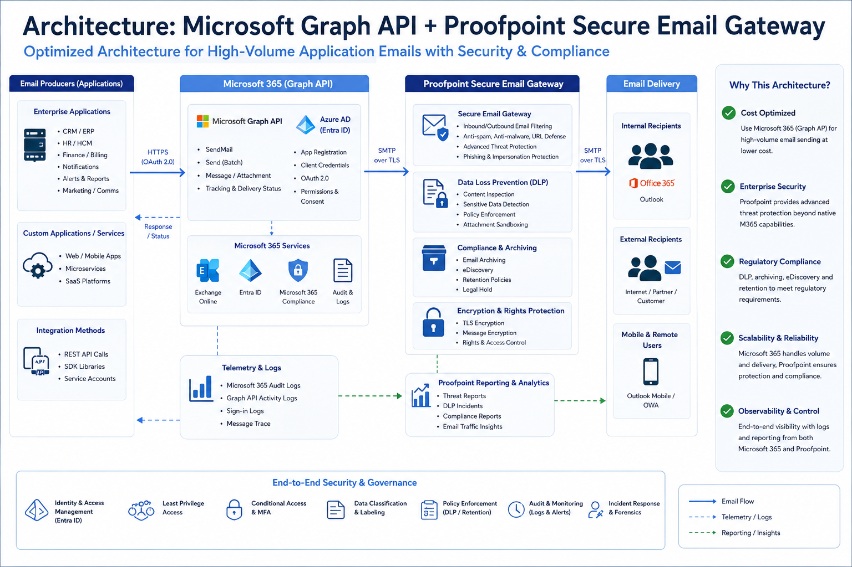
3 — ARCHITECTURE
Target architecture — Graph API + Proofpoint
Generated architecture diagram included as the core target-state view.
Proposal — Application Email Architecture | Confidential

Slide 5
3 — ARCHITECTURE
Detailed outbound mail flow
Recommended logical sequence for an application-generated email.
1 Application
2 Entra ID
3 Graph API
4 Exchange Online
CRM / ERP / HR / Finance / custom service creates email
Application authenticates using OAuth 2.0 / application identity
Application calls user/{mailbox}/sendMail with controlled permissions
Message is accepted into the M365 mail flow
5 Outbound routing
6 Proofpoint
7 Internet / recipient
8 Telemetry
Connector / mail-flow policy routes application mail to Proofpoint
Threat, DLP, content, attachment, policy and compliance inspection
Mail is delivered to internal or external recipient
M365 / Proofpoint logs feed monitoring, reporting and incident workflows
Control point
Proofpoint remains in the outbound path so security and compliance controls are not bypassed.
Proposal — Application Email Architecture | Confidential

Slide 6
4 — OPERATING MODEL
Clear division of responsibility
Avoid overlapping platforms and define a durable operating model.
Application teams
Microsoft 365 / Messaging
Proofpoint / Security
Architecture / Governance
Build email content and templates
Integrate with Graph API
Use approved sender identities
Handle business-level retry / queueing
Monitor application delivery outcomes
Manage Entra application registrations
Control mailbox / sender scope
Manage Graph permissions and consent
Configure Exchange Online mail flow
Monitor throttling, delivery and message trace
Threat protection
Outbound DLP and policy enforcement
URL / attachment inspection
Encryption / secure delivery where required
Compliance reporting and investigation
Reference architecture
Standards and exceptions
Capacity / risk review
Application onboarding
Periodic control assurance
Proposal — Application Email Architecture | Confidential

Slide 7
5 — SECURITY
Security and compliance control framework
Graph handles controlled application identity; Proofpoint remains the enforcement layer.
Identity
Least privilege
Entra ID app registration; certificate / secret management; managed identity where supported
Use only required Graph permissions; restrict application access to approved mailboxes / sender scope
Authentication
DLP
OAuth 2.0; eliminate embedded SMTP passwords where feasible
Inspect outbound application mail for sensitive data and policy violations
Threat protection
Data governance
Malware, phishing, URL and attachment controls at the gateway
Retention, audit, eDiscovery / investigation requirements remain aligned to enterprise policy
Monitoring
Change control
Correlate Graph / M365 audit, message trace and Proofpoint telemetry
Application onboarding, sender changes and permission changes require formal approval
Proposal — Application Email Architecture | Confidential

Slide 8
6 — SCALE
High-volume application email operating pattern
Design for bursts, throttling and controlled retries rather than assuming unlimited API throughput.
Application queue
Graph API client
Exchange / Proofpoint
Capacity guardrails
Buffer outbound messages
Apply business priority
Use idempotency / message IDs
Separate transactional vs bulk notification workloads
Expose backlog and failure metrics
OAuth token acquisition
Controlled concurrency
Respect HTTP 429 / Retry-After
Exponential backoff where required
Dead-letter failed messages
Alert on sustained throttling
Mail-flow routing
Gateway inspection
Policy enforcement
DLP decisions
Delivery / quarantine outcomes
Operational reporting
Volume baseline
Peak TPS / messages
Attachment profile
Recipient distribution
API throttling test
Gateway sizing
Failover / DR
Important design note
Microsoft documents Graph throttling and advises honoring Retry-After / exponential backoff; exact limits are scenario-dependent and should be validated during the POC.
Proposal — Application Email Architecture | Confidential

Slide 9
5 — SECURITY
Identity and access design
The strongest control improvement is replacing broad SMTP-style credentials with application identity and scoped permissions.
Application
Entra ID
Graph API
M365
Workload / service calling Graph API
App registration • OAuth 2.0 • consent
Mail.Send + controlled sender scope
Exchange
Recommended controls
Governance workflow
Dedicated application identity per critical application or application group
Least-privilege Graph permissions and administrative consent
Restrict application access to designated sender mailboxes where supported
Prefer certificate / managed identity patterns over long-lived client secrets
Separate non-production and production identities
1. Application owner submits use case and expected volume
2. Architecture validates pattern and sender model
3. IAM / Messaging grants scoped application access
4. Security validates Proofpoint policy and DLP treatment
5. Application passes volume / failure / DR testing
6. Production onboarding with periodic access review
Proposal — Application Email Architecture | Confidential

Slide 10
7 — BUSINESS CASE
Cost and value proposition
The proposal is primarily a platform-optimization decision; exact savings require traffic and licensing data.
Lower
Higher
Retained
Better
SEG dependency for application submission
Application integration standardization
Security & compliance controls
Separation of duties
Where value comes from
Business-case inputs to validate
Avoid treating the SEG as the application integration platform for every high-volume workload.
Standardize new application onboarding on a Microsoft-native API pattern.
Reduce custom SMTP / relay integrations and credential management overhead.
Preserve the Proofpoint investment where it delivers highest value: security, DLP and compliance.
Potentially improve capacity planning by separating application generation from gateway enforcement.
Monthly and peak application email volume
Average message size and attachment rate
Number of application senders / mailboxes
Current Proofpoint licensing / capacity model
M365 licensing and existing Exchange Online entitlement
Operational effort for current relay integrations
Required retention, DLP and encryption policies
Decision principle
Do not remove Proofpoint from the mail-security path; optimize where mail is generated and where security policy is enforced.
Proposal — Application Email Architecture | Confidential

Slide 11
8 — RISK
Key risks and mitigations
The architecture is viable when volume, routing and operational controls are validated before migration.
Graph throttling / burst traffic
Mail-flow routing complexity
Use queueing, controlled concurrency, Retry-After handling, backoff and capacity testing.
Build a dedicated application sender pattern and validate Exchange → Proofpoint routing in a non-production tenant.
Permission overreach
Delivery observability
Use least privilege, scoped sender mailboxes and periodic access reviews.
Correlate application logs, Graph responses, M365 message trace and Proofpoint events.
DLP false positives
DR / service dependency
Create application-specific policy exceptions only through formal governance; monitor quarantine rates.
Define alternate sender path, queue persistence and recovery objectives for critical applications.
Proposal — Application Email Architecture | Confidential

Slide 12
9 — ROADMAP
Implementation roadmap
Pilot first, measure, then migrate application groups in controlled waves.
1
2
3
4
5
0. Assess
1. POC
2. Pilot
3. Wave migration
4. Optimize
2–3 weeks
3–4 weeks
4–6 weeks
8–16 weeks
Ongoing
Baseline volume, peak rates, message sizes, current Proofpoint usage, sender inventory and compliance requirements.
Select 2–3 applications; configure Graph, sender mailbox, routing and Proofpoint policy; validate delivery and controls.
Run production-like volumes; validate throttling, DLP, monitoring, DR and operational ownership.
Migrate applications by risk / volume; retire legacy integrations after stabilization.
Tune policies, capacity, onboarding standards, dashboards and cost model.
Go / no-go gates
Architecture approval → Security approval → Volume / performance test → Compliance sign-off → Production onboarding
Proposal — Application Email Architecture | Confidential

Slide 13
10 — DECISION
Decision requested
Approve the target pattern as the strategic standard for new high-volume application email workloads.
Proposed decision
Immediate next actions
Adopt Microsoft Graph API as the preferred application email submission interface for Microsoft 365 workloads.
Retain Proofpoint as the secure email gateway and compliance enforcement layer.
Use Exchange Online mail flow / connectors to maintain controlled outbound routing through Proofpoint.
Establish a formal application onboarding pattern covering identity, permissions, volume, DLP, monitoring and DR.
Use Proofpoint-only integration only where a documented technical or regulatory exception exists.
Confirm current Proofpoint architecture and outbound routing model.
Collect application email inventory and 30-day / peak volume data.
Identify 2–3 representative pilot applications.
Validate Graph application permissions and sender mailbox model.
Build non-production Graph → Exchange → Proofpoint flow.
Execute security, DLP, volume and DR tests.
Finalize TCO and migration business case based on measured data.
Target outcome
A standardized, secure and scalable application-email platform that uses Microsoft 365 for application submission and Proofpoint for security and compliance.
Proposal — Application Email Architecture | Confidential

Slide 14
APPENDIX
Technical references and assumptions
Use these references for design validation during the POC and detailed engineering.
Microsoft Graph — sendMail
Microsoft Learn: user: sendMail (Graph v1.0). Confirms JSON/MIME send capability, 202 Accepted behavior, and that delivery remains subject to Exchange Online limitations and throttling.
Microsoft Graph — permissions
Microsoft Learn: Graph permissions reference. Mail.Send application permission requires admin consent; Microsoft recommends least-privilege permissions and supports restricting application access to specific mailboxes.
Microsoft Graph — throttling
Microsoft Learn: Graph throttling guidance and service-specific throttling limits. Limits vary by service/scenario; 429 responses and Retry-After should be handled, with backoff and controlled concurrency.
Assumption
Proofpoint remains deployed as the organization’s outbound secure email gateway and is technically capable of receiving/routing Microsoft 365 outbound application mail through the approved Exchange Online connector model. Validate exact Proofpoint topology and licensing during discovery.
Sources: Microsoft Learn — Graph sendMail, permissions, throttling | Proofpoint capabilities to be validated against current tenant / contract configuration

