Slide 1
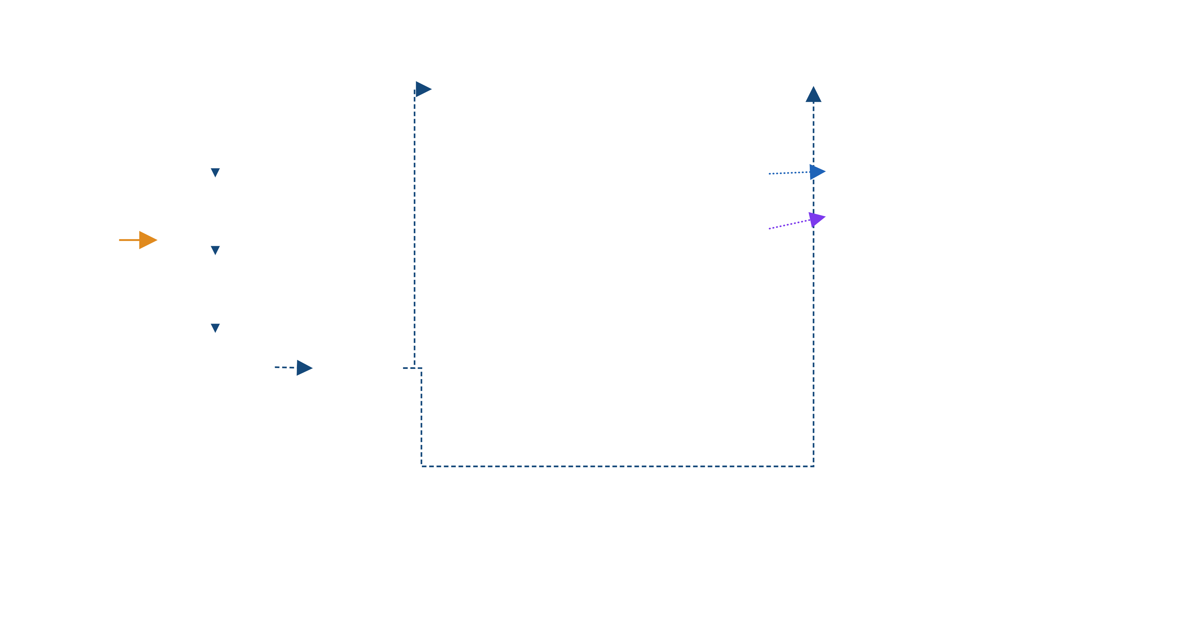
FCSS Architecture Diagram
Enterprise Network & Infrastructure Overview
GIFT Server Room
SGDC Production
SGDR (OCC)
Edge Router
APAC Colo - Nutanix Cluster
APAC Colo - Nutanix Cluster
Production Network Zone
Nutanix Cluster - Virtual Machines (Shared: DR + UAT)
Nutanix Cluster - Virtual Machines
DR (Production) Network Zone
Web Server 1
Web Server 2
PostgreSQL DB Server 1
PostgreSQL DB Server 2
PostgreSQL Replication
PostgreSQL DB Server 1
PostgreSQL DB Server 2
Web Server 1
Web Server 2
WAN Switch
IBM MQ Server 1
IBM MQ Server 2
Convertor Server 1
Convertor Server 2
Convertor Server 1
Convertor Server 2
IBM MQ Server 1
IBM MQ Server 2
FCSS Head Office
MPLS Link
RWAN Link
IBM MQ Replication
Corporate Network
UAT Network Zone
Firewall
Web Server 1
Web Server 2
PostgreSQL DB Server 1
PostgreSQL DB Server 2
IBM MQ Server 1
IBM MQ Server 2
Convertor Server 1
Convertor Server 2
Existing Core Switch
RWAN
RWAN
Regional WAN
SolarWinds Monitoring
Rubrik Backup
Domain Authentication / Active Directory
SolarWinds Monitoring
Rubrik Backup
Domain Authentication / Active Directory
RWAN Link
Legend
Notes
MPLS Link (solid)
RWAN Link (dashed)
SGDR (OCC) hosts both the DR Production and UAT environments on a single shared Nutanix cluster.
All application tiers (Web, DB, MQ, Convertor) are deployed as virtual machines on Nutanix hyper-converged infrastructure.
RWAN provides the primary WAN transport between GIFT Server Room and both colocation sites (SGDC Production and SGDR OCC).
PostgreSQL and IBM MQ replication links operate independently of the RWAN network path, directly between the two sites' DB and MQ tiers.
Monitoring (SolarWinds), Backup (Rubrik) and Directory (Active Directory) services are deployed locally and independently at each site.
PostgreSQL Replication (dotted)
IBM MQ Replication (dotted)
Nutanix Cluster (Virtual Machines)
SolarWinds Monitoring
Rubrik Backup
Domain Authentication / Active Directory

