Slide 1
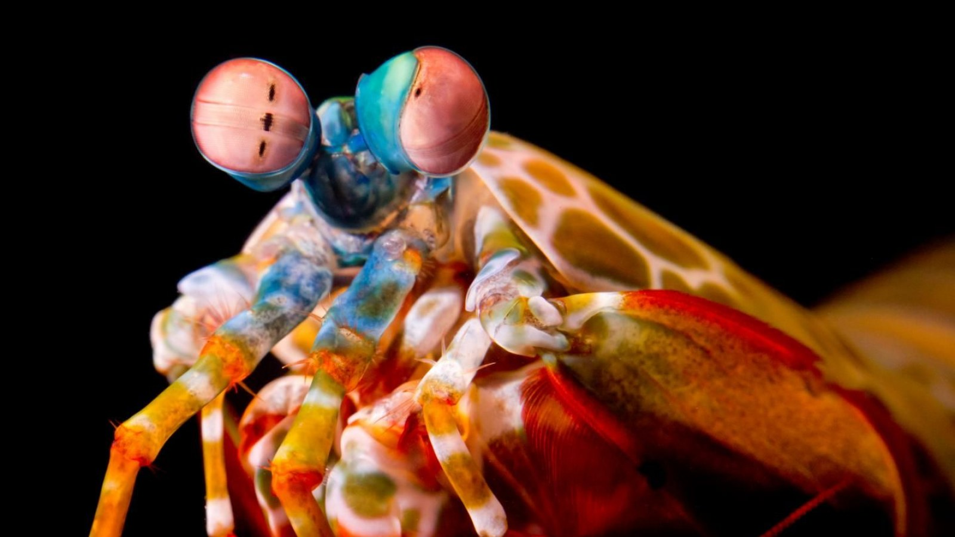
Project
Mantis
Shrimp
Quantitative Crypto Trading System
NU Fintech Project 2

Slide 2
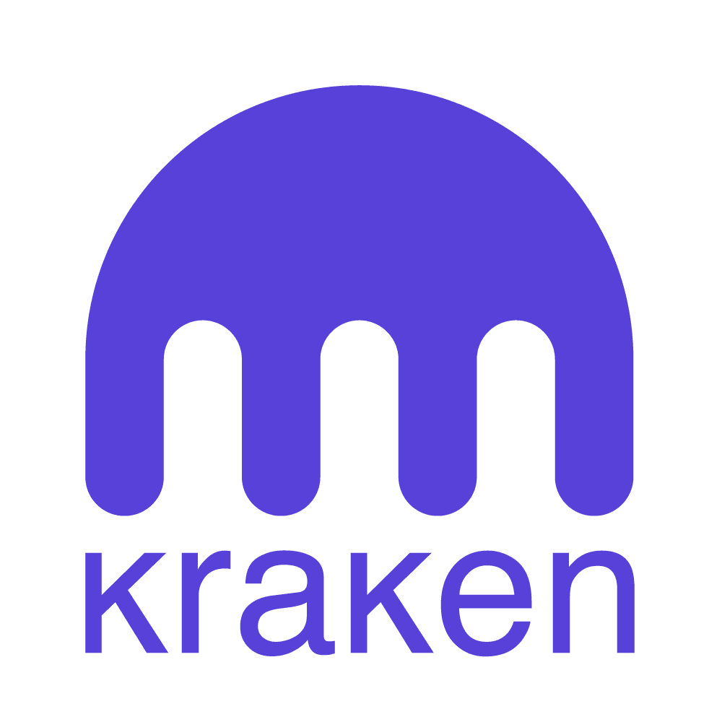


Agenda
Market Research (Perspective)
System Design
Signal Generation Example
Performance Viz
Value Prop
Plan of Action
Areas of Improvement
Team

Slide 3
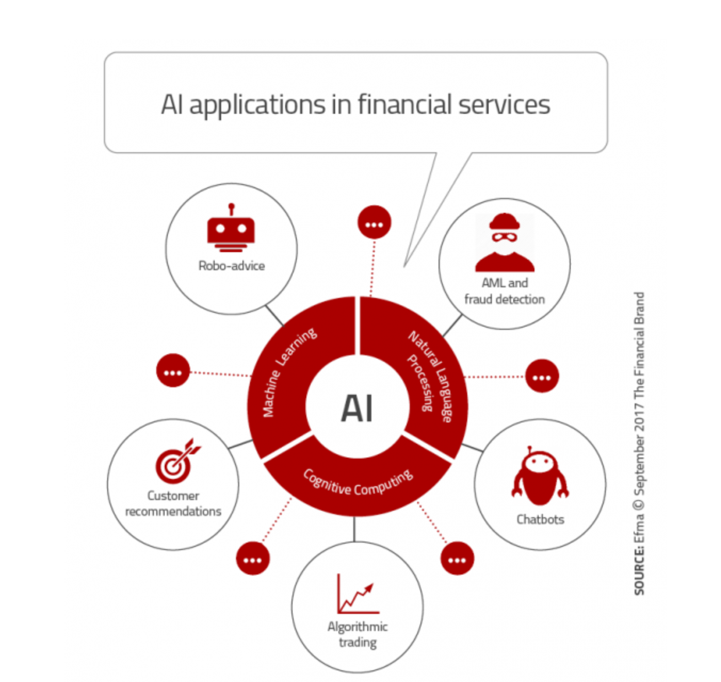
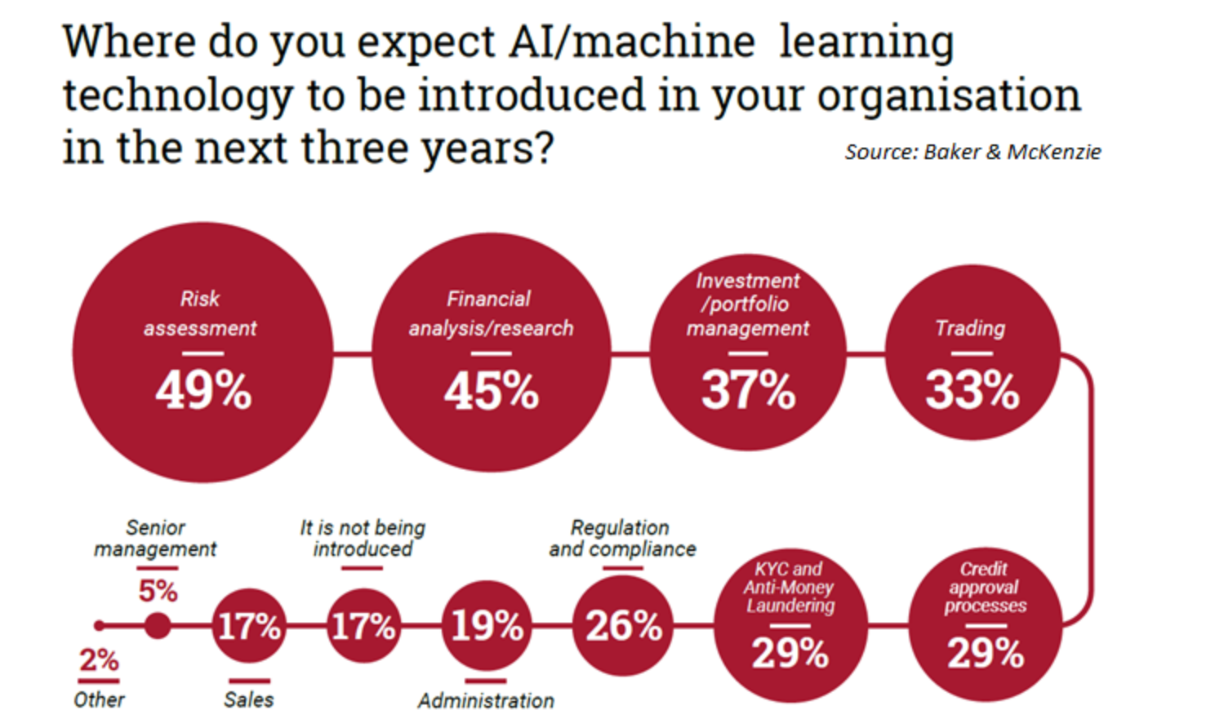

Slide 4
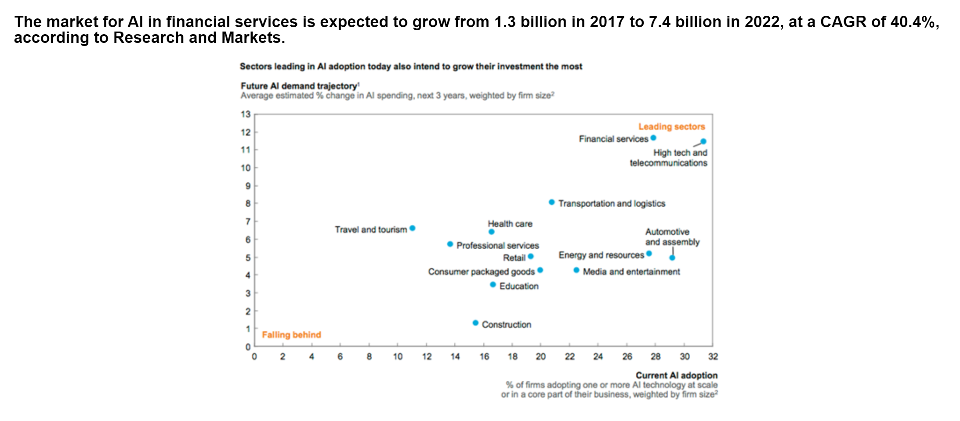

Slide 5
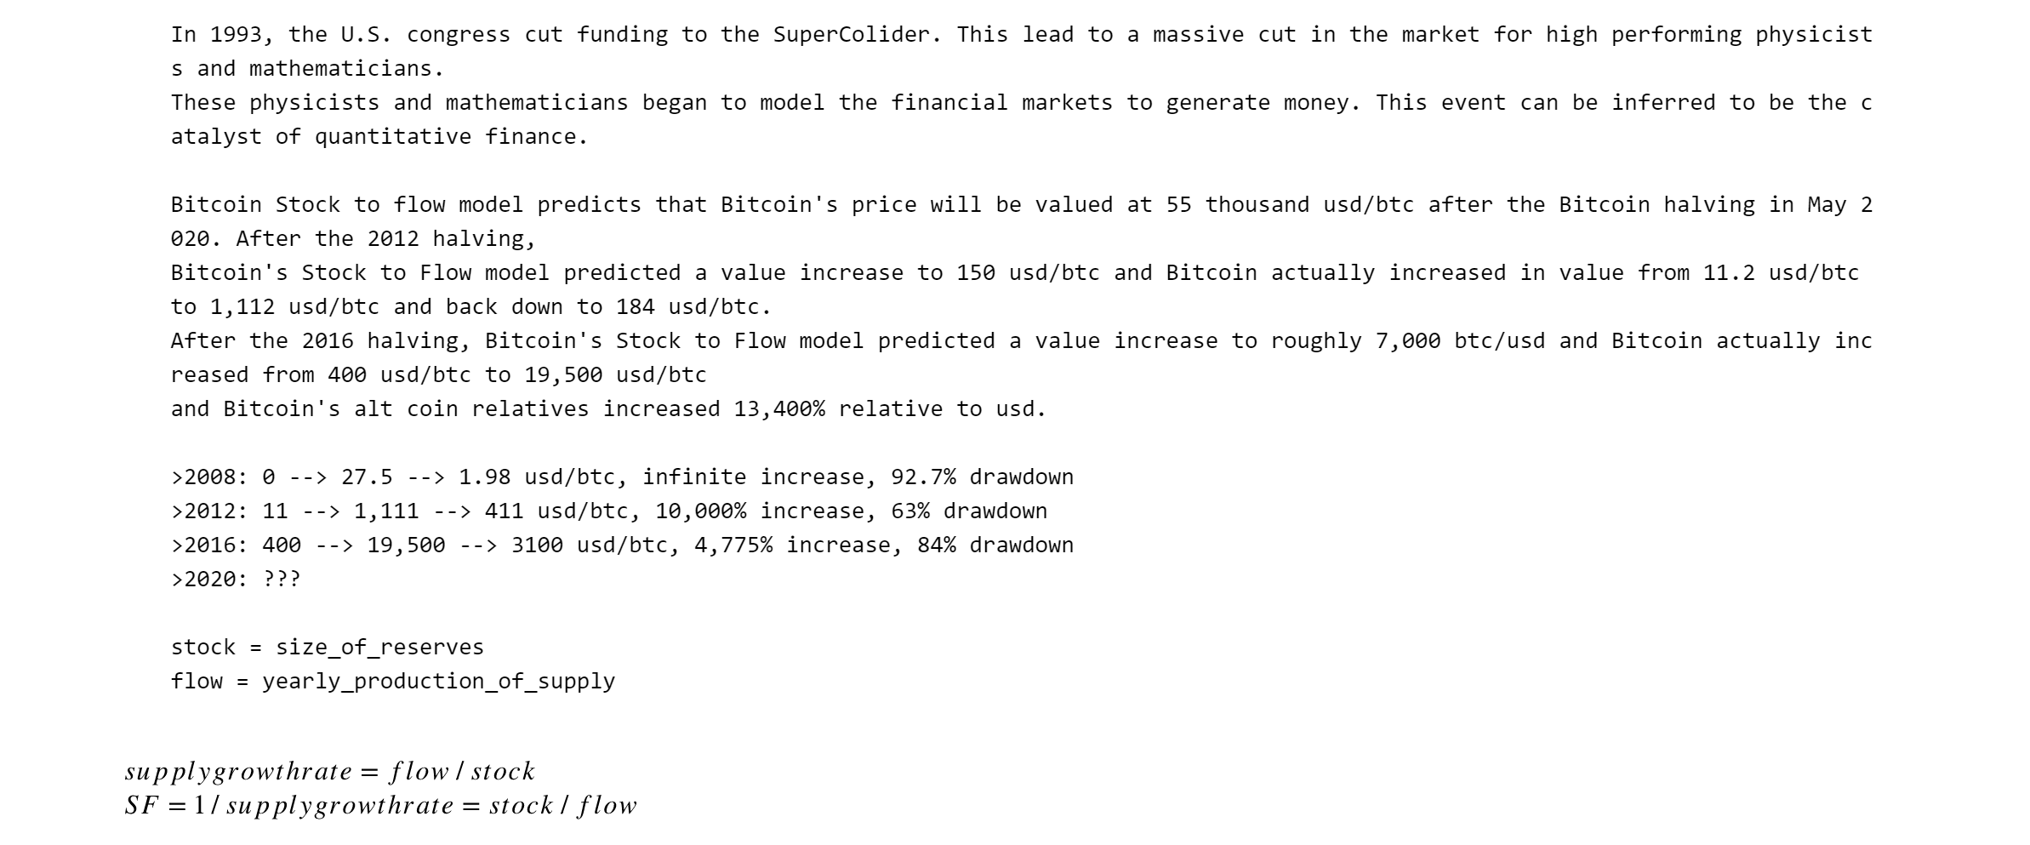

Slide 6
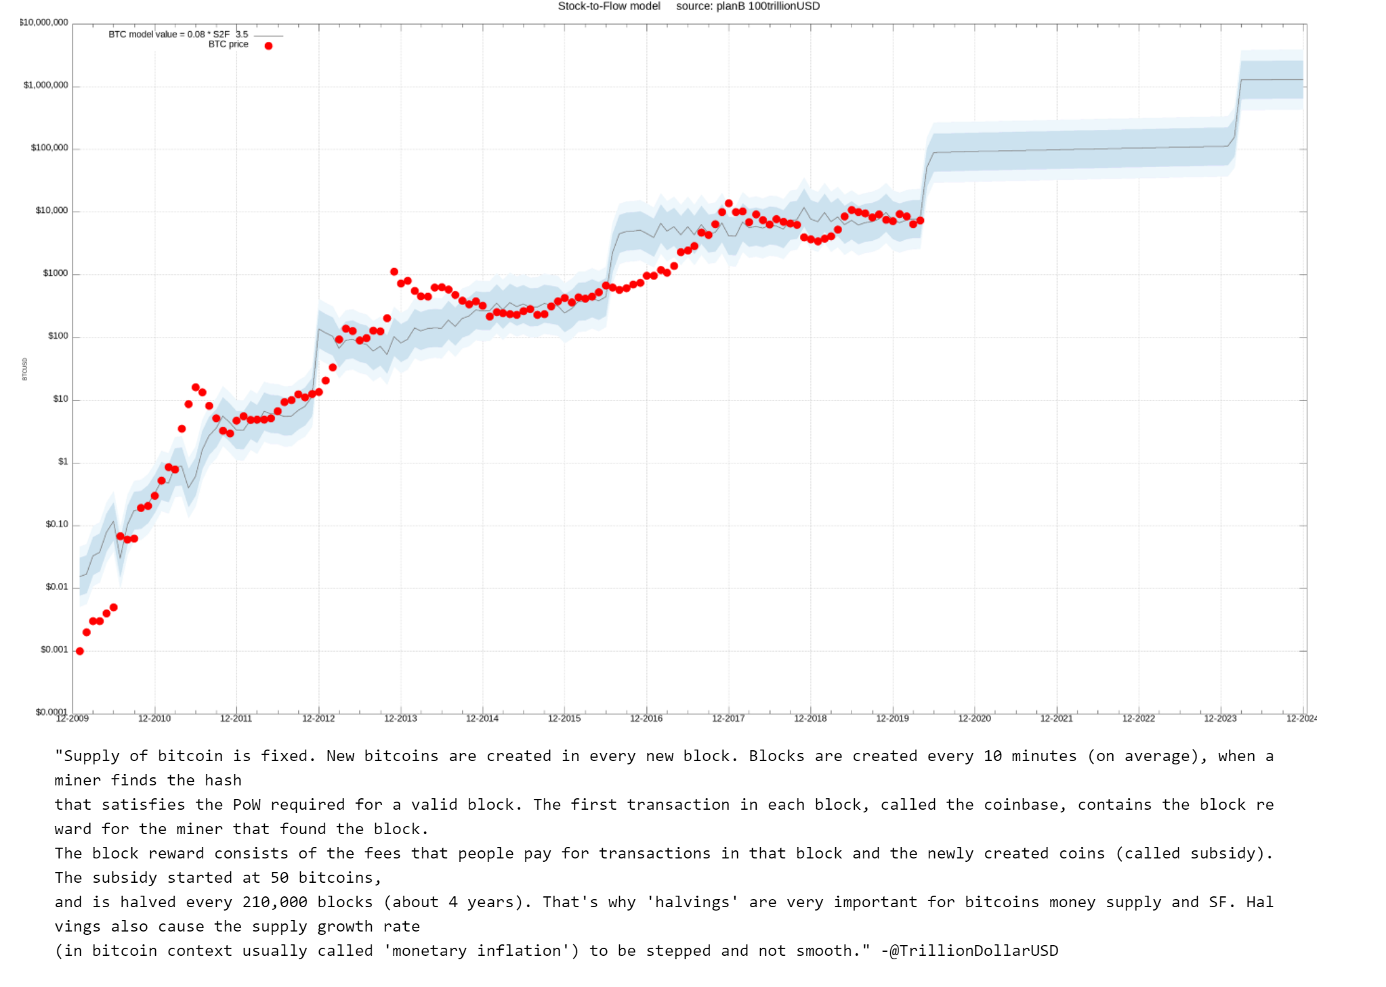

Slide 7
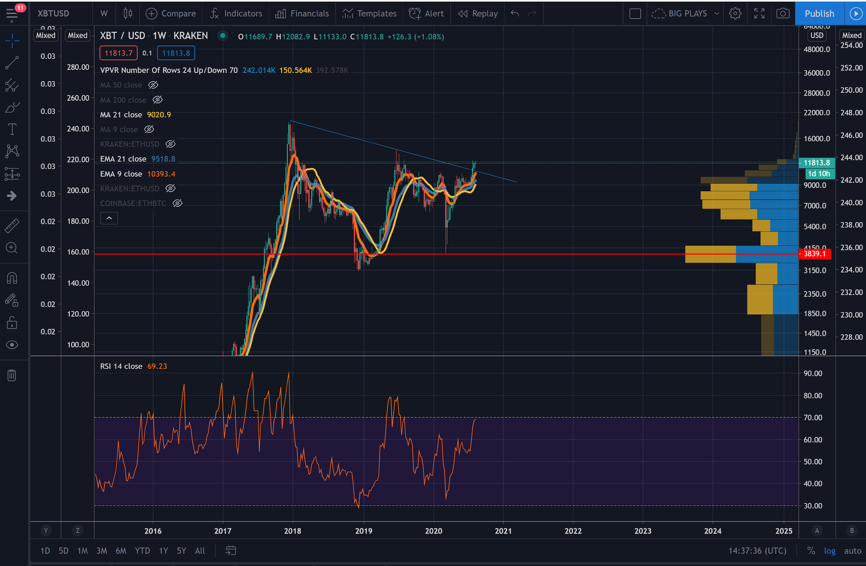

Slide 8
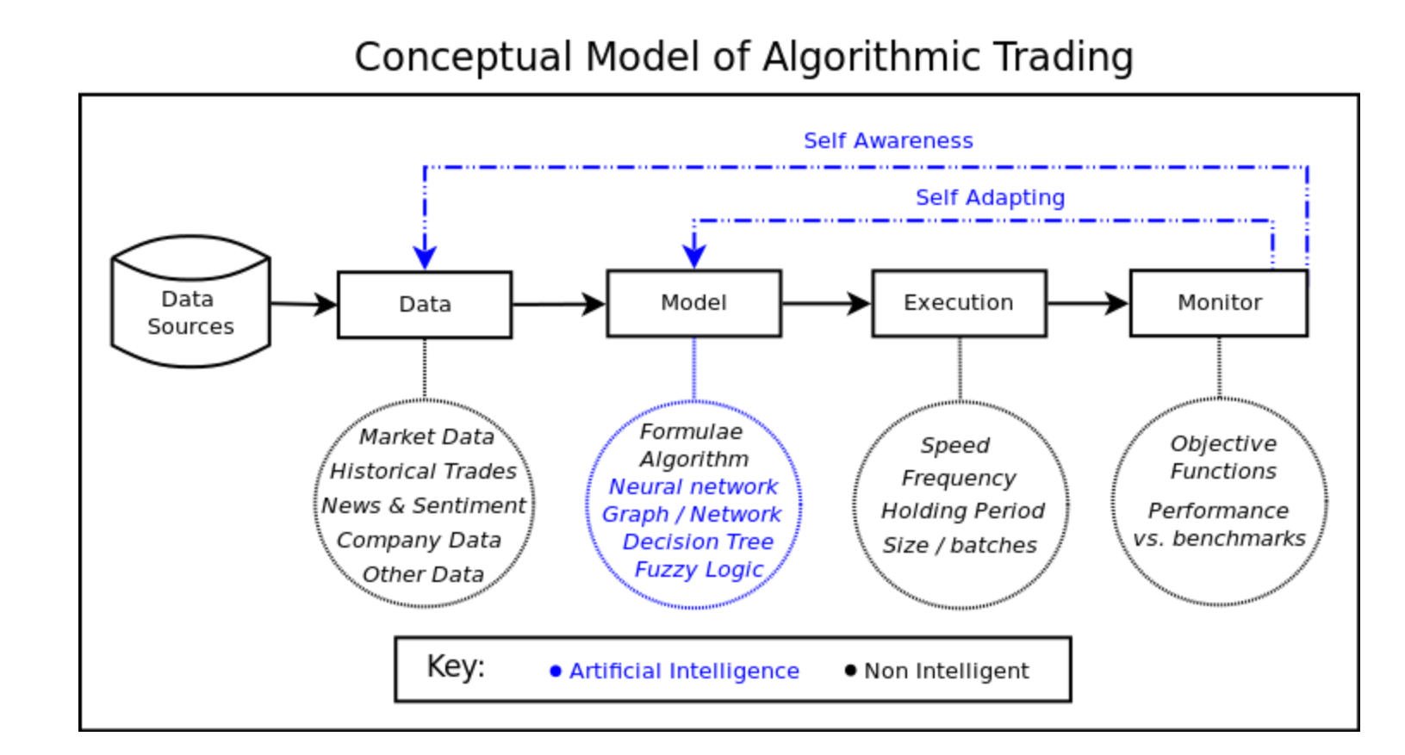

Slide 9
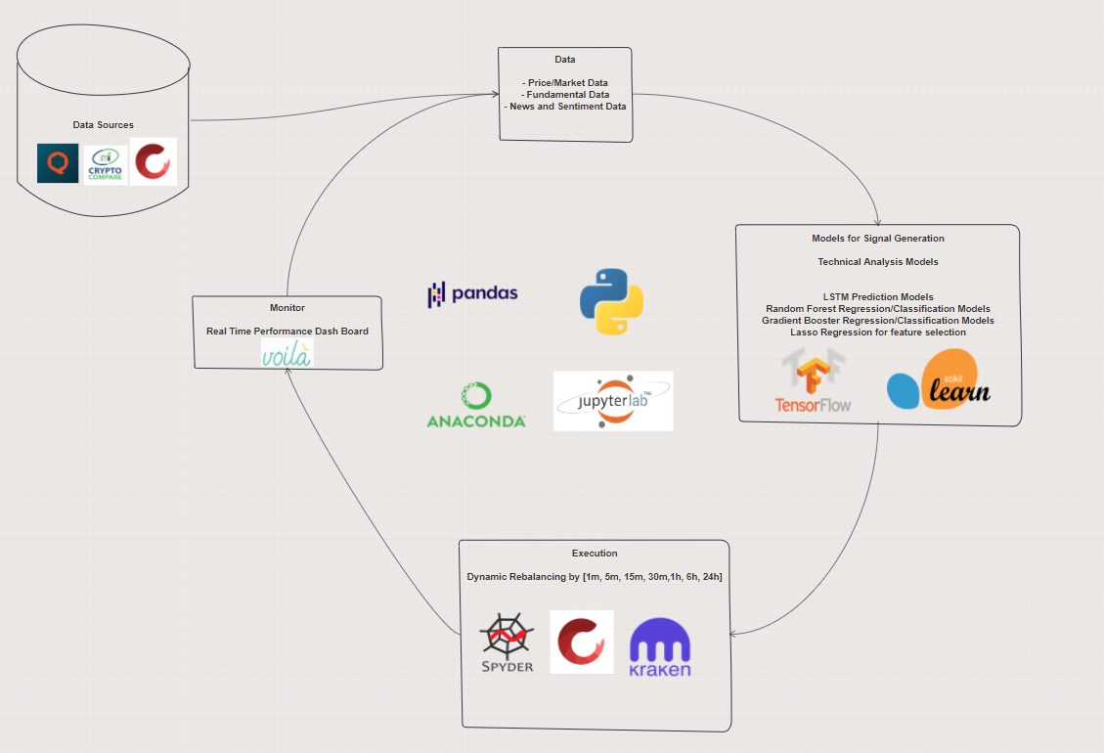
System Design
Goal:
Maximize Risk Adjusted Returns relative to BTC
Challenges/Risks
Operational
Market
Execution
Technical
Third Party
Human Error
Tax Risk
Software Components
Anaconda: open source distribution of the python programming language for scientific computing
JupyterLab: a web based interactive development environment for jupyter notebooks, code, and data
Python: Object oriented programming language
Pandas: data manipulation tool
Shrimpy: Universal Crypto Exchange Trading API (rest, websocket)
Crypto Compare: Crypto Data API
Quandl: BTC Fundamental Data API
TensorFlow: Deep Learning python library
SKlearn: Machine Learning Library
Spyder: Anaconda IDE
Kraken: Crypto Exchange
Voila: html version notebooks

Slide 10
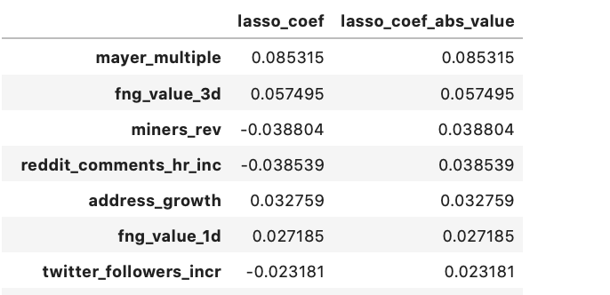
Signal Generation Example
Pre-processing
Feature Selection
Daily BTC Forecasting
Crypto-compare, Shrimpy, Quandl and Fear and Greed Index
Lasso regression for feature identification
LSTM (univariate and multivariate)

Slide 11
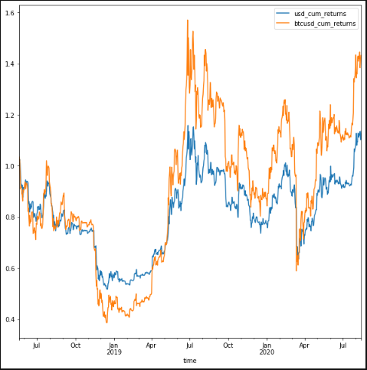
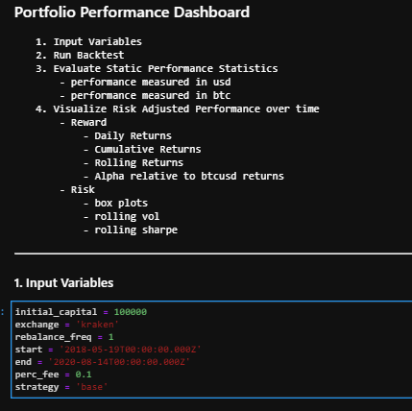
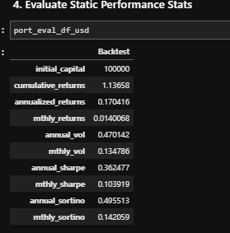
Performance Viz - voila demo
Voila Demo

Slide 12
Project Mantis: Value Prop
Target Market: Prop Trading Firms
Program/System Description: Project Mantis is an algorithmic trading application designed to minimize external risk and maximize long-term risk adjusted returns or alpha benchmarked against bitcoin’s returns.
Price: Seeking funding and profitshare’s from prop trading firm to start crypto trading desk
Benefits/Value Prop
Passionate, young, and hungry team
Dynamic Risk Management with Shrimpy
Leverage Machine Learning Techniques for more profit generating strategies
A system that can be evolved upon
Algorithmic Trading pipeline with robust infrastructure in an emerging asset class with little trading infrastructure in place.

Slide 13
Plan of Action
Build out Rest of initial Infrastructure for launch (1 month)
Build Team for Desk (2 months)
Test Strategies (1 month)
Live Testing (1 month)
Build out Risk Management Operations (2months)
Scale into larger Trading Positions (1 year)

Slide 14
Areas of Improvement
Data
Sentiment data inclusion (Cryptocompare social data is limited)
Higher Frequency Data
Resampled Tick Data
More data sources
Modeling
More Robust forecasting
Leverage more ML Engineering Techniques to build and test strategies
Execution
Need physical hardware to run algorithms, which is why we need trading firms resources
Add more exchanges than just kraken
Monitor
Add automated Performance Reporting
Build Real Time Dashboard

Slide 15
Team
Team Members
Alex, Dave, Grant
NU Fintech Skills Used
Financial Programming
Python, Pandas, Matplotlib, API Interactions
Machine Learning Applications in Finance
Algorithmic Trading, Financial Modeling
Lasso Regression, LSTM Regression, Random Forest Regression

